Slide 1

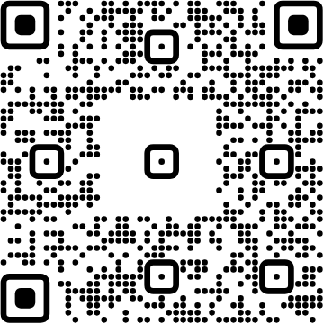


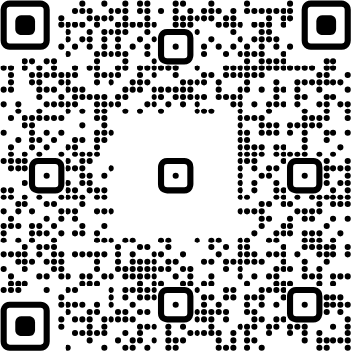

View online
Download PDF
Your First Node.js Contribution
Paolo Insogna
Marco Ippolito

Slide 2

All hope abandon
ye who enter here!

Slide 3
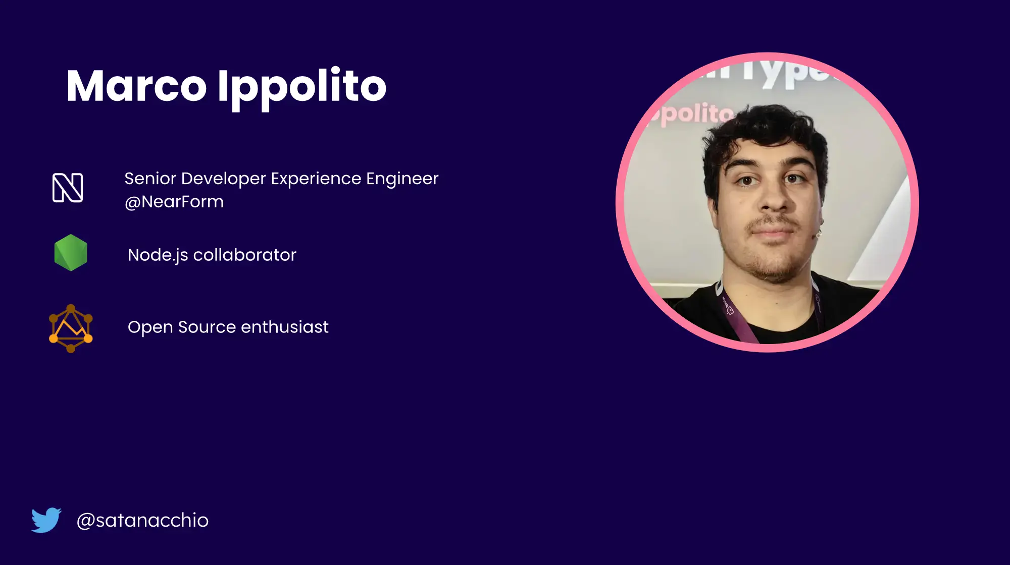

Slide 4


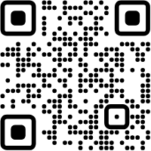



Hello, I'm
Paolo
!
Node.js
Core Member
NearForm
Staff Developer Experience Engineer
paoloinsogna.dev
ShogunPanda
p_insogna
pinsogna

Slide 5
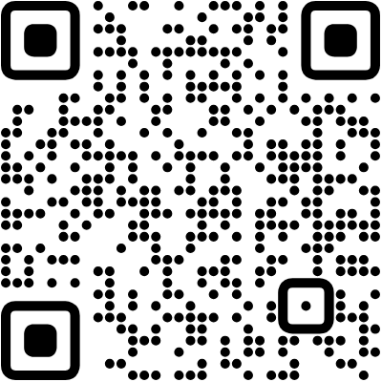

Getting started (1/2)!
Navigate to
the Node.js repository
.
Fork the repository.
On MacOS / Linux:
If you have the GitHub CLI:
open https://github.com/nodejs/node
gh repo clone nodejs/node

Slide 6

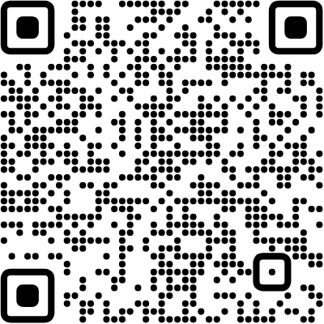
Getting started (2/2)!
Clone it.
Read the
BUILDING.MD
file.
git clone git@github.com:$YOURNAME/node.git
cd node && open BUILDING.md

Slide 7
Build Node.js
shogun@panda:~/example$ ./configure
shogun@panda:~/example$ make -j 4

Slide 8
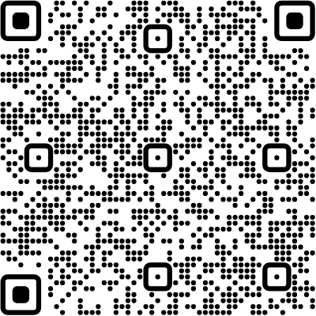
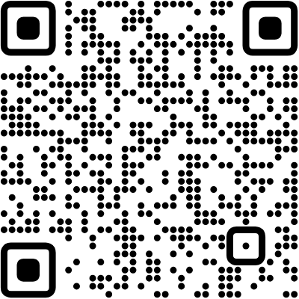
Choose an issue
You
can
pick
one
from
any
of
the
sources
below.
If
you
claim
one,
put
your
name
on
it!
Our list of
good first issue
.
Node.js
public issues list
.

Slide 9
Build, then run the tests and the linter
shogun@panda:~/example$ make jstest
shogun@panda:~/example$ make lint-js-fix

Slide 10
Configure GIT before committing
Make
sure
to
have
git
config
configured
with
your
GitHub
account.
shogun@panda:~/example$ git config user.name "$NAME"
shogun@panda:~/example$ git config user.email "$EMAIL"

Slide 11
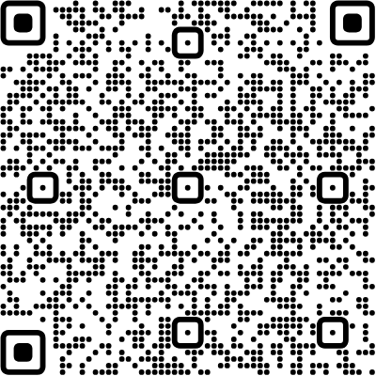
Make sure to follow commit guidelines
shogun@panda:~/example$ npm install -g @node-core/utils
shogun@panda:~/example$ core-validate-commit HEAD
You can find them
here
.

Slide 12


Thank you!
Paolo Insogna
@p_insogna
Platformatic
Marco Ippolito
@marco-ippolito

