Slide 1






View online
Workshop:
The bees are important:
Download PDF
use SDKs wisely
Paolo Insogna
Node.js TSC, Principal Engineer @
Platformatic

Slide 2






Hello, I'm
Paolo
!
Node.js
Technical Steering Committee Member
Platformatic
Principal Engineer
paoloinsogna.dev
ShogunPanda
p_insogna
pinsogna

Slide 3

What are we talking about?
Let's
start
with
a
brief
introduction.
https://talks.paoloinsogna.dev/bees

Slide 4


The details lie in the documentation
AWS S3 PutObject REST API
AWS Signature Version 4
Documentation
Calculations for the Authorization Header

Slide 5

Let's get to
the action!

Slide 6
Setup
No
dependencies
in
package.json
,
Node.js
already
has
our
backs
...
1
2
3
4
5
6
7
8
{
"name": "direct",
"version": "1.0.0",
"main": "index.js",
"type": "module",
"scripts": {},
"dependencies": {}
}

Slide 7
The skeleton
1
2
3
4
5
6
7
8
9
10
11
12
13
14
15
16
17
18
19
import { createHash, createHmac } from 'node:crypto'
import { readFile } from 'node:fs/promises'
const awsS3UnsignedPayload = 'UNSIGNED-PAYLOAD'
function sha256(contents) {
return createHash('sha256').update(contents).digest('hex')
}
function hmacSha256(key, contents) {
return createHmac('sha256', key).update(contents).digest()
}
// Implements the Authenticating Requests (AWS Signature Version 4) algorithm.
function signS3Upload(keyId, accessKey, region, method, rawUrl, headers, payloadHash) {
// CanonicalRequest calculation
// StringToSign calculation
// Signature calculation
}

Slide 8

Task 1: Create a
Canonical Request
Enjoy!
😈

Slide 9

Task 2: Create a
String to Sign
Enjoy!
😂

Slide 10

Task 3: Calculate
Signature
Enjoy!
😶

Slide 11
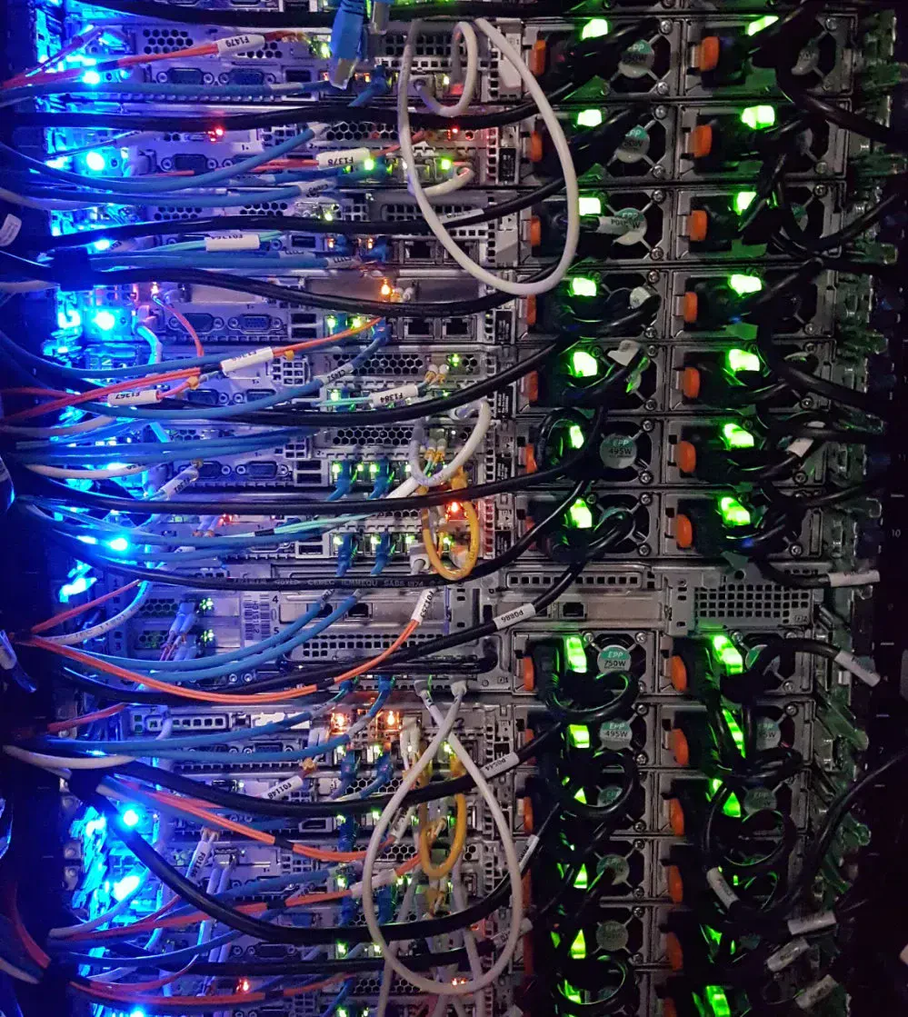
Task 4: REST API
call
Enjoy!
😎

Slide 12

Task 5: Main
function
Enjoy!
🍺

Slide 13

Take home
You
can
find
all
the
code
on
GitHub:
https://github.com/ShogunPanda/workshops-bees

Slide 14


Thank you!
Paolo Insogna
@p_insogna
Platformatic
Node.js TSC, Principal Engineer
paolo.insogna@platformatic.dev

