Slide 1


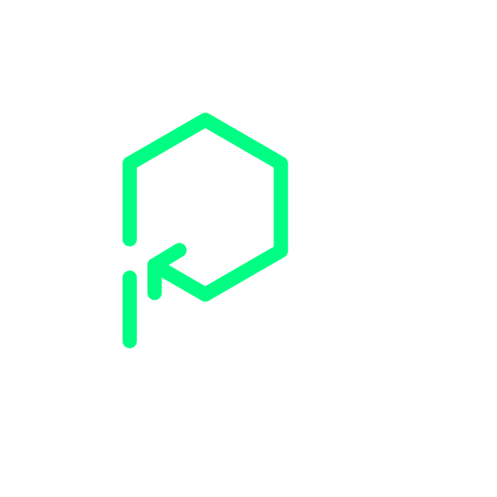



Platformatic
View online
Achieving 93% Faster Next.js
Download PDF
in (your) Kubernetes with Watt
Paolo Insogna
Node.js TSC, Principal Engineer

Slide 2

There is a lot
in the unknown!

Slide 3






Hello, I'm
Paolo
!
Node.js
Technical Steering Committee Member
Platformatic
Principal Engineer
paoloinsogna.dev
ShogunPanda
p_insogna
pinsogna

Slide 4



Some companies trusting us
Article
Case Study
Case Study

Slide 5

Node.js is
(no longer)
single threaded ...
...
and
it
hasn't
been
for
a
while
now!

Slide 6

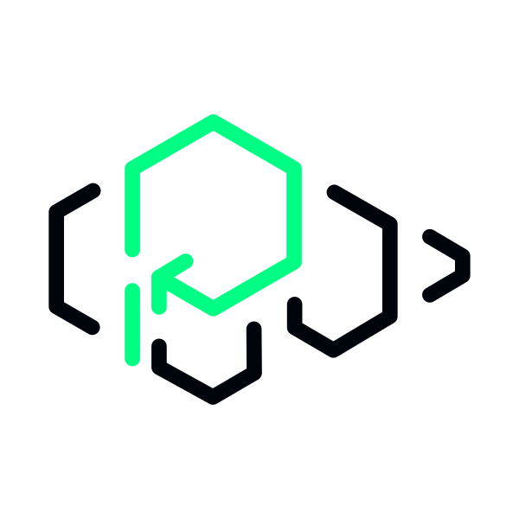
2018: "Node.js has threads!"
https://www.youtube.com/watch?v=-ssCzHoUI7M

Slide 7


Worker Thread API
This
is
supported
from
Node.js
10.5.0
(June
2018).
Create workers via
worker_threads
module
https://nodejs.org/dist/latest-v22.x/docs/api/worker_threads.html
Each thread has an independent event loop
This is crucial to offload CPU-intensive tasks out of the main thread.

Slide 8

Why do we care?

Slide 9
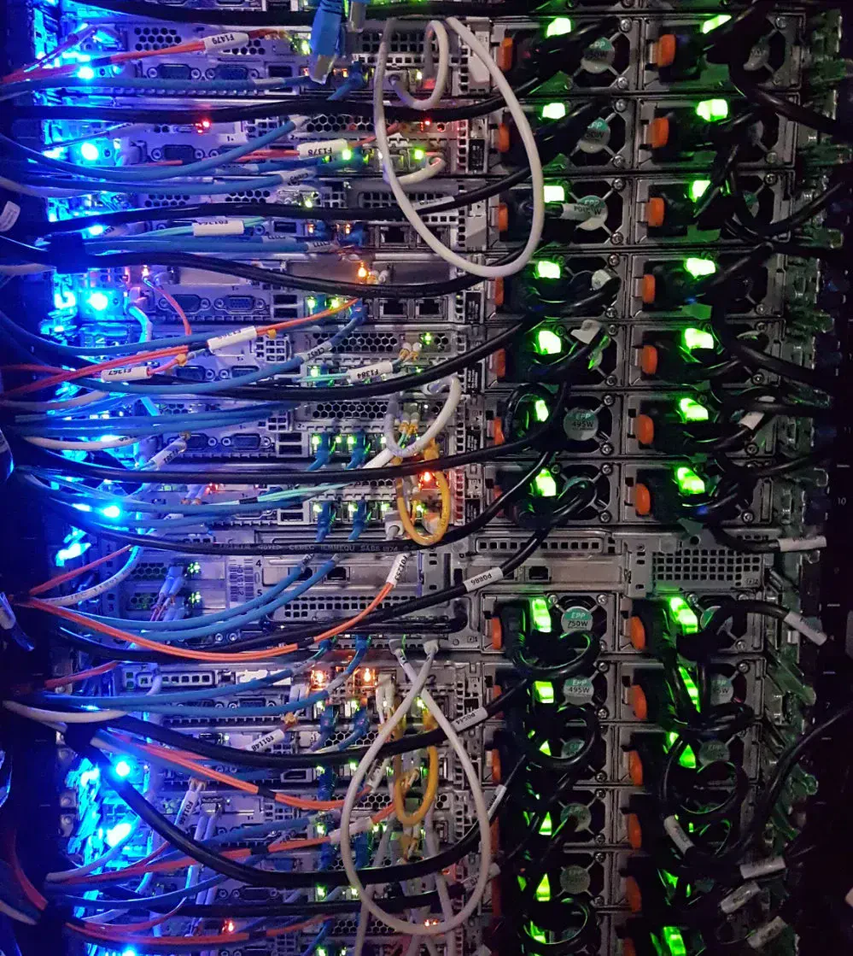
How do you scale
Node.js in
production?

Slide 10
A familiar story at scale
1
Traffic spikes create uneven load
Some pods are at 100% CPU while others are at 30%. Error rate climbs to 8%.
2
Over-provisioning costs money
You add 50% more pods to handle spikes. Cloud bill grows but the problem is not solved.
3
This is a revenue problem
Latency across API calls leads to abandoned carts and churned customers.

Slide 11



The Cluster Module: How It Works (1/2)
Introduced
in
Node.js
0.6
(2011)
to
scale
across
multiple
CPU
cores.
Master process coordination
IPC adds ~30% overhead
PM2 makes it easier
It distributes connections with a
Every connection is transferred to
Built on top of the cluster module.
round-robin policy.
workers via Unix domain sockets.
It inherits the same overhead.

Slide 12
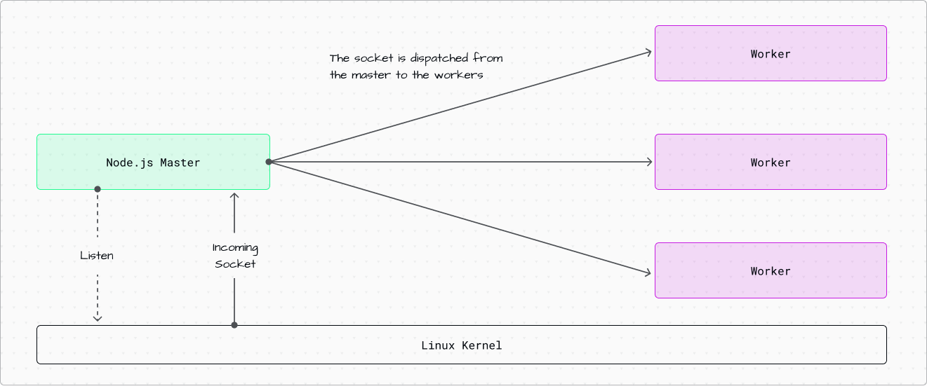
The Cluster Module: How It Works (2/2)

Slide 13



The Early Rejection Problem
Requests enter the event loop queue
After TCP accept, the request waits for its turn to be processed.
Cannot reject until processing begins
Once in the queue, requests consume resources, which affects everyone during overload.
Ideal servers reject early with 503
Load balancers can then route traffic elsewhere. In Node.js this is difficult.

Slide 14



Why Next.js Makes This Worse
Request context required first
SSR needs headers, cookies, and query params before making decisions.
Dynamic route matching happens after accept
Next.js middleware runs after request acceptance. Cannot reject before knowing what to do.
Data fetching dependencies
Server components require the request to be in-flight.

Slide 15



The Compounding Effect
These
problems
multiply
when
combined
with
traditional
scaling
approaches.
With cluster/PM2
Every request pays the ~30% IPC overhead, even when not overloaded.
With single-CPU pods
Isolated queues compound load imbalances. No work sharing.
Latency compounds across API calls
Three sequential calls at 180ms each = 540ms wait. Churned customers in SaaS.

Slide 16

We solved this.

Slide 17




The Technical Foundation - SO_REUSEPORT
Kernel-level hash-based distribution
Calculates a hash from source IP, port, destination IP, and port to select a worker.
Connection affinity and even distribution
The same client always reaches the same worker. Zero coordination needed.
One flag enables it all
Set
reusePort: true
on the HTTP server and the kernel handles the rest.
Available since Linux kernel 3.9 (April 2013)
It fundamentally changes how connections are distributed.

Slide 18
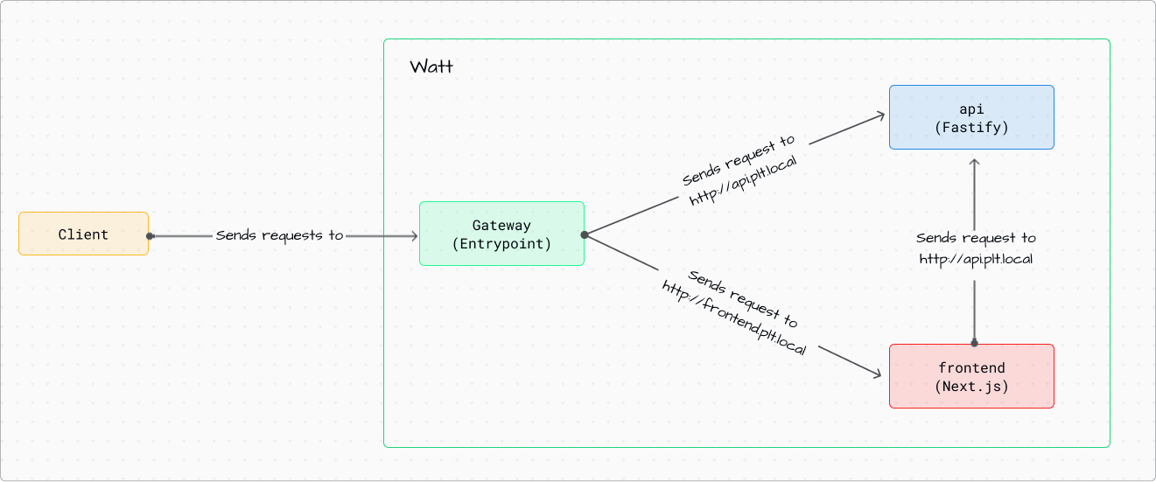
Introducing Watt, the Node.js application server

Slide 19


What is Watt?
Leverages SO_REUSEPORT
Multi-service architecture
Production-ready
Workers accept connections
Run multiple Node.js services with
Built-in monitoring, logging,
directly. No more IPC overhead.
inter-thread communication.
tracing, and health checks.

Slide 20
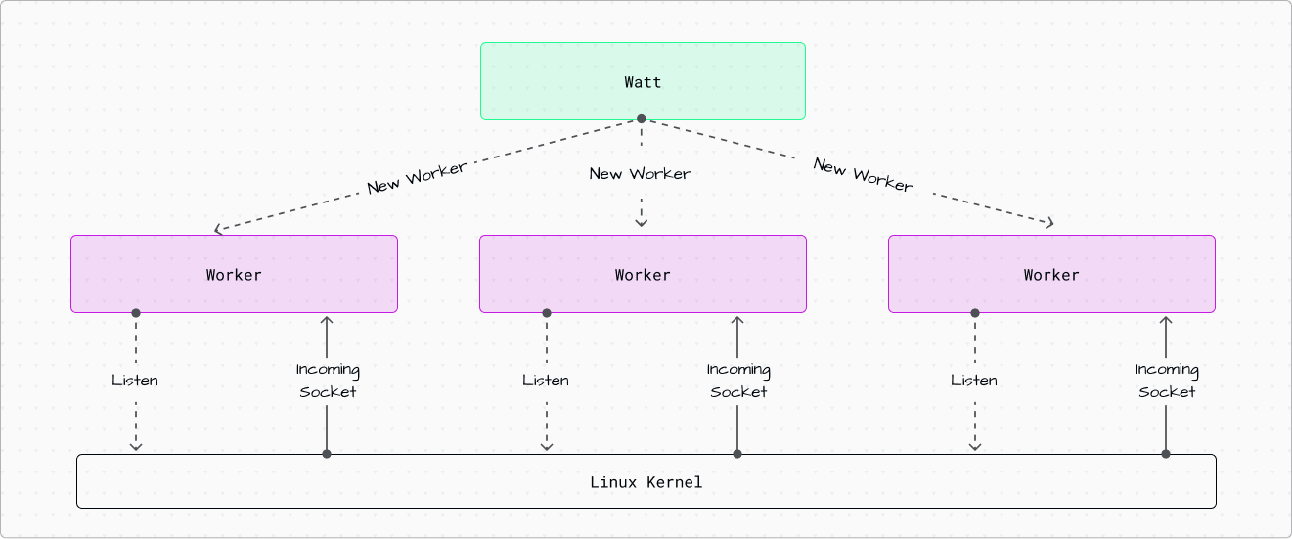
Watt: Architecture

Slide 21



Process Orchestration
Automatic restart of crashed processes
Worker failures are detected and restarted automatically without manual intervention.
Graceful shutdown handling
Coordinated shutdown ensures requests complete before workers terminate.
Health monitoring and metrics
Built-in monitoring tracks worker health and performance metrics in real-time.

Slide 22



Watt: Automatic Health Restarts
Event loop failure detection
Heap exhaustion handling
Zero downtime restart
Monitors event loop health.
Detects memory issues before
Failed workers are replaced in-
Detects unresponsive workers.
they crash the entire pod.
place. Others are unaffected.

Slide 23

Watt: Shared HTTP Cache
Cross-worker cache sharing
All workers access the same cache. No duplicate cache entries across processes.
Reduces redundant requests
Cached responses are reused across all workers, minimizing backend load.
Improves response times
Cache hits serve responses instantly without processing overhead.

Slide 24

Deploying Watt
in Kubernetes

Slide 25


Two-Layer Architecture
Layer 1: Kubernetes Service
Distributes new TCP connections across pods using a round-robin or configured algorithm.
Layer 2: SO_REUSEPORT within each pod
The kernel distributes connections across workers in a pod via hash-based selection.
Better statistical multiplexing than isolated single-CPU pods
The approach provides better load distribution and resource utilization.

Slide 26



Independent Event Loops
Independent processing
Less variance
Better utilization
A worker can handle slow requests
Request processing time variance
No single request can block the
without affecting others.
is isolated to individual workers.
entire pod anymore.

Slide 27


Resource Sharing Within Pods
Kernel page cache
File system operations benefit from shared page cache. Less disk I/O across workers.
Memory for binary code
Application code is loaded once in memory. Lower memory footprint per worker.
Single network namespace
Lower context switching overhead. Network operations share the same kernel structures.

Slide 28

What about
performance?

Slide 29


Benchmark: Summary
Next.js Application
Real Next.js application on AWS EKS. Sustained load of 1,000 req/s for 120 seconds.
AWS EKS Cluster
3 nodes: m5.2xlarge instances (8 vCPUs, 32GB RAM each)
Load Testing with k6
c7gn.large instance, constant-arrival-rate executor, 1,000 pre-allocated VUs

Slide 30

Benchmark: Configurations
Single-CPU pods (Traditional horizontal scaling)
6 replicas x 1000m CPU = 6 total CPUs
PM2 multi-worker pods (Cluster module approach)
3 replicas x 2000m CPU with 2 PM2 workers = 6 total CPUs
Watt multi-worker pods (SO_REUSEPORT approach)
3 replicas x 2000m CPU with 2 Watt workers = 6 total CPUs

Slide 31
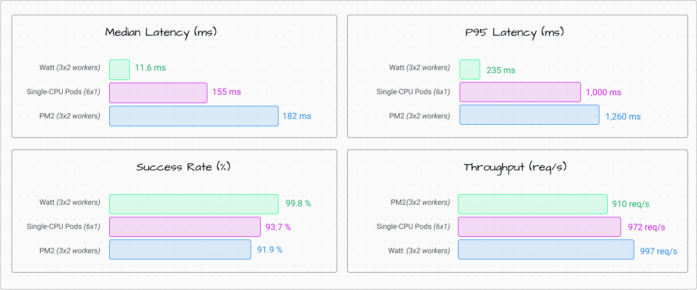
Benchmark: Results
Watt
dramatically
outperforms
both
traditional
approaches.

Slide 32


Latency Performance
93.6% faster median latency compared to PM2
From nearly 200ms to sub-15ms response times.
81.3% faster P95 latency compared to PM2
Consistent performance even at higher percentiles.
92.5% faster than single-CPU pods
Best of both worlds: scaling and performance.

Slide 33


Throughput and Reliability
9.6% more throughput than PM2
99.8% success rate
Same CPU resources, much better utilization.
Near-perfect reliability under sustained load.

Slide 34

How is that
possible?

Slide 35

Why PM2 Underperforms
Master process acts as internal load balancer via IPC
Every request transfers via Unix domain sockets.
About 30% overhead on every request
This overhead applies universally, even when the server is not overloaded.

Slide 36
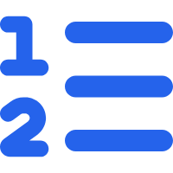

Why Single-CPU Pods Underperform
Isolated queues compound imbalances
Each pod operates independently. Round-robin creates uneven distribution.
No work sharing between pods
One pod drowns at 100% CPU while another idles at 30%. Cannot rebalance.

Slide 37


Watt's Advantages
Zero-overhead kernel distribution
SO_REUSEPORT eliminates IPC coordination. Workers accept connections directly.
Shared accept queue with statistical multiplexing
Workers within each pod share work naturally. Better distribution than isolated pods.
99.8% reliability under load
Architecture handles burst traffic effectively. Near-perfect success rate at higher loads.

Slide 38

Getting Started with Watt in Kubernetes
Ready
to
achieve
these
performance
gains
in
your
own
applications?
Follow
these
steps
to
deploy
Next.js
in
Kubernetes
with
Watt.
https://docs.platformatic.dev/docs/guides/deployment/nextjs-in-k8s

Slide 39


One last thing™
“You are always a student, never a master.
You have to keep moving forward.”
Conrad Hall

Slide 40

Thank you!
Paolo Insogna
@p_insogna
Platformatic
Node.js TSC, Principal Engineer
paolo.insogna@platformatic.dev

