Slide 1




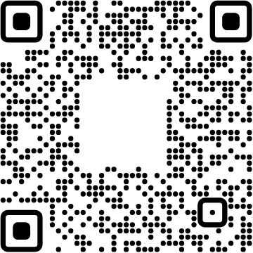

View online
From Smart Home to Smart Cats:
Download PDF
extending home automation to pets
Paolo Insogna
Node.js TSC, Principal Engineer @
Platformatic

Slide 2
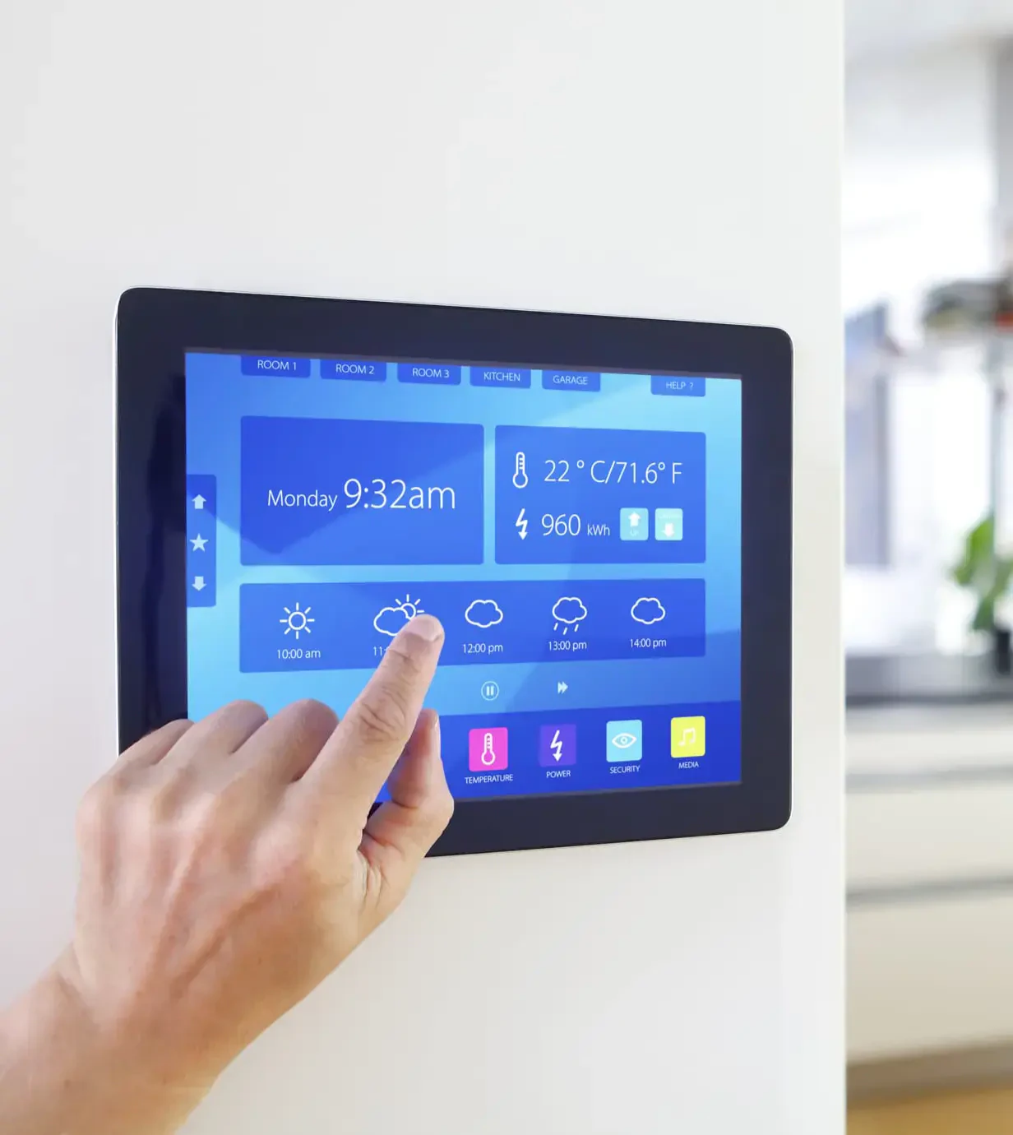
No automation,
no party!

Slide 3






Hello, I'm
Paolo
!
Node.js
Technical Steering Committee Member
Platformatic
Principal Engineer
paoloinsogna.dev
ShogunPanda
p_insogna
pinsogna

Slide 4



A lot has changed in the last few years
Networking is everywhere
Have you ever heard of a connected coffee machine?
The majority of the (western) population has a smartphone
There's an app for everything™
, isn't it?
Just connect the dots
Internet of Things was just a matter of time.

Slide 5
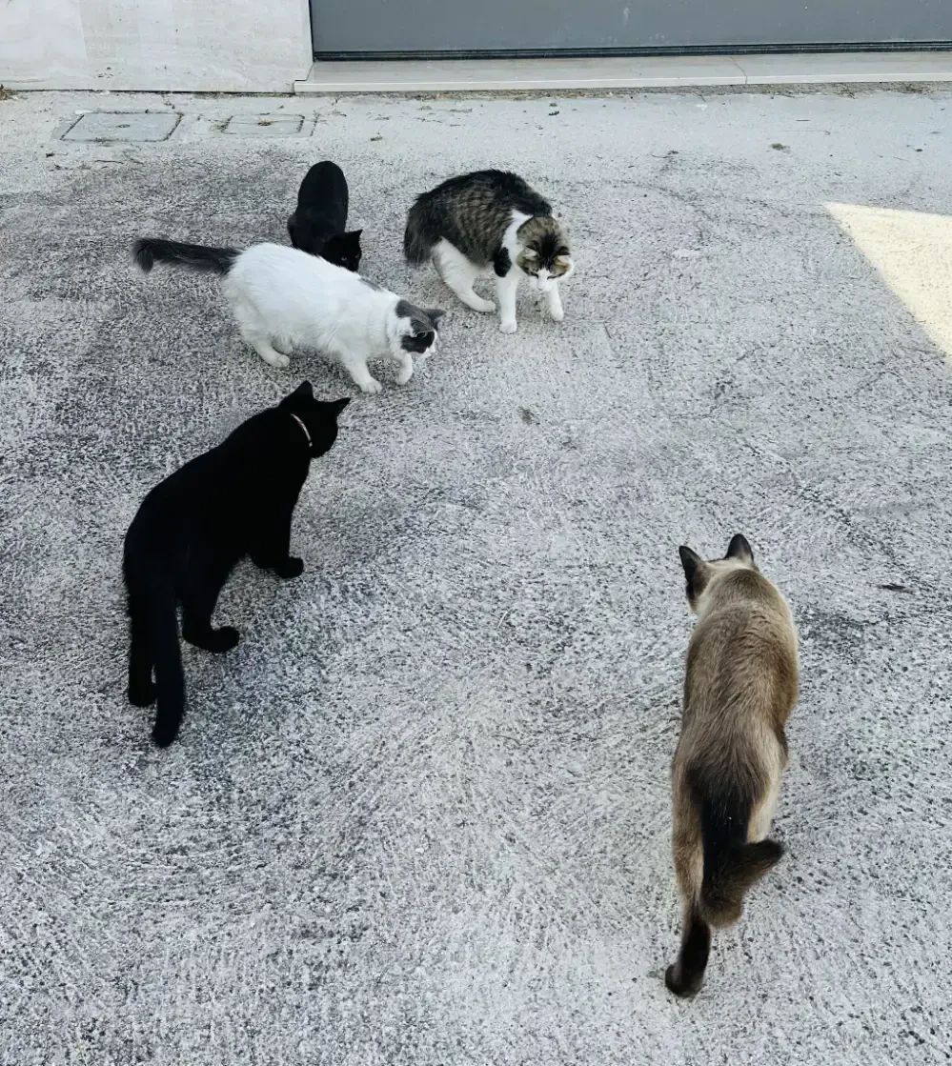
I'm literally
surrounded by
lovely chubby cats...

Slide 6
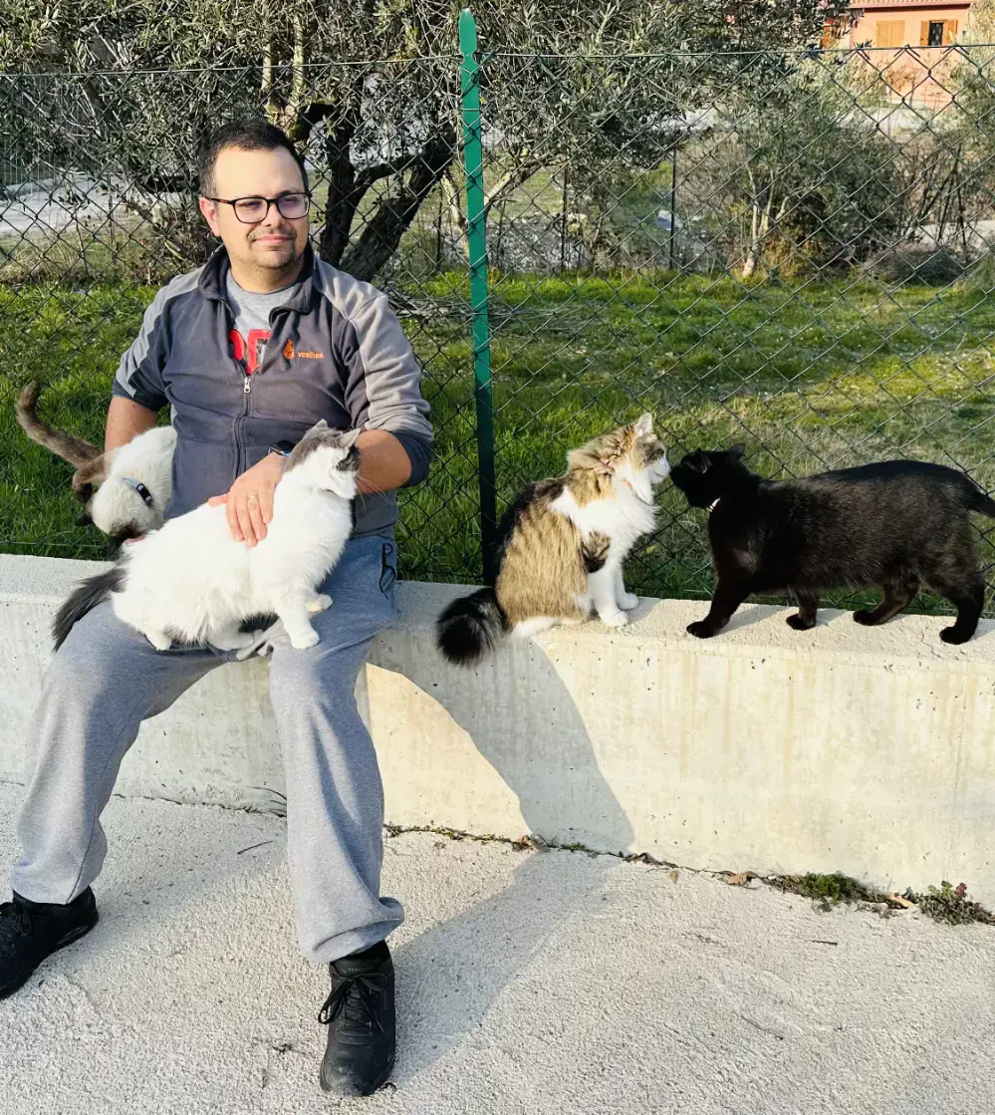
...and I deeply
love them!

Slide 7
There are three types of people
1
People who worship cats
You'll enjoy this talks and probably get some evil ideas.
2
People who are fine with cats
I'll make you happy with the home automation.
3
People who hate cats
Please leave, NOW!

Slide 8
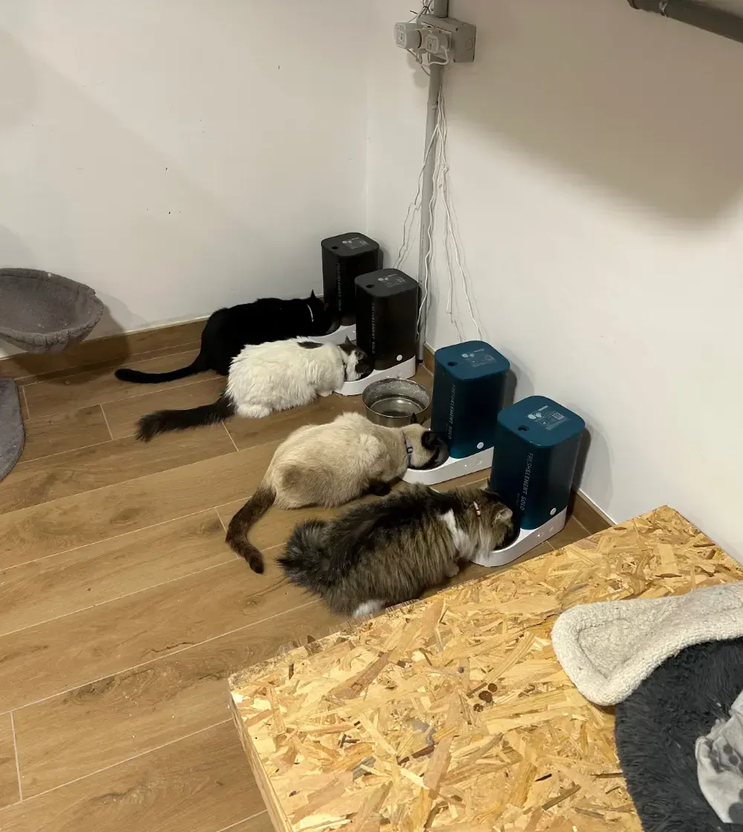
I automated
their lives...

Slide 9
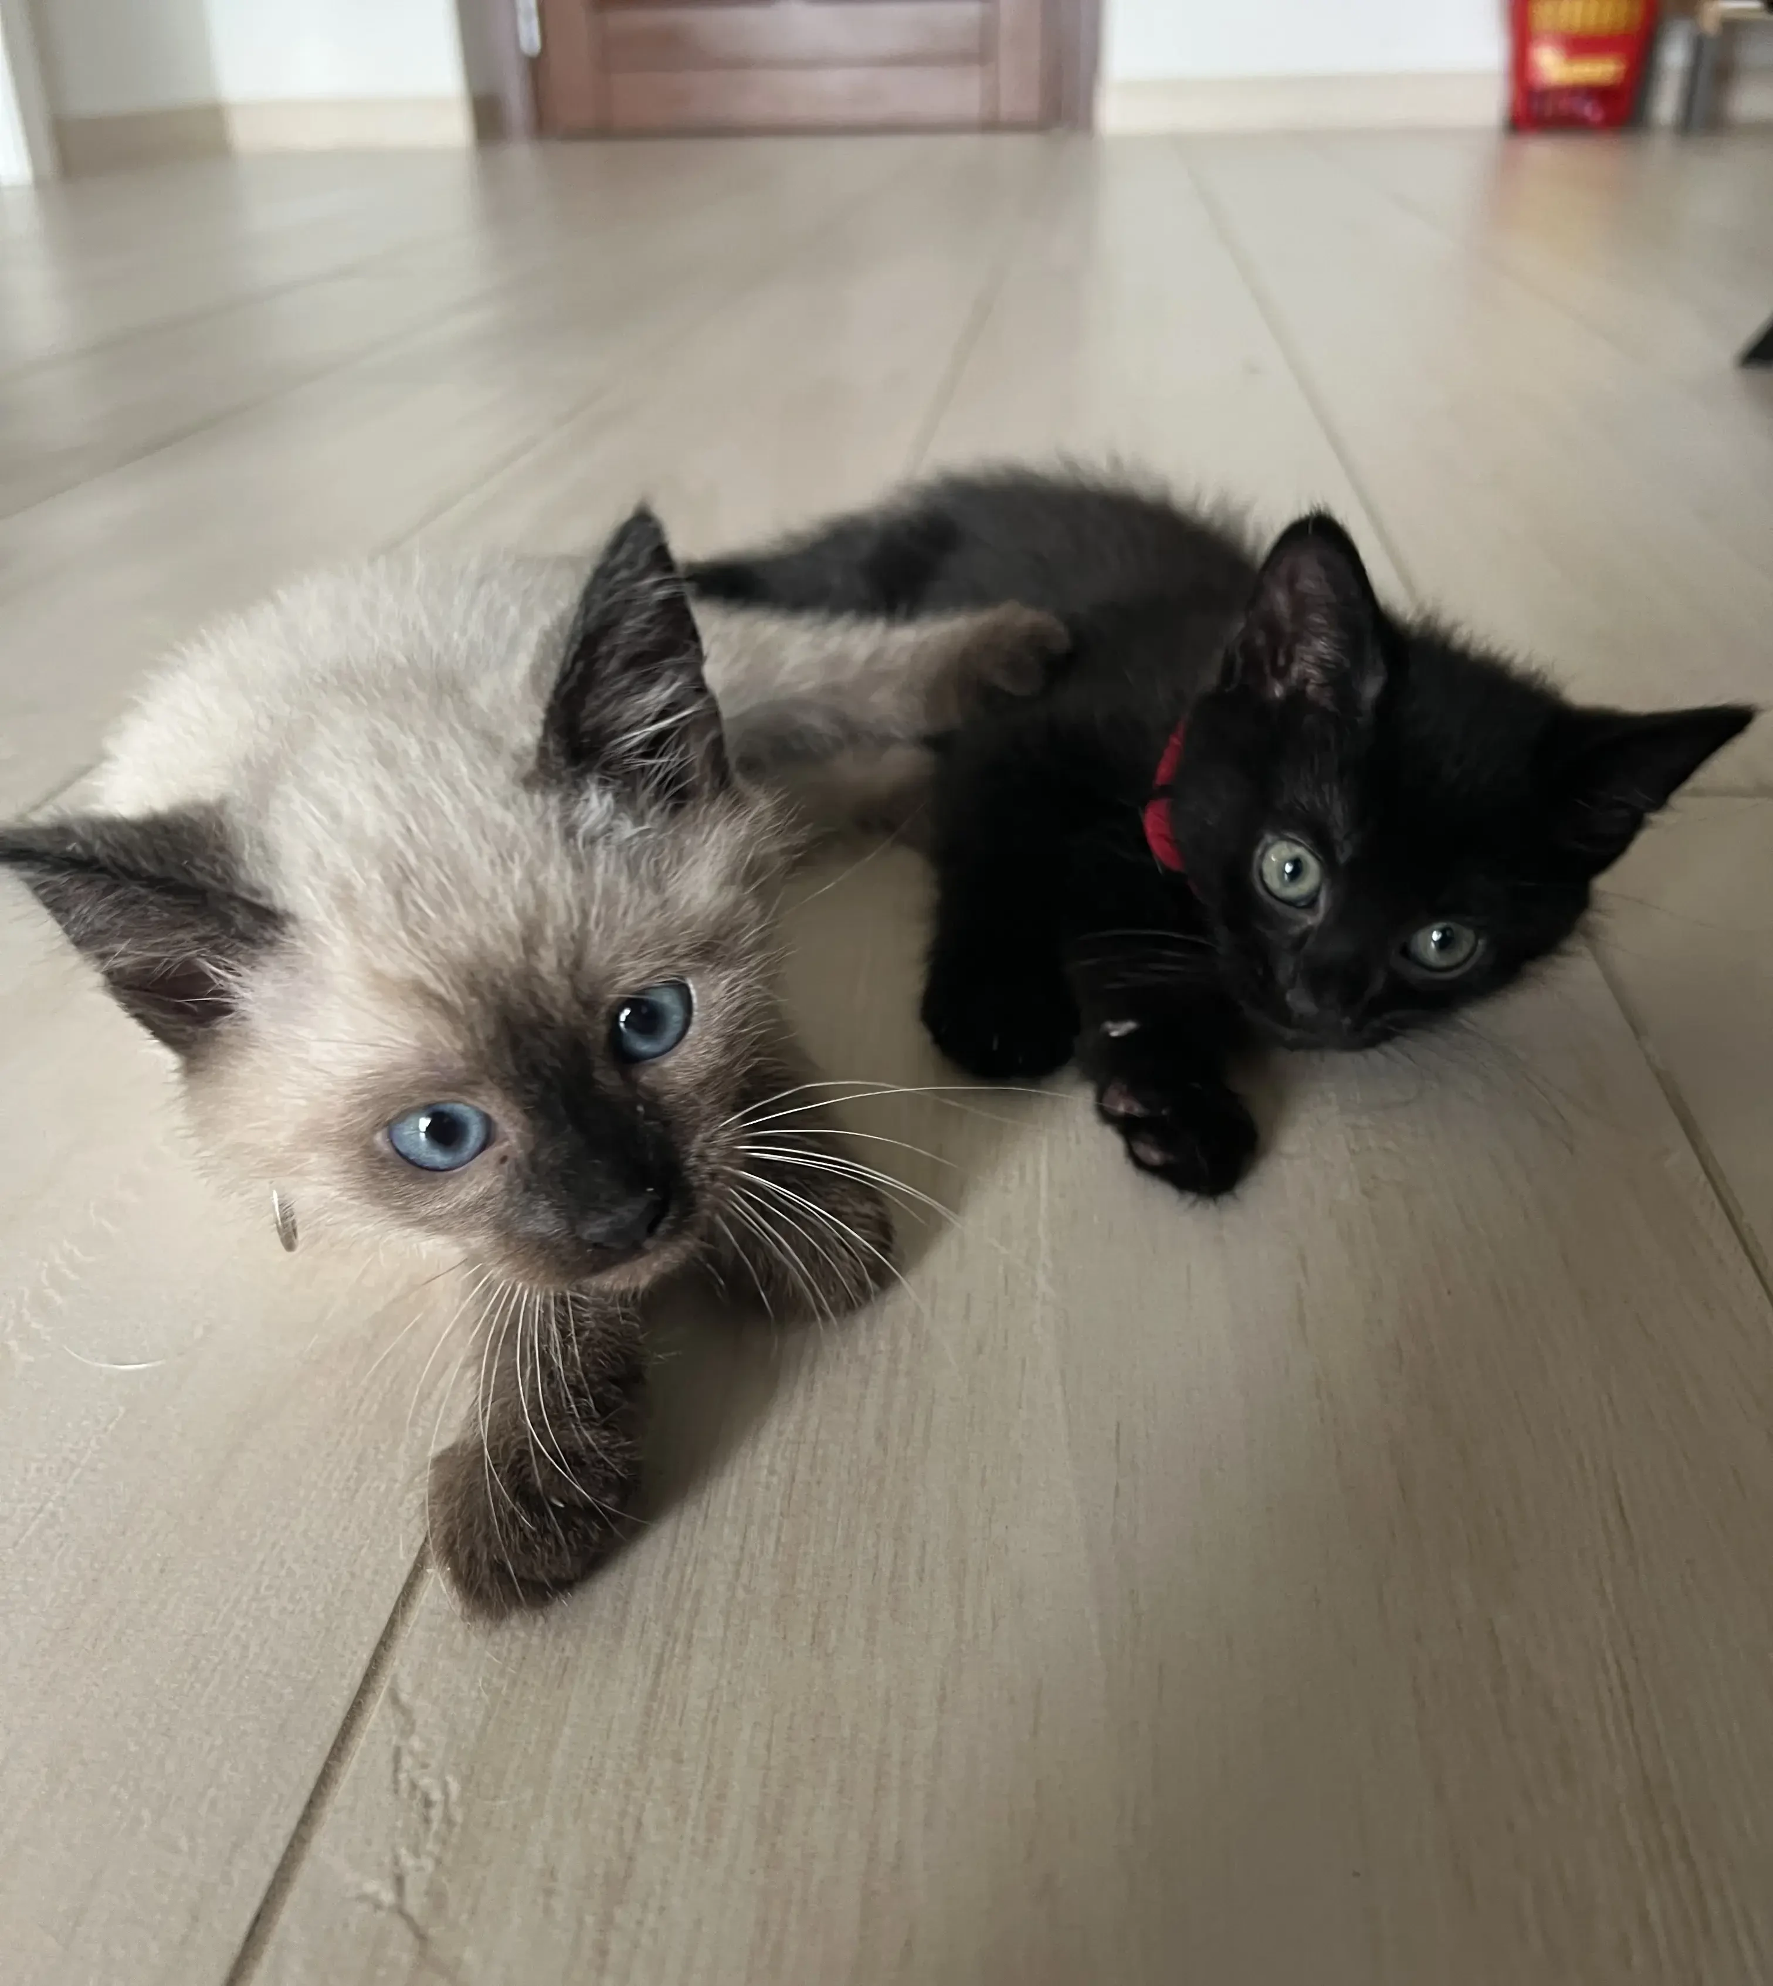
...since my wife kept
collecting new cats!

Slide 10


A little disclaimer
In
this
talk
I'll
mention
many
brands
and
products.
Nobody is sponsoring me
No brand knows I'm here
It just happen that these products were the
So everything that follows is just my personal
best for my specific needs.
opinion and experience.

Slide 11
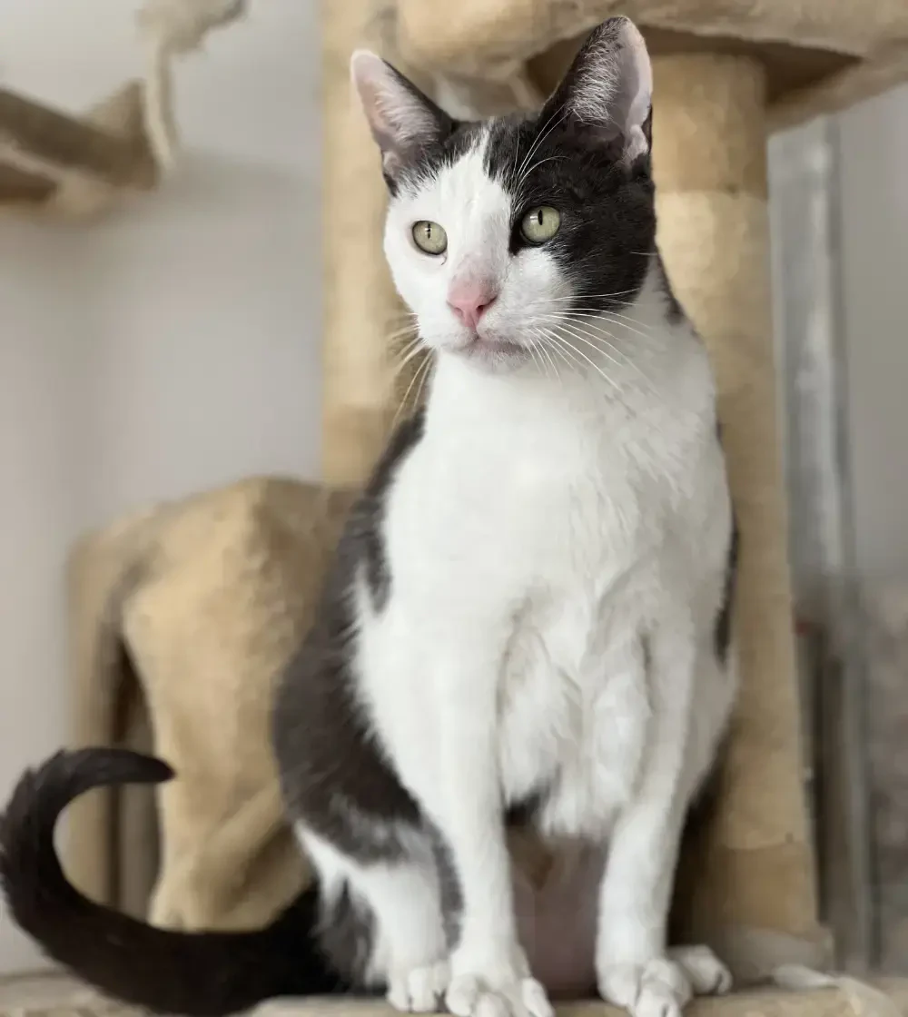
Let's start!
Say hello to
Bree
!

Slide 12
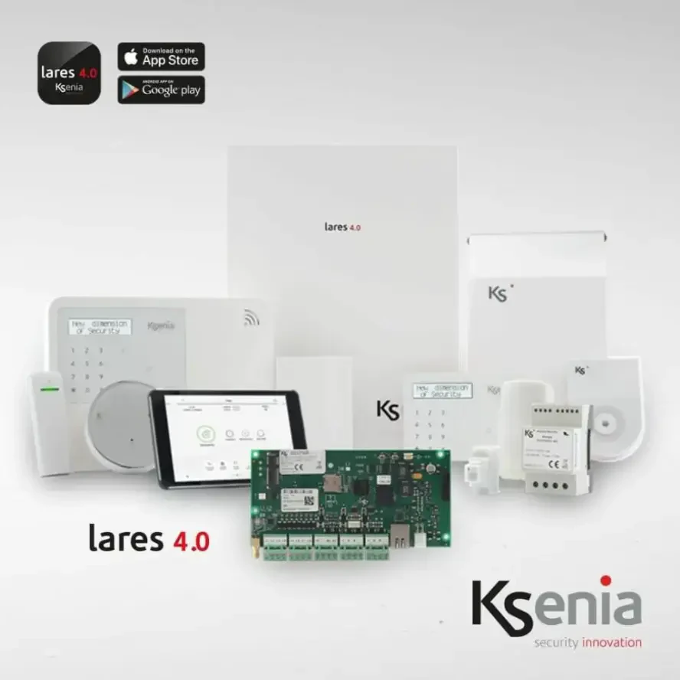


The beginning
It
started
with
my
home
alarm
system.
KSenia Lares 4.0
It is a innovative home alarm and automation
system all
made in Italy
.
Comprehensive solution
It can control alarms, sensors, doors, windows
and many other devices.

Slide 13


KSenia Lares 4.0: How do you control it?
WebSocket based protocol
Documentation is available
There is a WebSocket endpoint which is both
Once you know how to obtain the SDK
used by the Web UI and also exposed as API.
documentation, you are good to go.

Slide 14
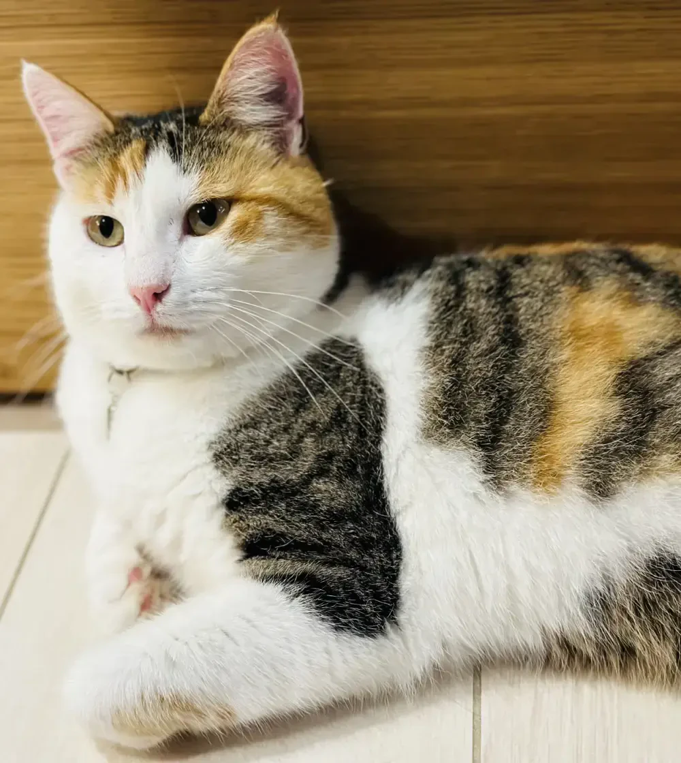
It's hot...
no wait, it's cold!
Say hello to
Cali
!

Slide 15



Let's optimize
Once
the
house
was
under
control,
it
was
time
to
take
care
of
climate
control.
Panasonic Aquarea as primary device
It's an electric heat pump which can either
heat or cool your house.
Ferroli BlueHelix as secondary heater
Despite the name, it's connected via sealed
Chinese cloud.
I gave up here!

Slide 16
Panasonic Aquarea: How do you control it?
1
2
Use their service Website
Use a custom MQTT firmware
The availability of the service was
Let's thank some nice devs of GitHub!
unfortunately questionable.
I modified the LAN interface.

Slide 17

Shall I buy a
power plant?
Say hello to
Cleo
!

Slide 18



With the power of the
Sun I will win!
After
installing
solar
panels
I
was
able
to
optimize
power
consumption.
Fronius Primo
A very easy to use and connected inverter.
This was a blessing
I reduce my power bills by
66%
!

Slide 19
Fronius Primo: How do you control it?
HTTP enabled
Documentation is available
The inverter exposes an API to query data.
You can download it from the Fronius website.

Slide 20
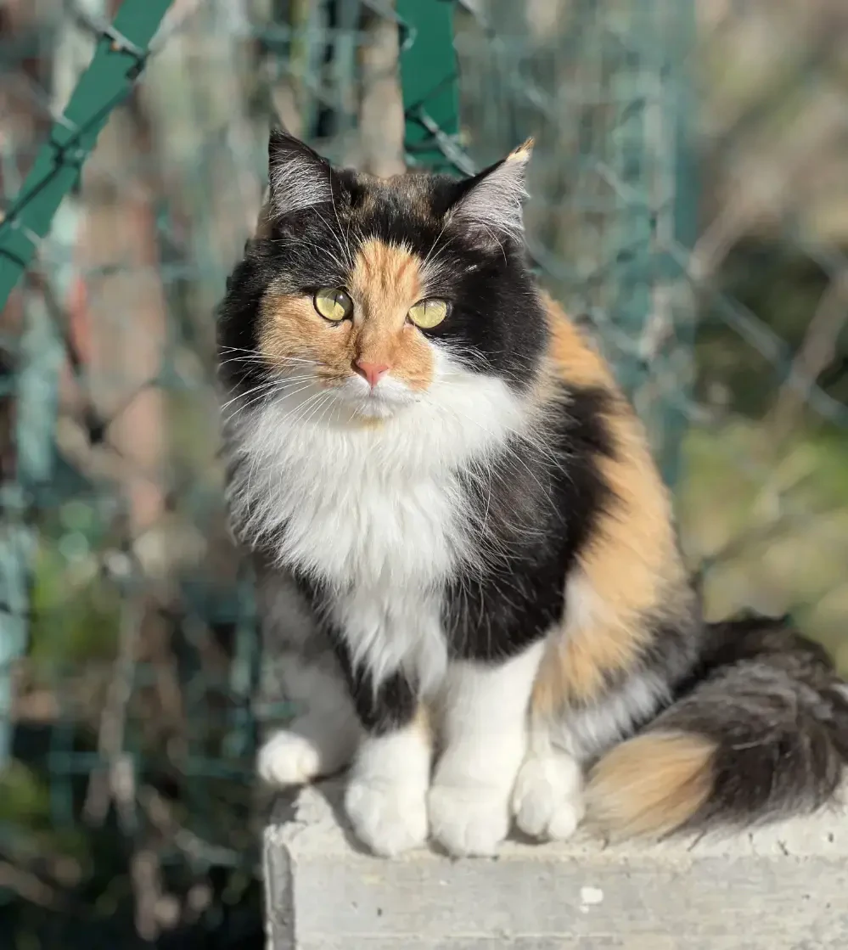
Don't brag,
you still use
gas to move!
Say hello to
Freya
!

Slide 21
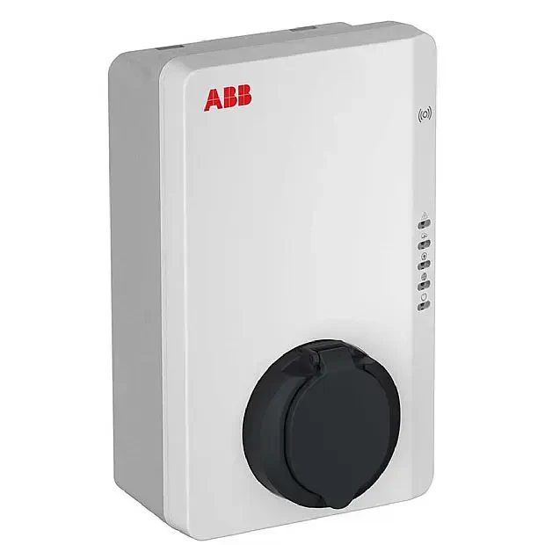


What have I told you
about the sun?
I
switched
to
electric
cars
and
therefore
I
installed
a
wallbox.
ABB Terra
It supports single-phases or three-phases
system, up to 22KW power.
ENEL is my enemy now
The voltage level in my house is completely
unreliable. Somebody protect my devices!

Slide 22
ABB Terra: How do you control it?
1
2
OCPP
ModBus
It's a open standard for wallboxes.
Via a RS485 to (W)LAN adapter,
I couldn't find a Node.js implementation.
I was able to control the device.

Slide 23
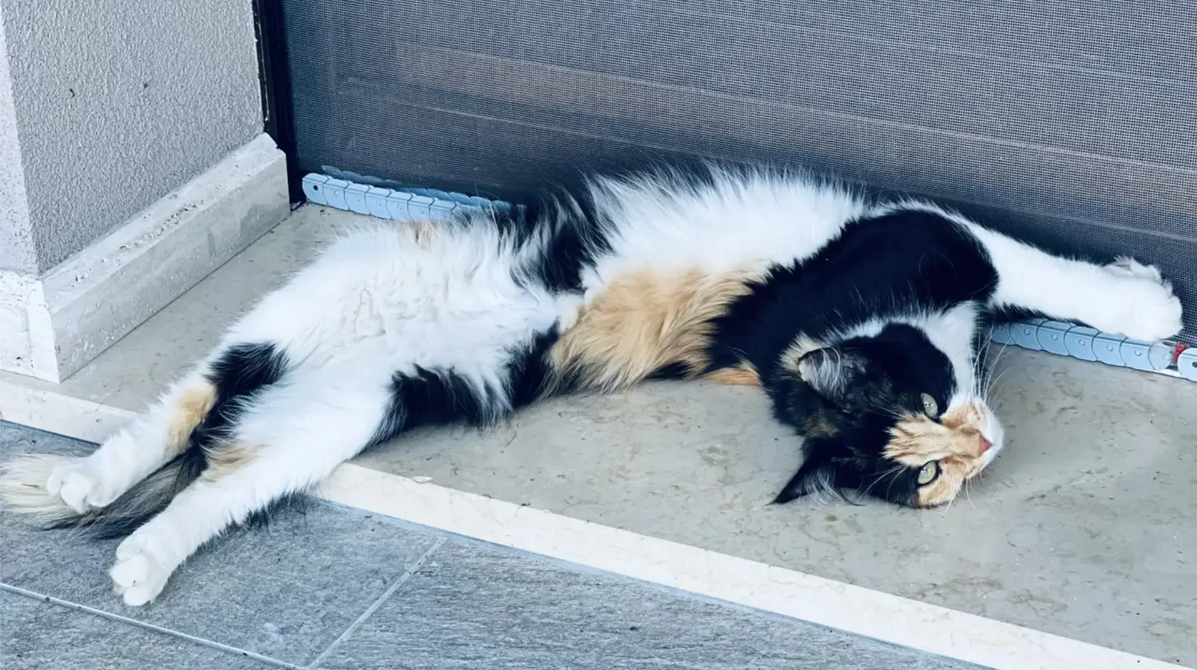
Gimme the cats!

Slide 24
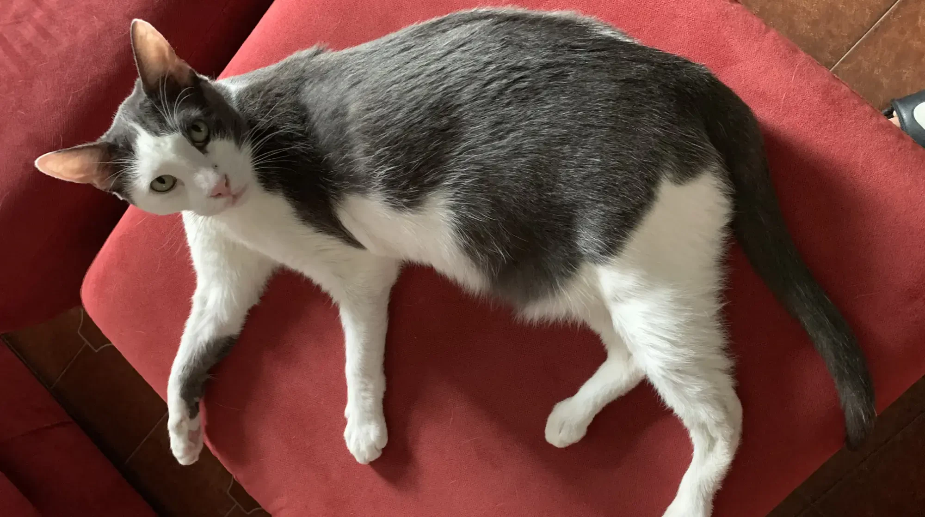
It all started with Bree

Slide 25



He was
always
hungry
No matter the time
It's food o' clock!
No matter if you had a life
You had to feed him 3-4 times a day.
Persistent staring or vocalizing can kill you
His biological clock was better than an atomic one.

Slide 26
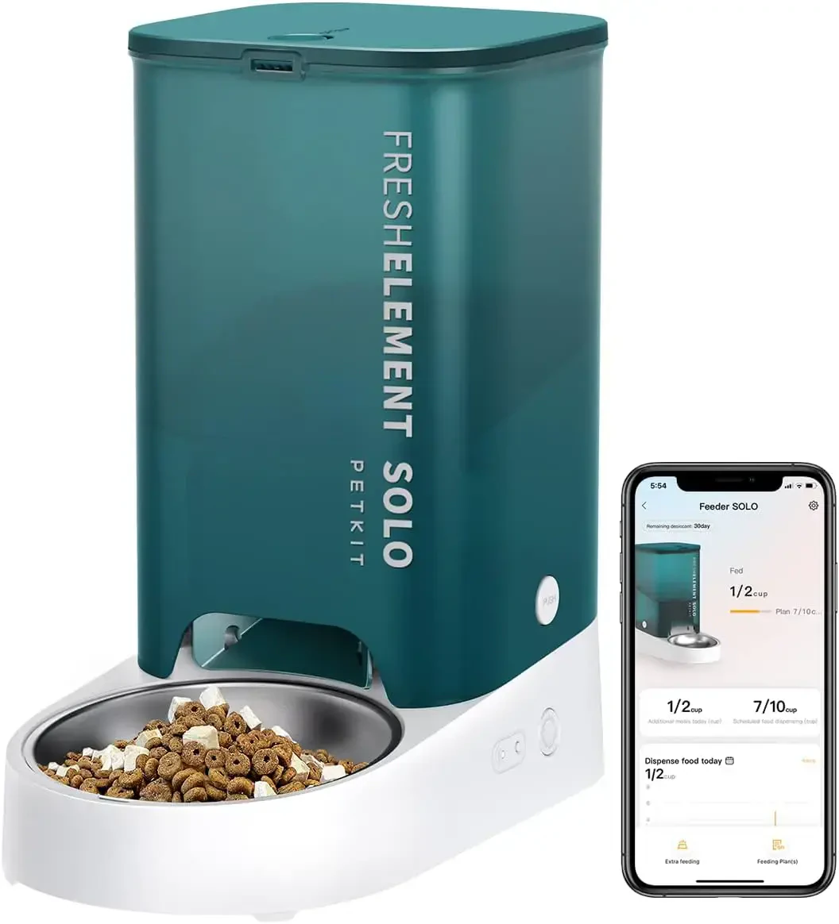

Thanks progress
After
many
years
of
struggling,
I
found
the
perfect
solution.
PetKit FreshElement Solo
Cheap, easy to use and reliable.
App controlled
But the UX is
questionable
.

Slide 27

PetKit FreshElement: How do you control it?
HTTP API
Let them be fat
It has an easy to use HTTP API.
The API accuracy varies per device.

Slide 28
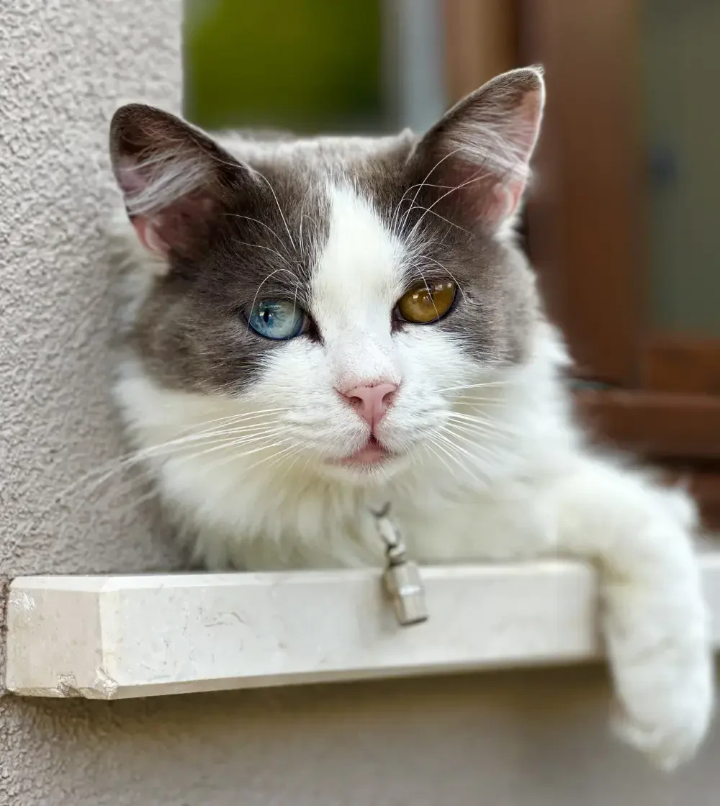
Why don't you
complicate things?
Say hello to
Yuna
!

Slide 29


In 2020 we moved
Bigger house, more cats
Do you remember what I said about collecting?
We (kinda) still live in the city
But we are literally on the border, in the countryside.
Wild animals are everywhere
After 30+ years I had to deal with foxes and similar on a daily basis.

Slide 30
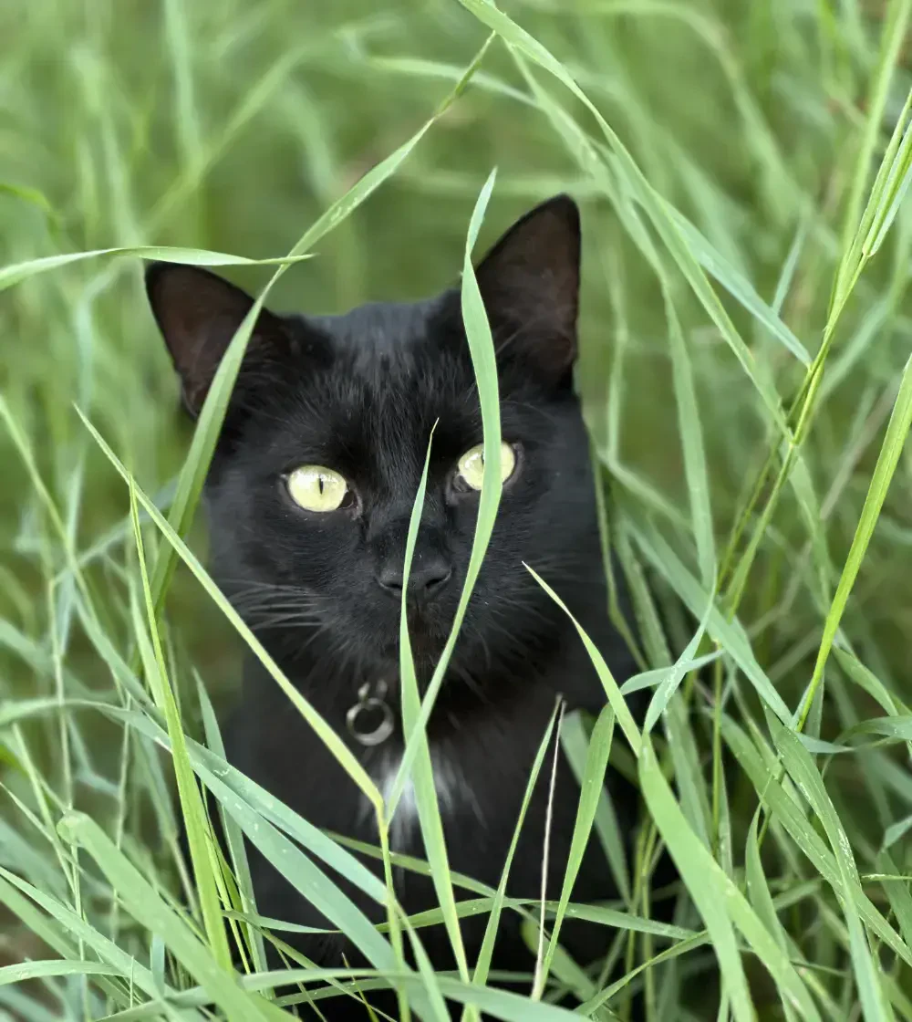
Let's protect them!
Say hello to
Kuro
!

Slide 31
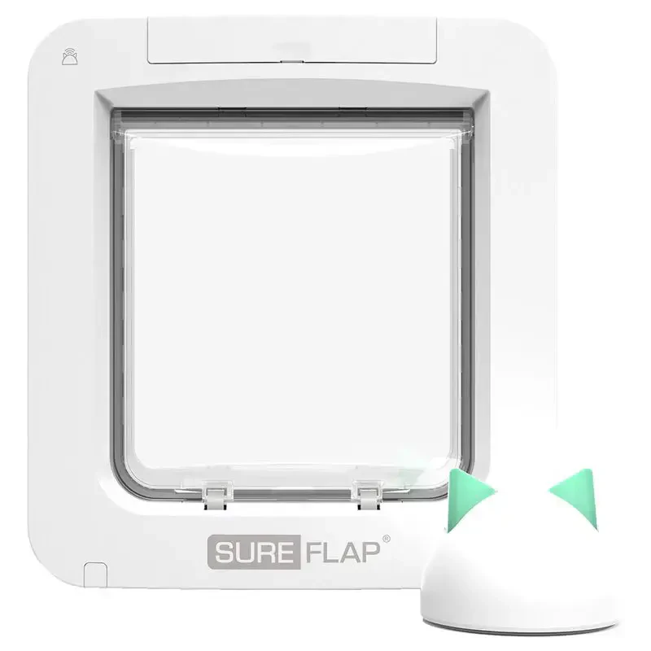


Can't beat a classic
There
are
some
solutions
that
take
advantage
of
pets'
subcutaneous
chip.
Sure PetCare Microchip Pet Door
Modern and comprehensive. Also pretty cute.
Just the good, old RFID.
The technology is more than 50 years old.

Slide 32

Microchip Pet Door: How do you control it?
HTTP API
MQTT on the way
The same used by the app and the website.
Some other good people on GitHub are
Yes, the app is just a web view.
working on a custom firmware.

Slide 33
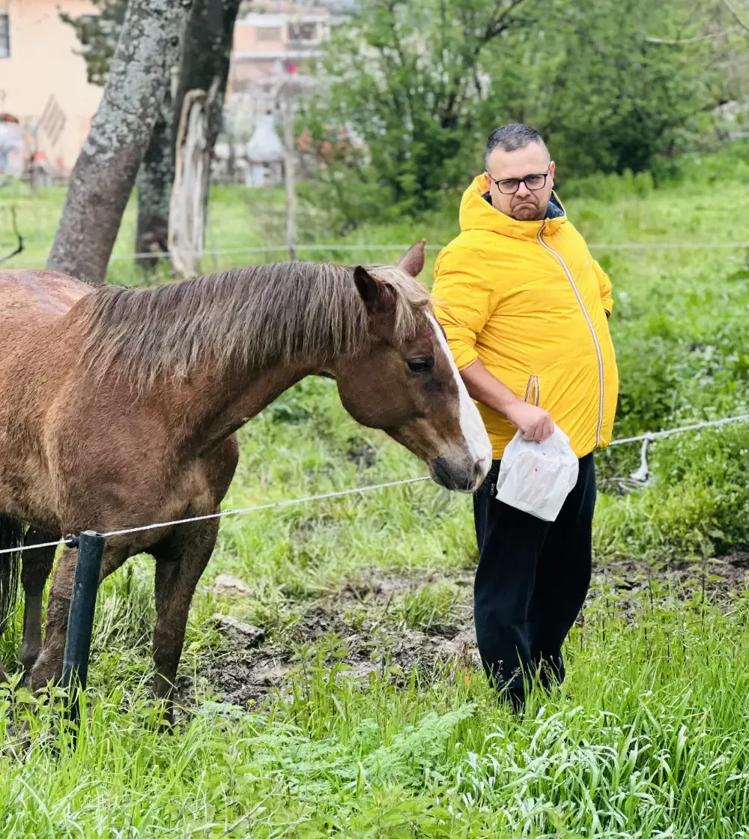
Did you really
believe it was just
about cats?
Say hello to
Snappy Shine
Braciolone
!

Slide 34
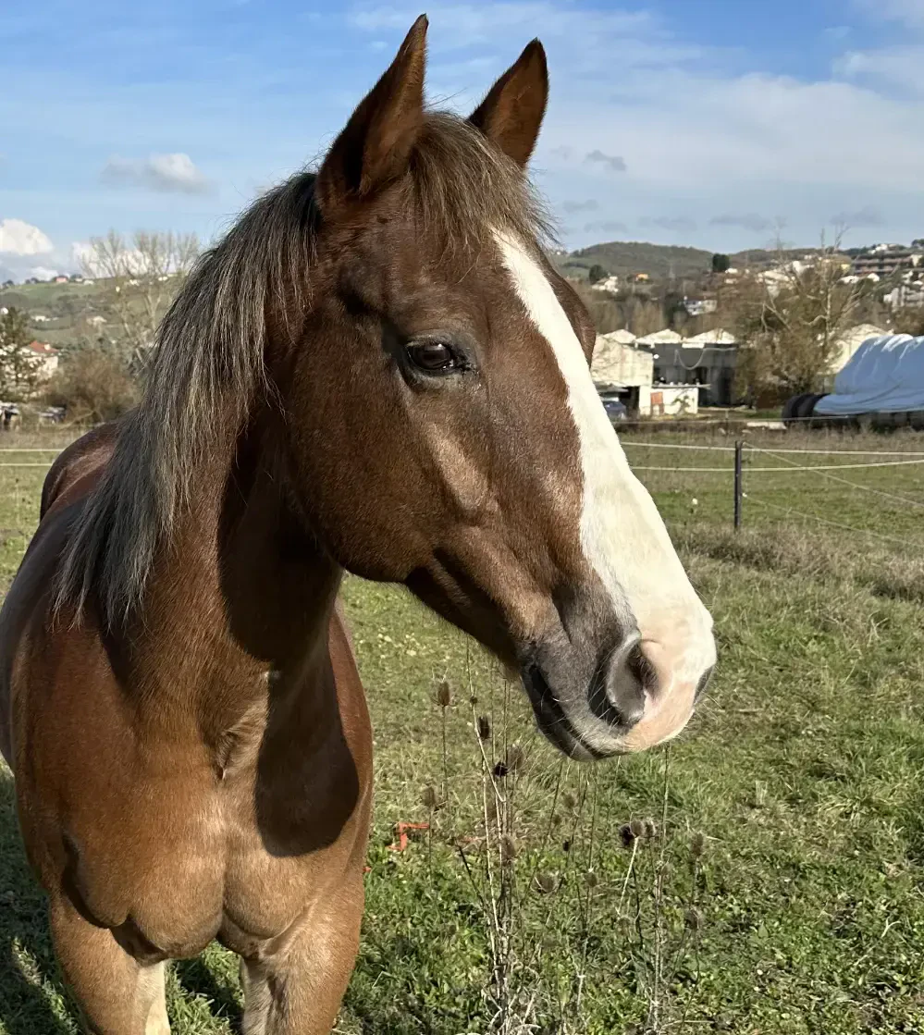
Sadly, I couldn't
automate his
life (yet)...

Slide 35
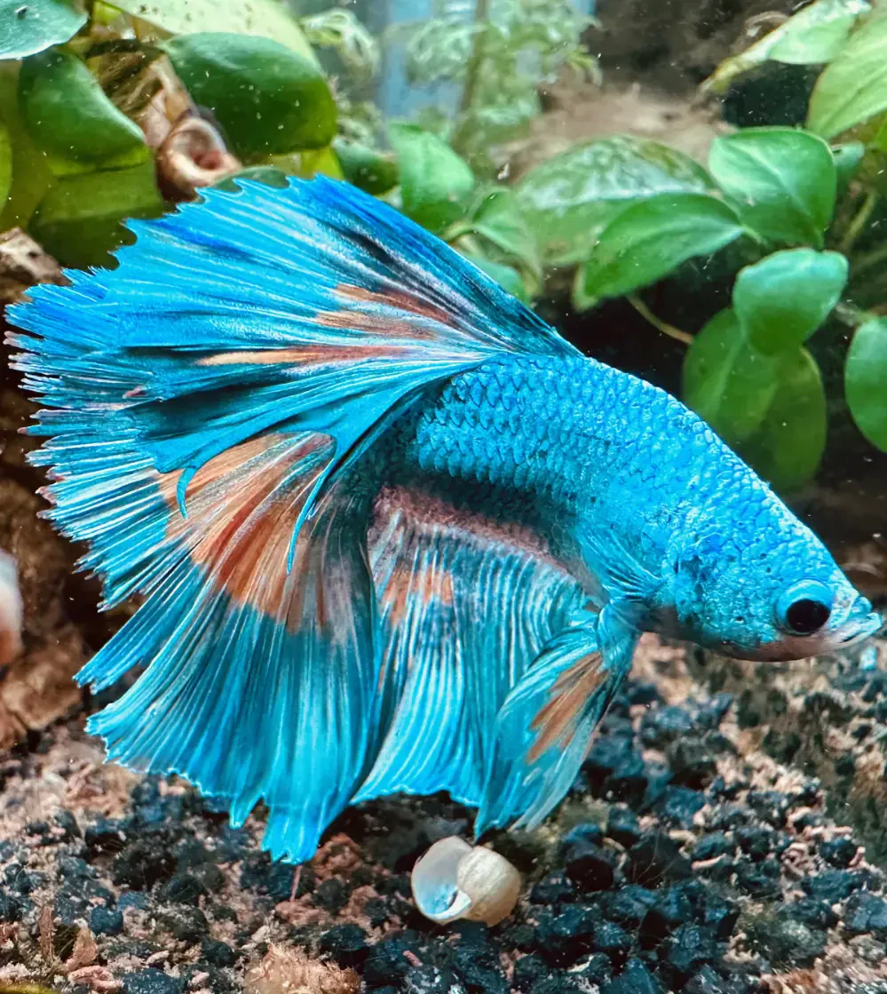
... but I could
automate his. Why
not?
Say hello to
Oscar
!

Slide 36
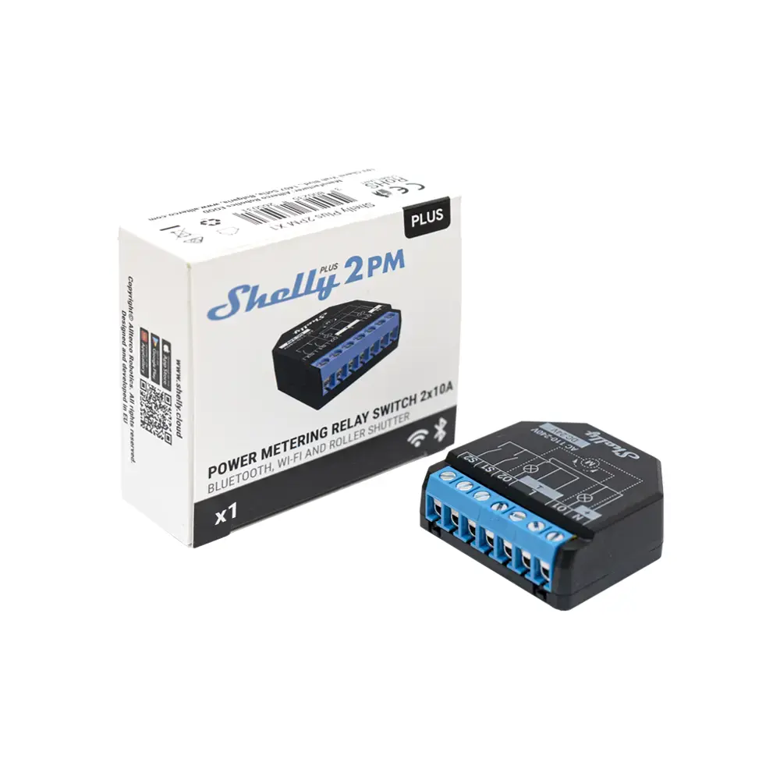

What is the fastest
way to get a divorce?
Just
discovered
a
new
brand.
Shelly devices
Small, cheap and made for the geeks.
They support a lot of protocols
MQTT, HTTP, WebSocket, you name it.

Slide 37
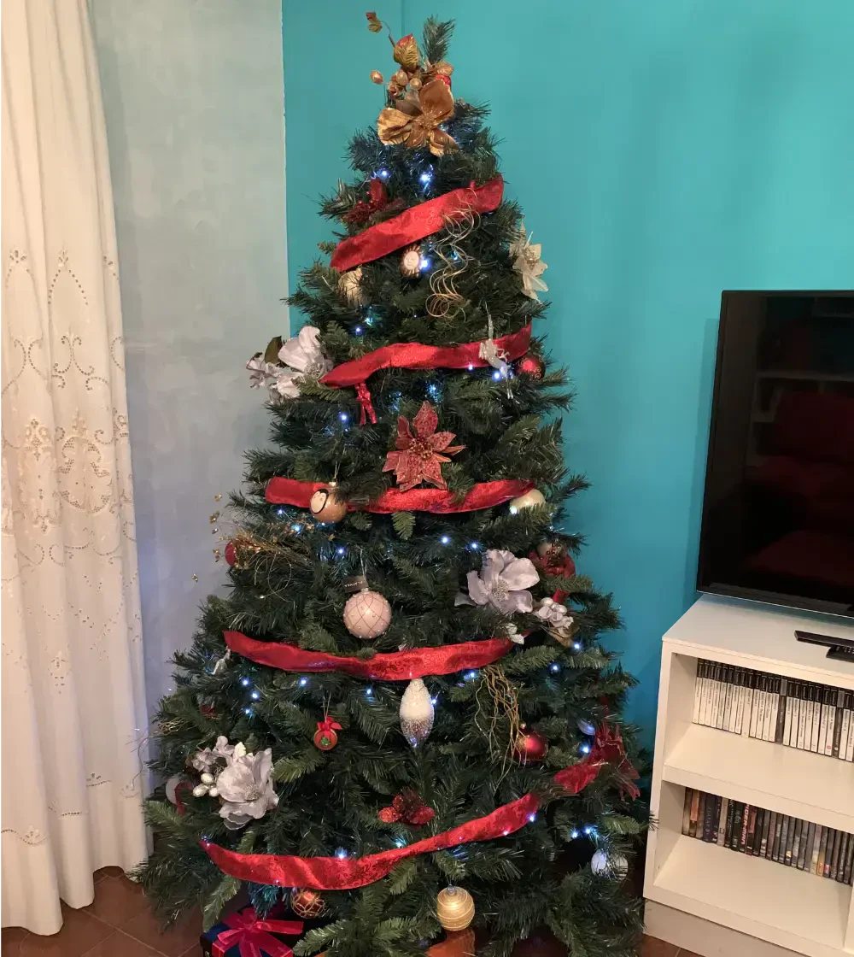
It also helps
with X-Mas!
Why?! Why not!

Slide 38
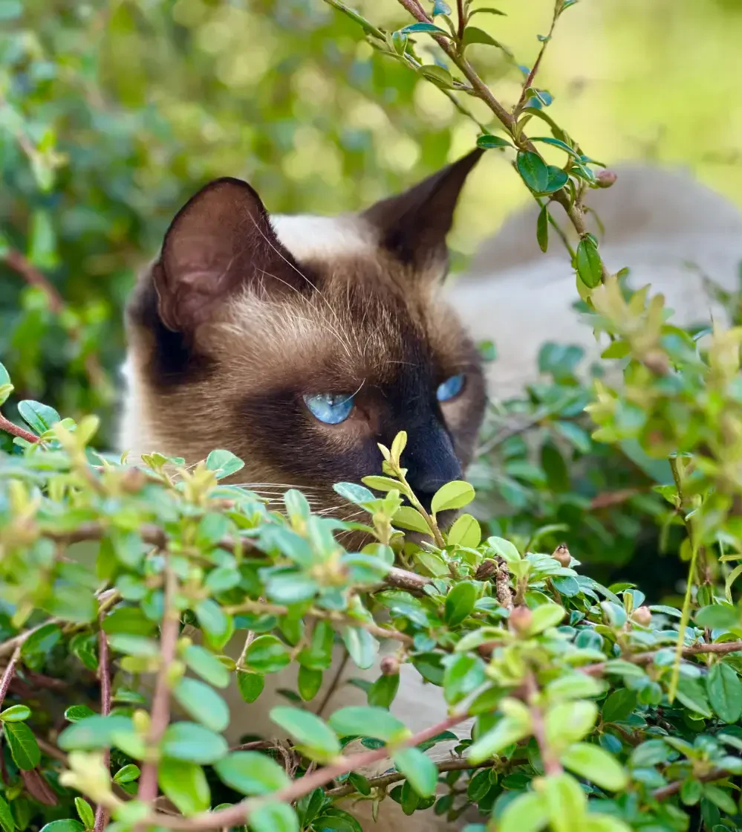
And that's
my house!
Say hello to
Loki
!

Slide 39



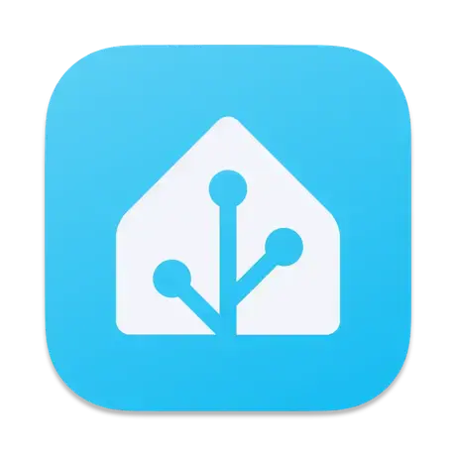
Home assistants
Let's
talk
about
the
most
known
vendors.
Apple HomeKit
Google Home
Amazon Alexa
Home Assistant

Slide 40


What do they have in common?
Do not reinvent the wheel
All integrations are (mostly) based on existing technologies.
It's all about presentation
Connecting the dots was the deal breaker.
They expose a (semi) public API
Anybody can write new devices or new integration.

Slide 41



The Perseveranza™ technical stack (1/2)
Node.js
Redis
Mosquitto

Slide 42



The Perseveranza™ technical stack (2/2)
Fastify
HAP (Homebridge)
GraphQL

Slide 43

Gimme the details!
Say hello to
Mora
!

Slide 44


Where is the code?
None of your business. 😘
All the code is in GitHub private repositories.
It's completely opinionated
This time I was not aiming for the public.
You (should) know how to write an API
Don't be lazy!

Slide 45
Let's
play
a
little
game
...
What is her name?

Slide 46
The
answer
is
...
Cleo!

Slide 47


Remember ...
“Home is where the heart is.”
Plinius the Elder

Slide 48
One last thing™
“In ancient times cats were
worshipped as gods.
They have not forgotten this.”
Terry Pratchett

Slide 49


This was my usual ending slide...
Paolo Insogna
@p_insogna
Platformatic
Node.js TSC, Principal Engineer
paolo.insogna@platformatic.dev

Slide 50
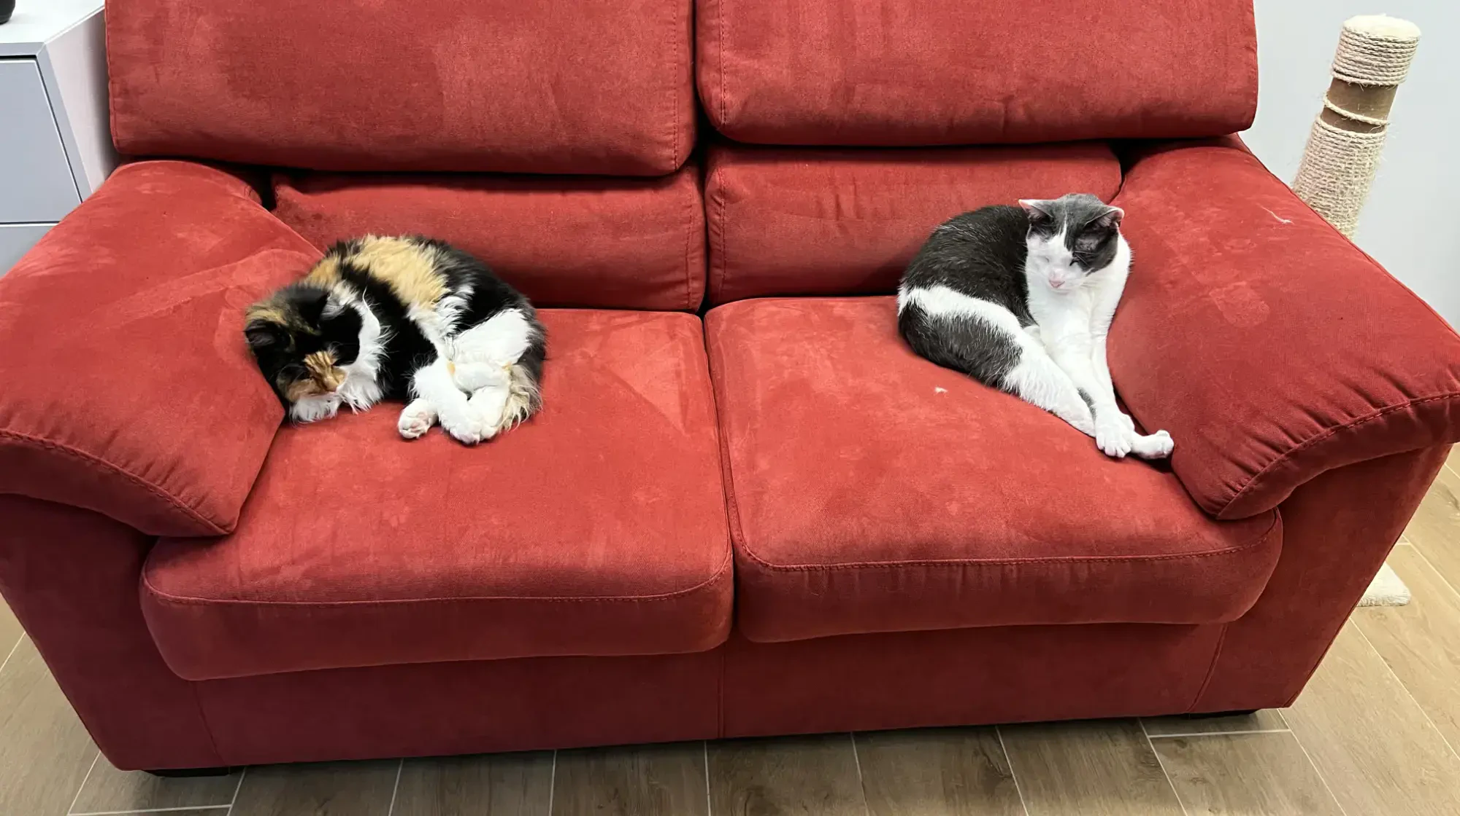
But this talk is special. Thank you!
We miss you both, a very lot! ❤️
Paolo Insogna
@p_insogna
Platformatic
Node.js TSC, Principal Engineer
paolo.insogna@platformatic.dev

