Slide 1






View online
The tale of avoiding a
Download PDF
time-based DDOS attack in Node.js
Paolo Insogna
Node.js TSC, Principal Engineer @
Platformatic

Slide 2

Sometimes, your
worst enemy is
slowness!

Slide 3






Hello, I'm
Paolo
!
Node.js
Technical Steering Committee Member
Platformatic
Principal Engineer
paoloinsogna.dev
ShogunPanda
p_insogna
pinsogna

Slide 4

What do we use
everyday?
Web
applications
play
a
very
important
part
of
our
lives.
They
must
not
go
down!

Slide 5

We are all
vulnerable!

Slide 6



Denial of Service Attack
Denial of Service Attack (DoS)
A network resource is maliciously made unavailable to its intended users.
Distributed Denial of Service (DDoS)
The incoming flooding traffic originates from many different sources.
In DDoS the attacker usually uses a lot of resources
Is that still true?

Slide 7
Fear the
real enemy ...

Slide 8


Slide 9
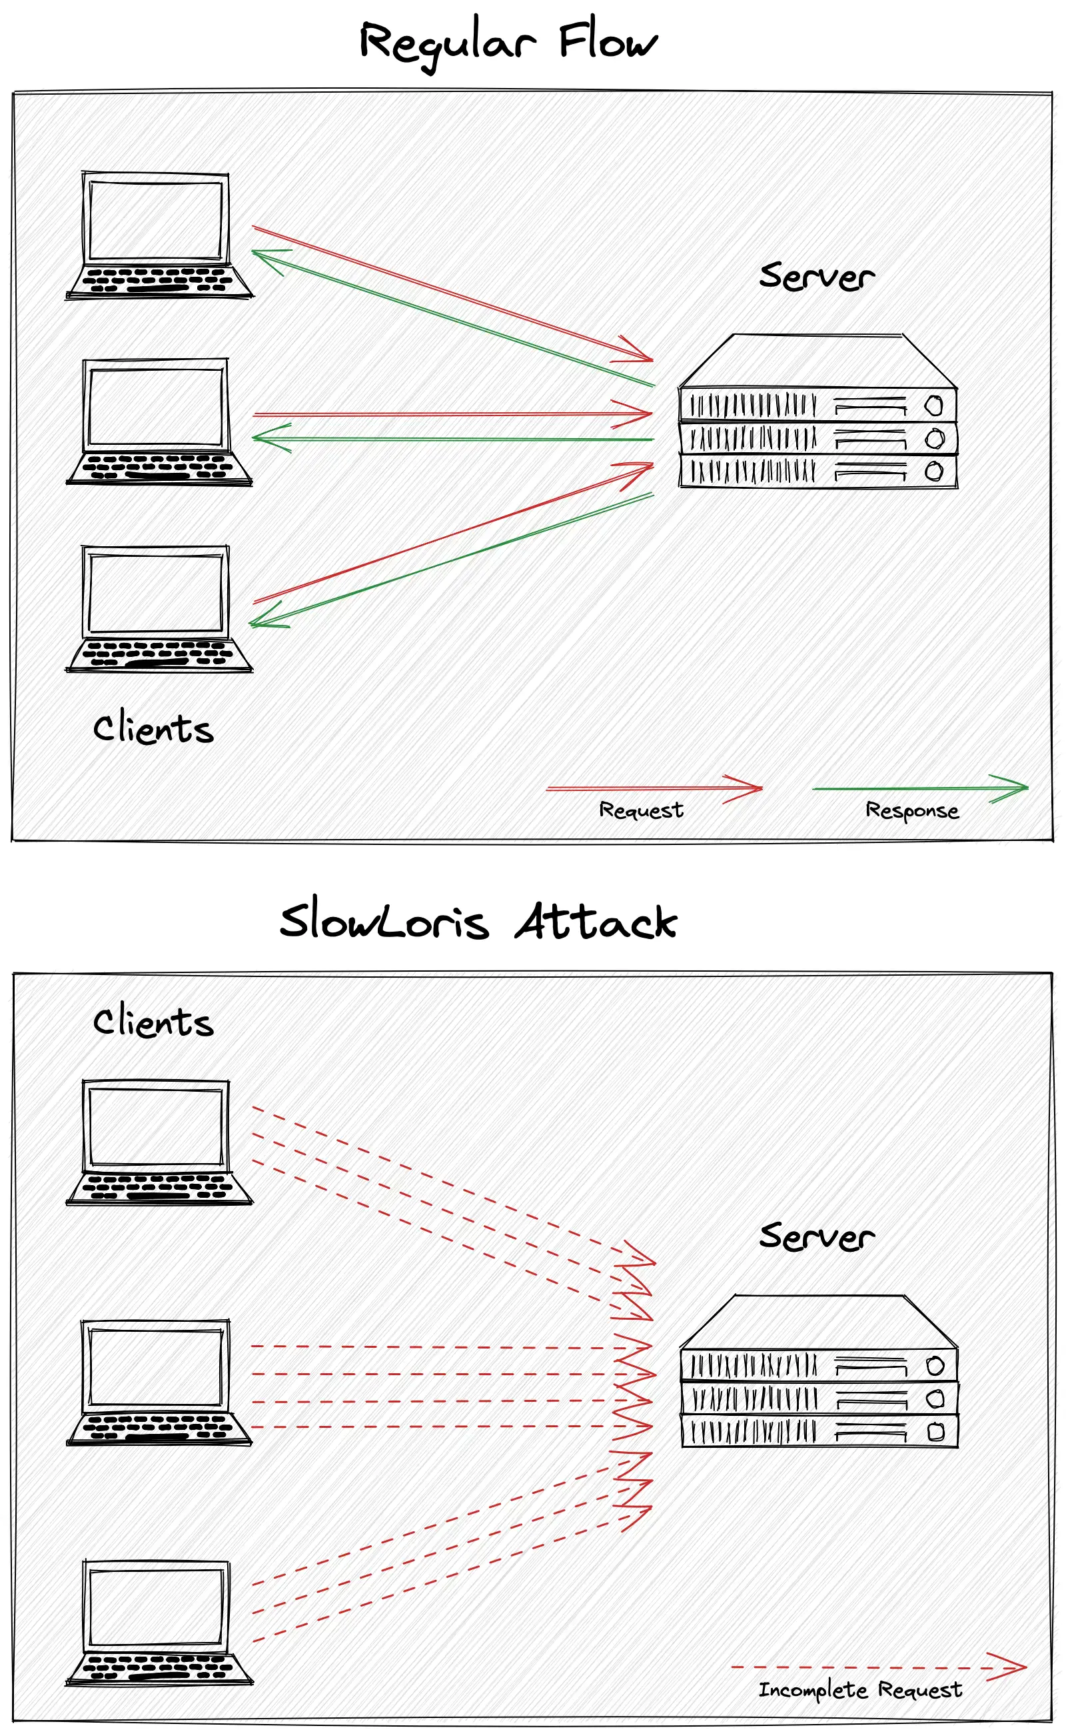


The Slowloris attack
What is it?
A DDoS attack which
uses minimal bandwidth.
When it was created?
Robert "RSnake" Hansen
created it in June 2009.
It's not just HTTP!
This attack can be abstracted
to similar protocols.

Slide 10
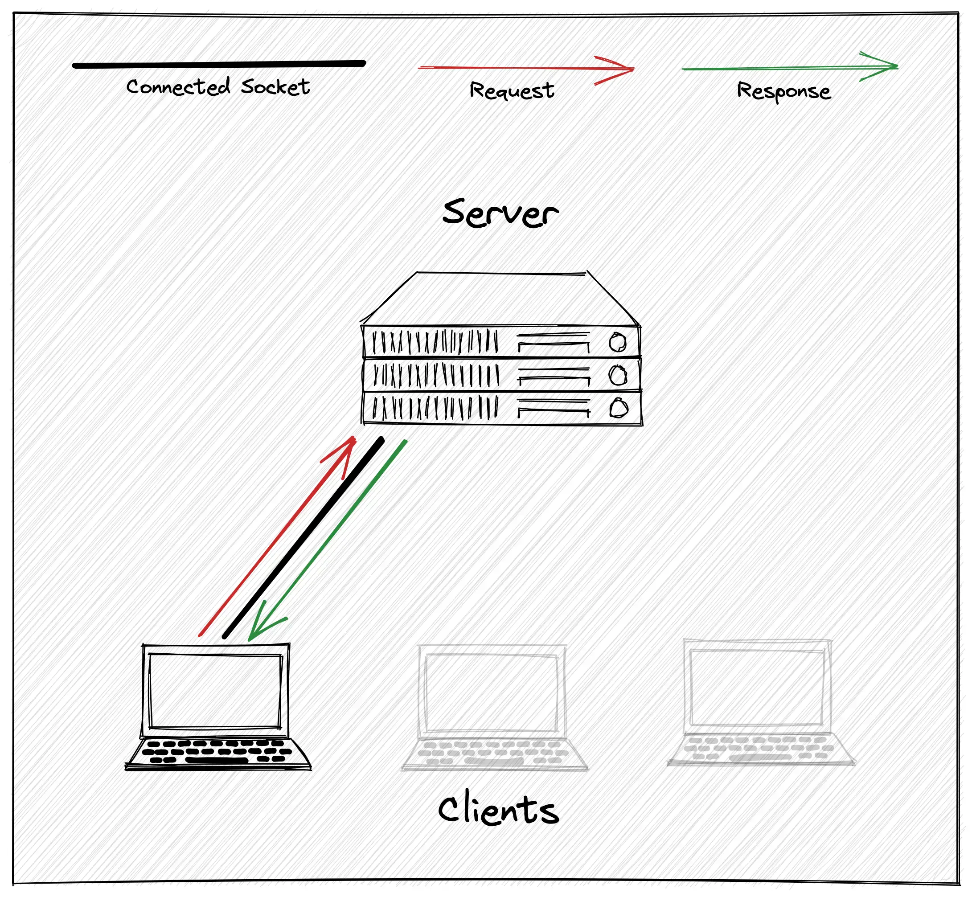
Normal HTTP server
activity
Each
socket
on
the
server
consumes
some
amount
of
RAM
and
other
system
resources.
1

Slide 11
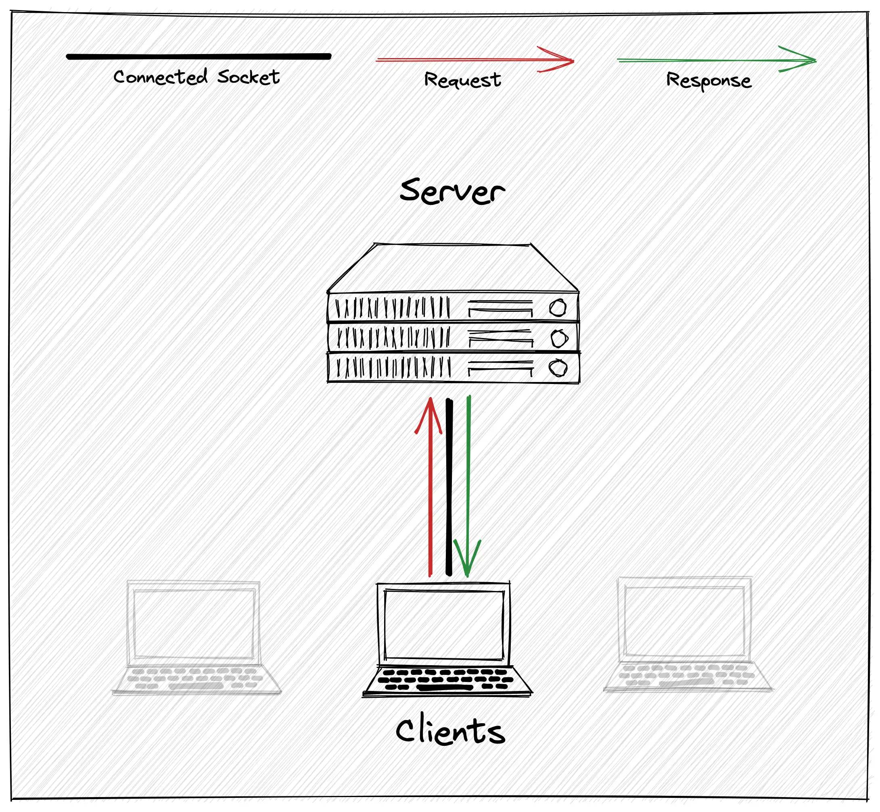
Normal HTTP server
activity
Clients
usually
disconnect
after
receiving
the
response.
2

Slide 12
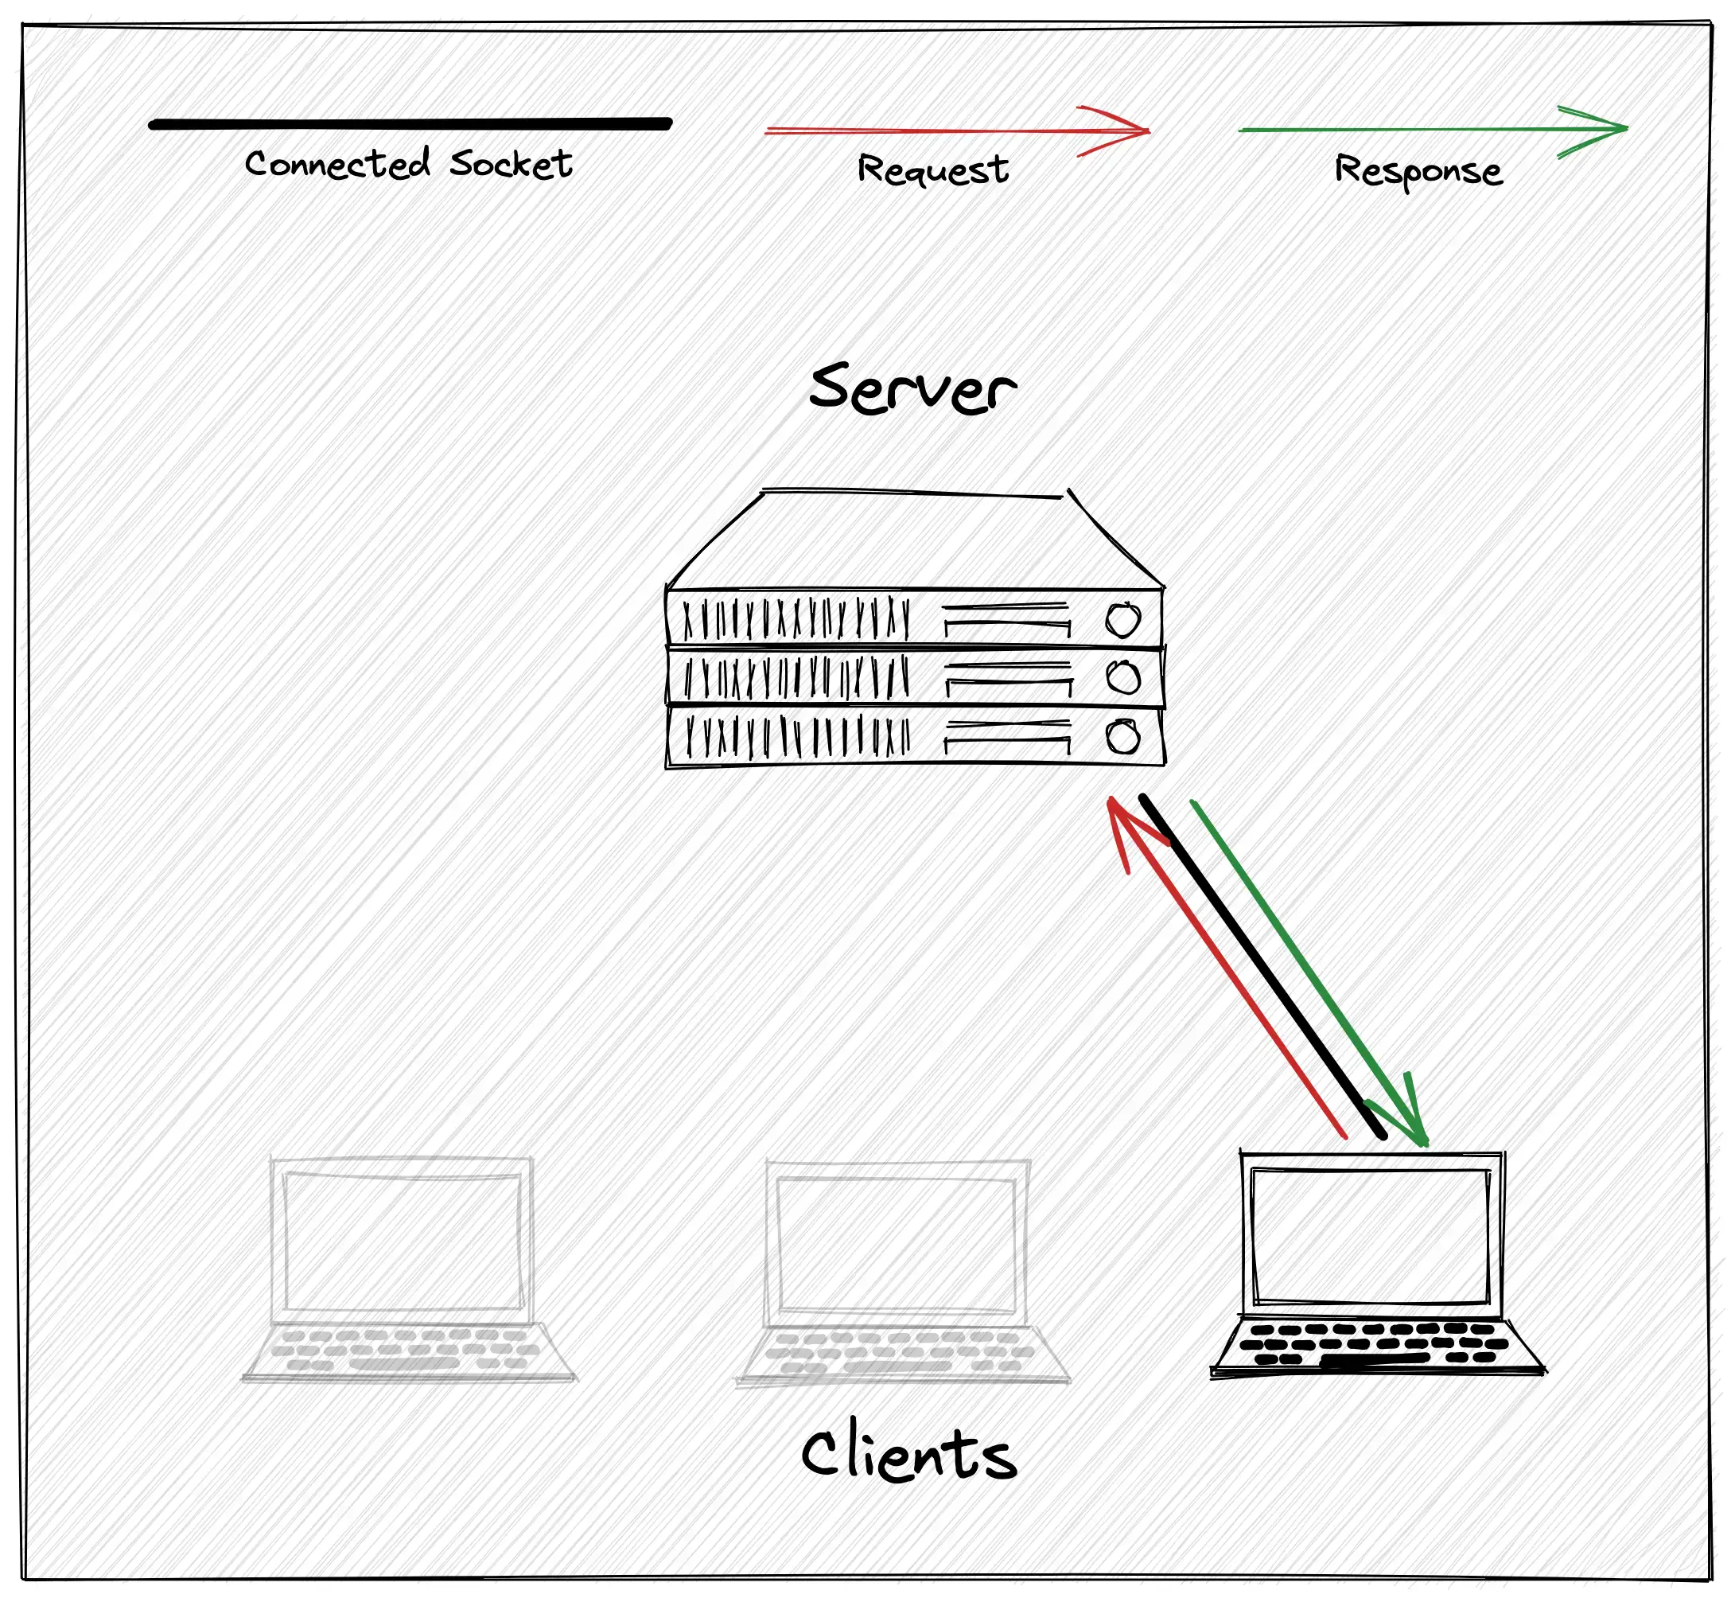
Normal HTTP server
activity
The
amount
of
resources
consumed
by
the
server
are
relatively
stable.
3

Slide 13



Retaining sockets is expensive
The operating system manages low-level operations
Each socket consumes several kilobytes of RAM.
Each socket is backed by a file descriptor
Each process has a limited number of descriptor available, managed via
ulimit
.
The application manages high-level operations
The application representation of the socket adds extra memory overhead.

Slide 14
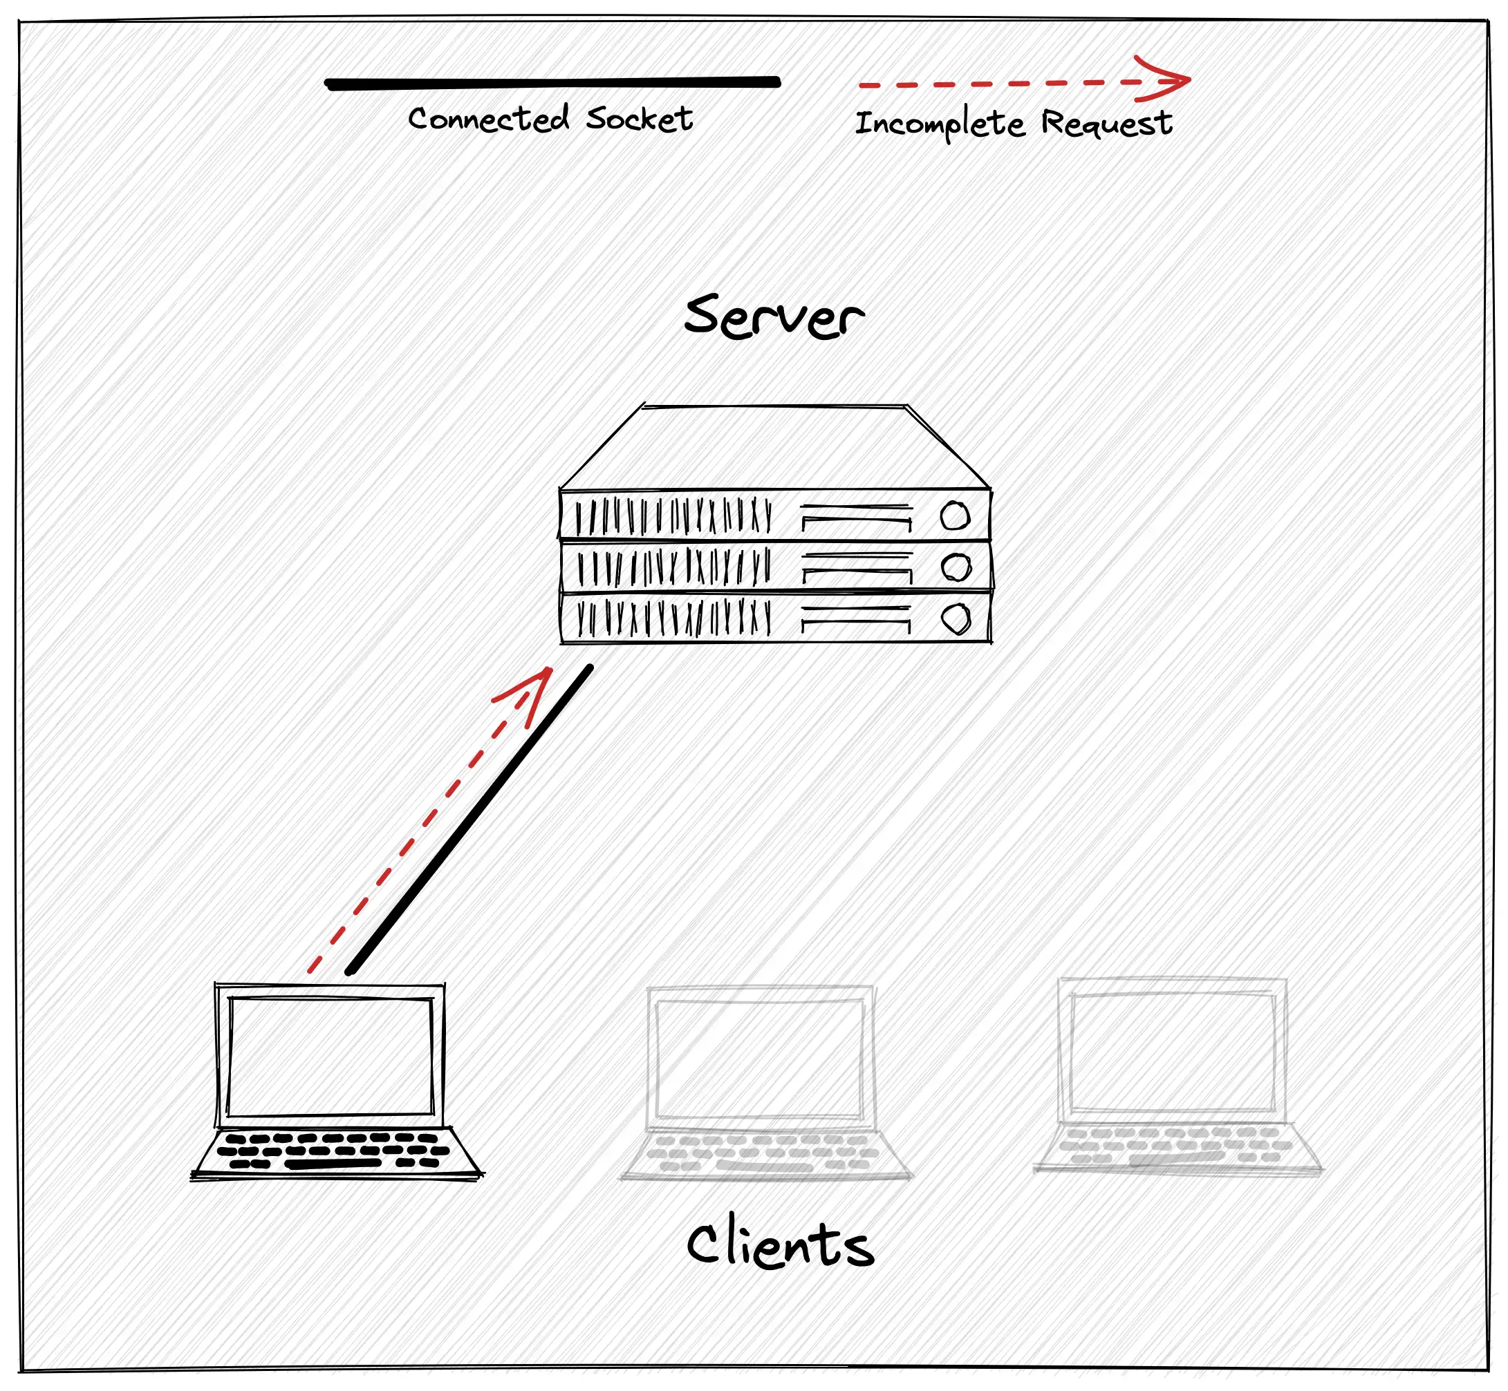
The Slowloris attack
Each
client
never
finishes
a
request
and
stays
connected
for
the
longest
time
possible.
1

Slide 15
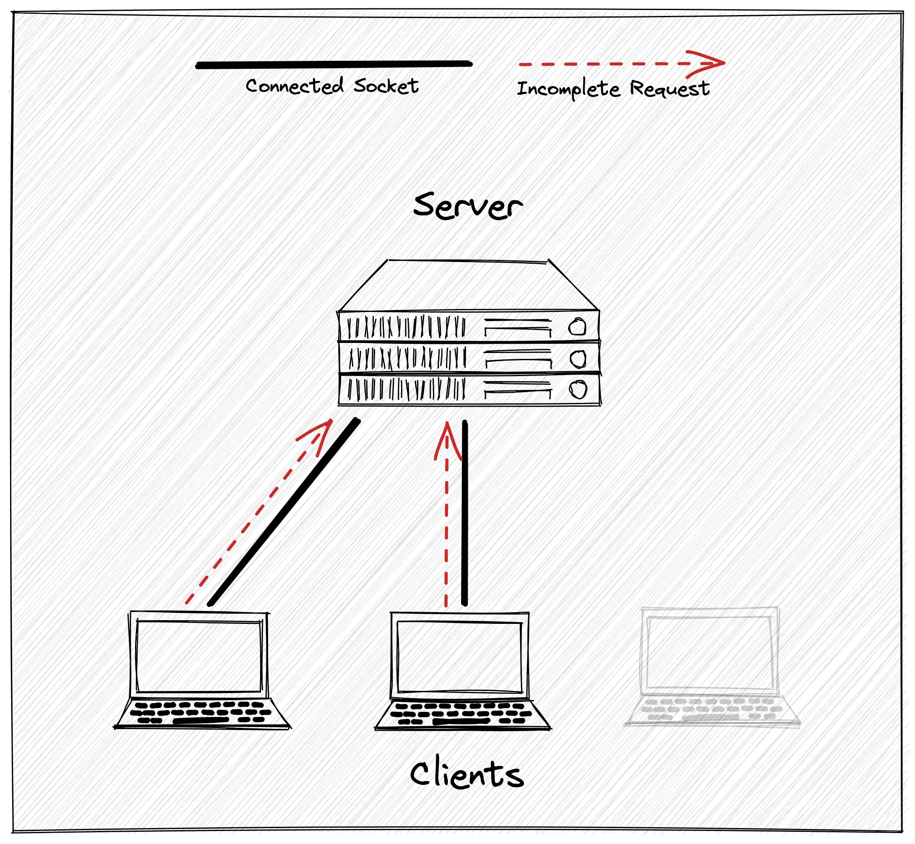
The Slowloris attack
As
more
clients
connect,
server
resources
usage
constantly
increases
over
time.
2

Slide 16
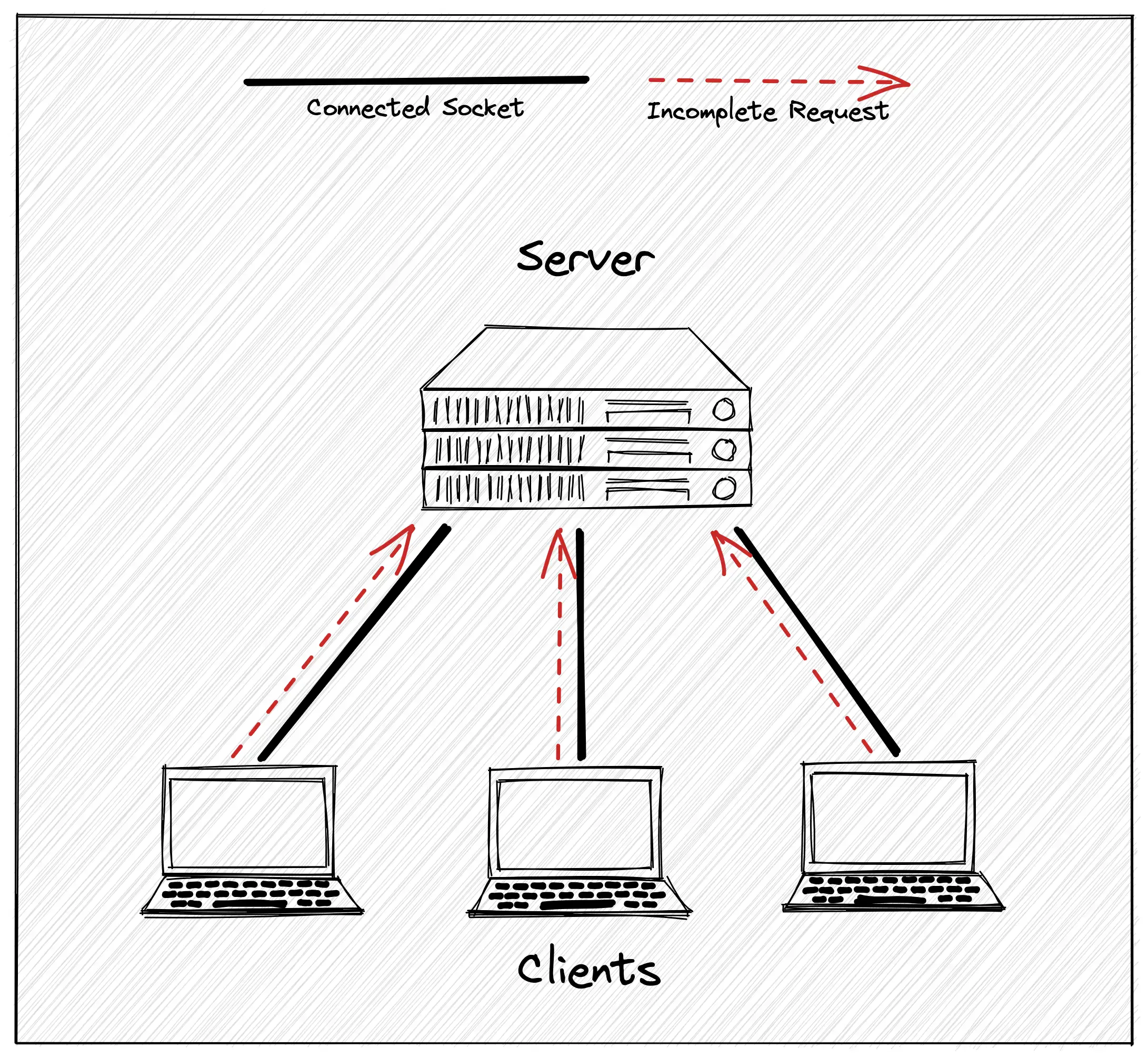
The Slowloris attack
At
some
point
server
has
no
more
free
resources
and
cannot
accept
any
new
client.
The
3
service
is
interrupted!

Slide 17

How do we stop it?

Slide 18

Use a reverse proxy
Never
put
Node.js
as
the
direct
point
of
contact
to
the
clients.
Servers
like
Nginx
have
better
protection
from
DDoS
attacks.

Slide 19


Mitigation strategies
Distinguish
between
requests
which
are
legit
and
requests
that
belong
to
the
attack
is
very
hard.
None
of
the
strategies
below
is
100%
accurate.
Limit connections per IP
Enforce speed or time constraints
As the attack is distributed, the attacker can
It's hard to establish a connection which will
easily switch to another IP.
not cut out slow legit clients.

Slide 20

What about
Node.js?

Slide 21

http.Server.headersTimeout
Partial fix as the body is not considered
Node.js never parses or consume request bodies.
10
Body handling is delegated
Applications are responsible for body timeouts.
Node.js 10.14.0, November 28th, 2018
Node.js has been completely unprotected for 10 years.

Slide 22

Trust the frameworks
Disable http.Server.timeout by default
The default value has been changed to nothing.
The
philosophy
behind
this
Node.js 13.0.0, October 22nd, 2019
choice
was
to
support
serverless
From now on, attacker can delay transfer indefinitely.
environments
which
needed
long
running
connections.

Slide 23


http.Server.requestTimeout
Complete fix
The client has now limited time to finish.
Available on all active Node.js lines
Added to Node.js 14.11.0, released on September 15th, 2020.
Disabled by default
Adding a clock for each new request is an expensive operation.

Slide 24

Are we safe now?

Slide 25
Yes, almost!

Slide 26


The countermeasures were loose
Custom configuration was needed to protect adequately
The attacker could still delay data transfer forever without being rejected.
Performance was prioritized
Whenever a timeout has gone off was checked only after new data was received.

Slide 27



How to protect Node.js 16 and below
Make sure sockets cannot be idle
http.Server.timeout
must be greater than 0 to detect malicious idle sockets.
Limit the total time for each request
http.Server.requestTimeout
must be greater than 0.
Have a lower timeout for the headers
http.Server.headersTimeout
should also be set to detect a malicious client earlier.

Slide 28
How to protect Node.js 16 and below
import { createServer } from 'node:http'
const server = createServer()
// The socket can be idle for 2 minutes before being terminated
server.timeout = 120000
// The entire request must be completely received by the server within 5 minutes
server.requestTimeout = 300000
// The request's headers must be completely received by the server within a minute
server.headersTimeout = 60000

Slide 29


Node.js 18.0.0 is finally safe by default
The
latest
major
version
of
Node.js
has
finally
solved
all
the
issues
described.
Changing
timeout
handling
has
improved
performance
by
2%.
Request are checked periodically
Have safer defaults
The HTTP server regularly checks for
The timeouts for headers and request
requests which might have timed out.
are finally enabled by default.
See the new option:
The default Node.js configuration
connectionsCheckingInterval
now protects against SlowLoris.

Slide 30


We made it!

Slide 31

Take home lessons
What
can
we
learn
from
this
long
journey?
Security, always
Sacrifice Performance
Validate regularly
Always think about security
Putting performance aside can
During regular activities, always
implication when implementing
drive to correct, innovative and
check the existing code for hidden
new features or fixing bugs.
eventually performant solutions.
flaws or vulnerabilites.

Slide 32


One last thing™
“Never assume the obvious is true.”
William Safire

Slide 33

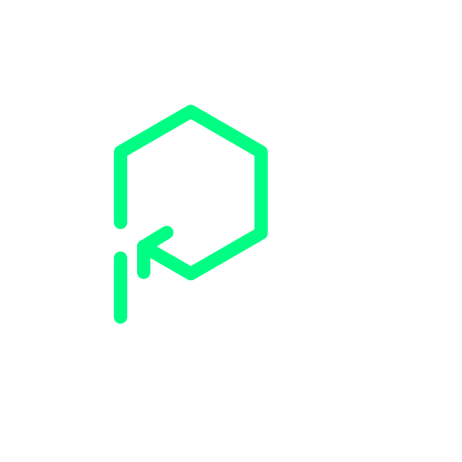
Thank you!
Paolo Insogna
@p_insogna
Platformatic
Node.js TSC, Principal Engineer
paolo.insogna@platformatic.dev

