Slide 1






View online
Download PDF
The last 5 years of streams in Node.js
Paolo Insogna
Node.js TSC, Principal Engineer @
Platformatic

Slide 2

Panta rei!

Slide 3






Hello, I'm
Paolo
!
Node.js
Technical Steering Committee Member
Platformatic
Principal Engineer
paoloinsogna.dev
ShogunPanda
p_insogna
pinsogna

Slide 4

What are streams
anyway?

Slide 5
Pretty simple, isn't it?
“A stream is an abstract interface for working
with streaming data in Node.js.”
Node.js official documentation

Slide 6



They are powerful
Fully asynchronous
Since they are based on events and async I/O, the event loop is not blocked.
Minimum memory footprint
Only single chunks of data are processed instead of loading the full data in memory.
Expandable
There are tons of ways to implement new streams.

Slide 7

Can I use them in
the browser?

Slide 8

Meet readable-stream
It
is
a
NPM
package
which
mirrors
the
Node.js
stream
module
and
additionally
adapts
it
to
use
in
the
browsers
and/or
bundlers.
https://www.npmjs.com/package/readable-stream

Slide 9
How is the package built?
1
Download the code
Node.js source code is downloaded.
2
Copy the stream module
The entire stream module is copied into the destination directory.
3
Manipulate the source
All references to other node modules are removed.
4
Add custom modules
Custom and platform-agnostic version of the needed modules are re-inserted.

Slide 10
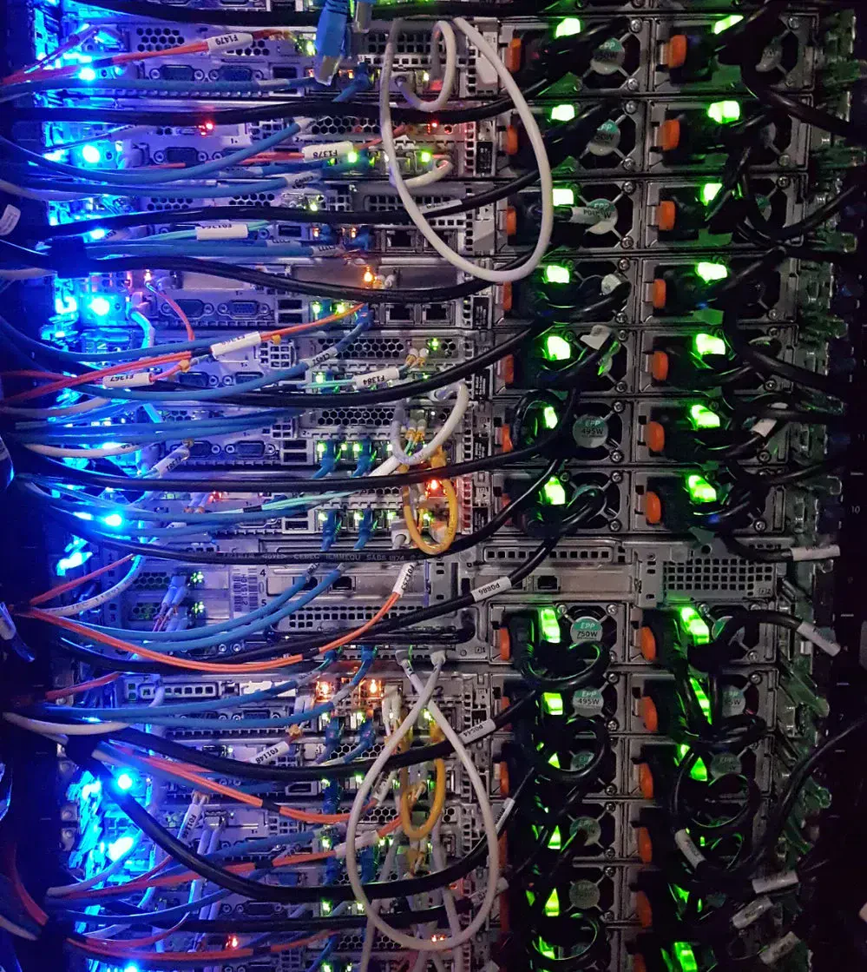



Project status
Latest series is 4.x.x.
It was initially released on
June 14th, 2022
,
three years after the last one.
Update of the stream module
It mirrors the module in Node.js
18.x.x
which
is the current LTS version.
Long overdue
Series 3.x.x shipped the module present in
Node.js
10.x.x
(2018).

Slide 11
Sorry for the long wait!

Slide 12

What has changed
in streams
since then?

Slide 13



Broader status handling
An entire new set of properties for readable stream
readableAborted
,
readableDidRead
,
readableEncoding
and
readableObjectMode
Tracking the
end
event
stream.Readable.readableEnded
and
stream.Writable.writableEnded
Tracking flushing status
stream.Writable.writableFinished

Slide 14



More predictable event flow
Be reasonable
The
autoDestroy
option is now enabled by default: after a
end
or
finish
event the stream
will call
destroy
automatically (and only once).
Less events chain
The
end
or
finish
events are not emitted if a
error
event was emitted.
Emitting a
close
event before the
end
event is now considered an error.
Do not be eager
stream.pipeline
will wait for unfinished streams.

Slide 15
... so boring ...

Slide 16
Let's see the exciting parts!

Slide 17
Stream from iterables
stream.Readable.from
is
a
new
function
that
allow
to
create
a
stream
from
any
object
implementing
the
(async)
iterator
protocol.
import Readable from 'readable-stream'
async function* generate() {
yield 'hello'
yield 'streams'
}
const readable = Readable.from(generate())

Slide 18
Duplex stream from anything
stream.Duplex.from
can
now
be
used
to
create
a
duplex
stream
from
something
else.
Let's
play
a
little
game!
import Duplex from 'readable-stream'
Duplex.from([
new Promise((resolve) => setTimeout(resolve('1'), 1500)),
new Promise((resolve) => setTimeout(resolve('2'), 1500)),
new Promise((resolve) => setTimeout(resolve('3'), 3000))
]);

Slide 19
Promises API
A
new
module
exposes
was
added
to
Node.js:
stream/promises
.
import { createReadStream, createWriteStream } from 'node:fs'
import { createGzip } from 'node:zlib'
import { Stream } from 'readable-stream'
const { finished, pipeline } = Stream.promises
await pipeline(
createReadStream('archive.tar'),
createGzip(),
createWriteStream('archive.tar.gz')
)
const rs = createReadStream('archive.tar')
await finished(rs.resume())
It
exposes
a
promises
based
API
version
of
finished
and
pipeline
.

Slide 20


Functional style helpers
You
can
manipulate
readable
streams
using
common
functional
style
helpers.
Manipulating
filter
,
map
,
reduce
,
forEach
,
flatMap
Searching
some
,
find
,
every
Fetching
toArray

Slide 21

With great power
comes great
responsibility™
The
toArray
method
reads
the
entire
stream
into
memory
,
which
is
exactly
what
streams
are
meant
to
avoid.
Promise
me
you
will
only
use
it
when
absolutely
necessary!

Slide 22
What is used under the hood?

Slide 23

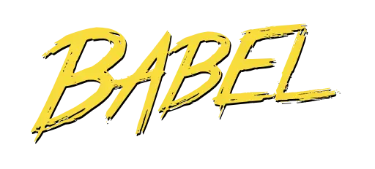

Build toolchain
Compared
to
the
previous
one
it
still
uses
regular
expression
but
it
is
much
smaller
thanks
to
a
more
modern
Javascript
environment.
ESM
Babel
Prettier

Slide 24
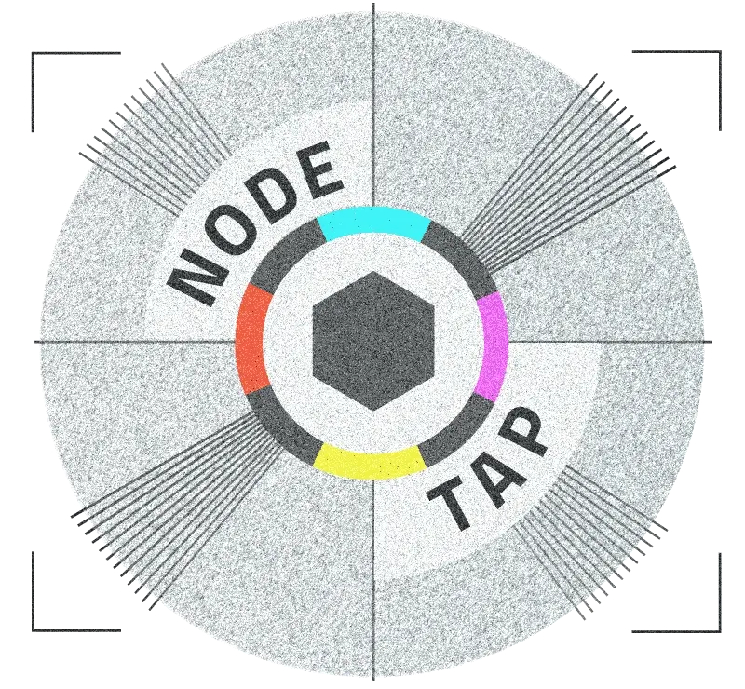


Testing technologies
A
complex
testing
environment
to
match
the
most
desired
scenarios
across
Node.js
version,
browsers
and
bundlers.
TAP
Tape
Playwright
Used to test in the Node.js
Along with custom runner and
It used to easily test
environment.
parser, it is used to test browsers.
in all major browsers.

Slide 25

We test 100
configurations in
the CI!

Slide 26

... that's all folks!™
There
are
obviously
more
changes,
but
these
were
the
most
juicy.

Slide 27



Remember to thank these guys!
Obviously
I
haven't
done
all
this
by
myself.
Matteo Collina
Robert Nagy
Benjamin Gruenbaum
https://github.com/mcollina
https://github.com/ronag
https://github.com/benjamingr

Slide 28


One last thing™
“The man who is swimming against
the stream knows the strength of it.”
Woodrow Wilson

Slide 29


Thank you!
Paolo Insogna
@p_insogna
Platformatic
Node.js TSC, Principal Engineer
paolo.insogna@platformatic.dev

