Slide 1

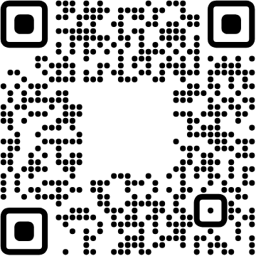
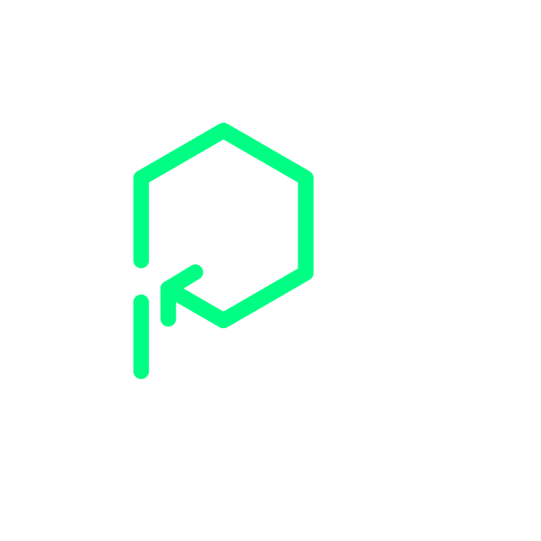

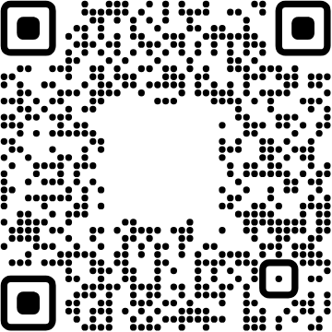

Platformatic
View online
Welcome to the QRverse:
Download PDF
let's build a rendering service
Paolo Insogna
Node.js TSC, Principal Engineer

Slide 2
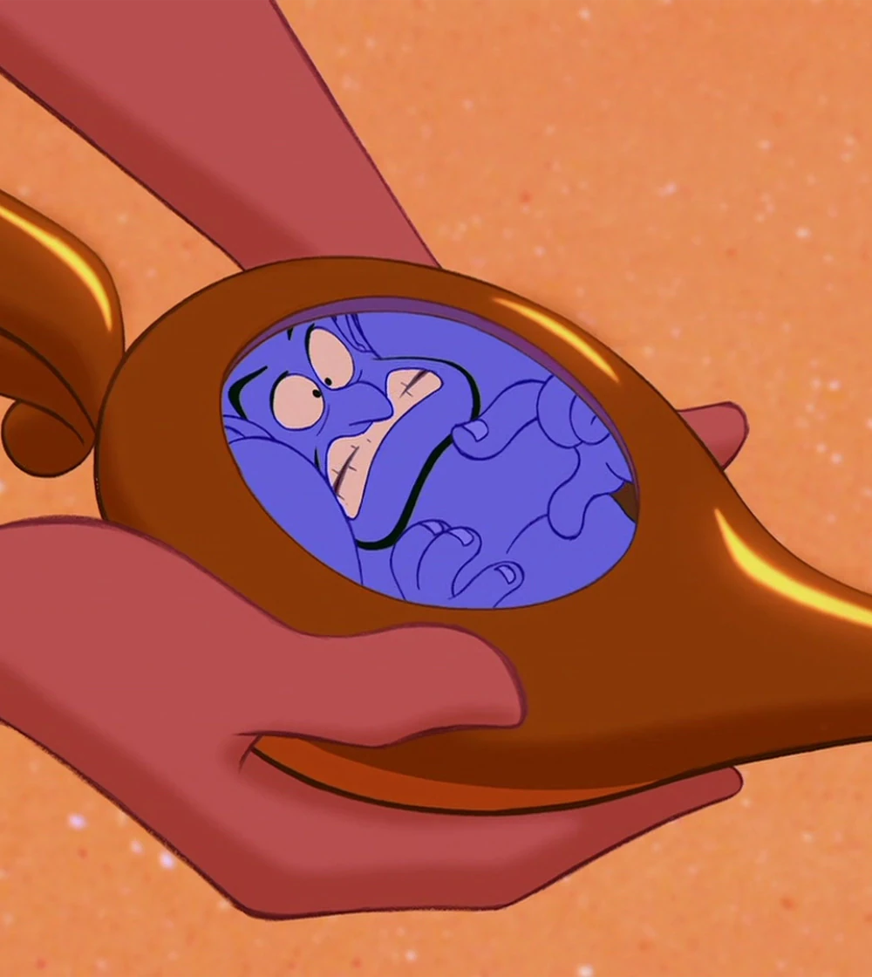
Phenomenal
cosmic powers...
Itty bitty living
space.

Slide 3


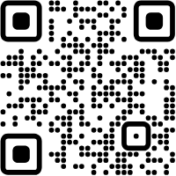



Hello, I'm
Paolo
!
Node.js
Technical Steering Committee Member
Platformatic
Principal Engineer
paoloinsogna.dev
ShogunPanda
p_insogna
pinsogna

Slide 4



Some companies trusting us
Article
Case Study
Case Study

Slide 5
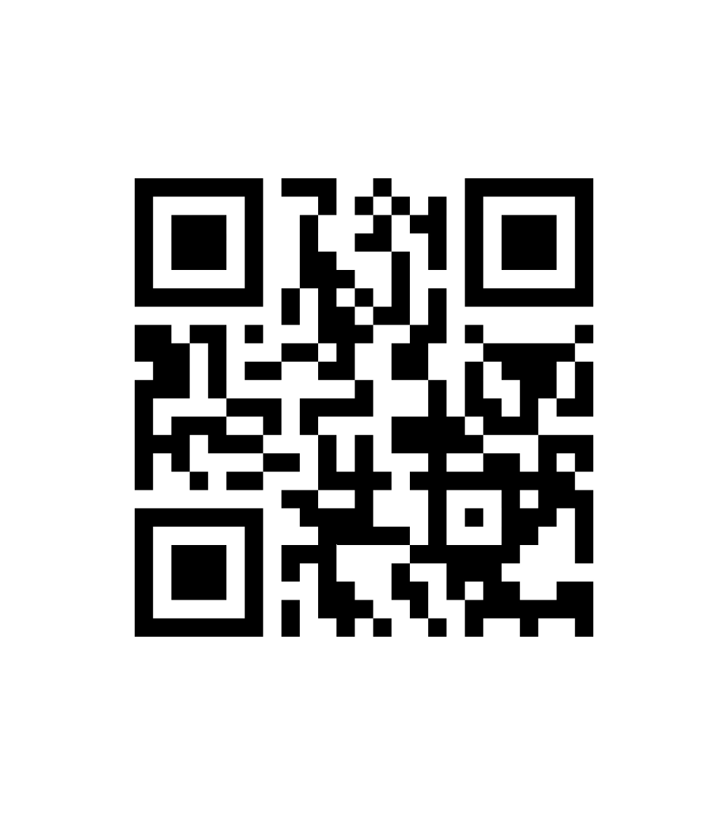
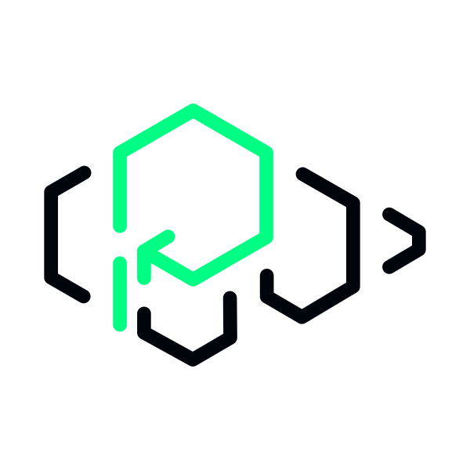
Have you ever
heard of QR codes?

Slide 6

Yes, of course!

Slide 7


They are everywhere
Easy to use
Lot of space
Static codes can be printed, while dynamic
Each code can contain up to
7089
numbers,
codes can be generated with low effort.
4296
characters,
2953
bytes or
1817
kanjis.

Slide 8



History of QR Codes
Created in Japan in 1994
Denso Wave
invented it to carry more data in a single code for its automotive parts.
Over 30 years of standards
Several revision of the
ISO 18004
standard were created to ensure compliancy.
Far beyond the original use case
QR are currently used in many aspect of our life, from official uses to games.

Slide 9



Main characteristics
Configurable resiliency
2-dimension code
Multiple modes
Four error thresholds that can
The size and orientation are
The data is encoded by choosing
detected at scan time.
between 4 different modes.
recover up to
30%
damaged
block.

Slide 10
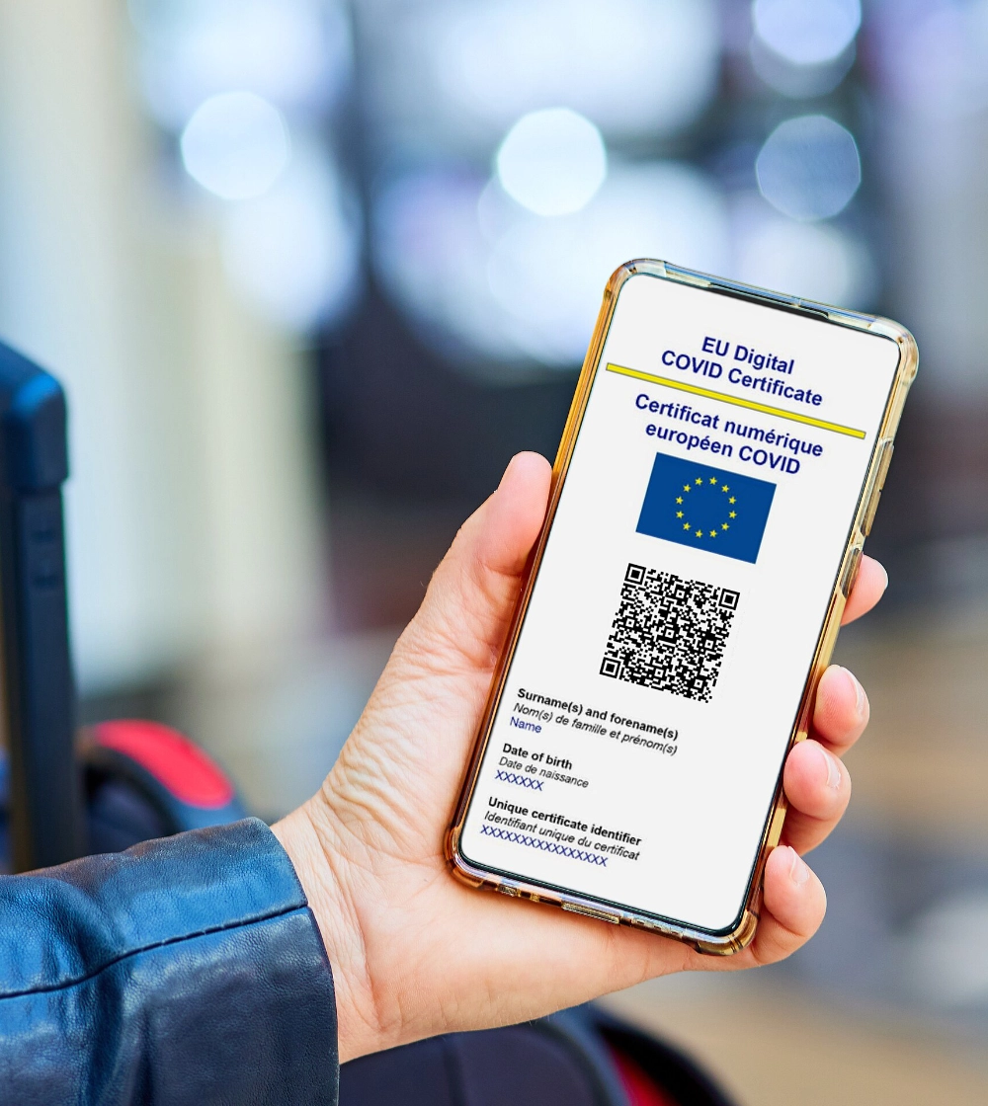
QR Codes make our
life way easier ...

Slide 11
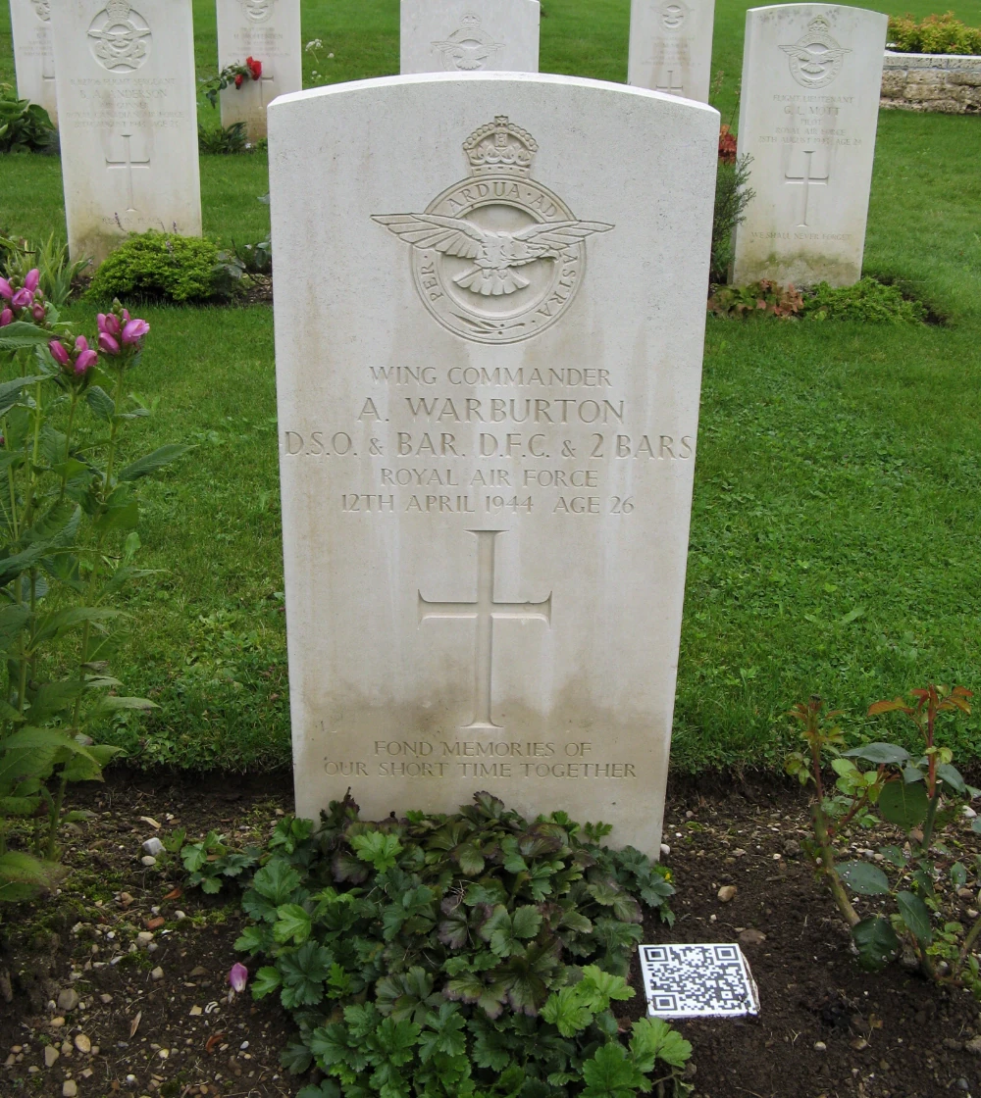
... sometimes in a
weird way!

Slide 12

If we look closely...

Slide 13

Position markers (finders)
They
are
positioned
in
three
corners
to
help
the
scanner
determine
the
boundaries.

Slide 14

Alignment markers
They
are
complementary
to
the
position
markers
to
determine
the
orientation.

Slide 15

Timing markers
They
are
used
from
the
scanner
to
understand
the
size.

Slide 16

Version information
They
specify
which
of
the
many
QR
version
has
been
chosen.

Slide 17

Format information
Similarly,
they
specify
the
encoding
chosen.

Slide 18
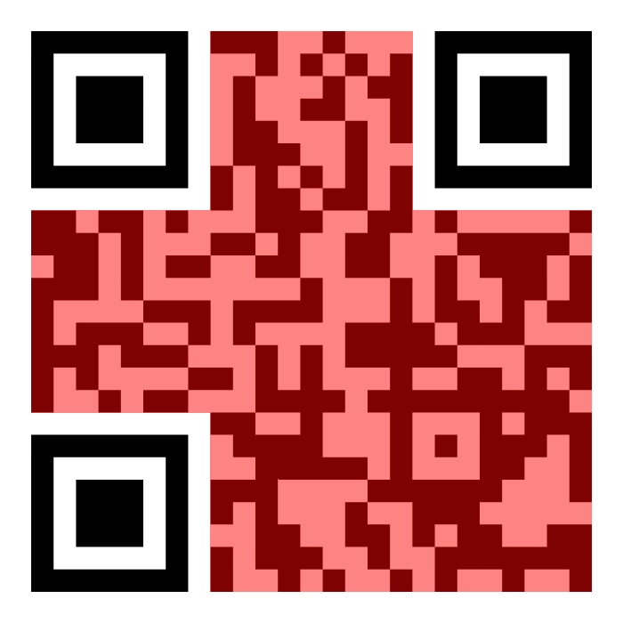
Data and Error correction
The
rest
of
the
code
delivers
the
data
and
the
error
correction
(ECC),
one
next
to
each
other.

Slide 19

Quiet zone
To
help
the
scanner
identify
a
QR
code,
it
is
required
to
pad
the
code
in
all
directions.

Slide 20
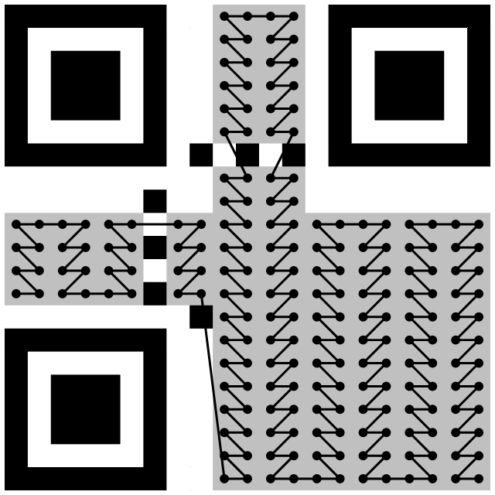
The best path might
not be the straight
one
The
data
and
ECC
sections
in
a
code
are
filled
from
the
bottom
right
to
the
top
left.
Each
sequence
of
8
bits
is
written
in
block
divided
in
two
columns.
When
encountering
alignments,
rows
are
skipped.

Slide 21
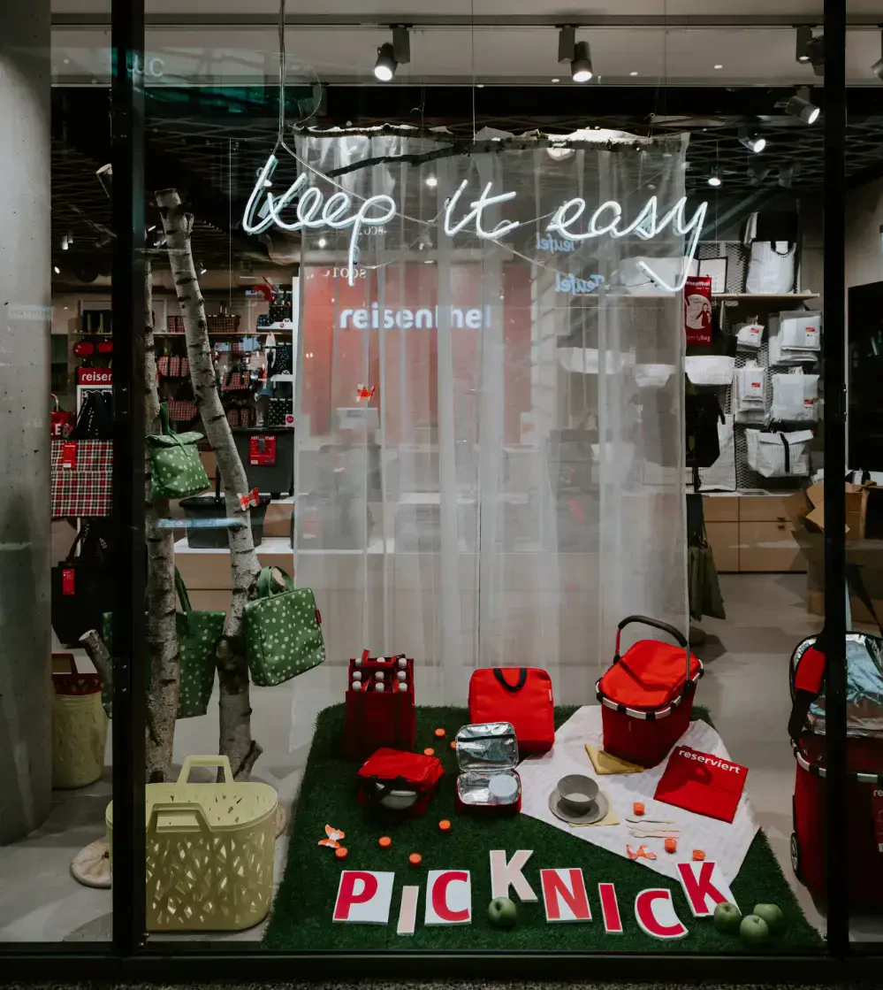
Can we get to the
practice please?

Slide 22


Let's build a QR rendering service
QR codes are easy to draw
(Almost) no libraries needed
Suited for backends
Everything is well documented in
Once you know which color each
Let's prove it with the
ISO 18004 standard.
cell is, you're good to go.
best one out there,
Watt
.

Slide 23

Let's go!

Slide 24
Create the skeleton
We
can
use
create-platformatic
,
it
is
that
simple!
shogun@panda:~/qr$ pnpx wattpm init
[12:28:13.861] DONE (63654): Created a watt application in /Volumes/DATI/Users/Shogun/qr.

Slide 25
Database service - Create a migration
All
the
data
schema
is
managed
via
migrations.
CREATE TABLE IF NOT EXISTS urls (
id VARCHAR(36) PRIMARY KEY,
url TEXT NOT NULL,
count INTEGER DEFAULT 0
);

Slide 26
Database service - Track our clicks
1
2
3
4
5
6
7
8
9
10
11
12
13
14
15
16
17
18
19
20
21
import sql from '@databases/sql'
export default async function (app) {
app.put(
'/urls/:id/track',
{ // ... schema definition ... },
async function (request) {
const id = request.params.id
await app.platformatic.db.query(
sql`UPDATE urls SET count = count + 1 WHERE id = ${id}`
)
const matching = await app.platformatic.entities.url.find({
where: { id: { eq: id } }
})
return matching[0]
}
)
}

Slide 27
URL service - Shorten a URL
1
2
3
4
5
6
7
8
9
10
11
12
13
14
15
16
17
18
19
20
21
server.post(
"/",
{ // ... schema definition ... },
async function (request, reply) {
const rootUrl = `http://${request.headers['x-forwarded-host']}`
const response = await fetch('http://database.plt.local/urls', {
method: 'POST',
headers: { 'Content-Type': 'application/json' },
body: JSON.stringify({ id: randomUUID(), url: request.body.url })
})
// ... Response error handling ...
const { id } = await response.json()
const url = new URL(`/urls/${id}`, rootUrl)
const url64 = Buffer.from(url.toString()).toString('base64url')
const qr = new URL(`/qr/${url64}`, rootUrl)
return { url: qr.toString() }
}
)

Slide 28
URL service - Track clicks
1
2
3
4
5
6
7
8
9
10
11
12
13
14
15
16
17
18
19
20
server.get(
"/:id",
{ // ... schema definition ... },
async function (request, reply) {
const response = await fetch(
`http://database.plt.local/urls/${request.params.id}/track`,
{ method: 'PUT' }
)
if (response.status !== 200) {
const error = await response.text()
reply.status(response.status)
return error
}
const url = await response.json()
reply.header('x-clicks', url.count)
reply.redirect(url.url, 301)
}
)

Slide 29
URL service - Get all stats
1
2
3
4
5
6
7
8
9
10
11
12
server.get('/stats', async function (_, reply) {
const response = await fetch('http://database.plt.local/urls')
if (response.status !== 200) {
const error = await response.text()
reply.status(response.status)
return error
}
const urls = await response.json()
return urls
})

Slide 30
Frontend - Add a rendering UI
The
frontend
file
uses
Preact
without
JSX
.
No
transpilation
needed.
1
2
3
4
5
6
7
8
9
10
11
12
13
import fastifyStatic from '@fastify/static'
import fastify from 'fastify'
import { fileURLToPath } from 'node:url'
export async function create() {
const server = fastify({ logger: true })
await server.register(
fastifyStatic,
{ root: fileURLToPath(new URL('./public', import.meta.url)) }
)
return server
}

Slide 31

Where are
the QR codes?

Slide 32

Let's dive in!

Slide 33
QR service - Some helpers (1/4)
1
1
2
3
4
5
6
export function isFinder(modules, y, x) {
return (
(y < 7 && (x < 7 || x > modules - 8)) || // Top corners
(y > modules - 8 && x < 7) // Bottom left corner
)
}

Slide 34
QR service - Some helpers (2/4)
1
2
3
4
5
6
7
8
9
10
11
12
13
14
15
16
17
18
export function getAlignments(modules) {
const version = (modules - 17) / 4
const aligments = []
const currentAlignments = alignmentsByVersion[version - 1]
for (const i of currentAlignments) {
for (const j of currentAlignments) {
if (isFinder(modules, i, j)) {
// Skip the one overlapping with finders
continue
}
aligments.push([i - 2, j - 2])
}
}
return aligments
}
2

Slide 35
QR service - Some helpers (3/4)
1
2
3
4
5
6
7
8
9
10
export function isAlignment(aligments, y, x) {
return aligments.some(([topLevelY, topLevelX]) => {
return (
y >= topLevelY &&
y <= topLevelY + 4 &&
x >= topLevelX &&
x <= topLevelX + 4
)
})
}
3

Slide 36
QR service - Some helpers (4/4)
Similarly,
drawFinder
and
drawAligment
behave
the
same.
They
are
way
more
complex
and
I
omitted
them
here
to
preserve
your
mental
health.
4
1
2
3
4
5
6
export function drawCircle(x, y) {
const posX = padding + x * unit
const posY = padding + y * unit + radius
return `M${posX},${posY} a${radius},${radius},0,1,0,${diameter},0 a${radius},${radius},0,1,0,${-diameter},0 `
}

Slide 37
QR service - Service skeleton
1
2
3
4
5
6
7
8
9
10
11
12
13
14
15
16
17
18
19
20
21
import { createServer } from 'node:http'
import QRCodeGenerator from 'qrcode-generator'
import {
drawAlignment,
drawCircle,
drawFinder,
getAlignments,
isAlignment,
isFinder,
padding,
unit
} from './rendering.js'
export function create() {
return createServer((req, res) => {
const data = req.url.split('/').at(-1)
const url = Buffer.from(data, 'base64url').toString('utf-8')
// Generate and return the QR code ...
}
})

Slide 38
QR service - Compute modules
The
service
uses
qrcode-generator
from
Kazuhiko
Arase
(which
has
no
other
dependencies).
1
2
3
4
5
6
7
8
9
const qr = QRCodeGenerator(0, "H")
qr.addData(url)
qr.make()
const modules = qr.getModuleCount()
const aligments = getAlignments(modules)
const dimension = modules * unit + padding
let svgPath = ""
let svgPoints = ""

Slide 39
QR service - Draw regular modules
1
2
3
4
5
6
7
8
9
10
11
12
13
14
15
16
// Draw regular modules
for (let x = 0; x < modules; x++) {
for (let y = 0; y < modules; y++) {
if (
!qr.isDark(y, x) ||
isFinder(modules, y, x) ||
isAlignment(aligments, y, x)
) {
continue
}
svgPoints += drawCircle(x, y)
}
}
svgPath += `<path d="${svgPoints}" fill="currentColor" stroke="none" />`

Slide 40
QR service - Draw other elements
1
2
3
4
5
6
7
8
9
// Draw the finders
svgPath += drawFinder(0, 0)
svgPath += drawFinder(modules - 7, 0)
svgPath += drawFinder(0, modules - 7)
// Draw the aligments
for (const aligment of aligments) {
svgPath += drawAlignment(aligment[0], aligment[1])
}

Slide 41
QR service - Return the SVG
1
2
3
4
5
6
7
8
9
res.writeHead(200, { 'x-plt-qr': url, 'content-type': 'image/svg+xml' })
res.end(`
<svg
xmlns="http://www.w3.org/2000/svg" version="1.1"
width="${dimension}" height="${dimension}" viewBox="0 0 ${dimension} ${dimension}"
>
${svgPath}
</svg>
`)

Slide 42
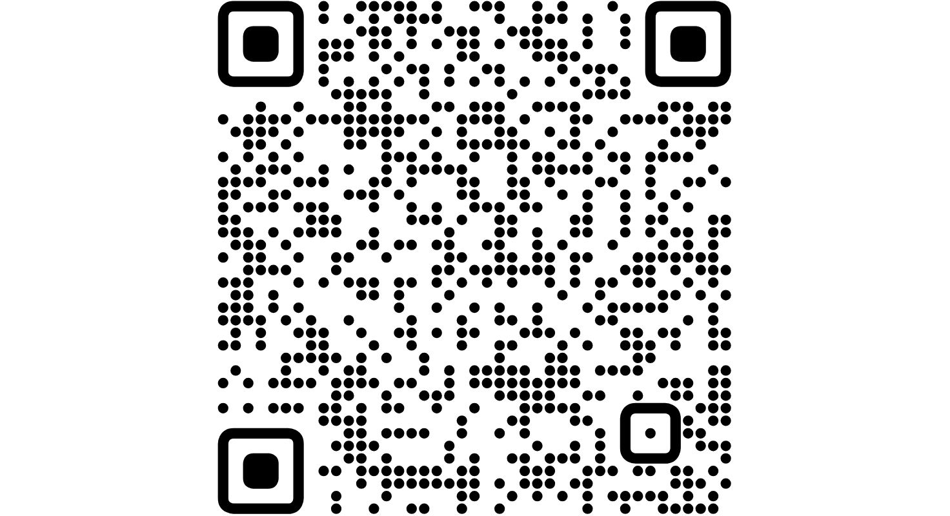
Check it out!
All
the
code
shown
today
is
online
on
GitHub.
https://github.com/ShogunPanda/plt-qr-rendering

Slide 43


One last thing™
“Sharing is good, and with digital
technology, sharing is easy.”
Richard Stallman

Slide 44

Thank you!
Paolo Insogna
@p_insogna
Platformatic
Node.js TSC, Principal Engineer
paolo.insogna@platformatic.dev

