Slide 1




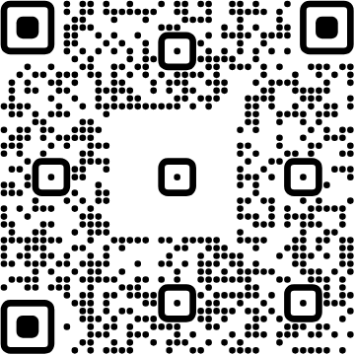

Platformatic
View online
How to create a PostgreSQL
Download PDF
based webhook system
Paolo Insogna
Node.js TSC, Principal Engineer

Slide 2

Don't shoot a fly
with a cannon!

Slide 3






Hello, I'm
Paolo
!
Node.js
Technical Steering Committee Member
Platformatic
Principal Engineer
paoloinsogna.dev
ShogunPanda
p_insogna
pinsogna

Slide 4



Some companies trusting us
Article
Case Study
Case Study

Slide 5




Distributed data in a distributed world
We don't live a in simple world
The complexity of data cannot be handled by a single system.
Divide et impera
This represents the only possible path to have a scalable and reliable architecture.
With new powers come new challenges
How many point of failure would you like to have?

Slide 6


Time matters, as usual!
Distribution implies synchronization
Do it right or you will fail miserably
When the data is distributed, keeping a global
Not all customers want to deal with things like
consistent state is
hard
.
overbooking, so be careful with your data.

Slide 7
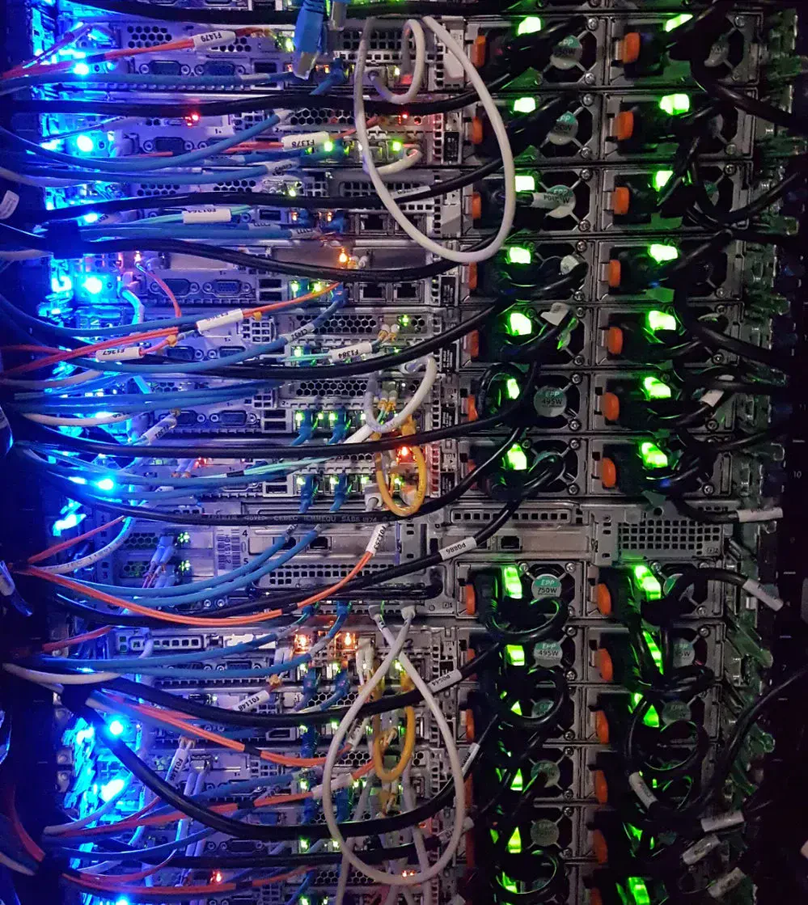
How do we keep
updated?

Slide 8


Batch updates via FTP or similar
The old good way
Not realtime and fragile
Still popular, especially in banks.
Data is processed with massive delays. A
Your money depends on this, unfortunately.
failure might impact the entire batch.

Slide 9



Polling (pull)
Relatively simple
Is responsibility of dependent system to periodically checks for updates.
Almost realtime
The system receives the list of updates in much shorter time.
Network intensive
A lot of uncessary requests are made, especially when updates are not frequent.

Slide 10



Events based (push)
Realtime
As soon as an update is available, all dependent systems are notified.
Network optimized
Not a single unnecessary byte is sent over the wire.
Delivery state is complex
The system must maintain the list of subscribers and handle delivery failures.

Slide 11

Which one
shall we choose?

Slide 12

Say hello to
Webhooks
!

Slide 13
What are we talking about?
“Webhooks are user-defined HTTP callbacks. They
are usually triggered by some event, such as [...] a
comment being posted to a blog and many more
use cases.”
Wikipedia

Slide 14

Let's implement
a real one!

Slide 15
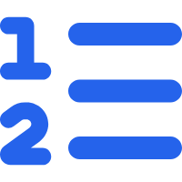


General architeture
Model as a queue
A webhook system is modeled as a queue of events.
Single target
Each queue is associated to a single URL.
Simple data structure
Few tables in a (No)SQL database are more than enough.

Slide 16



Yes, but which kind of queue?
Eventual
The queue might not deliver all messages.
At least once
The queue guarantees that all messages are delivered, but there might be repetitions.
Exactly once
Each message is guaranteed to be delivered only once.

Slide 17


Yes, but which kind of queue?
Eventual
The queue might not deliver all messages.
At least once
The queue guarantees that all messages are delivered, but there might be repetitions.
Exactly once
Each message is guaranteed to be delivered only once.

Slide 18

What about
failures?

Slide 19



Dead letter queue (DLQ)
Limited retries
A messages is retried a limited number of times.
Separate queue for troubleshooting
Messages that cannot be delivered are moved to a separate queue.
Manual intervention
A human operator is required to evaluate the DLQ.

Slide 20


Cron jobs
Messages can be repeated
A system can mark a message as "to be repeated regularly".
Easy extension of the queue system
Once a message is delivered, it is enqueued again.
Standard syntax
The repetition interval syntax is really flexible.

Slide 21

What about race
conditions?

Slide 22



Being equal is hard
Atomicity is hard
On distributed system, atomic access is complex and easily leads to an inconsistent state.
Concurrency is even harder
If implemented wrong, multiple peers will easily ending up operating on the same resource.
The queue model might be violated
Without coordination, policies like exactly-one might not be guaranteed.

Slide 23



Leader based queue system
All concur to elect a leader
All instance of the queue system must choose a leader.
Only the leader is active
No contention for resources and massive lock access attempts.
Automatic failover
When the leader resigns or fails, a new leader is automatically selected.

Slide 24



A simple selection implementation
Lock based
A distributed lock is used to select the leader.
Exclusivity is the key
Only one instance can hold the lock at any given time.
Bully-like algorithm
We are going replace the original concept of "higher ID" with locks.

Slide 25

How do you easily
get such a lock
implementation?

Slide 26

PostgreSQL
Advisory Locks

Slide 27
The leader election process
1
Lock access
All the peers, potentially at the same time, will try to get exclusive access to the lock.
2
Become the leader
Only one peer receives the lock and becomes the leader, other will be denied.
3
Leader coordinates
The leader will start the operation, potentially delegating to other peers.
4
Leader resigns or fail
When the leader voluntarily resigns or fails, the other peers start a new election.

Slide 28

Stop talking please.
Show me the
code
!

Slide 29



Technical stack
Node.js
PostgreSQL
Fastify
Watt

Slide 30
Database schema (1/2)
CREATE TABLE IF NOT EXISTS queues (
id SERIAL PRIMARY KEY,
name VARCHAR(255) NOT NULL,
url VARCHAR(2048) NOT NULL,
method VARCHAR(10) NOT NULL,
headers JSON DEFAULT NULL,
max_retries INTEGER NOT NULL DEFAULT 5,
created_at TIMESTAMPTZ NOT NULL DEFAULT NOW(),
UNIQUE(name, url, method, max_retries)
);

Slide 31
Database schema (2/2)
CREATE TABLE pending_messages (
id SERIAL PRIMARY KEY,
queue_id INTEGER NOT NULL REFERENCES queues(id),
headers JSON,
payload BYTEA DEFAULT NULL,
retries INTEGER DEFAULT 0,
schedule VARCHAR(100) DEFAULT NULL,
execute_at TIMESTAMPTZ DEFAULT NOW(),
created_at TIMESTAMPTZ NOT NULL DEFAULT NOW()
);
CREATE TABLE completed_messages (
id INTEGER,
queue_id INTEGER NOT NULL REFERENCES queues(id),
headers JSON,
payload BYTEA DEFAULT NULL,
retries INTEGER DEFAULT 0,
response TEXT,
created_at TIMESTAMPTZ NOT NULL DEFAULT NOW()
);
CREATE TABLE failed_messages (
id INTEGER,
queue_id INTEGER NOT NULL REFERENCES queues(id),
headers JSON,
payload BYTEA DEFAULT NULL,
retries INTEGER DEFAULT 0,
error TEXT,
created_at TIMESTAMPTZ NOT NULL DEFAULT NOW()
);

Slide 32


Services
Processor
The queue system that deliver messages.
API
It is used to add messages to the queue.
Composer
A
@platformatic/composer
service which orchestrates all other services.
Target
A sample Fastify application that receives the messages. It implements random failures.

Slide 33
Processor: Main
async function main () {
const db = createConnectionPool({ bigIntMode: 'bigint' })
globalThis.platformatic.events.on('stop', async () => {
logger.info('Received stop event. Stopping processing jobs...')
abortController.abort()
})
const abortController = new AbortController()
while (!abortController.signal.aborted) {
await runAsLeader(db, () => {
logger.info('Successfully elected as leader. Starting processing jobs...')
return processJobs(db, abortController.signal)
})
await scheduler.wait(1000)
}
await db.dispose()
}

Slide 34
Processor: Leader election and main loop
async function runAsLeader (db, task) {
return db.task(async leaderConnection => {
const [result] = await leaderConnection.query(
sql`SELECT pg_try_advisory_lock(0) as lock`
)
if (!result.lock) {
return
}
try {
await task()
} finally {
await leaderConnection.query(
sql`SELECT pg_advisory_unlock(0) as unlock`
)
}
})
}

Slide 35

And now, let's
deliver some
messages!

Slide 36
Processor: Query to select the next message
export function getNextPendingMessageQuery () {
return sql`
SELECT
messages.id, messages.queue_id as queue, messages.headers as message_headers,
messages.payload, messages.retries, messages.schedule,
queues.url, queues.method, queues.headers as queue_headers, queues.max_retries
FROM
pending_messages as messages
INNER JOIN
queues ON messages.queue_id = queues.id
WHERE
execute_at < NOW()
ORDER BY
messages.execute_at ASC
LIMIT 1
`
}

Slide 37
Processor: Select and deliver a message
async function processJobs (db, abortSignal) {
while (!abortSignal.aborted) {
let message
try {
const pending = await db.query(getNextPendingMessageQuery())
message = pending[0]
// Mark the message as "in-process" by clearing the execute_at field
if (message) {
await db.query(sql`UPDATE pending_messages SET execute_at = NULL WHERE id = ${id}`)
}
} catch (e) {
/* ... */
return
}
// No messages, wait for a while then continue
if (!message) {
await scheduler.wait(100)
continue
}
// Call the target, a non 2xx will be considered a failure
await invokeHook(db, message)
}
}

Slide 38
Processor: Deliver a message
async function invokeHook (db, message) {
try {
const response = await fetch(message.url, {
method: message.method,
headers: {
'content-type': 'application/octet-stream',
...message.queue_headers,
...message.message_headers
},
body: message.payload
})
const responsePayload = {
status: response.status,
headers: Object.fromEntries(response.headers.entries()),
body: await response.text()
}
if (response.ok) {
await handleMessageSuccess(db, message, responsePayload)
} else {
await handleMessageFailure(db, message, responsePayload)
}
} catch (e) {
await handleMessageFailure(db, message, e)
}
}

Slide 39

Why all those
delays?

Slide 40


Notifications based scheduling
Polling is not very efficient
But it was the easiest to implement.
Forgive my laziness.
Pushing based scheduling is way better
The processor can listen for notifications and act accordingly.
PostgreSQL pub/sub works flawlessly
Take a look at the
LISTEN
and
NOTIFY
commands. But don't forget about cron jobs.

Slide 41
Processor: Retry and error handling
function markMessageAsCompletedQuery (message, response) {
return sql`
INSERT INTO completed_messages (id, queue_id, headers, payload, retries, response)
VALUES (${message.id}, ${message.queue}, ${message.message_headers}, NULL, ${message.retries}, ${JSON.stringify(response, null, 2)})
`
}
function deletePendingMessageQuery (id) {
return sql`DELETE FROM pending_messages WHERE id = ${id}`
}
async function handleMessageFailure (db, message, error) {
if (message.retries < message.max_retries) {
const timestamp = new Date(Date.now() + exponentialBackoff(message.retries + 1)).toISOString()
try {
await db.query(sql`UPDATE pending_messages SET retries = retries + 1, execute_at = ${timestamp} WHERE id = ${message.id}`)
} catch (e) {
/* ... */
}
} else {
try {
await db.tx(async db => {
await db.query(markMessageAsFailedQuery(message, error))
await db.query(deletePendingMessageQuery(id))
})
} catch (e) {
/* ... */
}
}
}

Slide 42
Processor: Reschedule a successful cron job
function markMessageAsCompletedQuery (message, response) {
const serializedResponse = JSON.stringify(response, null, 2)
return sql`
INSERT INTO completed_messages (id, queue_id, headers, payload, retries, response)
VALUES (${message.id}, ${message.queue}, ${message.message_headers}, NULL, ${message.retries}, ${serializedResponse})
`
}
function rescheduleMessageQuery (message) {
return sql`
UPDATE pending_messages
SET retries=0, execute_at = ${parser.parseExpression(message.schedule).next()} WHERE id=${message.id}
`
}
async function handleMessageSuccess (db, message, response) {
try {
await db.tx(async db => {
await db.query(markMessageAsCompletedQuery(message, response))
await db.query(message.schedule ? rescheduleMessageQuery(message) : deletePendingMessageQuery(message.id))
})
} catch (e) {
/* ... */
}
}

Slide 43

Remember,
successful message
cannot
be retried!

Slide 44
API: Message creation endpoint
server.route({
method: 'POST',
url: '/messages',
async handler (request, reply) {
let { queue, headers, payload, schedule } = body
if (typeof queue === 'string') {
/* ... Find the queue by name */
}
if (!Buffer.isBuffer(payload)) {
payload = typeof payload !== 'string' ? JSON.stringify(payload) : payload.toString()
}
const [row] = await db.query(sql`
INSERT INTO pending_messages (queue_id, headers, payload, schedule)
VALUES (${queue}, ${headers ?? null}, ${payload}, ${schedule})
RETURNING id;
`)
reply.code(201)
return row
},
schema: {/* ... */}
})

Slide 45


Mission completed!

Slide 46
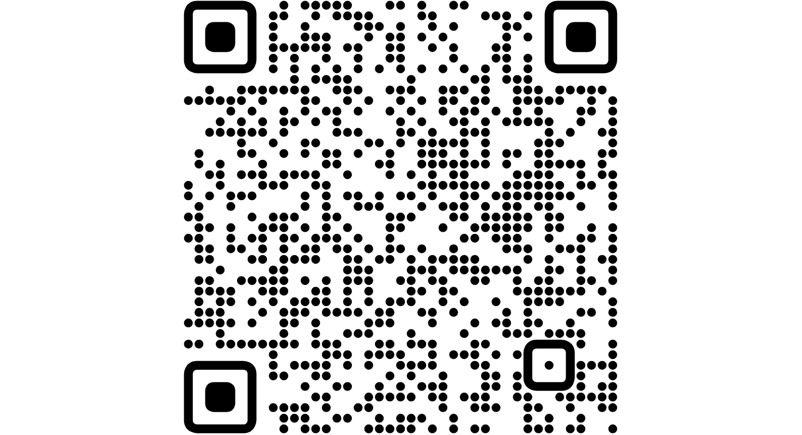
Check it out!
All
the
code
is
on
GitHub!
https://github.com/ShogunPanda/postgresql-webhooks

Slide 47


One last thing™
“Progress is man's ability
to complicate simplicity.”
Thor Heyerdahl

Slide 48

Thank you!
Paolo Insogna
@p_insogna
Platformatic
Node.js TSC, Principal Engineer
paolo.insogna@platformatic.dev

