Slide 1






Platformatic
View online
Node.js: More threads
Download PDF
than you think
Paolo Insogna
Node.js TSC, Principal Engineer

Slide 2

There is a lot
in the unknown!

Slide 3






Hello, I'm
Paolo
!
Node.js
Technical Steering Committee Member
Platformatic
Principal Engineer
paoloinsogna.dev
ShogunPanda
p_insogna
pinsogna

Slide 4



Some companies trusting us
Article
Case Study
Case Study

Slide 5

First of all, let’s give
credits!
This
talk
is
co-authored
by
Platformatic
CTO
and
friend
of
mine,
the
only
Matteo
Collina
.
Whatever
goes
wrong
today,
please
complain
directly
to
him
on
Twitter!
@matteocollina

Slide 6
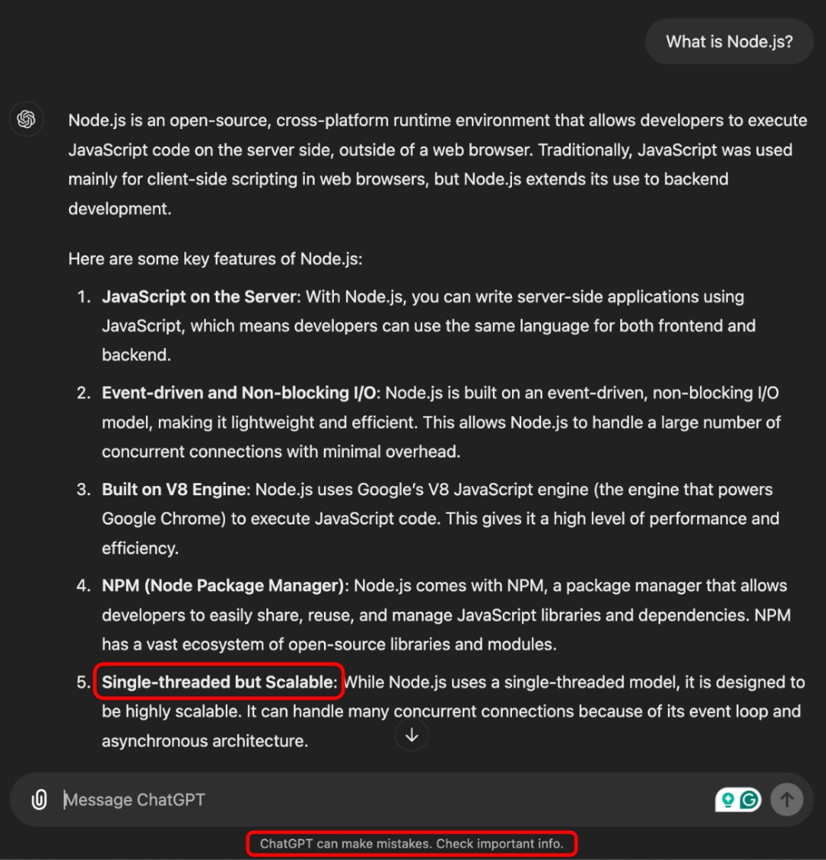
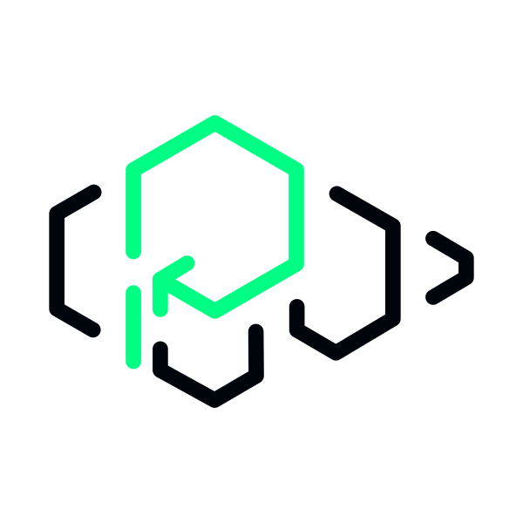
Let's start the right way! 🤦‍♂️

Slide 7

Node.js is
(no longer)
single threaded ...
...
and
it
hasn’t
been
for
a
while
now!

Slide 8

2018: "Node.js has threads!"
https://www.youtube.com/watch?v=-ssCzHoUI7M

Slide 9


Worker Thread API
This
is
supported
from
Node.js
10.5.0
(June
2018).
Create workers via
worker_threads
module
https://nodejs.org/dist/latest-v22.x/docs/api/worker_threads.html
Each thread has an independent event loop
This is crucial to off-load CPU intensive tasks out of the main thread.

Slide 10


How do threads communicate?
The API is fairly simple and straightforward.
Each thread can communicate with others by sending messages over a
MessagePort
.
Additional channels can be created via the
MessageChannel
API.
It returns a pair of message ports, one meant to be sent to the other thread.

Slide 11

Do you see how far
we have gone?

Slide 12
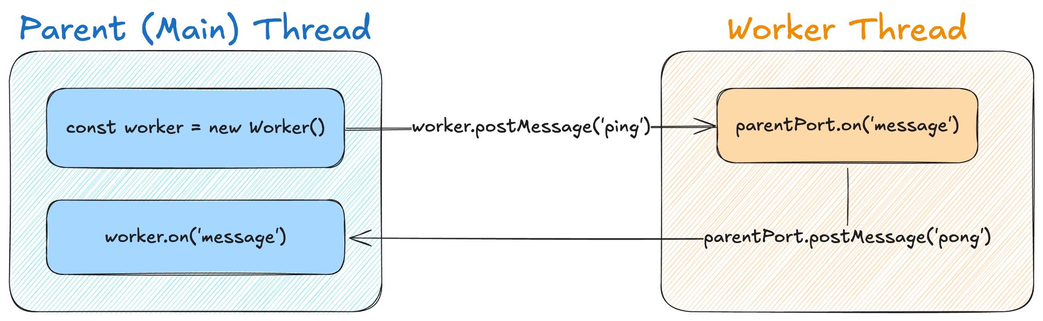
How do threads communicate?
The
graph
below
shows
a
summary
of
parent-children
thread
communication.

Slide 13
BroadcastChannel API
Less
known,
equally
powerful.
import {
BroadcastChannel,
isMainThread,
Worker
} from 'node:worker_threads'
const channel = new BroadcastChannel('main')
if (isMainThread) {
channel.onmessage = function (event) {
console.log(event.data) // Will print 10 events
}
for (let n = 0; n < 10; n++) {
new Worker(new URL(import.meta.url))
}
} else {
channel.postMessage('ready')
}
This
can
be
used
to
implement
a
simple
Pub/Sub
pattern.
All
channels
are
identified
by
a
global
ID
and
each
thread
can
subscribe
to
events.

Slide 14
postMessageToThread
This
is
only
available
in
Node
22.5.0+.
import {
isMainThread,
postMessageToThread,
threadId,
Worker
} from 'node:worker_threads'
if (isMainThread) {
for (let n = 0; n < 3; n++) {
new Worker(new URL(import.meta.url))
}
} else if (threadId === 1) {
postMessageToThread(3, { message: 'ready' })
} else {
process.on('workerMessage', (value, source) => {
// Will print "1 -> 3: Ready"
console.log(`${source} -> ${threadId}:`, value)
})
}
The
API
enables
for
direct
thread
to
thread
communication
without
the
need
of
using
MessageChannel
.
The
recipient
has
to
install
a
handler
for
the
process.workerMessage
event
in
order
to
receive
messages.

Slide 15

How can threads communicate?

Slide 16


Efficient inter-thread RPC
The
node:events
API alone is not suitable for the job.
It is not designed to work between threads.
Let's add promises!
By leveraging the EventEmitter and the Promise API, we can easily build a RPC system.
All you need is an unique identifier and
resolve
method.
The ID is sent to the other thread so that can be used later in a shared event handler.

Slide 17
Example: multithreaded HTTP server
We
all
know
this
snippet
is
more
worth
than
1000
words.
// In the server creation function, define the following
const pending = {}
worker.on('message', message => {
pending[message.id](message)
})
// In the route handler, define the following
let resolve
const promise = new Promise(_resolve => {
pending[request.reqId] = _resolve
})
worker.postMessage({id: request.reqId })
const hash = await promise

Slide 18

Is all that easy?

Slide 19
Structured Clone
The
reality
is
a
bit
harsher.
Not all objects can be sent via a MessagePort.
A object cannot contain functions or some native Node.js object (as
net.Socket
).
The object will be cloned according to the Structured Clone Algorithm.
Check the documentation on MDN!

Slide 20
Transferable (1/2)
You
can’t
always
clone
everything.
Some
objects,
usually
the
ones
backed
by
a
C++
representation,
can
only
be
moved
between
threads.
These
objects
are
called
transferrable
and
thus
must
be
explicitly
listed
in
the
second
argument
of
postMessage
.

Slide 21
Transferable (2/2)
Some
example
of
transferable
objects
are:
•
MessagePort
•
CryptoKey
•
FileHandle
•
WebStream
(
ReadableStream
and
WritableStream
)
The
full
list
can
be
found
in
the
MessagePort
documentation
.

Slide 22

Ready for
another dive?

Slide 23

Piscina
It
is
a
powerful
NPM
module
which
provides
an
easy
to
use
API.
A
Piscina
instance
dynamically
adjusts
the
number
of
workers
to
the
maximum
number
of
parallelism
available
on
the
machine.
All
the
messaging
and
synchronization
is
managed
so
you
focus
on
the
core
logic.
https://www.npmjs.com/package/piscina

Slide 24

How to use Piscina
How
easy
can
multithreading
be?
// Main thread
import { Piscina } from 'piscina'
const piscina = new Piscina({
filename: new URL(
'./worker.mjs', import.meta.url
).href
})
const result = await piscina.run({ a: 4, b: 6 })
console.log(result) // Prints 10
// Worker thread
export default ({ a, b }) => {
return a + b
}

Slide 25

Are we done?

Slide 26

Do you know what
you can use Worker
Threads for?

Slide 27

“It's
not
who
you
are
underneath,
it’s
what
you
do
that
defines
you”
“Everything is
impossible until
somebody does it”

Slide 28
How can a Promise be invoked synchronously?
You
can
use
Worker
Threads
to
invoke
an
async
function...
synchronously
!
import { setTimeout as sleep } from 'node:timers/promises'
async function echo (value) {
await sleep(1000)
return value
}

Slide 29

everysync (1/2)
A
tiny
utility
to
expose
an
asynchronous
API
via
a
worker
thread…
synchronously!
import { join } from 'node:path'
import { strictEqual } from 'node:assert'
import { Worker } from 'node:worker_threads'
import { makeSync } from 'everysync'
const buffer = new SharedArrayBuffer(1024, {
maxByteLength: 64 * 1024 * 1024,
})
const worker = new Worker(join(__dirname, 'echo.mjs'), {
workerData: { data: buffer },
})
const api = makeSync(buffer)
assert.strictEqual(api.echo(42), 42)
worker.terminate()
https://github.com/mcollina/everysync

Slide 30
everysync (2/2)
This
is
all
you
need
to
expose
an
API
from
a
thread.
import { wire } from 'everysync'
import { workerData } from 'node:worker_threads'
import { setTimeout } from 'node:timers/promises'
wire(workerData.data, {
async echo(value) {
await setTimeout(1000)
return value
}
})
// Keep the event loop alive
setInterval(() => {}, 100000)

Slide 31

How?

Slide 32
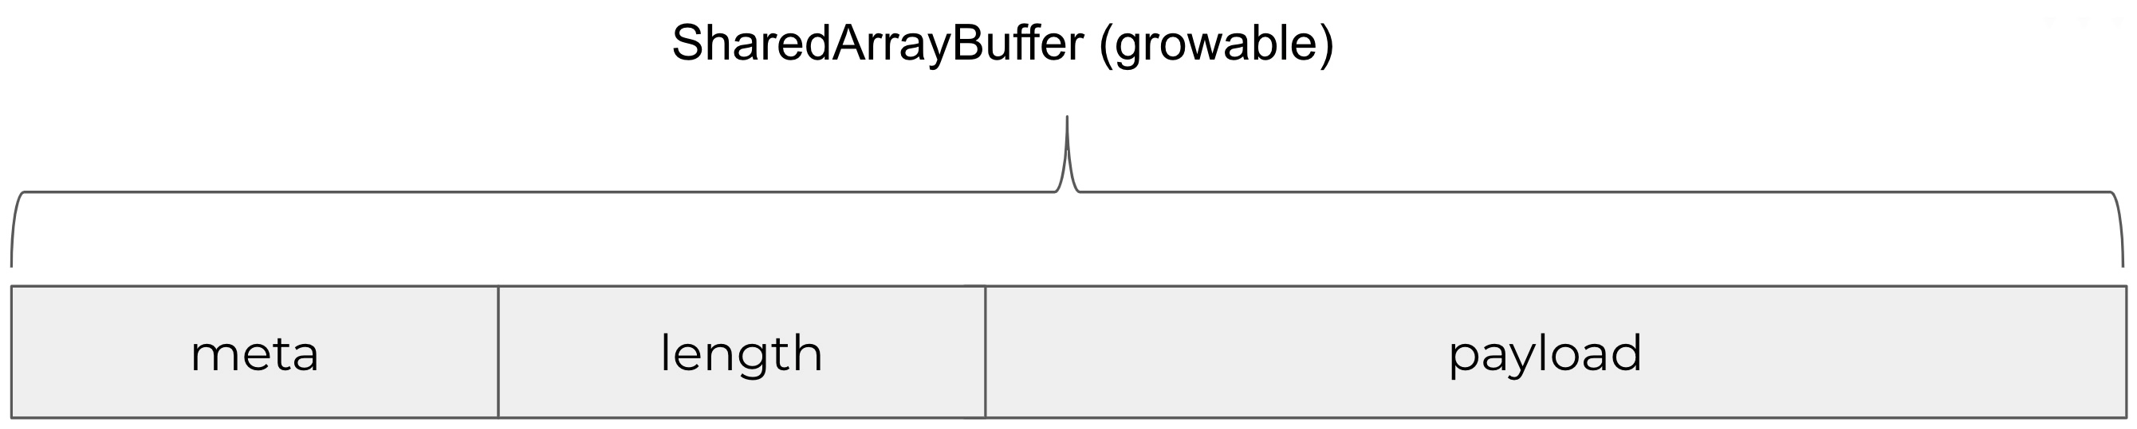
Atomics.waitAsync
and
SharedArrayBuffer
Atomics.waitAsync
is
used
to
synchronize
the
main
thread
with
the
worker
thread
in
meta.
Payload
contains
the
message
to
be
sent,
and
length
its
is
size.

Slide 33
Use the same mechanism of
postMessage
https://github.com/mcollina/everysync/blob/main/lib/objects.js
import { serialize, deserialize } from 'node:v8'
function read(buffer, byteOffset = 0) {
const view = new DataView(buffer, byteOffset)
const length = view.getUint32(0, true)
const object = deserialize(new Uint8Array(buffer, byteOffset + 4, length))
return object
}
function write(buffer, object, byteOffset = 0) {
const data = serialize(object)
if (buffer.byteLength < data.byteLength + 4 + byteOffset) {
if (!buffer.growable) {
throw new Error('Buffer is not growable')
}
buffer.grow(data.byteLength + 4 + byteOffset)
}
const view = new DataView(buffer, byteOffset)
view.setUint32(0, data.byteLength, true)
new Uint8Array(buffer, byteOffset + 4).set(data)
}

Slide 34
Calling a method to the worker thread
All
happens
thanks
to
the
SharedArrayBuffer
.
const OFFSET = 64
// * 0: writing from worker, reading from main
const TO_WORKER = 0
// * 1: writing from main, reading from worker
const TO_MAIN = 1
const data = new SharedArrayBuffer(1024, {
maxByteLength: 64 * 1024 * 1024,
})
const metaView = new Int32Array(data)
write(data, { key: 'echo', args: "42" }, OFFSET)
Atomics.store(metaView, TO_MAIN, 1)
Atomics.notify(metaView, TO_MAIN, 1)
const res = Atomics.wait(metaView, TO_WORKER, 0, timeout)
Atomics.store(metaView, TO_WORKER, 0)
if (res === 'ok') {
const obj = read(data, OFFSET)
console.log('result', obj)
} else {
throw new Error(`The response timed out after ${timeout}ms`)
}

Slide 35
Receiving the calls using Atomics.waitAsync
Don’t
forget
to
also
use
Atomics.notify
.
import { workerData } from 'node:worker_threads'
import { setTimeout as sleep } from 'node:timers/promises'
const data = workerData.data
const metaView = new Int32Array(data)
// ...
const obj = { echo }
while (true) {
const waitAsync = Atomics.waitAsync(metaView, TO_MAIN, 0)
const res = await waitAsync.value
Atomics.store(metaView, TO_MAIN, 0)
if (res === 'ok') {
const { key, args } = read(data, OFFSET)
const result = await obj[key](...args)
write(data, result, OFFSET)
Atomics.store(metaView, TO_WORKER, 1)
Atomics.notify(metaView, TO_WORKER, 1)
}
}

Slide 36


Why this is useful?
Pino
uses
this
technique
to
support
async
transports
and
flush
the
logs
on
exit.
https://getpino.io

Slide 37
Loader hooks
Node.js
supports
loading
hooks
via
the
node:module
module,
which
allows
to
customize
the
resolving
and
the
loading
of
any
file
or
module,
including
Node.js
internals.
While
the
import
or
require
statements
are
still
synchronous,
all
the
works
under
the
hood
happens
in
an
asynchronous
way
thanks
to
the
use
of
an
internal
separate
worker
thread,
with
a
mechanism
similar
to
everysync.
The
multithreading
architecture
is
the
foundation
of
features
like
require(esm)
or
-experimental-strip-types
.

Slide 38

Are we finally done?

Slide 39
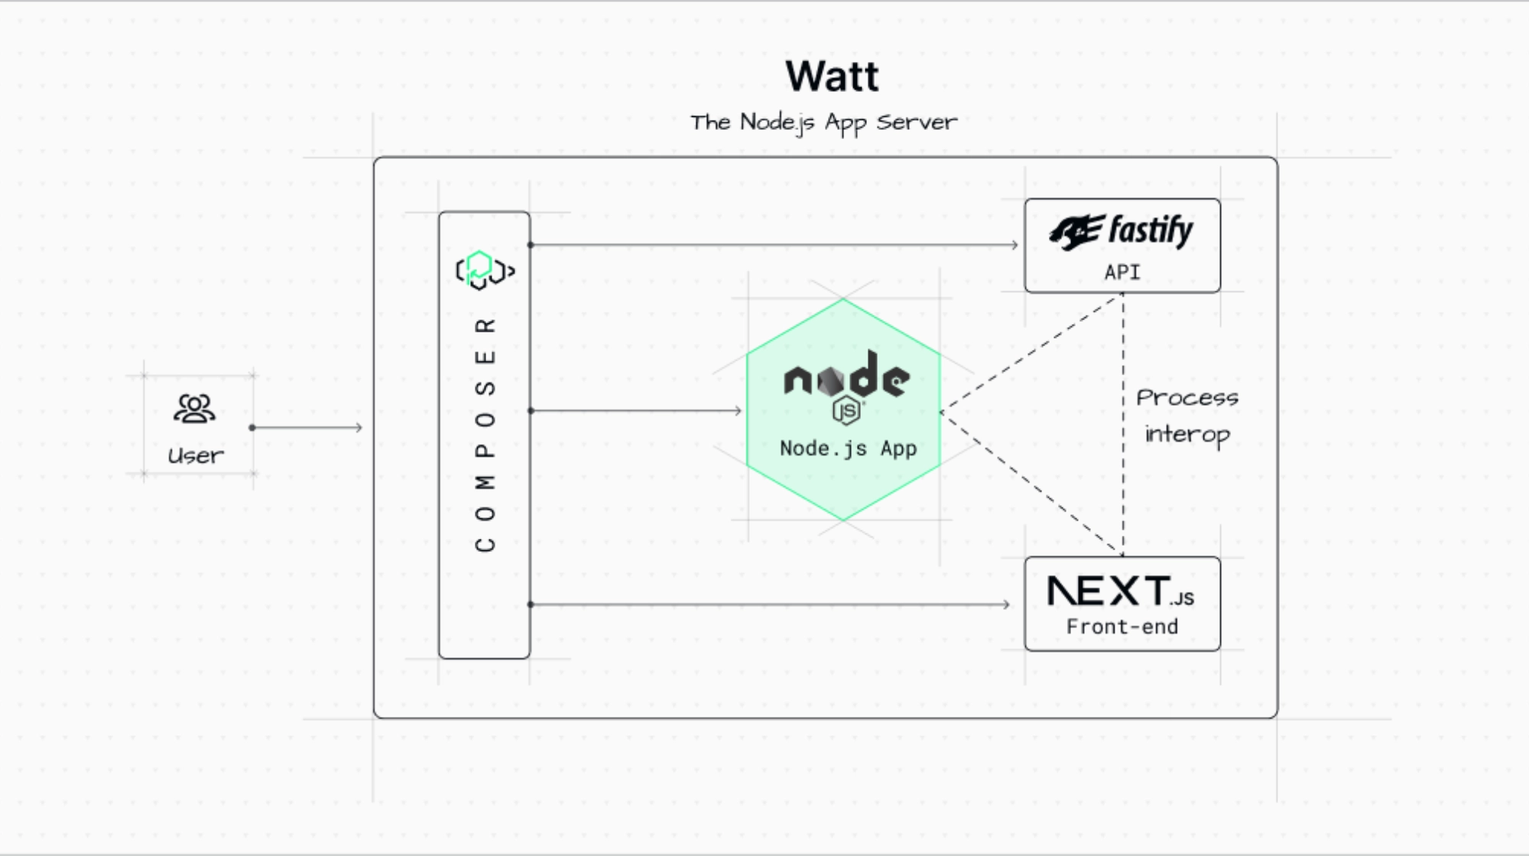
Introducing Watt, the Node.js application server

Slide 40
Watt
Watt
(
https://platformatic.dev/watt
)
abstracts
away
time-consuming
tasks
like
monitoring,
logging
and
tracing
all
while
supporting
full
stack
applications.
It
allows
you
to
run
multiple
Node.js
services
within
the
same
process
with
inter-threading
communication
over
HTTP.
Each
service
runs
in
its
worker
thread
so
they
cannot
interfere
with
each
other.

Slide 41
How do you configure Watt?
An
easy
to
understand
configuration
file
is
all
you
need.
Create
it
with
wattpm
init
.
{
"$schema": "https://schemas.platformatic.dev/wattpm/2.44.0.json",
"server": {
"hostname": "127.0.0.1",
"port": 3000
},
"logger": {
"level": "error"
},
"autoload": {
"path": "web"
},
"watch": true
}

Slide 42
How do you create a service?
Conventions
over
configuration.
Ring
a
bell?
Create
a
folder
named
after
the
service
in
the
web
folder
then
create
a
package.json
file
with
some
values
like
in
the
snippet
below.
{
"private": true,
"type": "module",
"main": "index.js",
"dependencies": {
"@platformatic/node": "^2.44.0"
}
}

Slide 43
Configure your service
Create
a
new
watt.json
in
the
service
folder.
You
can
use
wattpm
import
to
get
one
very
easily.
It
generates
the
following
file.
shogun@panda:~/example$ wattpm import
shogun@panda:~/example$ cat watt.json
{
"$schema": "https://schemas.platformatic.dev/@platformatic/node/2.44.0.json"
}

Slide 44
How do you write a service?
1
Create a simple Node.js application
Export a
build
or
create
function which returns a supported HTTP application.
2
You can omit
listen
.
Watt will automatically invoke listen for entrypoint only. Other services are not exposed.
3
Use the mesh network via
fetch
.
Each service is internally reachable on the
http://[SERVICE].plt.local
domain.

Slide 45
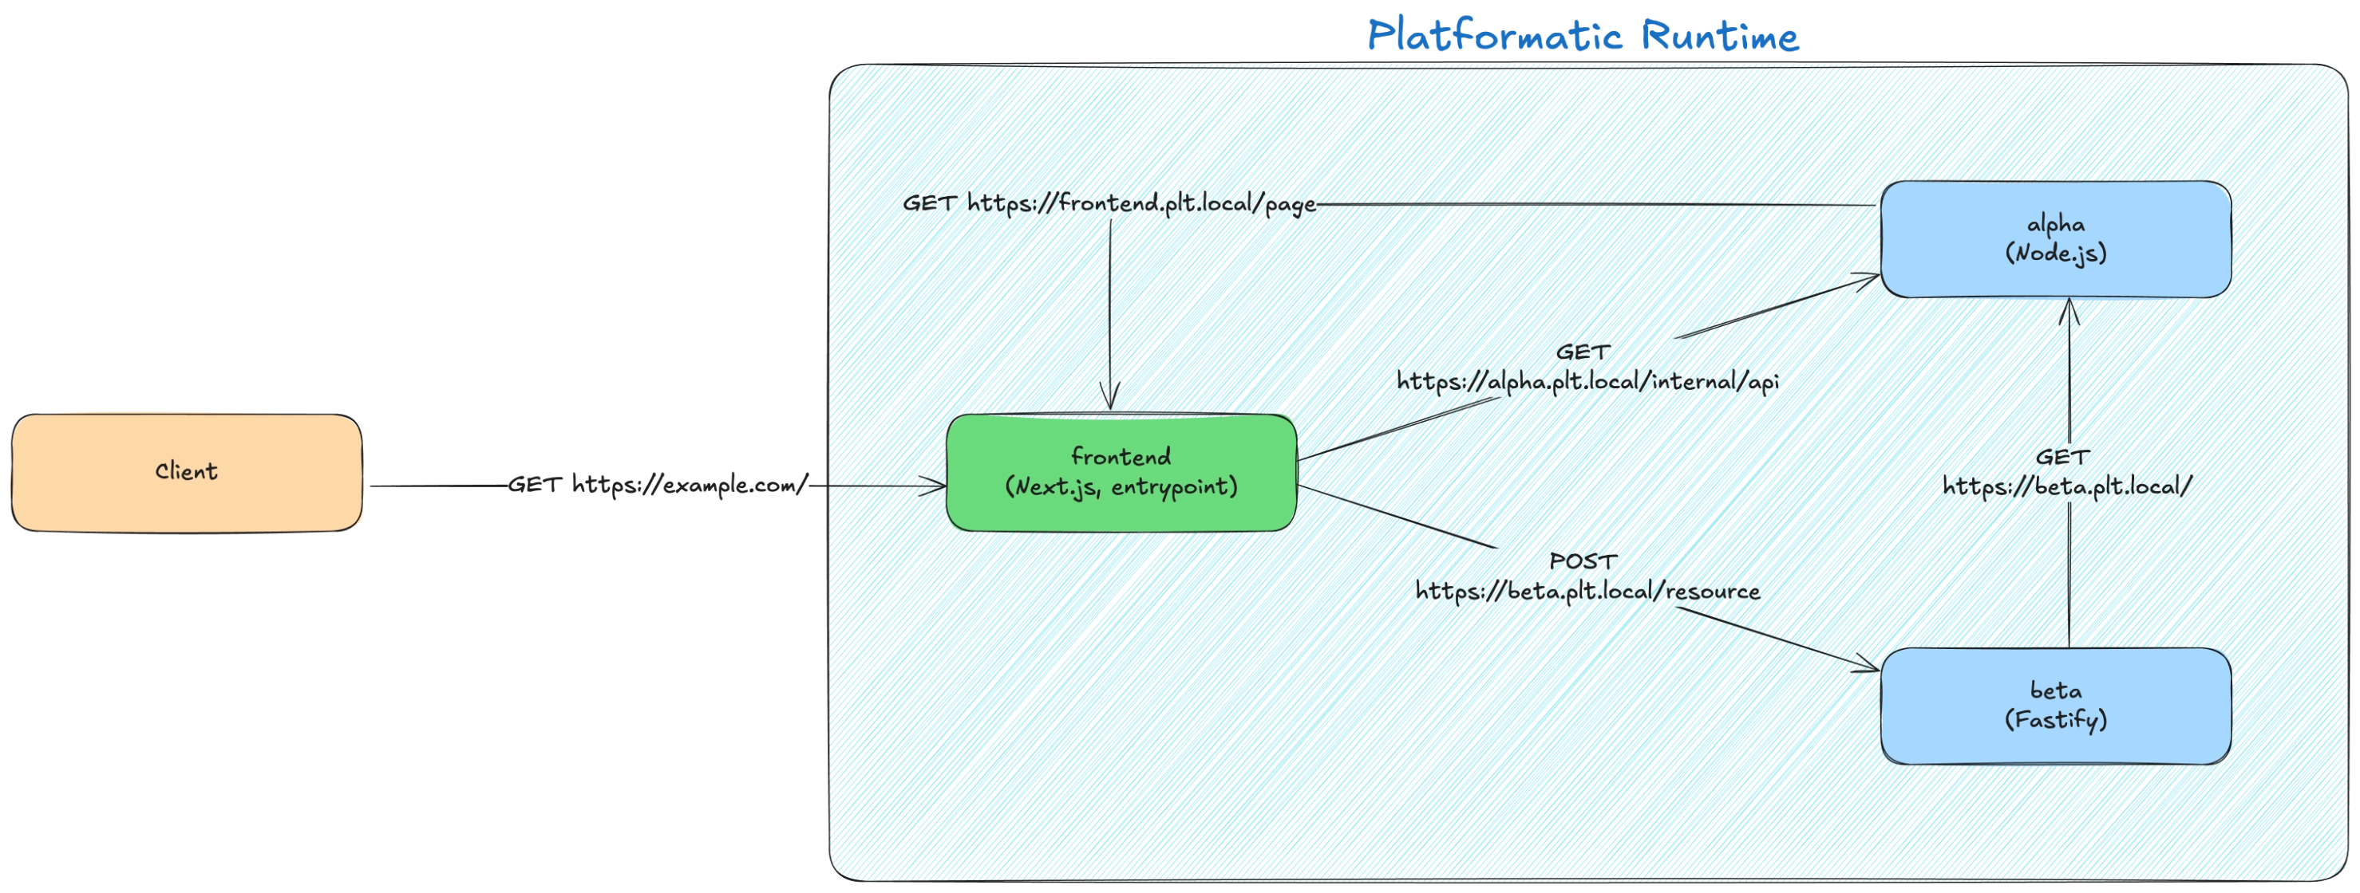
Network-less HTTP
The
Platformatic
mesh
network.
Our
secret
sauce.

Slide 46
Example: a service which invokes another service
Like
earlier,
we
all
know
this
snippet
is
more
worth
than
1000
words.
import fastify from 'fastify'
export function create() {
const app = fastify({})
app.get('/fast', async () => {
return { time: Date.now() }
})
app.get('/slow', async () => {
const response = await fetch('http://worker.plt.local/hash')
return response.json()
})
return app
}

Slide 47


Slide 48

GoFundMe campaign
We
are
running
a
GoFundMe
campaign
to
support
the
Code
Their
Future
initiative.
https://www.gofundme.com/f/code-their-future-unlocking-opportunities-for-underserved-k

Slide 49


One last thing™
“Keep your face always toward the sunshine
and shadows will fall behind you.”
Walt Whitman

Slide 50

Thank you!
Paolo Insogna
@p_insogna
Platformatic
Node.js TSC, Principal Engineer
paolo.insogna@platformatic.dev

