Slide 1






View online
Download PDF
Milo, a new HTTP parser for Node.js
Paolo Insogna
Node.js TSC, Principal Engineer @
Platformatic

Slide 2

Being reckless
(sometimes)
pays off!

Slide 3






Hello, I'm
Paolo
!
Node.js
Technical Steering Committee Member
Platformatic
Principal Engineer
paoloinsogna.dev
ShogunPanda
p_insogna
pinsogna

Slide 4

We all love HTTP!

Slide 5

Which HTTP
are you?

Slide 6
The choice is narrow
Even
if
the
HTTP
protocol
is
more
than
30
years
old,
only
three
current
versions
of
it
exist
as
of
today.
The
others
are
considered
obsolete.
1
HTTP/1.1
The last version of the initial protocol. By far the most famous and most used.
2
HTTP/2
Developed on top of SPDY to remove some problems of HTTP.
3
HTTP/3
Developed on top of QUIC to solve TCP problems.

Slide 7
What about Node.js?
1+2
3
HTTP/1.1 and HTTP/2
HTTP/3
Node.js has a stable implementation.
Work in progress,
stay tuned!

Slide 8

Let's focus!

Slide 9
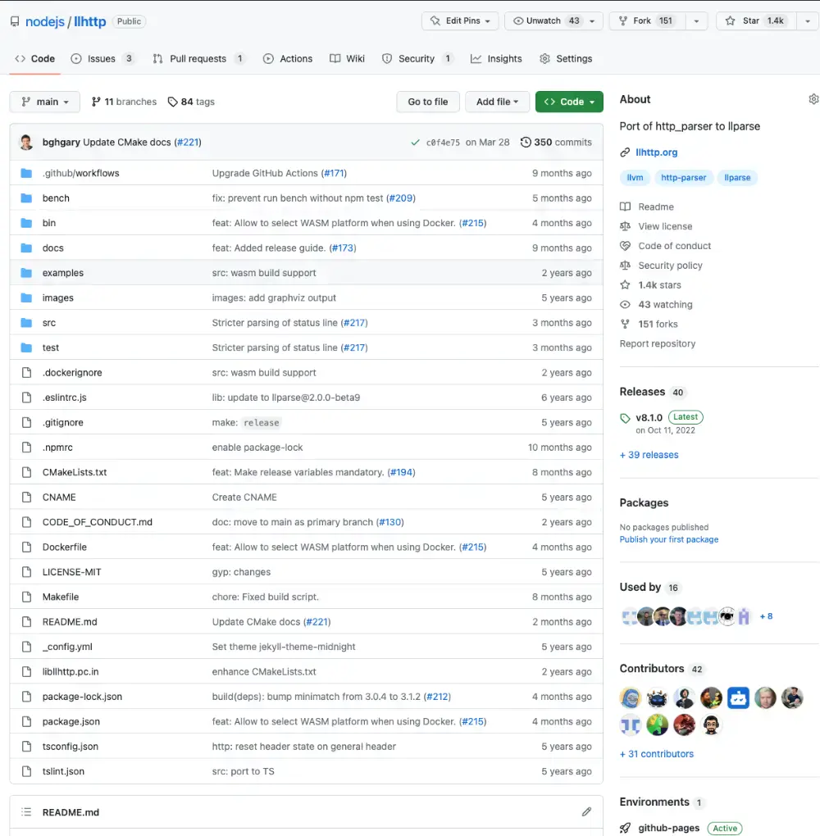
The current parser
llhttp
is
the
current
HTTP
parser.
Written
by
Fedor
Indutny
in
2019,
is
the
default
since
Node.js
12.

Slide 10

How does it work?
llhttp
is
a
state
based
HTTP
parser
based
on
llparse.
llparse
is
capable
to
generate
a
very
performant
C
code
out
of
a
TypeScript
description
of
the
possible
states.

Slide 11



llhttp: what's wrong with it?
Hard to debug and release
The transpilation makes hard to debug issues.
Backward compatibility
Supporting obsolete versions of HTTP introduces unneeded complexity.
You give them a finger, they take the arm
A lenient approach opens the door for edge cases and vulnerability opportunities.

Slide 12

Do we have the
solution?

Slide 13

Yes, start fresh!

Slide 14

Say hello to
Milo
!

Slide 15



Let's drop the bomb!
Milo is written in Rust
The language has proven flexible and
performant to achieve the task.
I did not know it before Milo
I purposely made the choice to see how hard
it is for a new prospect contributor.
Be cool
I don't want to start another language flame.
Please.
❤️

Slide 16


Do not throw the goods away
llhttp is a piece of art
It deeply inspires Milo and I kept most of his architecture.
Kudos to Fedor!
Still a state machine, but simpler
llhttp has
80
possible states, Milo only
32
.
Declarative, reinvented
Rust enables to declare states with no code restriction.

Slide 17

How is that
possible?

Slide 18

It's all in the
macros!

Slide 19

Rust macro system is insanely powerful
It is evaluated at compile time
The executed code is inherently optimized.
No code limitation
As long as you return valid Rust code, everything is permitted.
Easily debuggable
Via
cargo-expand
, it's easy to see what is the final compiled code.

Slide 20

Examples are worth more than 1000 words
#[inline(always)]
pub fn state_request_protocol(
parser: &mut Parser, data: &[c_uchar],
) -> usize {
let mut data = data;
match data {
[72u8, 84u8, 84u8, 80u8, 47u8, ..] |
[82u8, 84u8, 83u8, 80u8, 47u8, ..] => {
#[cfg(not(target_family = "wasm"))]
{
(parser.callbacks.on_protocol)(
parser, parser.position, 4,
);
};
parser.position += 4;
parser.move_to(STATE_REQUEST_VERSION, 1)
}
[_u0, _u1, _u2, _u3, _u4, ..] => {
parser.fail(
ERROR_UNEXPECTED_CHARACTER,
"Expected protocol",
)
}
_ => SUSPEND,
}
}
state!(request_protocol, {
match data {
string!("HTTP/") | string!("RTSP/") => {
callback!(on_protocol, 4);
parser.position += 4;
move_to!(request_version, 1)
}
otherwise!(5) =>
fail!(UNEXPECTED_CHARACTER, "Expected protocol"),
_ => suspend!(),
}
});

Slide 21

What about
resources?

Slide 22


Milo has very small memory footprint
(Almost) No copy eager parsing
Data is analyzed in place without copying it.
Only one exception (optional)
When parsing, only the unconsumed part of the input is copied in the parser.
Convenience at your service
Milo manages unconsumed data for you, making your life easier.

Slide 23

Strict, period!

Slide 24

Let's get to
the action!

Slide 25
Sample code (Rust)
use core::ffi::c_void;
use core::slice;
use milo::Parser;
fn main() {
// Create the parser.
let mut parser = Parser::new();
// Prepare a message to parse.
let message = String::from("HTTP/1.1 200 OK\r\nContent-Length: 3\r\n\r\nabc");
parser.context = message.as_ptr() as *mut c_void;
// Milo works using callbacks, All callbacks have the same signature.
parser.callbacks.on_data = |p: &mut Parser, from: usize, size: usize| {
let message = unsafe {
std::str::from_utf8_unchecked(slice::from_raw_parts(p.context.add(from) as *const u8, size))
};
// Do something with the informations.
println!("Pos={} Body: {}", p.position, message);
};
// Now perform the main parsing using milo.parse.
parser.parse(message.as_ptr(), message.len());
}

Slide 26
Output (Rust)
shogun@panda:~/example$ cargo run
Pos=38 Body: abc

Slide 27

But Node.js
uses C++!

Slide 28

The C++ workflow
A tool generates the headers
cbindgen
generates a fully working C or C++
header file. Only a small TOML file is needed.
Cargo generates a static library
The generated
libmilo.a
file can be statically
linked in any C/C++ executable.

Slide 29
Sample code (C++)
#include "milo.h"
#include "stdio.h"
#include "string.h"
int main() {
// Create the parser.
milo::Parser* parser = milo::milo_create();
// Prepare a message to parse.
const char* message = "HTTP/1.1 200 OK\r\nContent-Length: 3\r\n\r\nabc";
parser->context = (char*) message;
// Milo works using callbacks, All callbacks have the same signature.
parser->callbacks.on_data = [](milo::Parser* p, uintptr_t from, uintptr_t size) {
char* payload = reinterpret_cast<char*>(malloc(sizeof(char) * size));
strncpy(payload, reinterpret_cast<const char*>(p->context) + from, size);
printf("Pos=%lu Body: %s\n", p->position, payload);
free(payload);
};
// Now perform the main parsing using milo.parse. The method returns the number of consumed characters.
milo::milo_parse(parser, reinterpret_cast<const unsigned char*>(message), strlen(message));
// Cleanup used resources.
milo::milo_destroy(parser);
}

Slide 30
Output (C++)
shogun@panda:~/example$ clang++ -std=c++11 -o example libmilo.a main.cc
shogun@panda:~/example$ ./example
Pos=38 Body: abc

Slide 31
But I want
to support
SmartOS!

Slide 32

WASM will save us!
WebAssembly is fully supported
Rust has always considered WebAssembly a
first class citizen.
The toolchain makes it easy
wasm-bindgen
generates a fully working JS
module which internally loads a WASM file.

Slide 33
Sample code (Node.js with WebAssembly)
import { milo } from '@perseveranza-pets/milo'
// Prepare a message to parse.
const message = Buffer.from('HTTP/1.1 200 OK\r\nContent-Length: 3\r\n\r\nabc')
// Allocate a memory in the WebAssembly space. This speeds up data copying to the WebAssembly layer.
const ptr = milo.alloc(message.length)
// Create a buffer we can use normally.
const buffer = Buffer.from(milo.memory.buffer, ptr, message.length)
// Create the parser.
const parser = milo.create()
// Milo works using callbacks, All callbacks have the same signature.
milo.setOnData(parser, (p, from, size) => {
console.log(`Pos=${milo.getPosition(p)} Body: ${message.slice(from, from + size).toString()}`)
})
// Now perform the main parsing using milo.parse. The method returns the number of consumed characters.
buffer.set(Buffer.from(message), 0)
const consumed = milo.parse(parser, ptr, message.length)
// Cleanup used resources.
milo.destroy(parser)
milo.dealloc(ptr, message.length)

Slide 34
Output (Node.js with WebAssembly)
shogun@panda:~/example$ node index.mjs
Pos=38 Body: abc

Slide 35


And that's Milo!

Slide 36
Performance in Node (native, preliminary)
======================================== llhttp ====================================
--------------------------------------------------------------------
| Stat | 2.5% | 50% | 97.5% | 99% | Avg | Stdev | Max |
--------------------------------------------------------------------
| Latency | 0 ms | 0 ms | 0 ms | 0 ms | 0.01 ms | 0.12 ms | 17 ms |
--------------------------------------------------------------------
-----------------------------------------------------------------------------------
| Stat | 1% | 2.5% | 50% | 97.5% | Avg | Stdev | Min |
-----------------------------------------------------------------------------------
| Req/Sec | 25119 | 25119 | 29055 | 30447 | 28808 | 1411.49 | 25114 |
-----------------------------------------------------------------------------------
| Bytes/Sec | 2.11 MB | 2.11 MB | 2.44 MB | 2.56 MB | 2.42 MB | 118 kB | 2.11 MB |
-----------------------------------------------------------------------------------
Req/Bytes counts sampled once per second.
# of samples: 11
317k requests in 11.02s, 26.6 MB read
======================================== milo ====================================
--------------------------------------------------------------------
| Stat | 2.5% | 50% | 97.5% | 99% | Avg | Stdev | Max |
--------------------------------------------------------------------
| Latency | 0 ms | 0 ms | 0 ms | 0 ms | 0.01 ms | 0.11 ms | 17 ms |
--------------------------------------------------------------------
--------------------------------------------------------------------------------
| Stat | 1% | 2.5% | 50% | 97.5% | Avg | Stdev | Min |
--------------------------------------------------------------------------------
| Req/Sec | 28511 | 28511 | 30287 | 33407 | 30765.1 | 1458.2 | 28507 |
--------------------------------------------------------------------------------
| Bytes/Sec | 2.4 MB | 2.4 MB | 2.55 MB | 2.81 MB | 2.58 MB | 122 kB | 2.39 MB |
--------------------------------------------------------------------------------
Req/Bytes counts sampled once per second.
# of samples: 11
338k requests in 11.02s, 28.4 MB read

Slide 37



What's missing?
Node.js integration
SIMD in WebAssembly
Migrate llhttp test suite
I just finished integrating the
Milo matches or outperforms llhttp
The llhttp test suite (originally from
WebAssembly version in undici.
in native mode, but it is slower
http_parser) is crucial to ensure
Our beloved runtime is next.
when compiled in WebAssembly.
correctness of the parser.

Slide 38

A due thanks to ...
Without
their
trust,
support
and
sponsorship,
Milo
would
have
never
been
possible.
Love
you!
❤️

Slide 39


One last thing™
“A person who never made a mistake
never tried anything new.”
Albert Einstein

Slide 40


Thank you!
Paolo Insogna
@p_insogna
Platformatic
Node.js TSC, Principal Engineer
paolo.insogna@platformatic.dev

