Slide 1


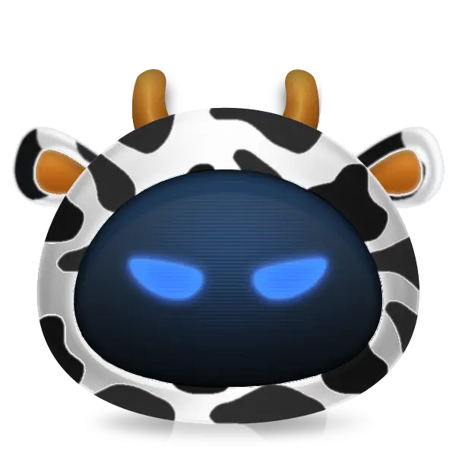



View online
Download PDF
Programming with a martial art principles
Paolo Insogna
Node.js TSC, Principal Engineer @
Platformatic

Slide 2
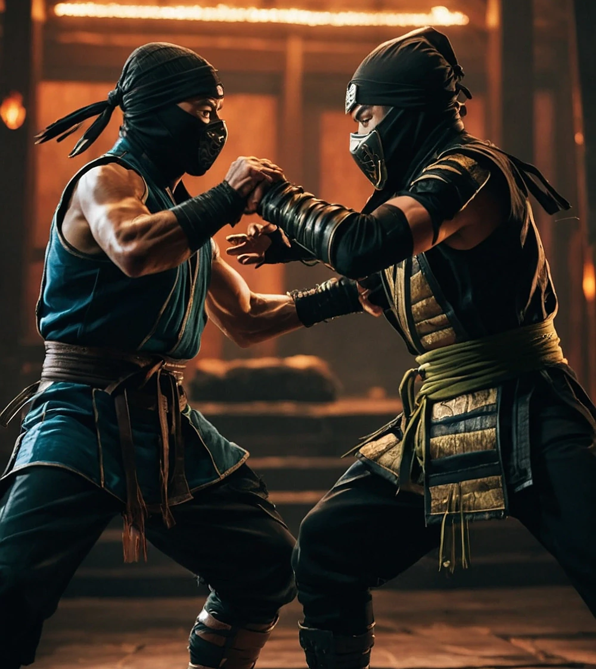
There is no
knowledge that is
not power!

Slide 3






Hello, I'm
Paolo
!
Node.js
Technical Steering Committee Member
Platformatic
Principal Engineer
paoloinsogna.dev
ShogunPanda
p_insogna
pinsogna

Slide 4

What is
programming
?

Slide 5
What is programming?
“The process of writing and
testing programs for computers”
The Oxford Dictionary

Slide 6
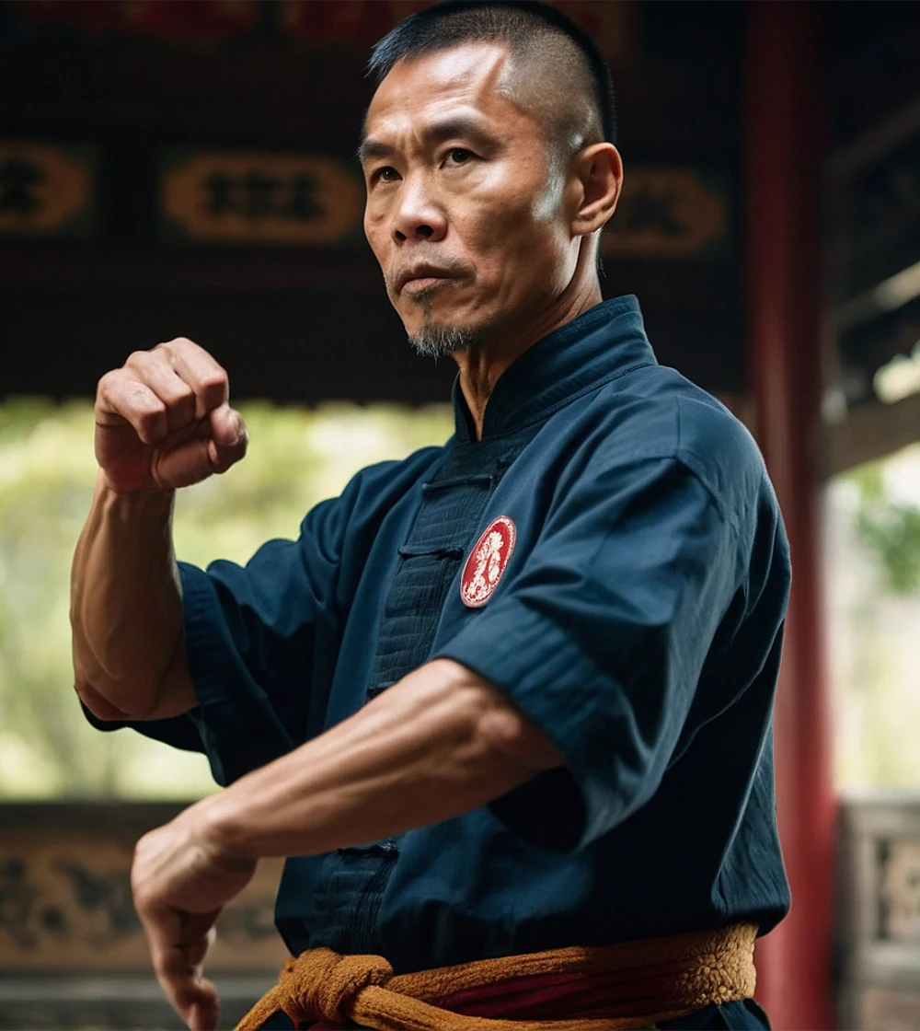
What is a
martial art
?

Slide 7
What is programming?
“A traditional form of fighting or defending
yourself, practised as a sport or as exercise.”
The Cambridge Dictionary

Slide 8

But they are
completely
unrelated!

Slide 9



It's all about us ...
Everybody is a multitude of traits
For instance, we are programmers, spouses or parents.
The different traits are not disjoint
They all influence the other ones.
The process is not voluntary
No matter how much you try, all the traits define you.

Slide 10



... and our brain, in particular
Everything you learn is useful
New brain connections are literally created every second.
You don't fully control your brain ...
Do not
think about an elephant.
You have lost!
... and that is a good thing
How many times your subconcious solved the problem?

Slide 11
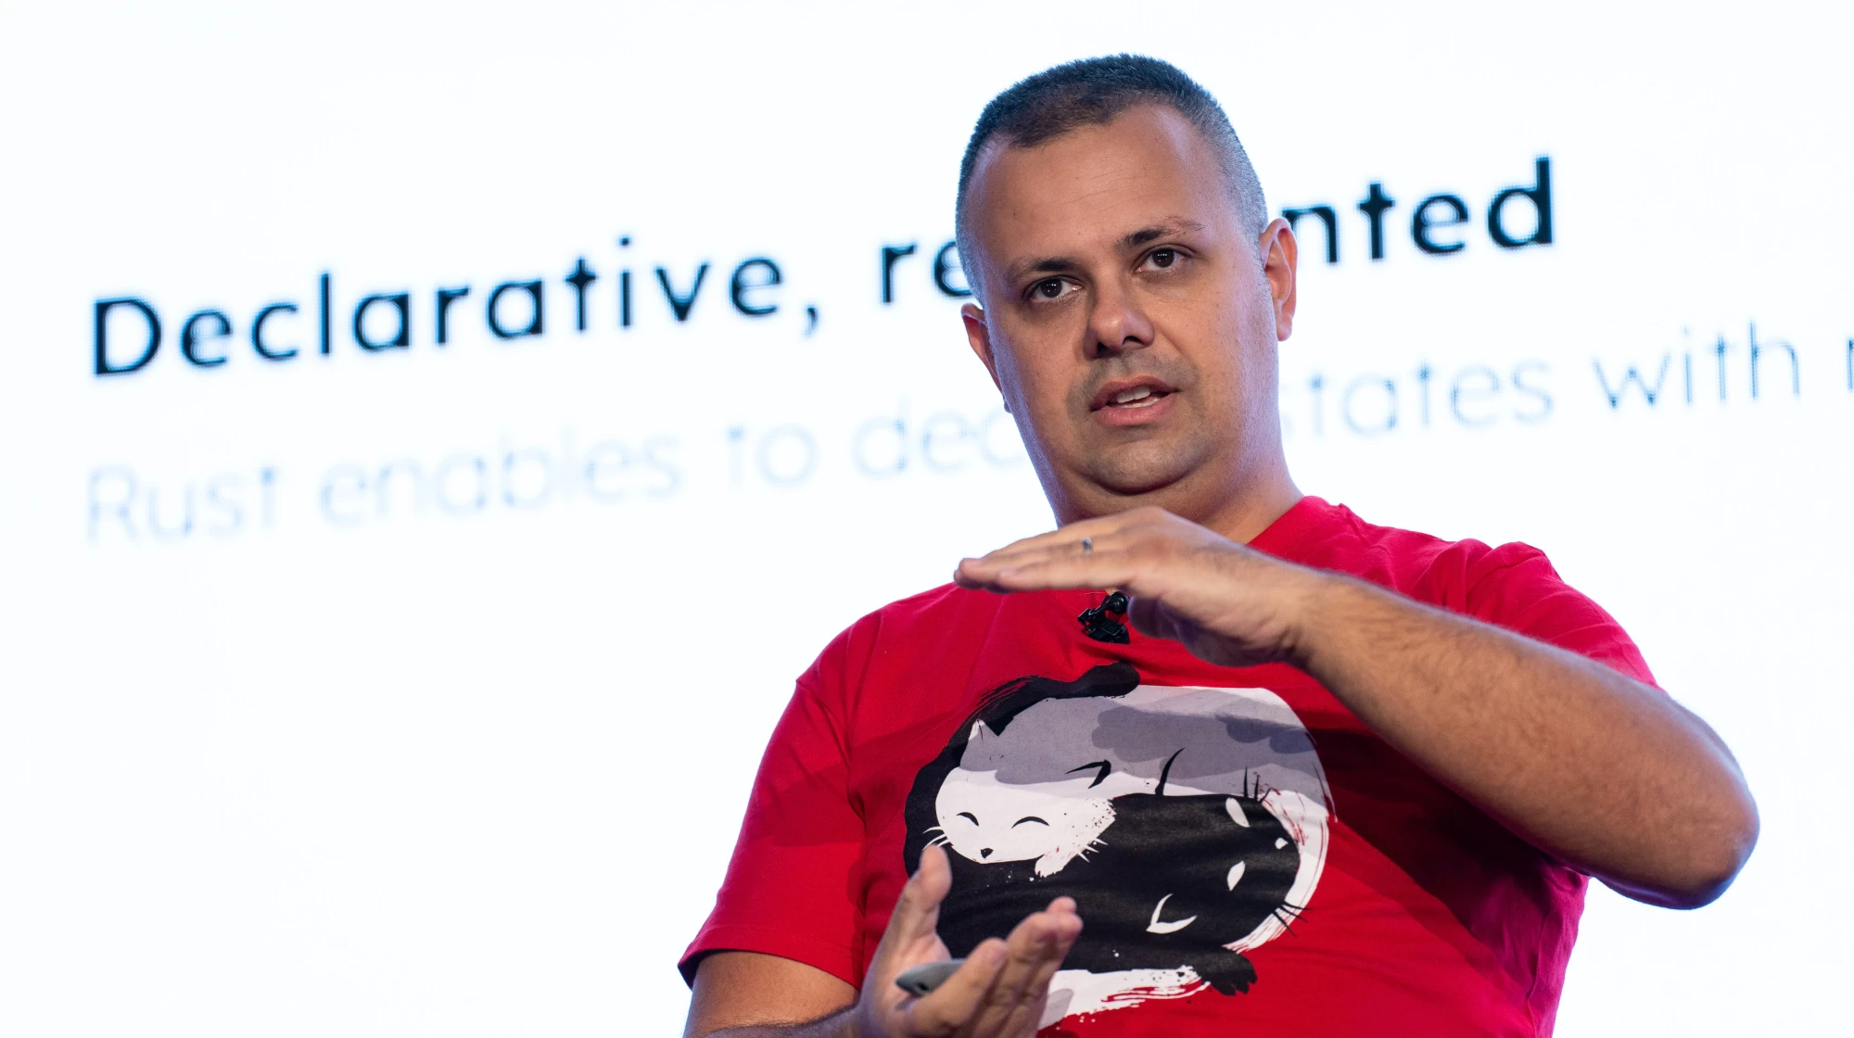
Take me, for instance

Slide 12



I have several passions (1/2)
(Chubby) Cats
(Played) Soccer
Manga & Animes
Those furry balls have seriously
Pretty obvious for a
It's easy to be an otaku now.
messed with my mind.
'84 Italian male.
Boring!
Try in 2000's Southern Italy.

Slide 13



I have several passions (2/2)
Videogames
RPG & LARP
Programming
Since I was 6, as many developers.
I started them late and they also
As most of us, isn't it?
Boring, again!
seriously messed with my mind.
How boring am I?

Slide 14

One last
thing™
passion

Slide 15
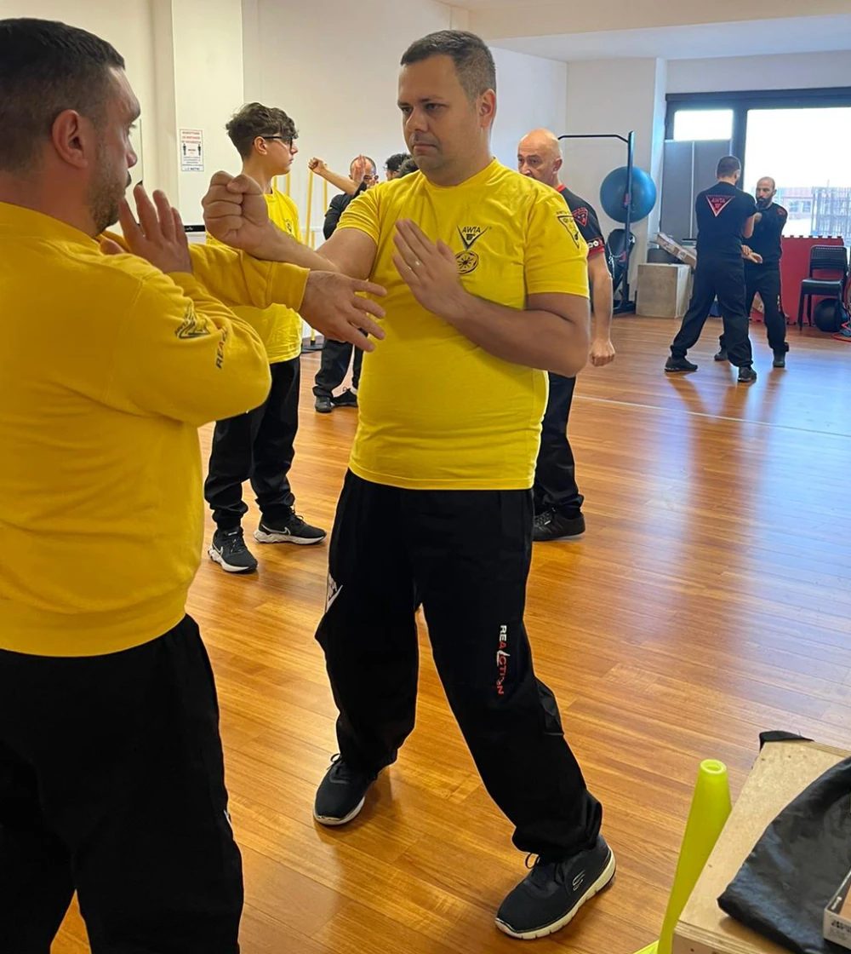
Martial art

Slide 16

The wait
is over ...

Slide 17
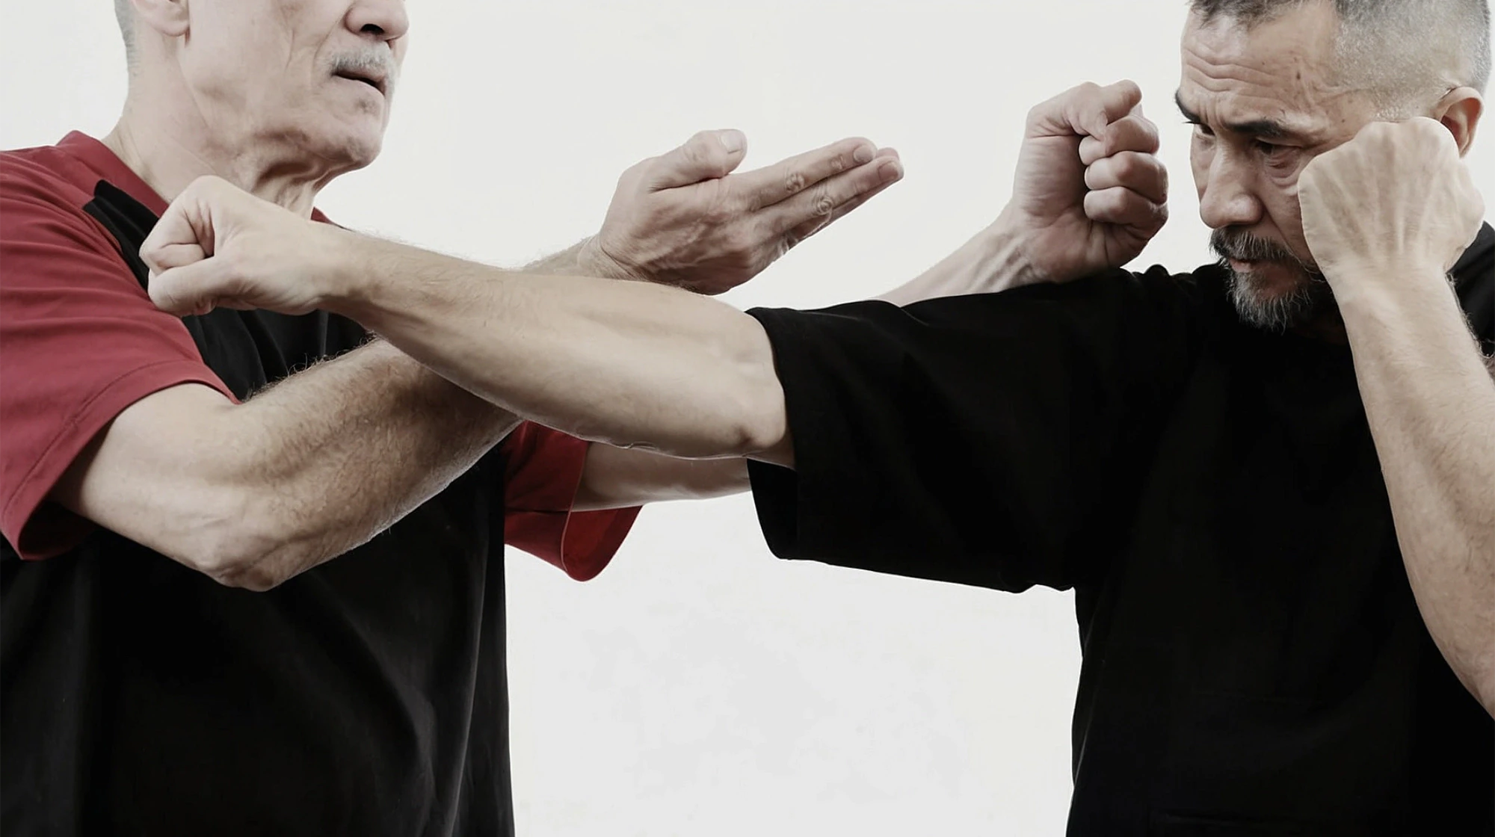
Wing Tsun*
*Romanization is controversial

Slide 18



What is that?
It has various possible translations
The most commonly used is "Eternal Spring".
Who catches the citation?
It is part of kung fu
In particular, it is part of the Southern China martial arts.
Pretty atypical
You won't see any spectacular roundhouse kicks or similar.

Slide 19



Where did it come from?
It was made for women
The tradition says it was created for Yim Wing Tsun to defend herself.
It derives from Shaolin
The tradition states the women monk Ng Mui as her original creator.
It also includes weapons
Butterfly knives and 3m staff are trained regularly.

Slide 20
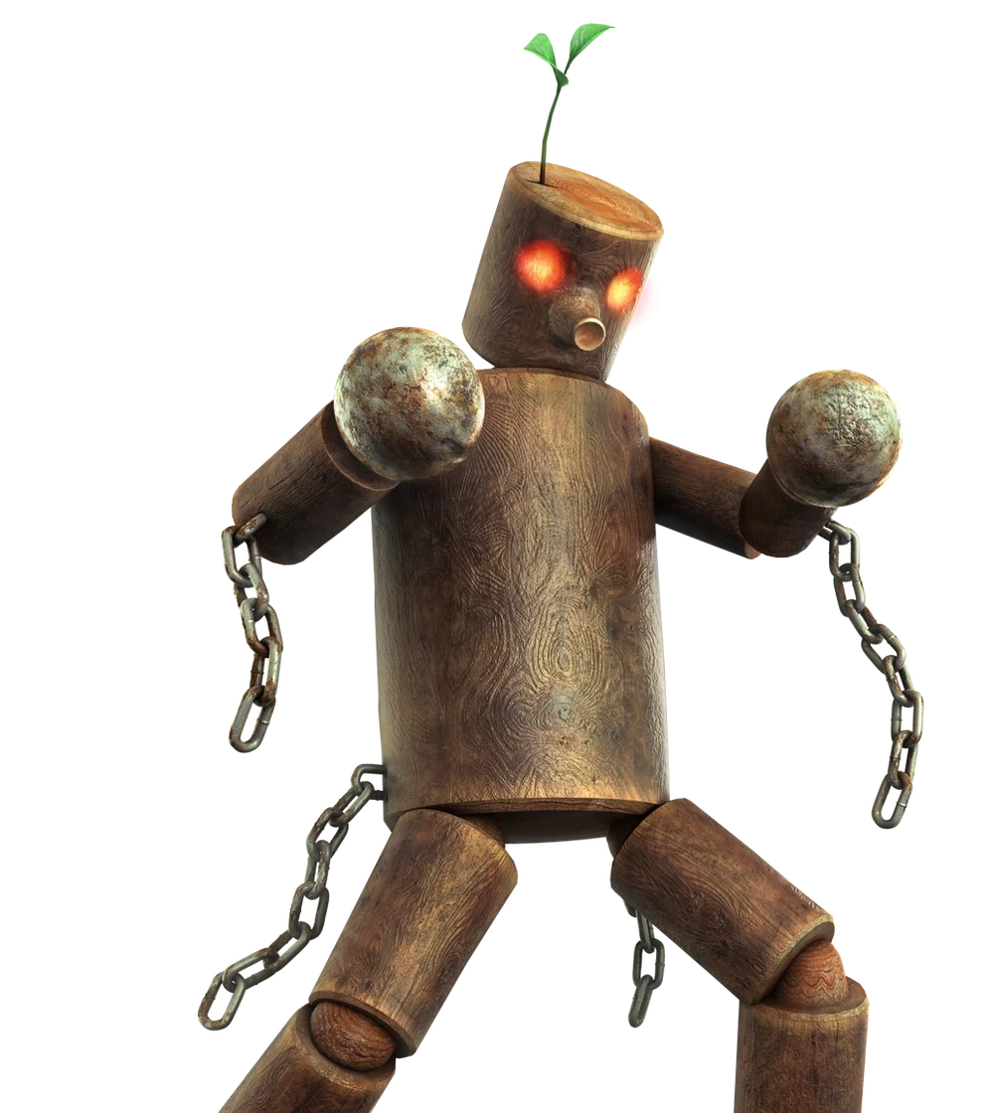
Meet our training
dummy

Slide 21

Sorry, I totally
could not resist!

Slide 22

Meet our
real
training dummy

Slide 23



Why did I chose Wing Tsun?
It focuses on effectiveness
Every millisecond matters.
Ring a bell?
It is for everyone
You don't need to be able to do splits to throw a kick.
It redefines the concept of strength
You don't really need muscles.

Slide 24
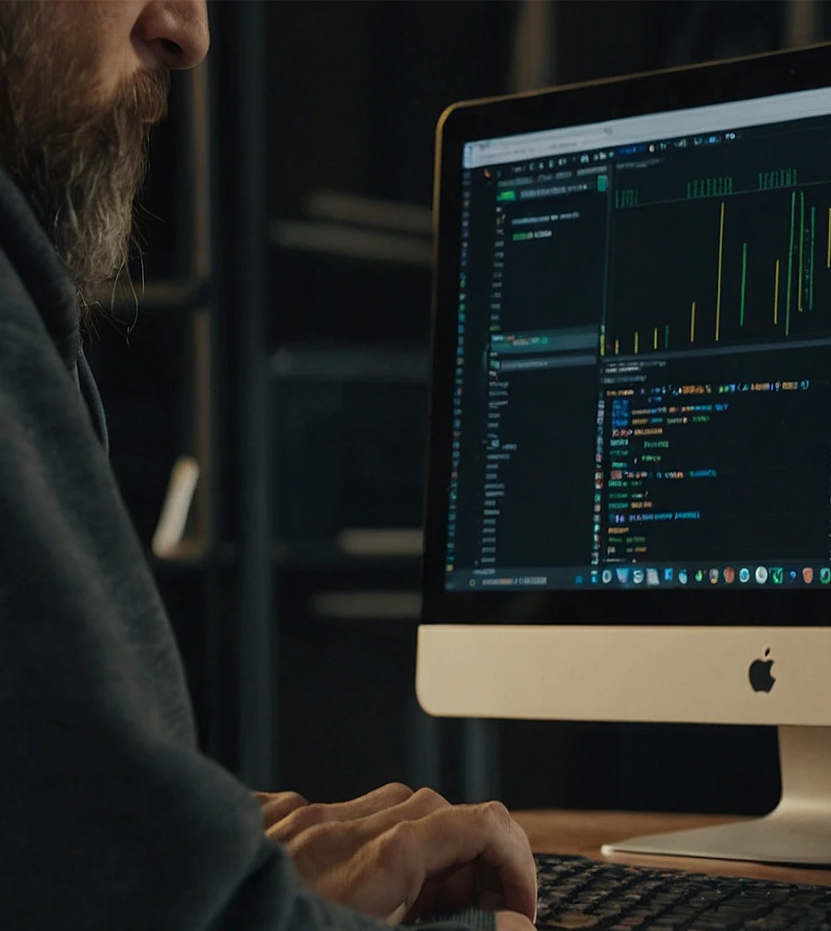
What about
programming?

Slide 25

Let's clarify few things
Fighting is everywhere
Is not only on the ring or on the street. It's a general principle.
Martial arts are not just about fighting
Sometimes, they become a life philosophy.
Remember about the personas?
I unconsciously use what I learned in Wing Tsun everywhere.

Slide 26

Let's apply the
Wing Tsun
principles to
programming!
...
finally!
😂

Slide 27
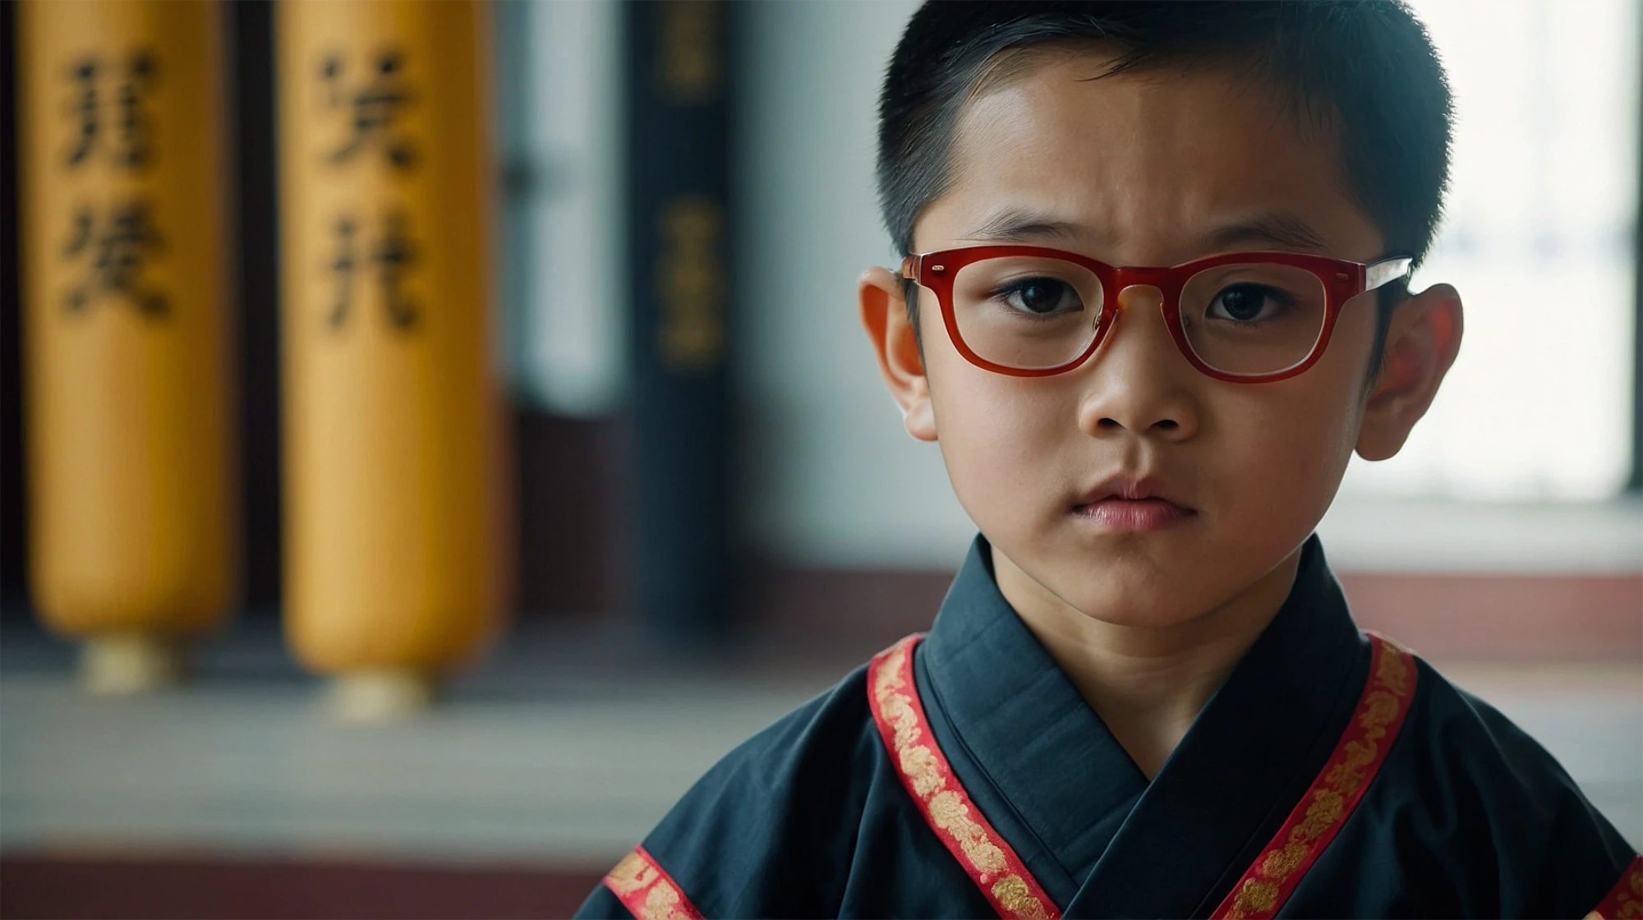
No
sifu
has proof
checked this talk!
Opinions are mine and I'm still learning. Be gentle! 🙏

Slide 28

Energy Principles

Slide 29

Energy Principles (1/4)
1
“Give up your own Force.”
1st Energy Principle

Slide 30

Give up your own Force
1
“K.I.S.S. and don't be stubborn.”
1st Energy Principle applied to programming

Slide 31
Energy Principles (2/4)
2
“Give up your opponent's Force.”
2nd Energy Principle

Slide 32
Give up your opponent's Force
“Contain or redirect any point
2
of failure where it cannot harm.”
2nd Energy Principle applied to programming

Slide 33
Energy Principles (3/4)
3
“Use your attacker's Force against him/her.”
3rd Energy Principle

Slide 34
Use your attacker's Force against him/her
“Thoroughly study the APIs and
3
existing systems you have to work with.”
3rd Energy Principle applied to programming

Slide 35
Energy Principles (4/4)
4
“Add your own Force.”
4th Energy Principle

Slide 36
Add your own Force
“Apply lateral thinking when
4
solving others' complex problems.”
4th Energy Principle applied to programming

Slide 37

Chi Sao principles

Slide 38

But what is exactly
Chi Sao
?

Slide 39



Chi Sao
It means "sticky hands"
It's a drill system which focuses on
NEVER
losing contact with opponent's arms.
It stimulates reflexes
As soon as you feel the way is free,
you hit
.
It stimulates self-perception
You must be careful in how much and where you use your force.

Slide 40
Back to Chi Sao
principles!

Slide 41

Chi Sao Principles (1/4)
1
“If the way is free, go forward.”
1st Chi Sao Principle

Slide 42
If the way is free, go forward
“Never think short-term
1
and deliver continously.”
1st Chi Sao Principle applied to programming

Slide 43
Chi Sao Principles (2/4)
2
“If the way is not free, stick to the opponent.”
2nd Chi Sao Principle

Slide 44
If the way is not free, stick to the opponent
“When there is an obstacle, put it aside
2
for a little but continue to monitor.”
2nd Chi Sao Principle applied to programming

Slide 45
Chi Sao Principles (3/4)
3
“If the opponent is stronger, yield.”
3rd Chi Sao Principle

Slide 46
If the opponent is stronger, yield
“You can't always have it your way.
3
Be ready to yield in a controlled manner.”
3rd Chi Sao Principle applied to programming

Slide 47
Chi Sao Principles (4/4)
4
“If the opponent goes back, follow him/her.”
4th Chi Sao Principle

Slide 48
If the opponent goes back, follow him/her
“When debugging, always follow a
4
problem up to its resolution.
Don't believe in luck or coincidences.”
4th Chi Sao Principle applied to programming

Slide 49
Bonus principle!

Slide 50

A good Chum Kiu shall be performed
within the space occupied by a laying cow.
The Chum Kiu principle

Slide 51
Sorry, could not
resist (again)!

Slide 52



Take home lessons
What
can
we
learn
from
this
long
journey?
Everything matters
You can't control everything
Programming is like fighting
All the knowledge we have
Including your own brain.
Fighting strategies can improve our
helps us in our daily tasks.
Remember the elephant?
approach to programming.

Slide 53


One last thing™
“Mastering others is strength.
Mastering yourself is true power.”
Lao Tzu

Slide 54


Thank you!
Paolo Insogna
@p_insogna
Platformatic
Node.js TSC, Principal Engineer
paolo.insogna@platformatic.dev

