Slide 1

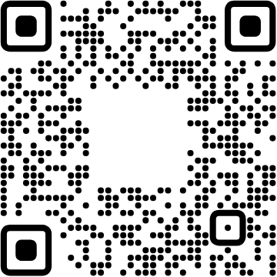


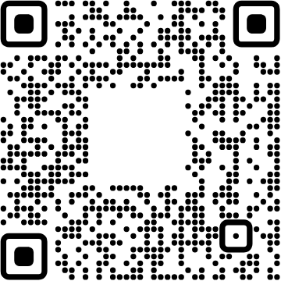

View online
Download PDF
Love your maintainers
Paolo Insogna
Node.js TSC, Principal Engineer @
Platformatic

Slide 2
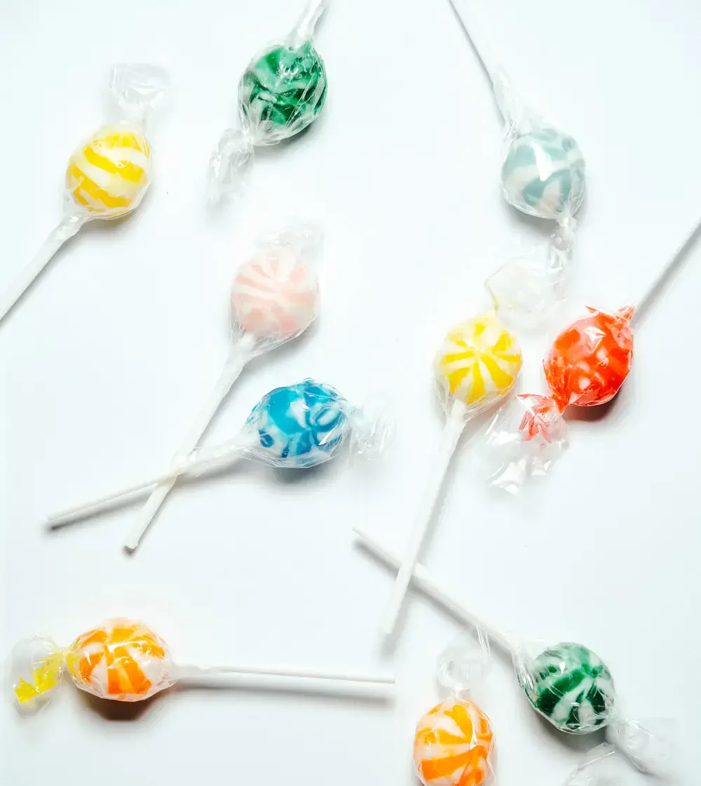
The secret is
in the manners!

Slide 3

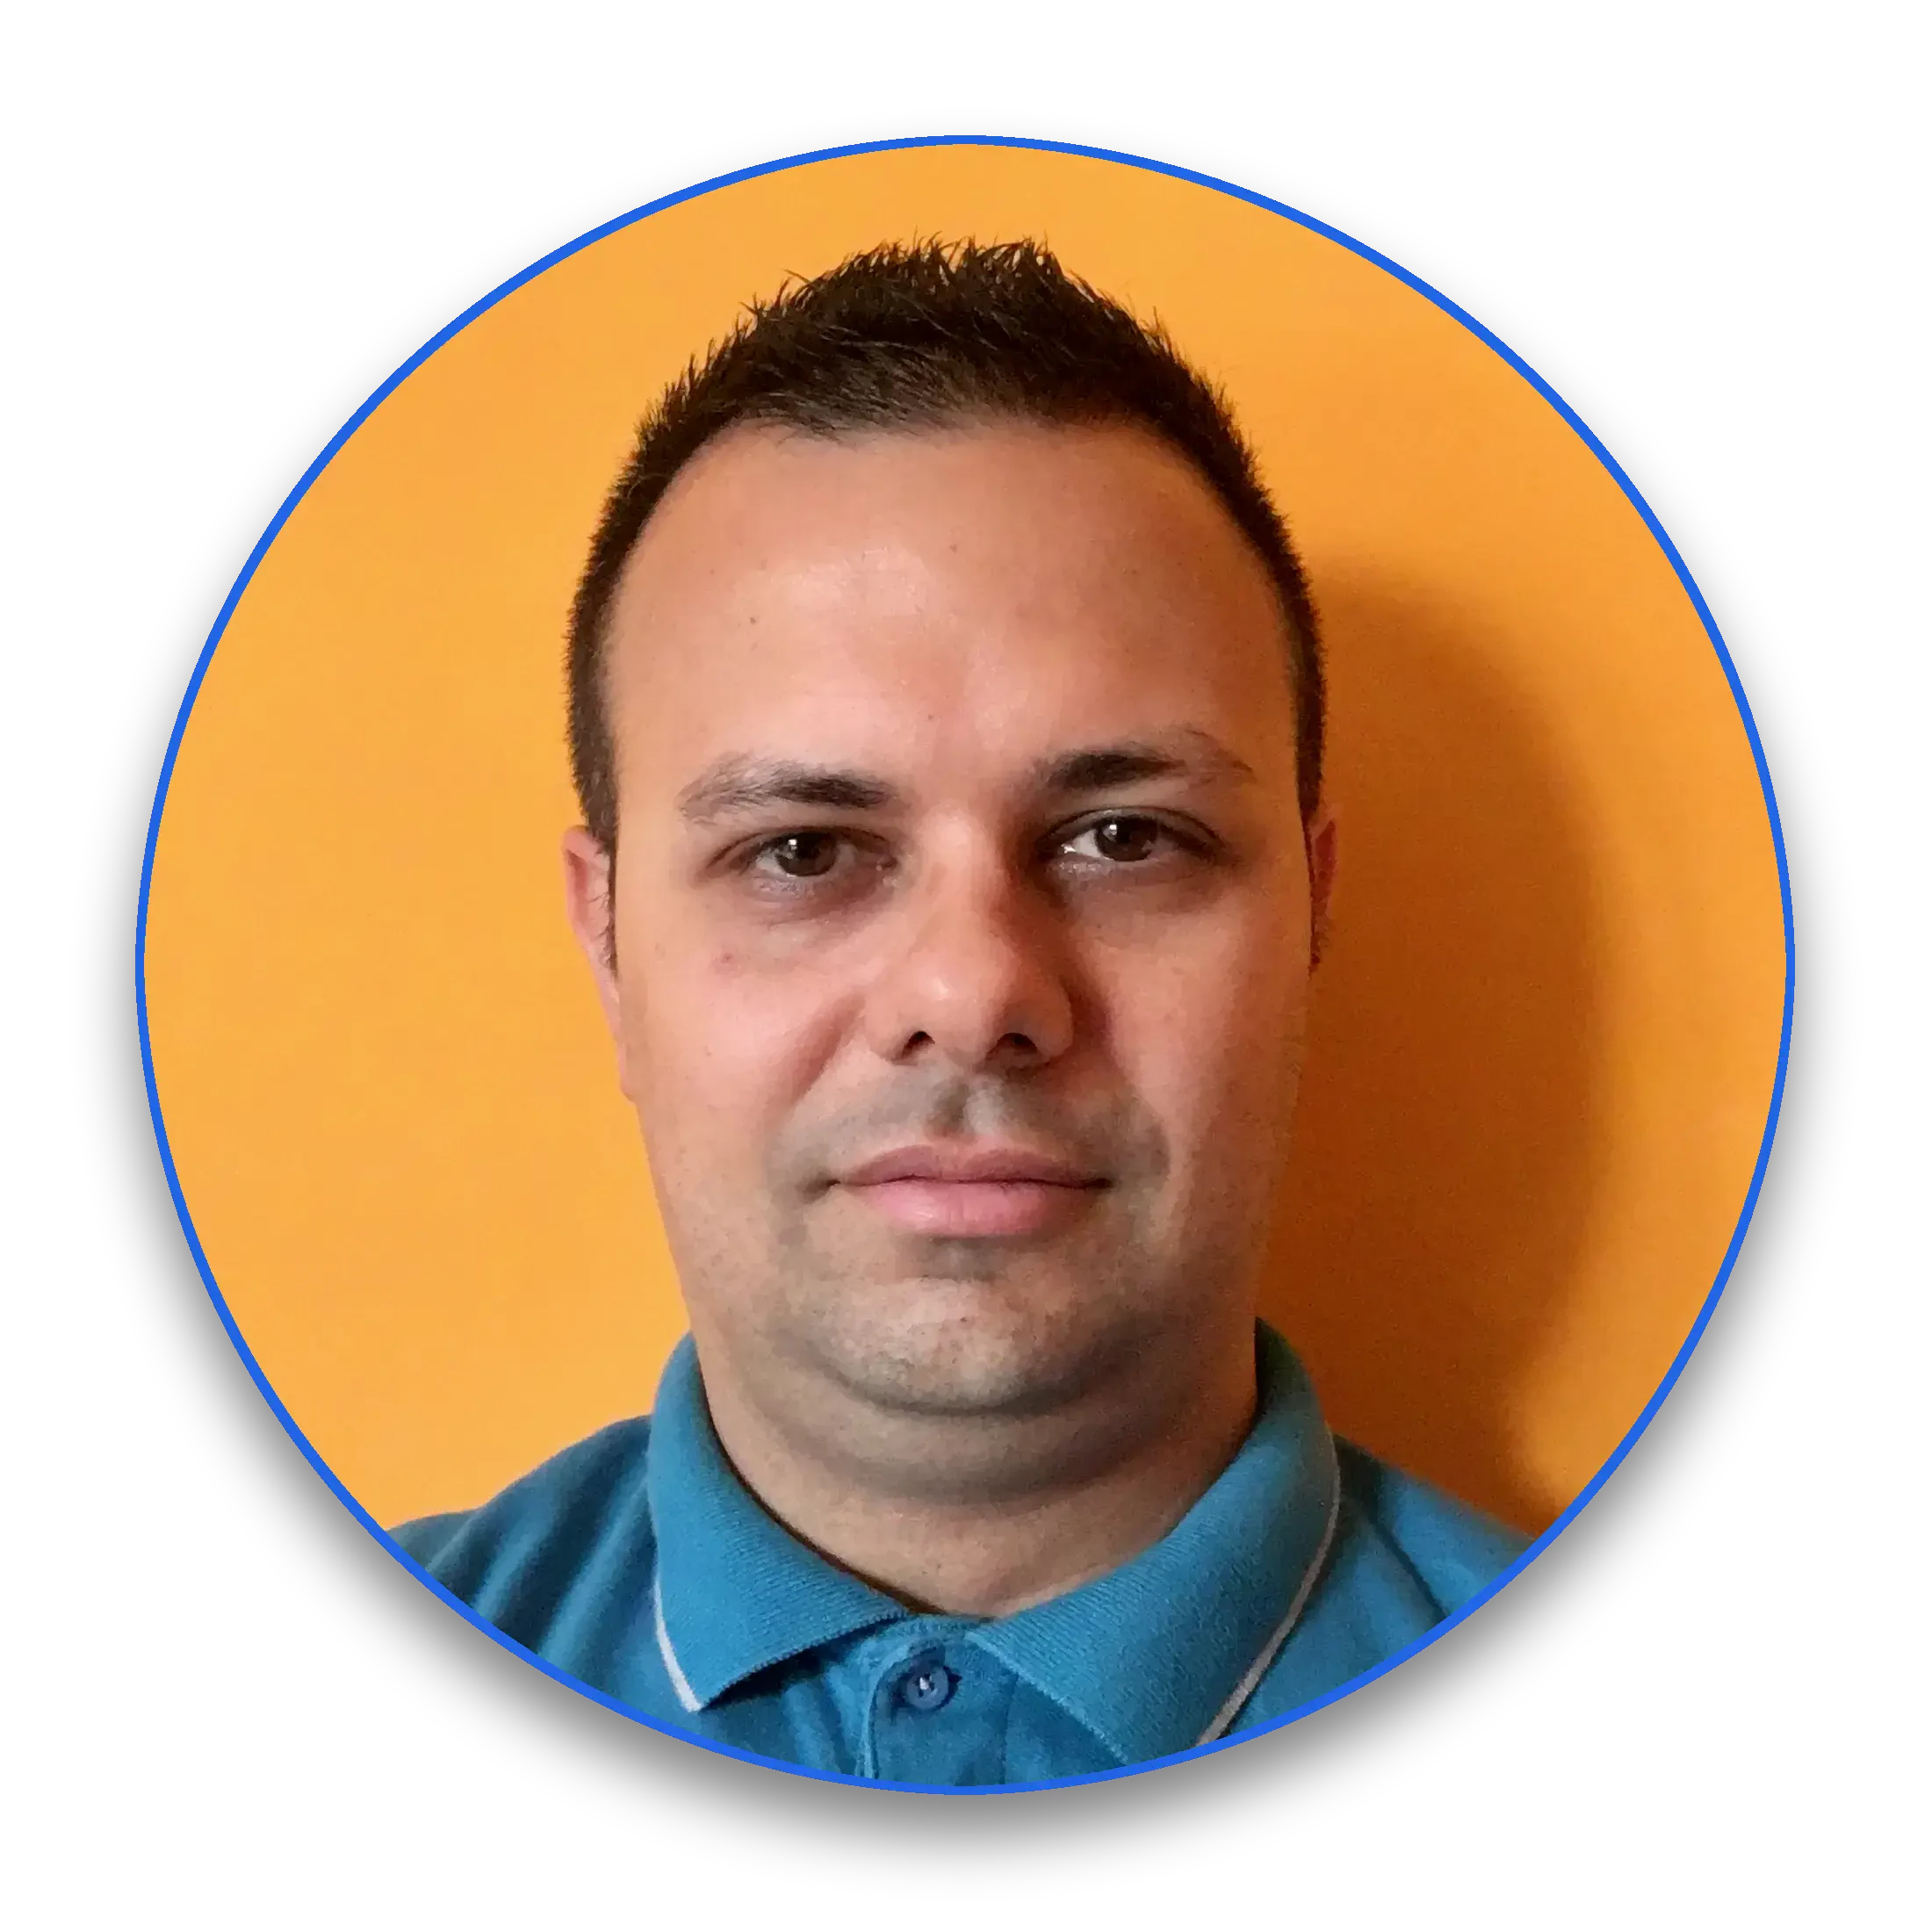
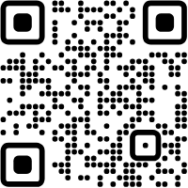



Hello, I'm
Paolo
!
Node.js
Technical Steering Committee Member
Platformatic
Principal Engineer
paoloinsogna.dev
ShogunPanda
p_insogna
pinsogna

Slide 4

What do you
expect
pretend from Open
Source?

Slide 5



Let's clarify things
What is it?
A decentralized software development model that
encourages open collaboration
.
How is it possible?
The secret is in the
passion
of the people.
Is it working?
Open Source has proven to be really effective in improving software quality.

Slide 6


How did it start?
Initially, it was free, not open
In the 70s the
free software movement
challenged the for-profit based development.
Free means too much
In English, the word free is ambiguous.
Not paid
was the most understood meaning.
Open Source was branched off the Free Software Movement
OSS software can be used for commercial purposes.
The freedom is retained.

Slide 7


Why would somebody want to go Open Source?
The best of the best of the best
You can access a developer base not physically close to you.
Different cultures, backgrounds and capabilities
You get different point of views, which increases quality.
Low maintenance cost
You don't need an office, just a version control server.

Slide 8
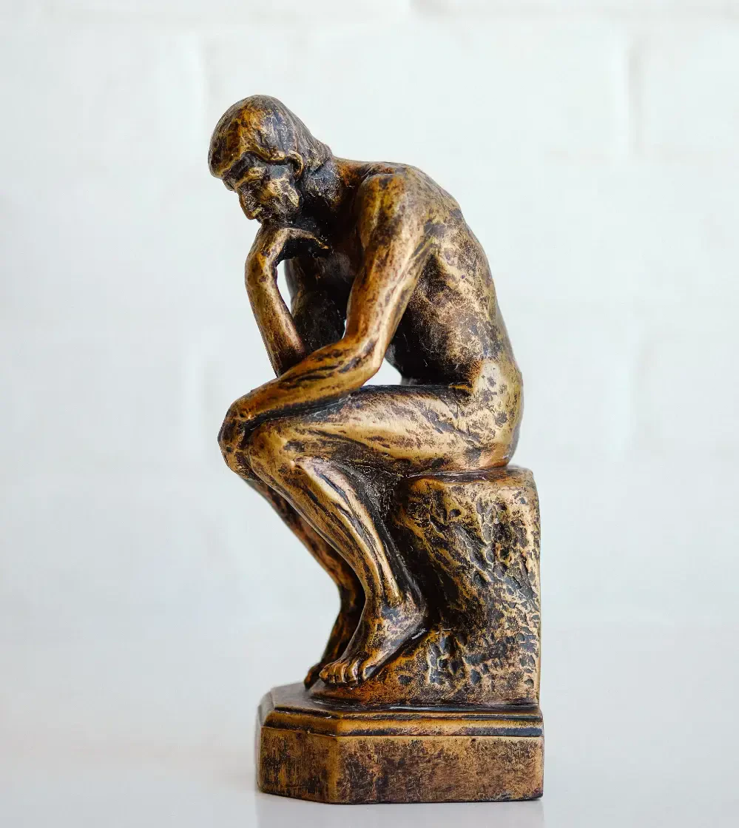
Wait a sec...

Slide 9
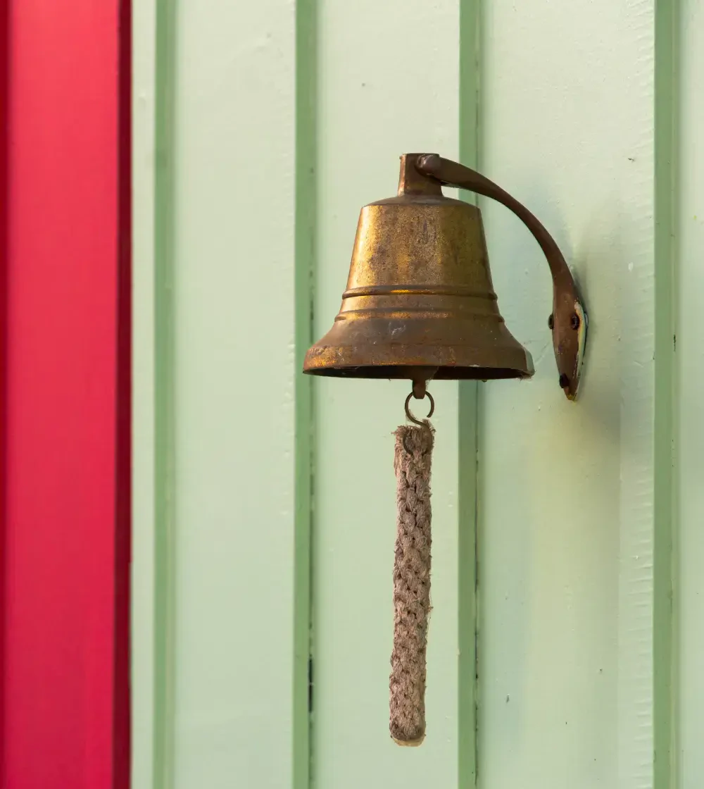
Ring a bell?

Slide 10
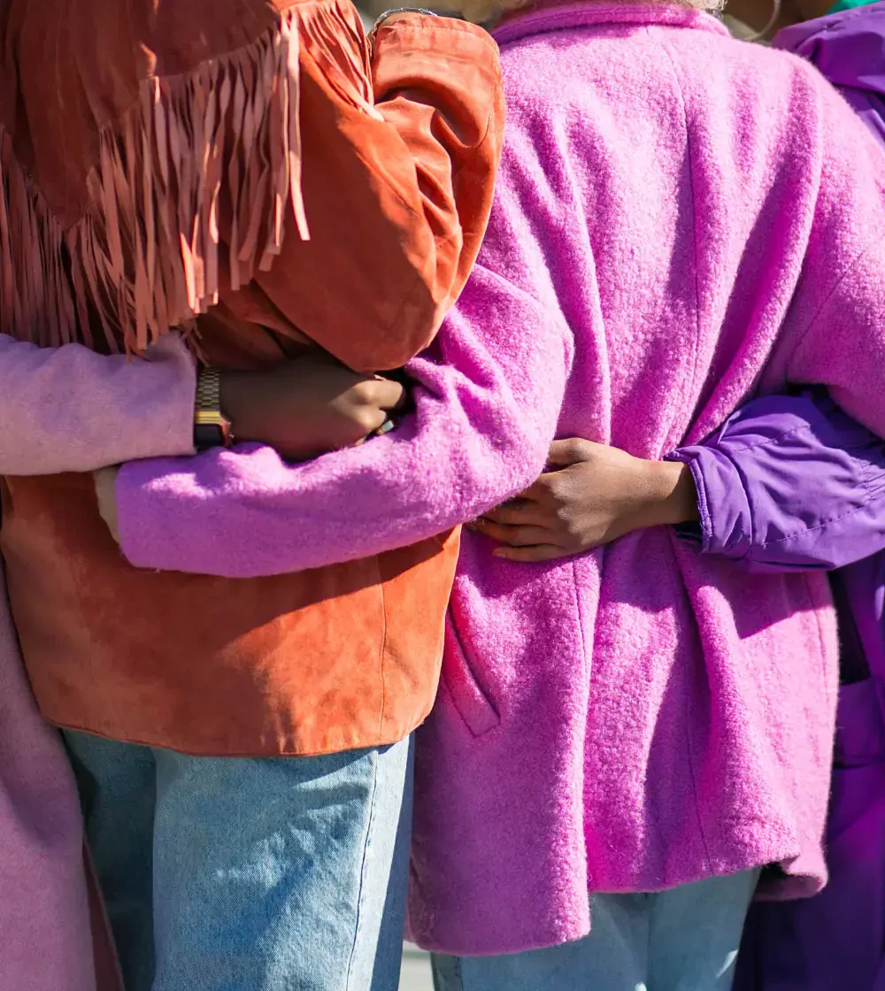
It's similar, not the
same!
The
Open
Source
development
model
is
similar
to
Remote
Working.
The
huge
difference
is
that
people
are
driven
by
passion
,
not
money.
You
are
not
their
boss!

Slide 11


Everybody is nice if
people are kind.
Passion
Maintainers love that you use their software.
Respect
They don't owe you anything. They are giving
you their
free
time.
Actions have consequences
Demanding fixes, features or simply attention
will push
people away.

Slide 12
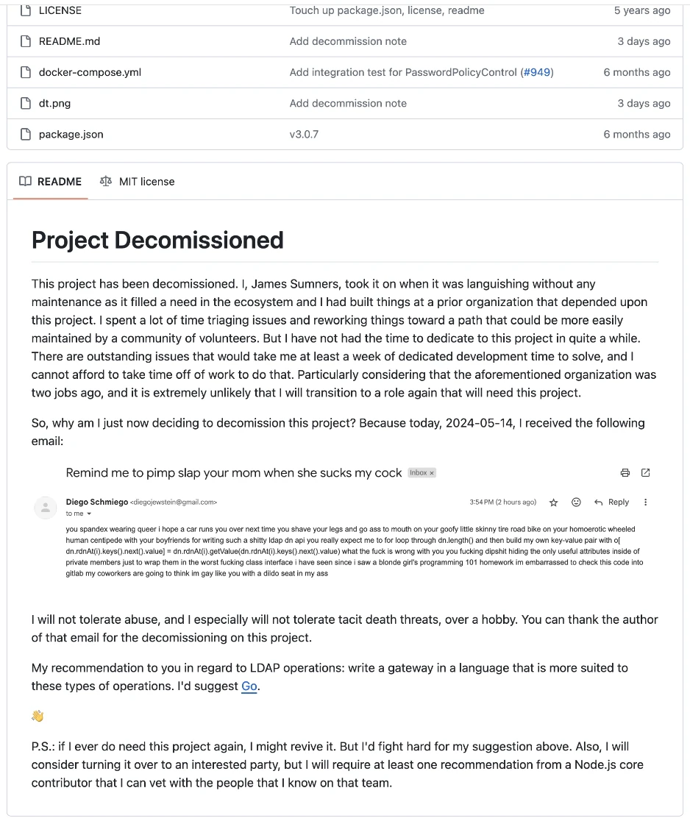
Avoid burnouts!
Needless
to
say,
people
have
sentiments
and
a
life
in
the
real
world.
Even
a
single
small
act
of
rudeness
can
burn
people
out
.

Slide 13

How do you
ask for help?

Slide 14
It all starts with a detailed search
1
Issues
The easier is to reproduce a problem, the higher the chance somebody already reported it.
2
PRs
Similarly to the above, somebody might already be working on it.
3
Code
Examples, tests or just the plain source code might already have the solution.
4
Documentation
Known workaround or out of scope problems are usually well documented.

Slide 15

Don't worry about overcommunicating
We are distributed
Working across the globe introduced delays.
We are different
Developers come from different cultures and expertises.
Time is finite
We all have our lives. We don't have time to request missing informations.

Slide 16
It is like journalism
1
Who and Where
This is usually implicit, but it's always better to be explicit.
2
What and When
Explain what happened, what did not happen and what were you expecting.
3
How
What is the smallest way to reproduce the problem?
This will return
.

Slide 17

Dude, you forgot
the
Why
!
No,
I
have
not
...

Slide 18



Narrow things down
Avoid flooding
Even if you don't worry to overcommunicate, you shouldn't just paste tons of output.
Keep focus
Reports with lots of superfluous information will likely distract the maintainer.
It's for your own good
The more superfluous information you give, the less the chance to see you problem solved.

Slide 19
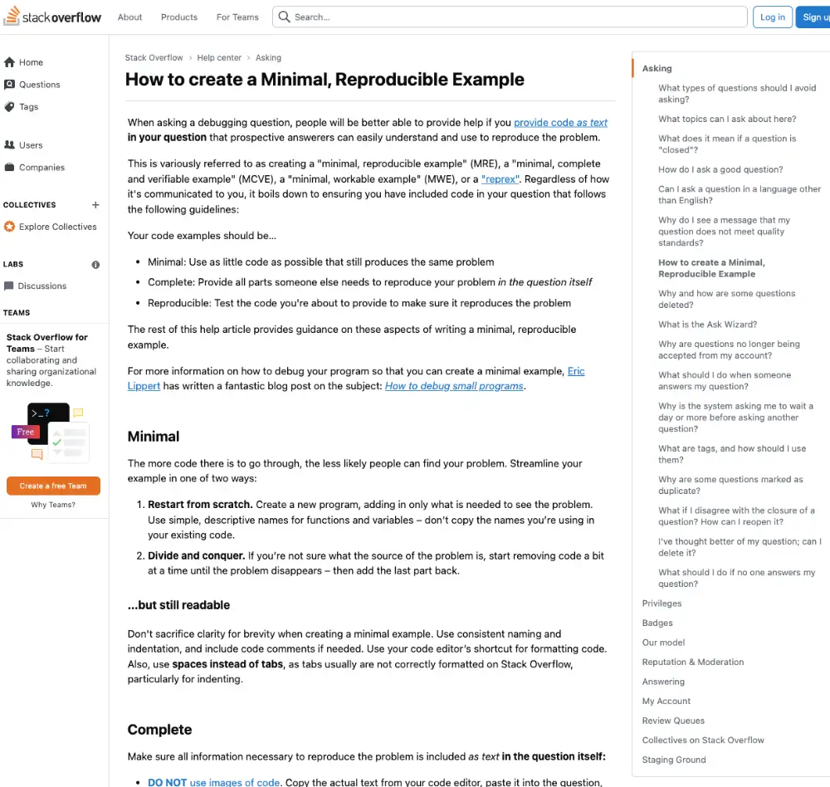


Reproducible repos
Reduce to the minimum
You want to rule out all irrelevant details.
Remove sensitive information
Nobody wants to get in trouble.
Provide a public repository
It will facilitate the triagers' work.

Slide 20



Follow up
Look out for clarification requests
The maintainer might need additional information in order to process the report.
Be heard
Following up on the report is your only way to give your feedback before it's too late.
Setup notifications
This is the easiest way to follow the discussion.

Slide 21

Contribute to the development
Engage
If you have the expertise you can propose to provide a PR.
Test
Once the issue has been reported fixed, test it right away.
Give feedback
Let the maintainer know if the issue is solved.

Slide 22
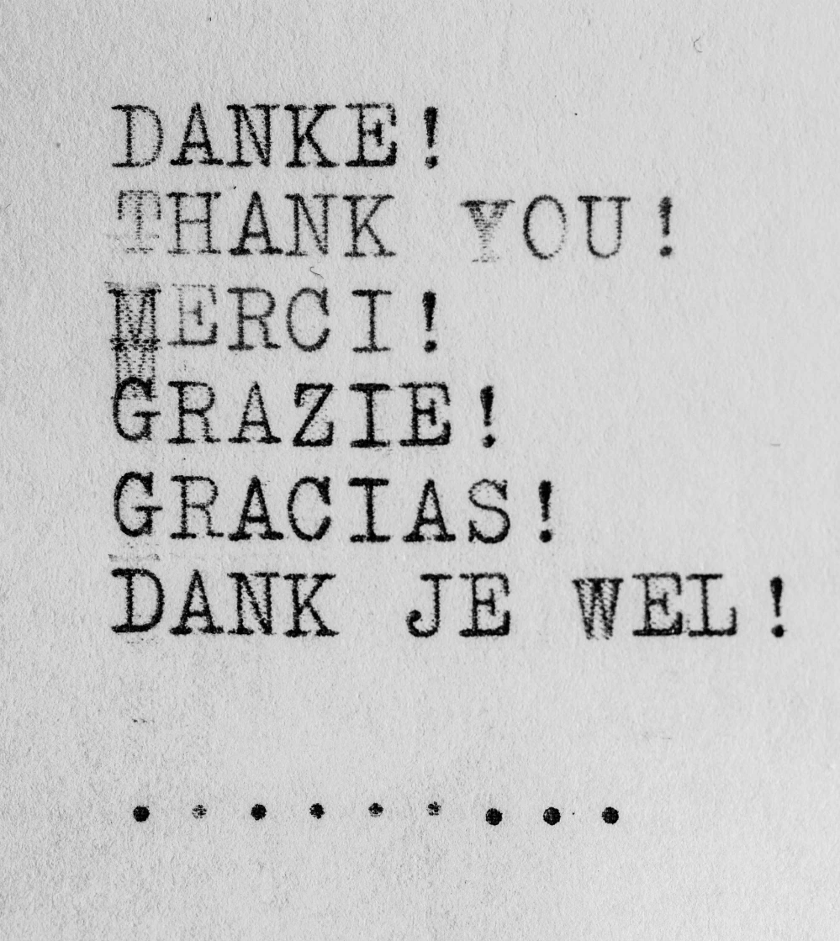
And don't forget to
thank them
!

Slide 23


One last thing™
“No act of kindness, no matter
how small, is ever wasted.”
Aesop

Slide 24
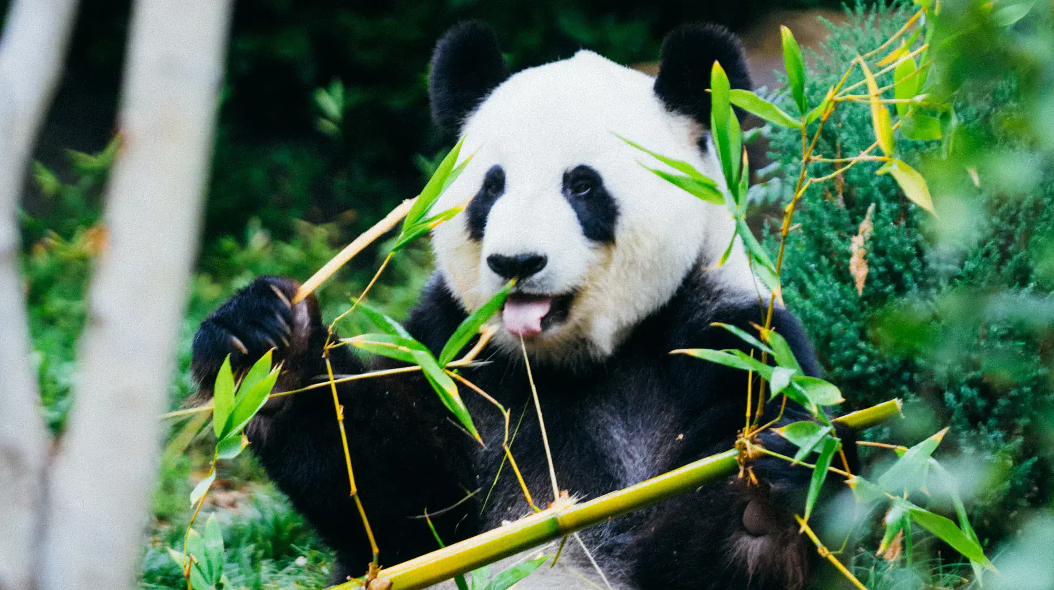
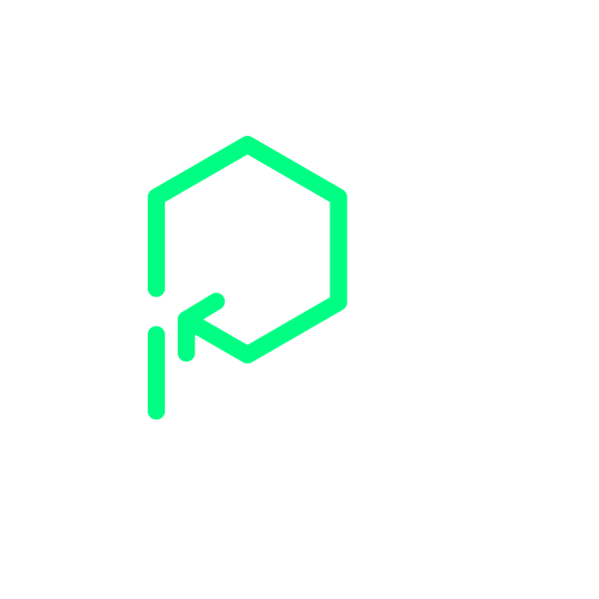
Thank you!
Paolo Insogna
@p_insogna
Platformatic
Node.js TSC, Principal Engineer
paolo.insogna@platformatic.dev

