Slide 1


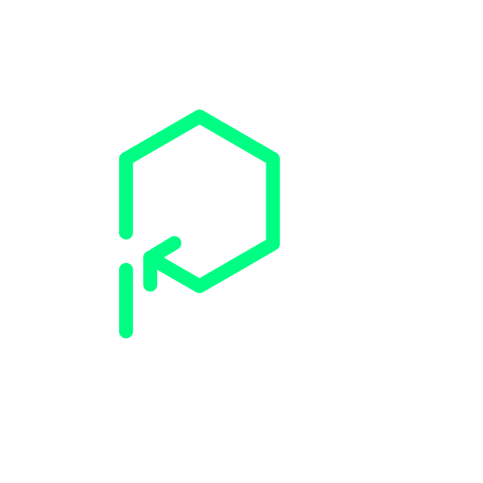



View online
Platformatic
Download PDF
Reimagining Kafka for Node.js
Paolo Insogna
Node.js TSC, Principal Engineer

Slide 2

Let's dive into
the unknown!

Slide 3






Hello, I'm
Paolo
!
Node.js
Technical Steering Committee Member
Platformatic
Principal Engineer
paoloinsogna.dev
ShogunPanda
p_insogna
pinsogna

Slide 4



Some companies trusting us
Article
Case Study
Case Study

Slide 5





Hello Apache Kafka!
A key component of the world
It is undoubtedly the backbone of modern
event-driven systems.
Used by the giants
Powers real-time data processing for
companies like Netflix, LinkedIn, and Uber.
Impressive performance
Millions of messages with minimal latency.

Slide 6



How does it work?
Brokers
Topics
Partitions
Kafka servers that store and serve
Named streams of records, like
Topics are split into partitions for
data across a distributed cluster.
channels for organizing messages.
parallelism and scalability.

Slide 7




How do we use it?
Producers
Applications that write/publish messages to Kafka topics.
Consumers
Applications that read/subscribe to messages from topics.
Consumer Groups
Consumers are organized into groups for load balancing.
Partition Assignment
Each partition is assigned to
only one
consumer within a group.

Slide 8



Kafka API Versioning
Dynamic versioning
Independent advancement
Protocol complexity
Evolution with backward
Each API has its own
Clients must handle multiple API
compatibility considerations.
independent version number.
versions and features.

Slide 9

That's a lot to
handle ...
...
especially
if,
like
me,
you
have
never
used
Kafka!
😂

Slide 10

...and it got much
worse! 😭

Slide 11



Where is your documentation?
No client building support
Low-level API documentation is scattered and incomplete.
KIP archaeology
You need to dig through Kafka Improvement Proposals (KIP) to understand APIs.
Implementation details hidden
Critical protocol details buried in JIRA tickets and mailing lists.

Slide 12

What about
Node.js?

Slide 13
There were already some solutions
node-rdkafka
KafkaJS
https://github.com/Blizzard/node-rdkafka
https://kafka.js.org/

Slide 14



node-rdkafka
import RDKafka from 'node-rdkafka'
const producer = new RDKafka.Producer(
{
'client.id': 'id',
'metadata.broker.list': 'localhost:9092',
dr_cb: true
}
)
producer.on('delivery-report', () => {
producer.disconnect()
})
producer.connect({}, () => {
producer.setPollInterval(1)
producer.produce(
'topic', 0,
Buffer.from('value'), 'key',
-1, null,
[{ a: '123', b: '456' }]
)
})
Native dependency
Based on native C library (librdkafka).
Compatibility issues
No Worker Threads support.
Cumbersome API
The API is clunky and hard to use.

Slide 15


KafkaJS
Abandoned
import { Kafka } from 'kafkajs'
const client = new Kafka({
clientId: 'id', brokers: ['localhost:9092']
})
const consumer = client.consumer({
groupId: 'group'
})
await consumer.connect()
await consumer.subscribe({ topics: ['topic'] })
await consumer.run({
async eachMessage ({ message}) {
console.log('Received message', message)
return consumer.disconnect()
}
})
It has not been maintained in the last years.
Latest Kafka features missing
Incomplete protocol support due to inactivity.
Complex and unperformant API
Caused to unnecessary memory allocation.

Slide 16

We needed a
better solution ...

Slide 17

... so we
started fresh!

Slide 18

Hello
@platformatic/kafka
!
A
modern,
easy
to
use
and
high-performance
Kafka
client
for
Node.js
https://github.com/platformatic/kafka

Slide 19

How did we build a
client with no
documentation
available?

Slide 20



AI to the Rescue
Documentation synthesis
AI synthesized scattered information into coherent implementation guides.
Hallucinations were common
So the information had to be fact-checked. But it was still faster than manual research.
Life Saver
Without AI assistance, this project would have taken months longer.

Slide 21



Design Principles
The developer is the center
Performance matters
TypeScript first
We prioritized developer
We avoided unnecessary memory
Our first Typescript experiment.
experience above all.
allocations and copies.
Big thanks to
type stripping
.

Slide 22


Integrated Serialization and Deserialization
Type-safe
Cached (de)serializers
Zero copying overhead
The package is typed end-to-end.
This leads to massive V8
Avoids unnecessary data copying
Your IDE will love it.
optimizations.
during (de)serialization process.

Slide 23


One consuming semantic: Node.js Streams
Stream-only architecture
Built
exclusively
around Node.js streams for optimal performance.
Multiple consumption patterns
Supports callback, promise-based, and
AsyncIterable
approaches.
Natural fit
Perfect integration with Node.js ecosystem.

Slide 24



Benefits of Node.js Streams
Memory efficiency
Process large datasets without loading everything into memory.
Backpressure handling
Automatic flow control prevents overwhelming downstream processes.
Error propagation
Built-in error handling and graceful failure management.

Slide 25

Every medal has two faces!
Dual API on the outside ...
... only callbacks on the inside!
Supports both callbacks and
Not a single promise is used internally.
promises externally for flexibility.
Are we in 2015 again? 🤦‍♂️

Slide 26

Show the code!

Slide 27
Producer API
import { Producer, ProduceAcks, stringSerializers } from '@platformatic/kafka'
const producer = new Producer({
clientId: 'id',
bootstrapBrokers: 'localhost:9092',
serializers: stringSerializers
})
await producer.send({
messages: [
{ key: 'key', value: 'value', headers: { a: '123', b: '456' } }], acks: 0 })
],
acks: ProduceAcks.NO_RESPONSE
})
console.log('The message has been delivered')
await producer.close()

Slide 28
Consumer API
import { Consumer, stringDeserializers } from '@platformatic/kafka'
const consumer = new Consumer({
clientId: 'id', group: 'group',
bootstrapBrokers: 'localhost:9092', deserializers: stringDeserializers
})
const stream = await consumer.consume({ topics: ['topic'] })
// Since streams are AsyncIterable, both following approaches are possible
stream.on('data', message => {
console.log('Received message', message)
stream.close(true)
})
// The stream will be implicitly destroyed after exiting the loop
for await (const message of stream) {
console.log('Received message', message)
break
}
await consumer.close()

Slide 29

What about
performance?

Slide 30
Producer API
--------------------------------------------------------------------------------------------------------------------
| Slower tests | Samples | Result | Tolerance | Difference with previous |
--------------------------------------------------------------------------------------------------------------------
| node-rdkafka | 100000 | 17452.32 op/sec | ± 18.42 % | |
| @confluentinc/kafka-javascript (KafkaJS) | 100000 | 20215.32 op/sec | ± 13.10 % | + 15.83 % |
| @confluentinc/kafka-javascript (node-rdkafka) | 100000 | 20771.13 op/sec | ± 12.69 % | + 2.75 % |
| KafkaJS | 100000 | 61877.92 op/sec | ± 0.67 % | + 197.90 % |
--------------------------------------------------------------------------------------------------------------------
| Fastest test | Samples | Result | Tolerance | Difference with previous |
--------------------------------------------------------------------------------------------------------------------
| @platformatic/kafka | 100000 | 95039.18 op/sec | ± 0.71 % | + 53.59 % |
--------------------------------------------------------------------------------------------------------------------

Slide 31
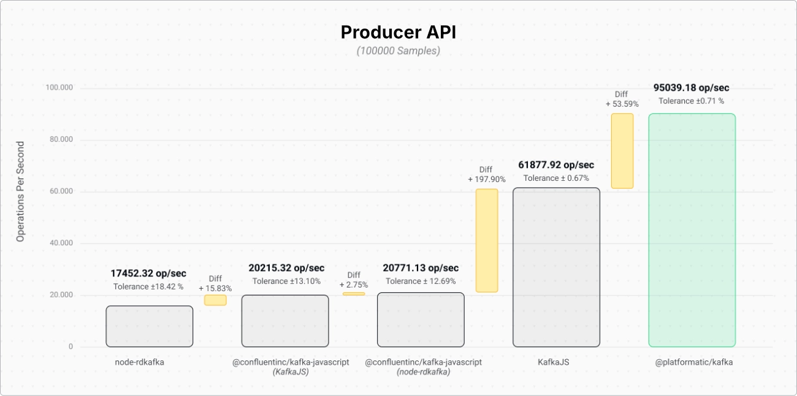
Producer API

Slide 32
Consumer API
----------------------------------------------------------------------------------------------------------------
| Slower tests | Samples | Result | Tolerance | Difference with previous |
----------------------------------------------------------------------------------------------------------------
| node-rdkafka (stream) | 100000 | 49423.52 op/sec | ± 6.63 % | |
| @confluentinc/kafka-javascript (stream) | 100000 | 55990.54 op/sec | ± 10.58 % | + 13.29 % |
| @confluentinc/kafka-javascript (KafkaJS) | 100000 | 123289.64 op/sec | ± 16.86 % | + 120.20 % |
| @confluentinc/kafka-javascript (evented) | 100000 | 125986.77 op/sec | ± 23.14 % | + 2.19 % |
| KafkaJS | 100000 | 126963.99 op/sec | ± 4.15 % | + 0.78 % |
| node-rdkafka (evented) | 100000 | 135950.87 op/sec | ± 19.03 % | + 7.08 % |
----------------------------------------------------------------------------------------------------------------
| Fastest test | Samples | Result | Tolerance | Difference with previous |
----------------------------------------------------------------------------------------------------------------
| @platformatic/kafka | 100015 | 152567.14 op/sec | ± 1.48 % | + 12.22 % |
----------------------------------------------------------------------------------------------------------------

Slide 33
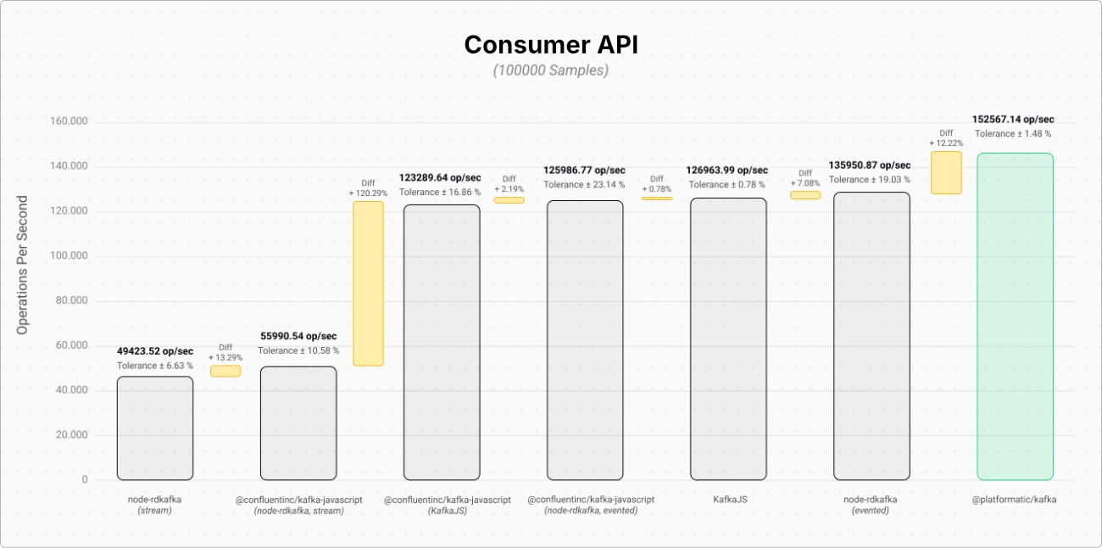
Consumer API

Slide 34


One last thing™
“Paths are made by walking.”
Franz Kafka

Slide 35

Thank you!
Paolo Insogna
@p_insogna
Platformatic
Node.js TSC, Principal Engineer
paolo.insogna@platformatic.dev

