Slide 1






View online
Download PDF
Node.js HTTP parser, what's going on?
Paolo Insogna
Node.js TSC, Principal Engineer @
Platformatic

Slide 2

Nothing
beats a classic!

Slide 3






Hello, I'm
Paolo
!
Node.js
Technical Steering Committee Member
Platformatic
Principal Engineer
paoloinsogna.dev
ShogunPanda
p_insogna
pinsogna

Slide 4

We all love HTTP!

Slide 5

Which HTTP
are you?

Slide 6
The choice is narrow
Even
if
the
HTTP
protocol
is
more
than
30
years
old,
only
three
current
versions
of
it
exist
as
of
today.
The
others
are
considered
obsolete.
1
HTTP/1.1
The last version of the initial protocol. By far the most famous and most used.
2
HTTP/2
Developed on top of SPDY to remove some problems of HTTP.
3
HTTP/3
Developed on top of QUIC to solve TCP problems.

Slide 7



HTTP/1.1: Can't beat a classic
The grandparent
Developed in 1989 and by far the mostly used (80% of websites).
Textual protocol
Parsing can be easily implemented in any language.
Keep-Alive and FIFO pipelining
A single TCP connection can be reused.

Slide 8


HTTP/2: Don't break too much
The parent
Development started in 2012 and end up being standardized in 2015.
Baby-steps
The semantics are the same, only the TCP connection usage has changed.
Multiplexing and real parallelism
It uses a SPDY derived communication protocol for better multiplexing.

Slide 9


HTTP/3
The sibling
Development started in 2018 and end up being standardized in 2022.
Farewell, TCP!
QUIC is now used, which means HTTP has switched to UDP.
No head of line blocking
Using multiplexing over UDP minimizes problems introduced by lost packets.

Slide 10
What about Node.js?
1+2
3
HTTP/1.1 and HTTP/2
HTTP/3
Node.js has a stable implementation.
Work in progress,
stay tuned!

Slide 11

Let's focus!

Slide 12
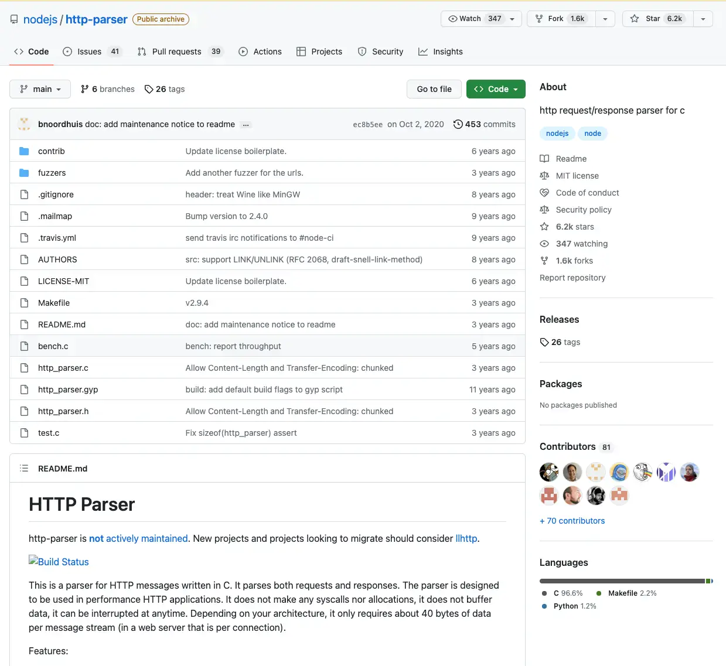
The original parser
http_parser
was
the
original
HTTP/1.1
parser
of
Node.js
It
existed
since
the
early
days
of
Node.js
and
it
was
one
of
its
oldest
dependencies.

Slide 13



http_parser: the goods
Good performance
The original parser had good performance, around 1.5 million requests per second.
Lenient
It supported both HTTP/0.9, HTTP/1.0 and HTTP/1.1 specs and non compliant clients.
Well tested
It had a comprehensive and battle tested test suite.

Slide 14



http_parser: the bads
Written in C
It is not the most user friendly language.
Hard to maintain
Over the course of ten years, the codebase became unmaintainable.
Vulnerability-prone
The maintainability problem made it also hard to promptly address bugs and vulnerabilities.

Slide 15
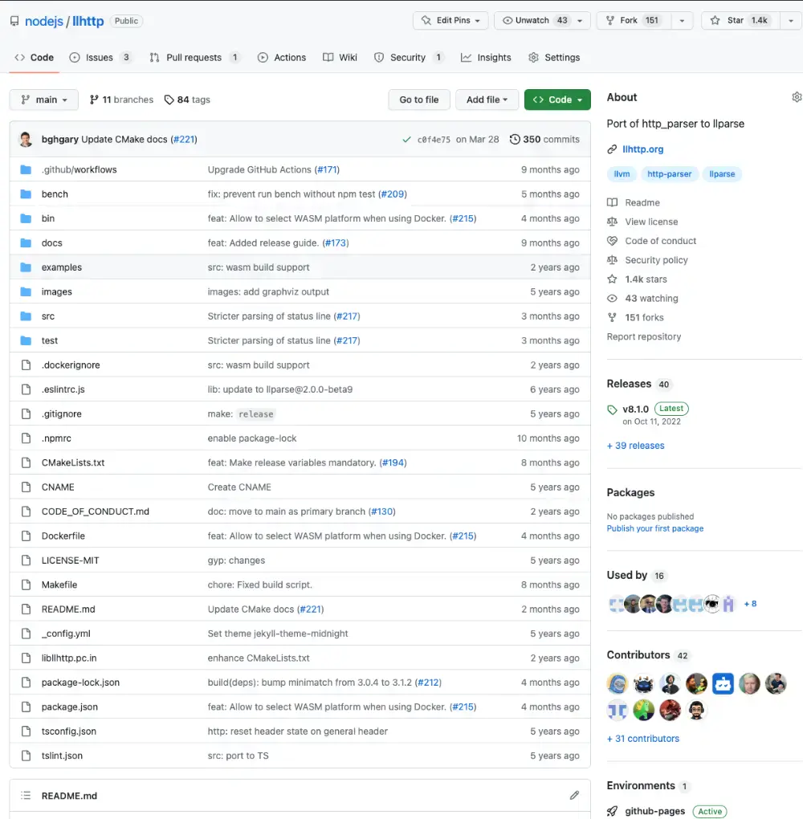
The current parser
llhttp
is
the
current
HTTP
parser.
Written
by
Fedor
Indutny
in
2019,
is
the
default
since
Node.js
12.

Slide 16

How does it work?
llhttp
is
a
state
based
HTTP
parser
based
on
llparse.
llparse
is
capable
to
generate
a
very
performant
C
code
out
of
a
TypeScript
description
of
the
possible
states.

Slide 17

Wait, what?!

Slide 18

Yes, you
got it right!

Slide 19
There's more!
The
http_parser
test
suite
has
been
ported
### Invalid HTTP version with lenient
```http
GET / HTTP/5.6
```
```log
off=0 message begin
off=0 len=3 span[method]="GET"
off=3 method complete
off=4 len=1 span[url]="/"
off=6 url complete
off=11 len=3 span[version]="5.6"
off=14 version complete
off=18 headers complete method=1 v=5/6 flags=0 content_length=0
off=18 message complete
```
and
extended
in
llhttp.
The
test
suite
is
now
described
in
Markdown
,
transpiled
at
runtime
to
a
C
source
code
and
then
compiled
and
executed.

Slide 20

That's a genius
in action!

Slide 21
llhttp: what's wrong with it?
Hard to debug and release
The transpilation makes hard to debug issues.
Backward compatibility
Supporting obsolete versions of HTTP introduces unneeded complexity.
You give them a finger, they take the arm
Leniency-prone approach opens the door for a lot of edge cases.

Slide 22

Where are
the docs?

Slide 23

Do we have the
solution?

Slide 24

Yes, start fresh!

Slide 25


Keep the goods
Piece of art design
Testability
llhttp has a wonderful
The test suite is invaluable
and performant architecture.
to ensure correctness.

Slide 26



What shall we change?
Better transpilation
Use a higher level language
Modern and strict
Try to transpile to a human
Rust is a good candidate that can
Only support latest HTTP/1.1
readable form and then generate
be used for both developer input
standard (RFC 9110) and initially
static libs and include headers.
and transpilation output.
have no leniency logic.

Slide 27

Work in progress,
stay tuned!

Slide 28


One last thing™
“If there is no struggle,
there is no progress.”
Frederick Douglass

Slide 29


Thank you!
Paolo Insogna
@p_insogna
Platformatic
Node.js TSC, Principal Engineer
paolo.insogna@platformatic.dev

