Slide 1






View online
Download PDF
Don’t break GraphQL, extend it!
Paolo Insogna
Node.js TSC, Principal Engineer @
Platformatic

Slide 2

Being kind
never hurts!

Slide 3






Hello, I'm
Paolo
!
Node.js
Technical Steering Committee Member
Platformatic
Principal Engineer
paoloinsogna.dev
ShogunPanda
p_insogna
pinsogna

Slide 4
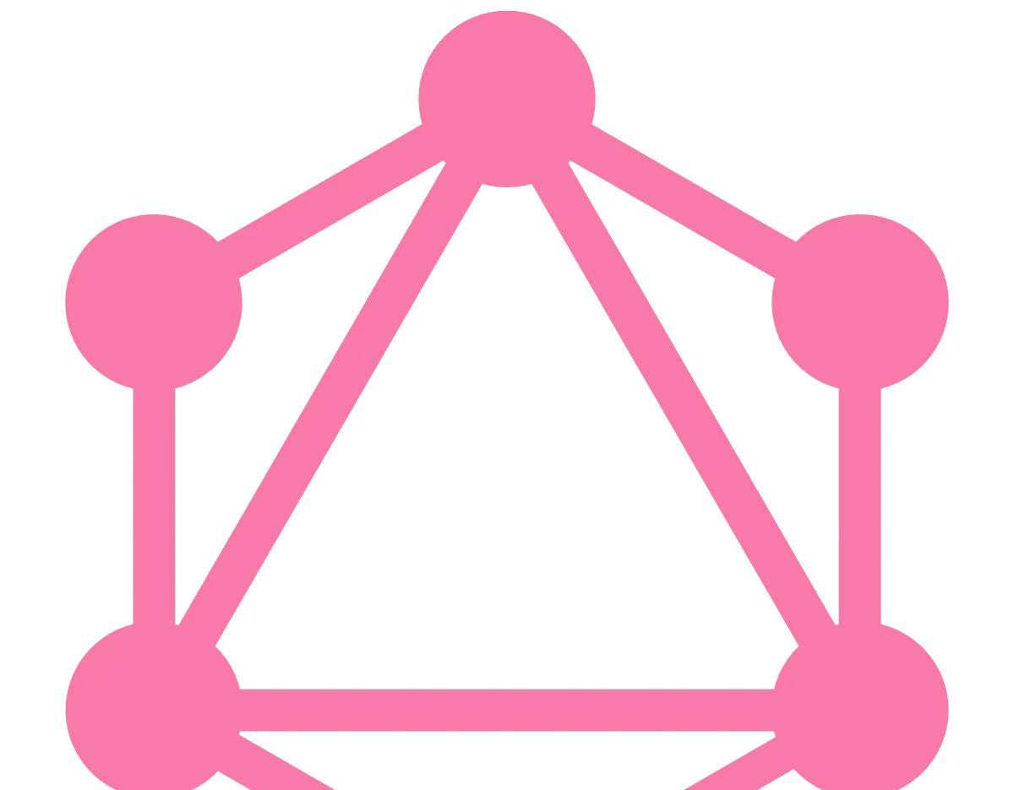
Let's celebrate GraphQL!
We
all
know
how
this
technology
has
made
our
life
easier.

Slide 5



Why is it good?
Many resources, less overhead, expressive language
You can ask for multiple resources in a single request and save network bandwidth.
No overfetching or underfetching
The server will return exactly the data we asked for.
This will return.
Federation
Multiple schemas can be easily joined.

Slide 6


Federation
Split the schema in subgraphs
This is great for separation of concerns.
Integration with remote services
Each subgraph is handled by a separate service, possibly remote.
Only works with GraphQL service
You can't directly integrate with REST APIs or similar.

Slide 7



Serialization
GraphQL does not enforces a serialization format
Developers are free to use whatever they want to.
The network stack is your choice
Neither the data format or the transfer protocol are mandated by the spec.
Let's face the honest truth
99% (total arbitrary) of the times we are talking about JSON data exchanged over HTTP.

Slide 8
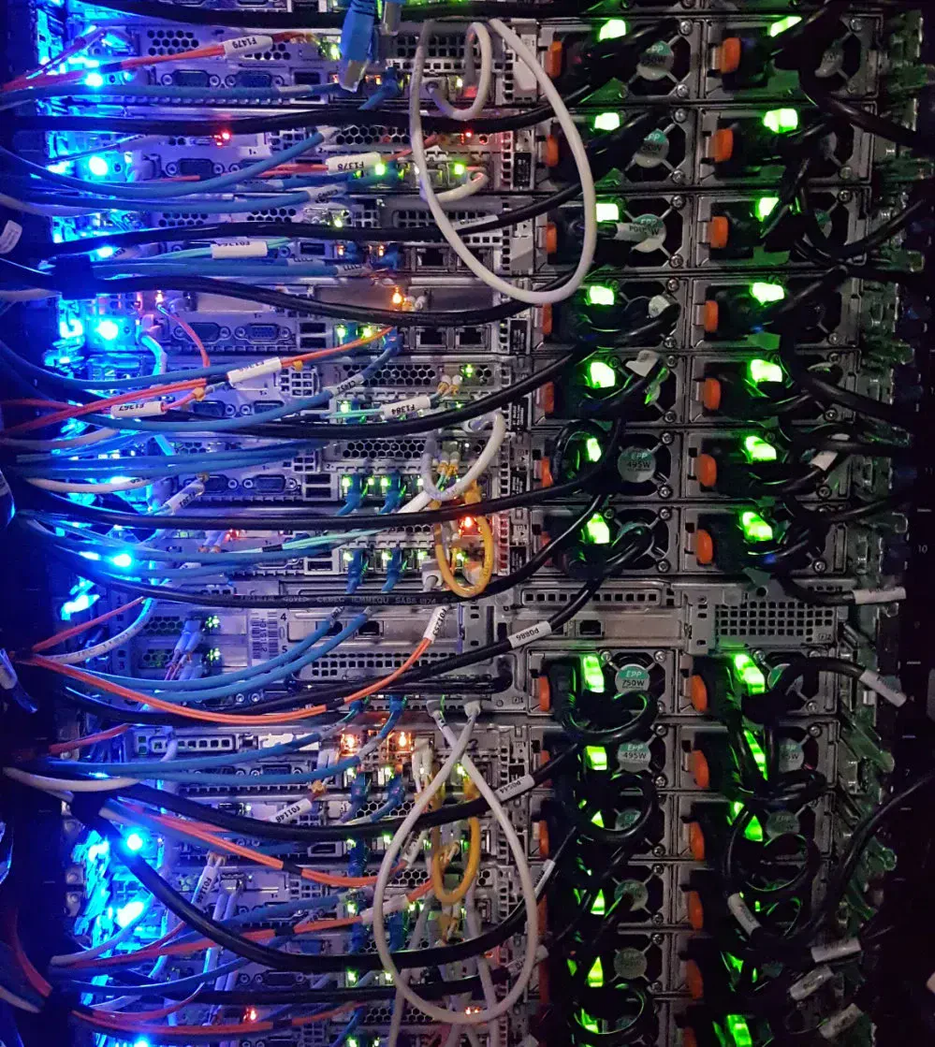
The server knows
it better
It's
relative
easy
to
attach
new
data
sources
to
the
server.
How
to
push
additional
data
to
a
client
that
didn't
ask
for
it?

Slide 9

How to be
proactive?

Slide 10
Happy case: we control everything
1
Add new data to the server's schema
You should not break backward compatibility.
2
Verify the clients are still working
Double checking that nothing broke is never a bad choice.
3
Update the clients
Update queries in the client to use the new data.

Slide 11

Are we done?

Slide 12

You already know
the answer...

Slide 13


The happy case is mostly theoretical
You have to be in control of the clients
You also have to consider users that don't usually upgrade their applications often.
Nothing can go out of sight
If even a single component is not updated at the right time, compatibility problems will arise.
Specification will be broken
Even if the client is able to handle data it didn't ask for,
we are breaking the specification
.

Slide 14
BAD!
DON'T!

Slide 15

Do we have a
choice?

Slide 16

Yes, let's make
an
enriching
proxy!

Slide 17

Check it out!
We
can
reuse
parsing
and
serialization
from
the
reference
GraphQL
Javascript
implementation.
https://github.com/ShogunPanda/graphql-enrich-proxy

Slide 18
How it works
1
Analyze the query
Parse and validate the query received by the client. In case of request error, stop here.
2
Ensure types information with temporary modifications
Each selection set must contain the type to give all information to the enriching handler.
3
Execute the query
This can be done directly on the server or we can create an enriching GraphQL proxy server.
4
Fetch the additional data
Using a tree traversal algorithm, fetch additional data for each field according to the handler.
5
Enrich the response
Store the additional data in the extensions field, using the JSONPath selector as the key.

Slide 19


Meet GraphQL extensions
The
extensions
field
is
already
documented
in
the
specification
and
it's
perfect
to
ensure
both
compatibility
and
expandability.
Extensions are for developers
Existing clients will ignore them
The specification states that the field is
Unaware clients will ignore the field and the
reserved for developers.
server is still specification compliant.

Slide 20
Overview
import fastify from 'fastify'
import { parse, print, visit } from 'graphql/language/index.js'
/* ... */
server.post('/graphql', async function handleQuery(req, reply) {
// Step 1: Parse the query and check for syntax error
const document = parse(req.body.query)
// Step 2: Add types information to the query
const [enrichedAst, enrichedId] = addTypesInformation(document)
// Step 3: Execute the query on the upstream
const response = await graphql('https://api.geographql.rudio.dev', print(enrichedAst))
// Step 4 and 5: Execute the enriching handler to fetch additional data
const extensions = await enrich(response.data, enrichedId, addWeatherInformation)
// Return to the client
return { ...response, extensions: { ...response.extensions, ...extensions }}
})

Slide 21

Leveraging types
We
make
sure
__typename
is
in
all
selection
sets
so
we
can
easily
parse
the
query test {
hero {
__typename
name
friends {
__enriched: __typename
name
homeglobe {
aliasedType: __typename
__enriched: __typename
name
climate
}
}
}
}
response.
The added fields are temporary
Never return these to the client.
Leverage field aliasing
Use it to easily spot the fields added.

Slide 22
Ensuring type
information
function injectedTypeField(id) {
return {
kind: 'Field',
alias: { kind: 'Name', value: id },
name: { kind: 'Name', value: '__typename' }
}
}
function addTypesInformation(document) {
const injectedFieldId = `enrichType_${Date.now()}`
const injectedField = injectedTypeField(injectedFieldId)
const updatedDocument = visit(document, {
SelectionSet(node) {
// Check if the type is already included unaliased
for (const f of node.selections) {
if (f.name.value === '__typename' && !f.alias) {
return
}
}
// If we got there, we still have to add the typename
node.selections.unshift(injectedField)
return node
}
})
return [updatedDocument, injectedFieldId]
}
The
visit
API
and
the
AST
from
the
GraphQL
reference
implementation
makes
our
life
very
easy.

Slide 23


Cache the queries
Parsing
and
executing
GraphQL
is
expensive.
Cache
them
when
possible.
Cache the original query…
…and the enriched query
This also includes invalid queries as it will
Traversing a complex query to ensure types
speed up the handling of misbehaving clients.
information can be time consuming.

Slide 24
Let me introduce two friends...

Slide 25
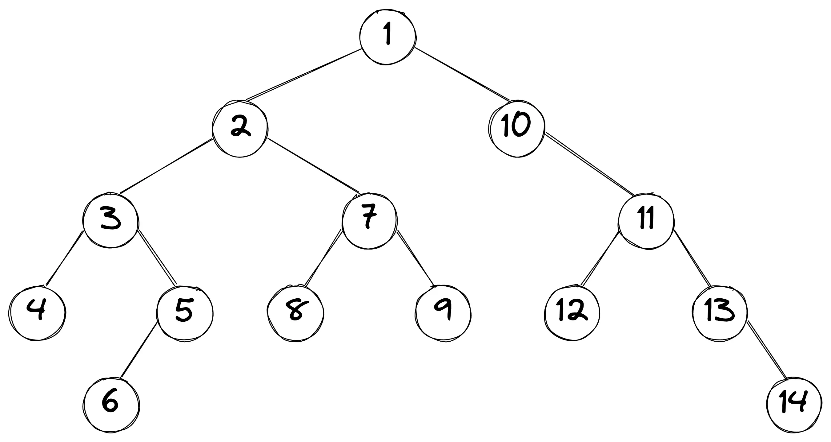
Depth first tree traversal

Slide 26
JSONPath
It
is
a
string
syntax
for
selecting
and
extracting
values
within
a
JSON
value.
shogun@panda:~/example$ cat example.json
{
"countries": [
{ "name": "Iceland", capital: "Reykjavík", },
{ "name": "Italy", capital: "Roma" }
]
}
shogun@panda:~/example$ jq ".countries[1].capital" example.json
"Roma"
Well known
You are already using JSONPath or a
similar syntax.
Easily implementable
The syntax is easy to understand and
implement.

Slide 27
... and now the show goes on!

Slide 28
Enrich the data
async function enrich(data, enrichedId, handler) {
const extensions = {}
await traverse(data, async function (value, path) {
// Execute the handler on the node
// and eventually add the returned data
const additional = await handler(
value.__typename || value[enrichedId],
path,
value
)
if (additional) {
const jsonPath = path
.join('.')
.replace(/\.(\d+)\./g, '[$1].')
extensions[jsonPath] = additional
}
// Make sure we remove any fields we added
value[enrichedId] = undefined
})
return extensions
}
We
traverse
the
upstream
response,
executing
the
handler
on
each
node.
If
data
is
returned
from
the
handler,
we
append
to
the
extension
using
JSONPath.

Slide 29
Tree traversal
async function traverse(current, path, visitor) {
// This is to handle the initial call
if (typeof path === 'function') {
visitor = path
path = ['$']
}
// First of all, call the visitor on the current object
await visitor(current, path)
// For each enumerable property in the object,
// perform a depth first traverse of the property
// if it is an array of objects or an object.
for (const [key, val] of Object.entries(current)) {
if (Array.isArray(val)) {
for (let i = 0; i < val.length; i += 1) {
await traverse(val[i], path.concat(key, i), visitor)
}
// Say thanks to JS typing for the null checking
} else if (typeof val === 'object' && val !== null) {
await traverse(val, path.concat(key), visitor)
}
}
}
Implementing
a
depth
first
tree
traversal
is
quite
easy
when
using
recursion.

Slide 30
Fetch additional data
async function addWeatherInformation(type, path, value) {
if (type !== 'City') {
return
}
// Get weather information for today for the city
const response = await undici.request(
'https://goweather.herokuapp.com',
{
method: 'GET',
path: `/weather/${value.name}`,
dispatcher: agent
}
)
const body = JSON.parse(await getStream(response.body))
return response.statusCode === 200
? { temperature: body.temperature }
: {
error: {
statusCode: response.statusCode,
body
}
}
}
Using
the
type
and/or
the
path
we
can
choose
whether
the
node
needs
additional
data.

Slide 31

Only an example
can enlighten us!

Slide 32
Input query
{
country(iso2: "US") {
aliasedType: __typename
name
cities(page: {first: 2}) {
__typename
edges {
node {
name
}
}
}
}
}

Slide 33
Query executed from the upstream
{
enrichType_1677506561773: __typename
country(iso2: "US") {
enrichType_1677506561773: __typename
aliasedType: __typename
name
cities(page: {first: 2}) {
__typename
edges {
enrichType_1677506561773: __typename
node {
enrichType_1677506561773: __typename
name
}
}
}
}
}

Slide 34
Upstream response
{
"data": {
"enrichType_1677506561773": "Query",
"country": {
"enrichType_1677506561773": "Country",
"aliasedType": "Country",
"name": "United States",
"cities": {
"__typename": "CityConnection",
"edges": [
{
"enrichType_1677506561773": "CityEdge",
"node": {
"enrichType_1677506561773": "City",
"name": "Abbeville"
}
},
{
"enrichType_1677506561773": "CityEdge",
"node": {
"enrichType_1677506561773": "City",
"name": "Alabaster"
}
}
]
}
}
}
}
It
contains
the
enriched
type
information
that
will
be
removed
from
the
final
response.

Slide 35
Proxy response (1/2)
{
"data": {
"country": {
"aliasedType": "Country",
"name": "United States",
"iso": "US",
"cities": {
"__typename": "CityConnection",
"edges": [
{
"node": {
"name": "Abbeville"
}
},
{
"node": {
"name": "Adamsville"
}
}
]
}
}
},
"extensions": {
/* ... */
}
}
The
client
will
receive
the
original
data
requested
...

Slide 36
Proxy response (2/2)
...and
all
our
enriched
data
is
in
the
{
"data": {
/* ... */
},
"extensions": {
"$.country.cities.edges[0].node": {
"temperature": "+5 °C"
},
"$.country.cities.edges[1].node": {
"error": {
"statusCode": 404,
"body": {
"message": "NOT_FOUND"
}
}
}
}
}
extensions
field.

Slide 37


Mission completed!

Slide 38



Take home lessons
What
can
we
learn
from
this
long
journey?
Read the specification
Be compliant
Analyse the environment
The specifications are formal and
Even if peers are lenient with
Even if you develop the experience
verbose but they
might already
specification break, they might
end to end, you will never be able
contain what you need
.
stop at any time.
Don't risk!
to
control everything
.

Slide 39


One last thing™
“You are remembered for
the rules you break.”
Douglas MacArthur

Slide 40


Thank you!
Paolo Insogna
@p_insogna
Platformatic
Node.js TSC, Principal Engineer
paolo.insogna@platformatic.dev

