Slide 1






Platformatic
View online
Fighting the imposter:
from nowhere in Molise
Download PDF
to Node.js contributor
Paolo Insogna
Node.js TSC, Principal Engineer

Slide 2
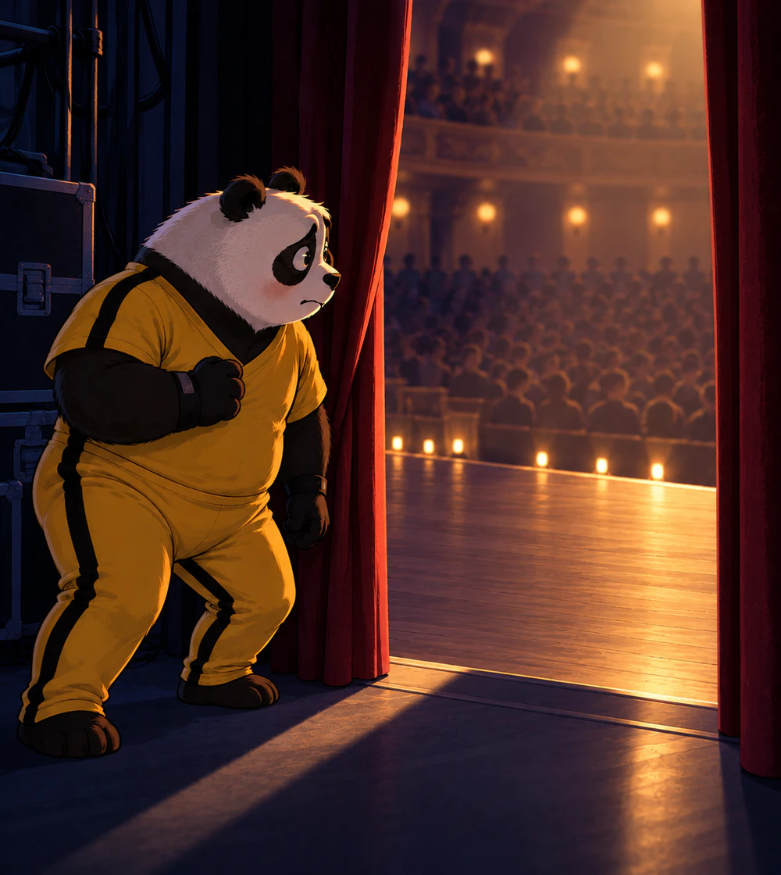
"Somebody else
should be here."

Slide 3






Hello, I'm
Paolo
!
Node.js
Technical Steering Committee Member
Platformatic
Principal Engineer
paoloinsogna.dev
ShogunPanda
p_insogna
pinsogna

Slide 4



Some companies trusting us
Article
Case Study
Case Study

Slide 5
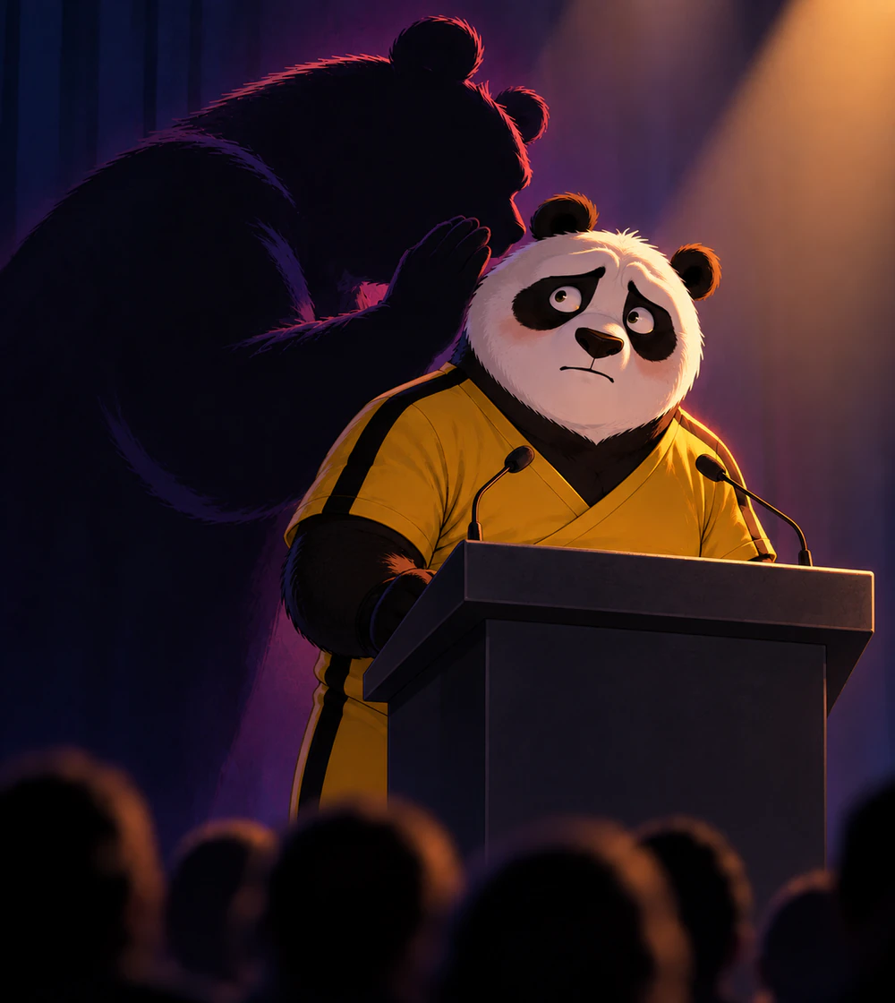
That voice
is always here.

Slide 6
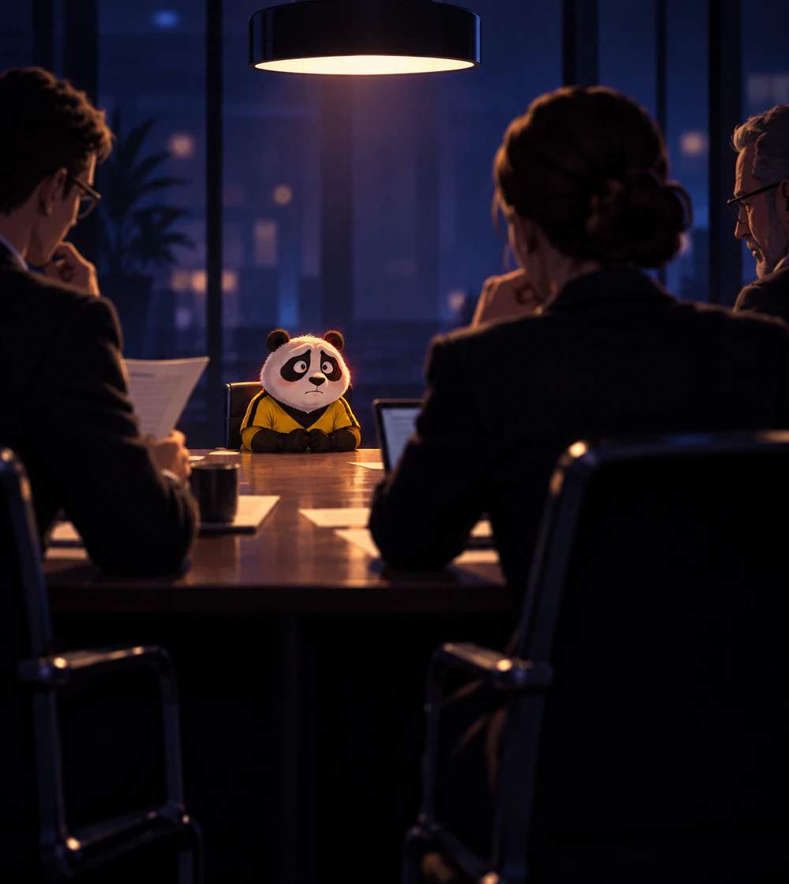
"What if they
find out?"

Slide 7

"It was just
luck
."

Slide 8
What does that
voice stop you
from
doing
?

Slide 9


Let me tell you
MY
story.

Slide 10
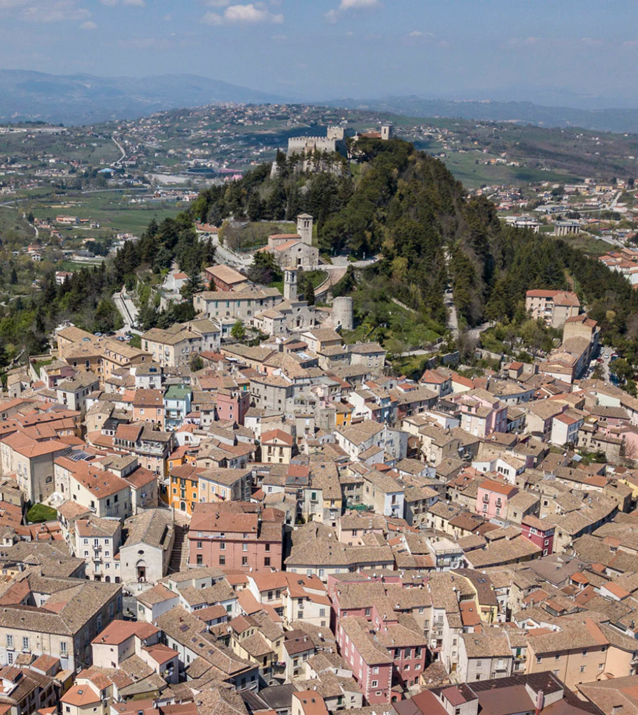
From nowhere
in Molise.
Born
in
1984
in
Campobasso

Slide 11

Computer
Engineering
Tor
Vergata,
Rome
·
2006

Slide 12
And then,
back home.
2009

Slide 13

Someone believed I could do
more
.

Slide 14

Viralheat,
H-1B visa
Foster
City,
CA,
USA
·
2012

Slide 15
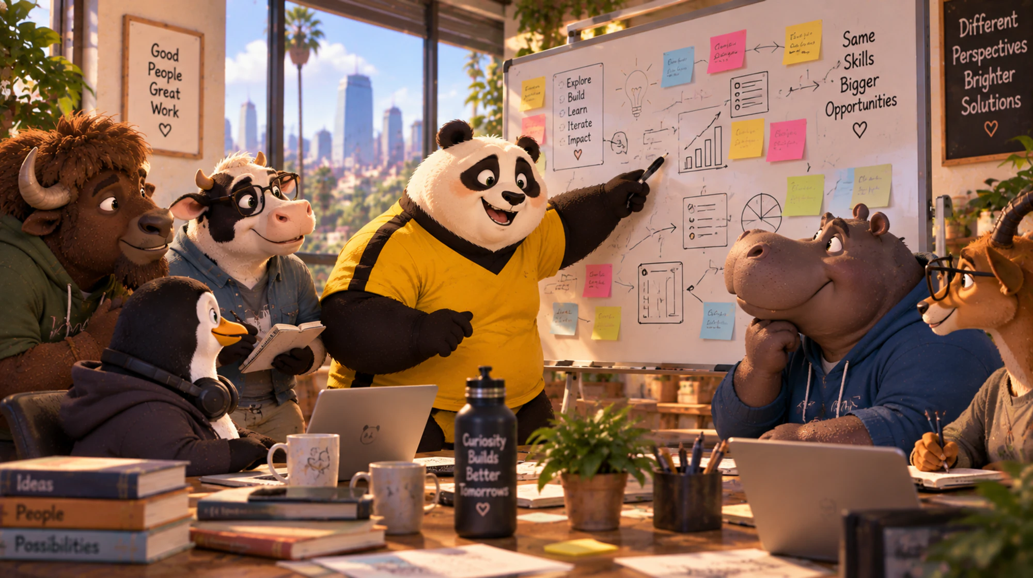
What did I find there?

Slide 16
Back in Italy,
working remotely.
2016

Slide 17

Senior Developer
,
NearForm
2018

Slide 18
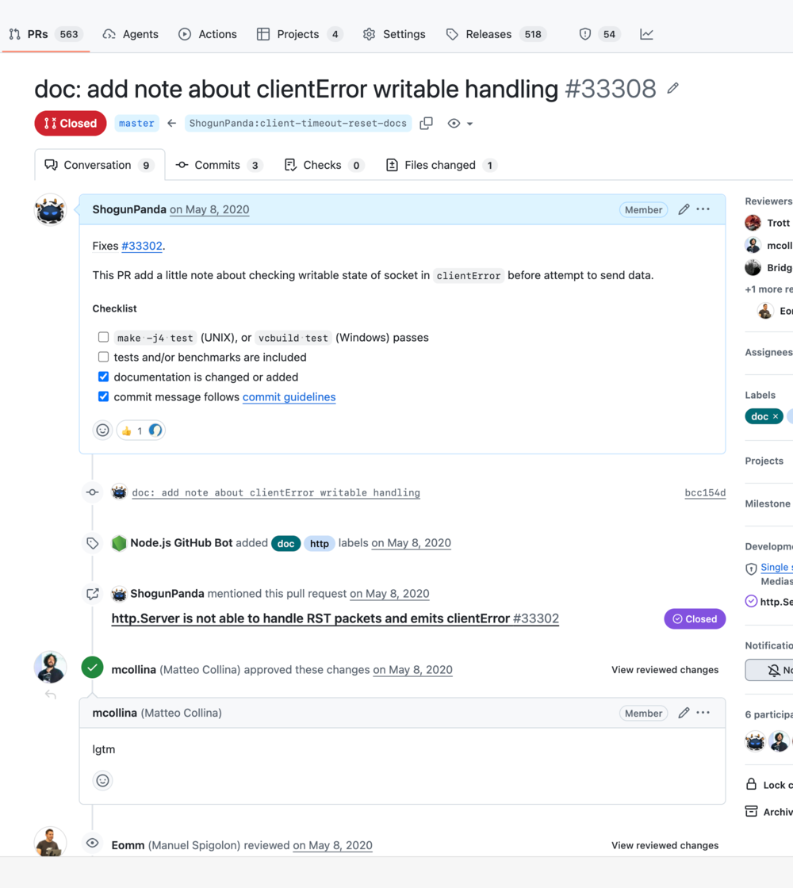
My first
Node.js
contribution
2020

Slide 19
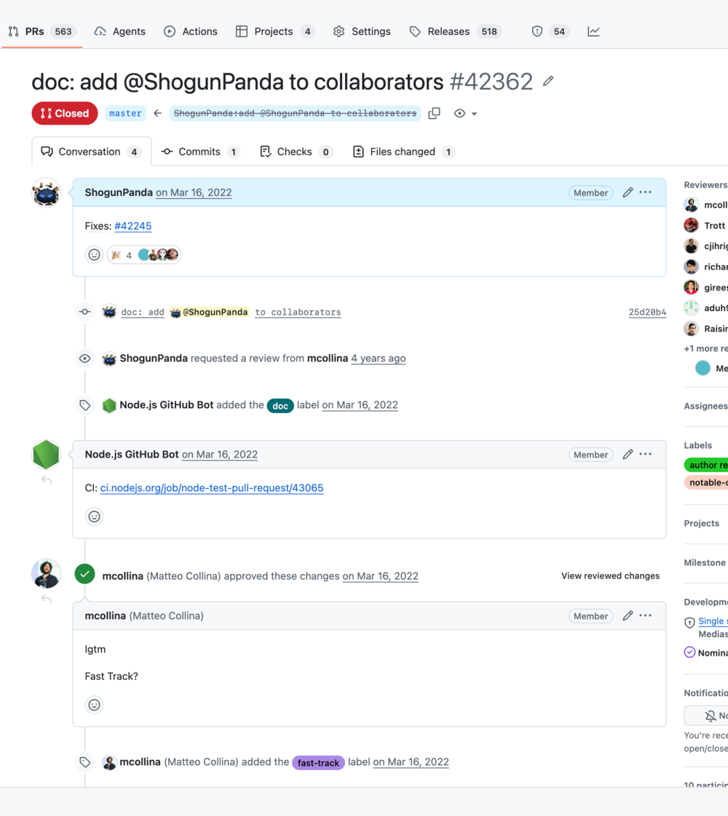
Node.js
collaborator
2022

Slide 20
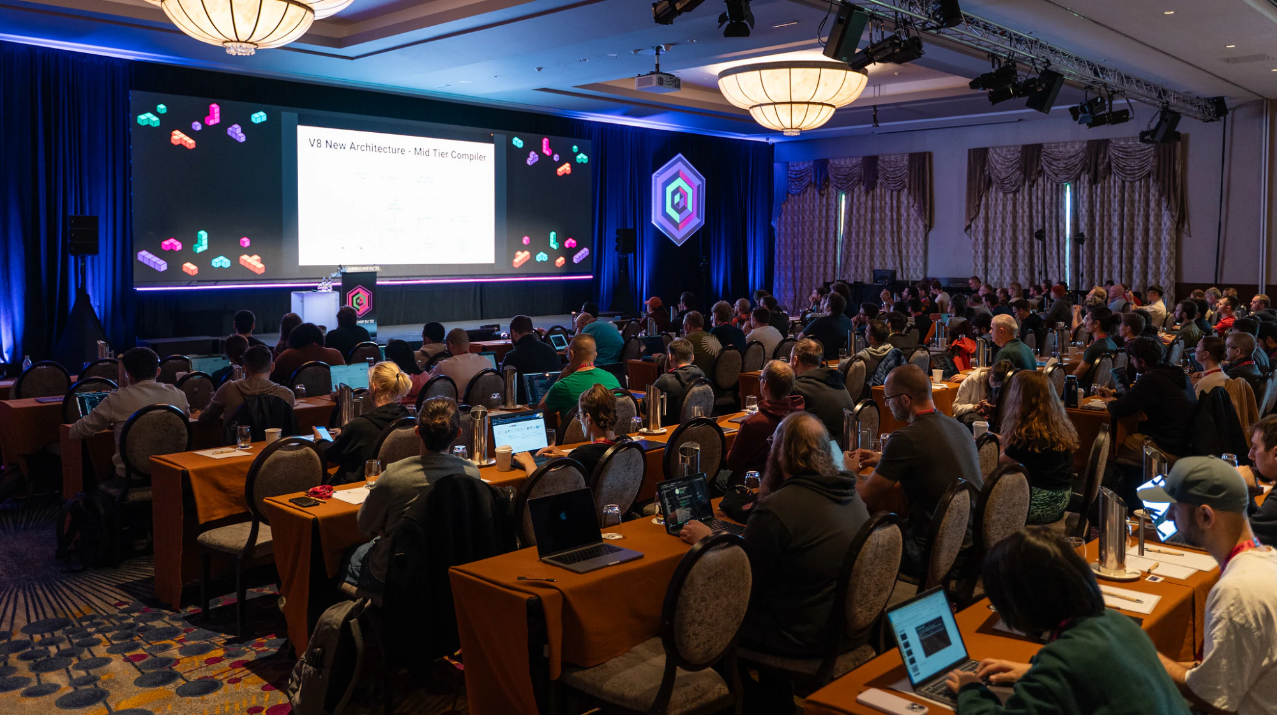
Then I stepped onto a stage.
Almost
60
speaking appearances since 2022.

Slide 21
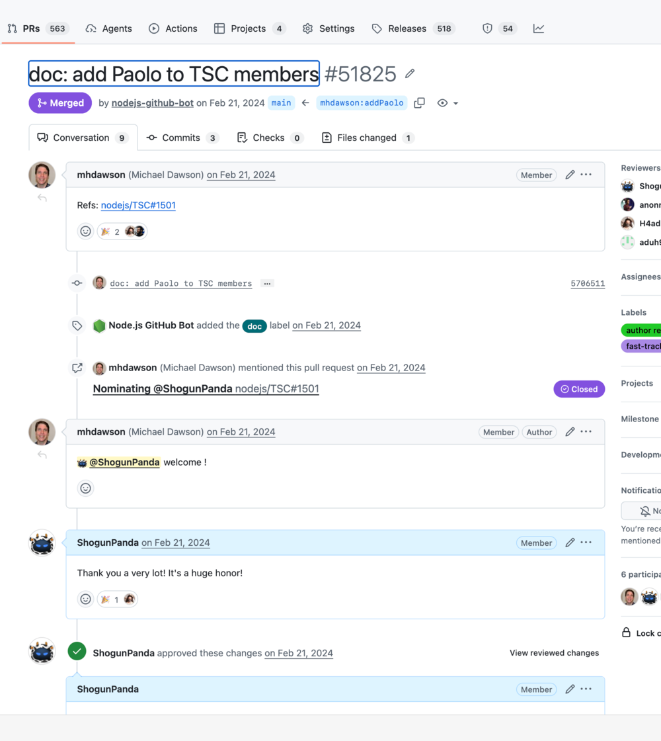
Node.js
TSC
2024

Slide 22

Principal Engineer
,
Platformatic
2024

Slide 23
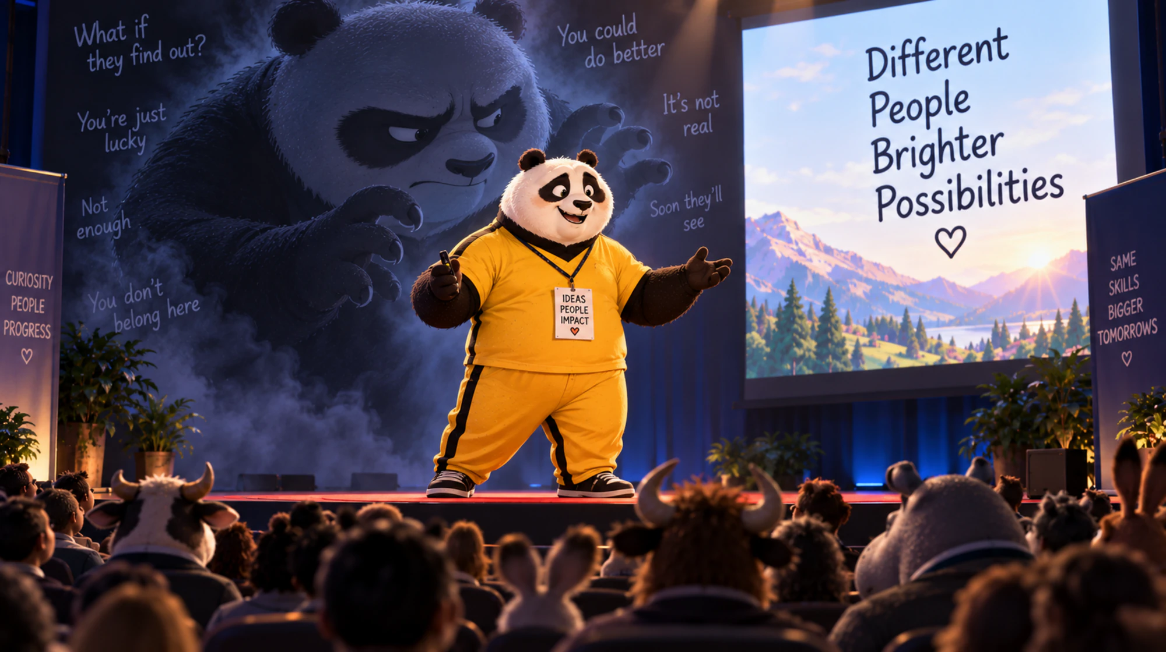
And yet, that voice is still
here
.

Slide 24
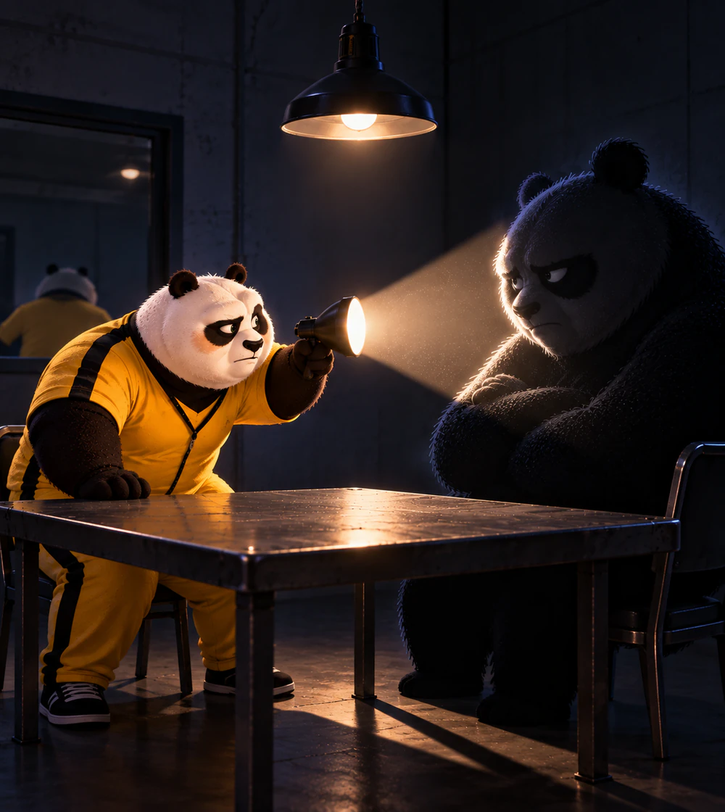
So, what is
that voice?

Slide 25


Imposter syndrome
“A psychological phenomenon in which
individuals struggle to internalize their
achievements and fear being exposed as frauds,
despite evidence of their competence.”
Adapted from Clance & Imes (1978) and Bravata et al. (2020)

Slide 26
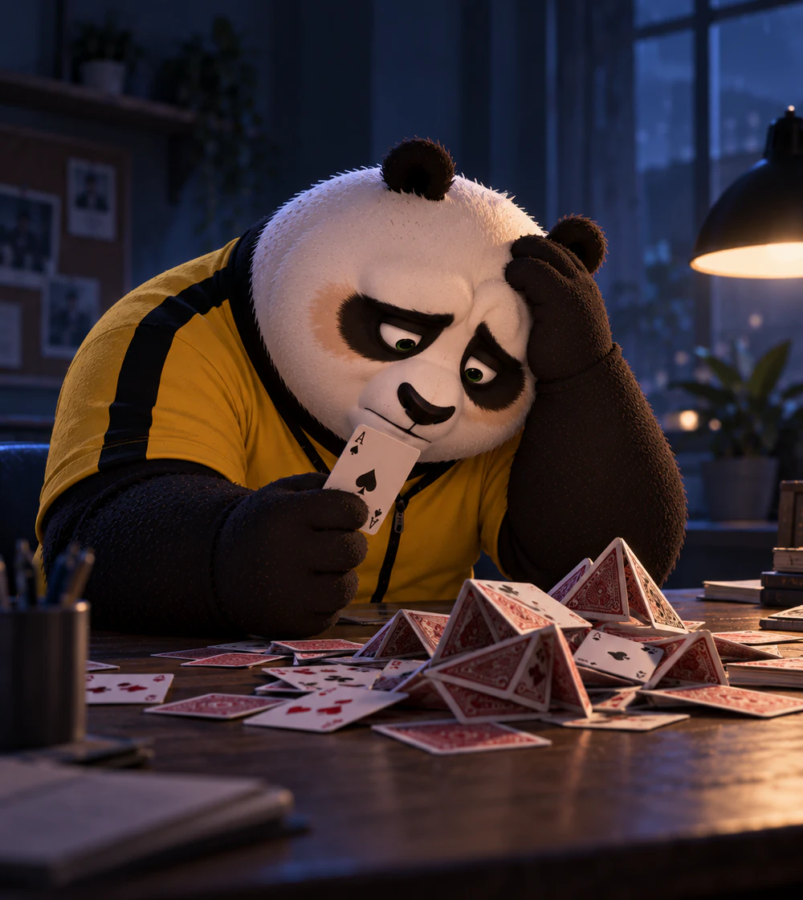
Success is luck.
Failure is me.

Slide 27

I just need
one more
achievement.

Slide 28
HAVE YOU EVER
HEARD
THESE?

Slide 29
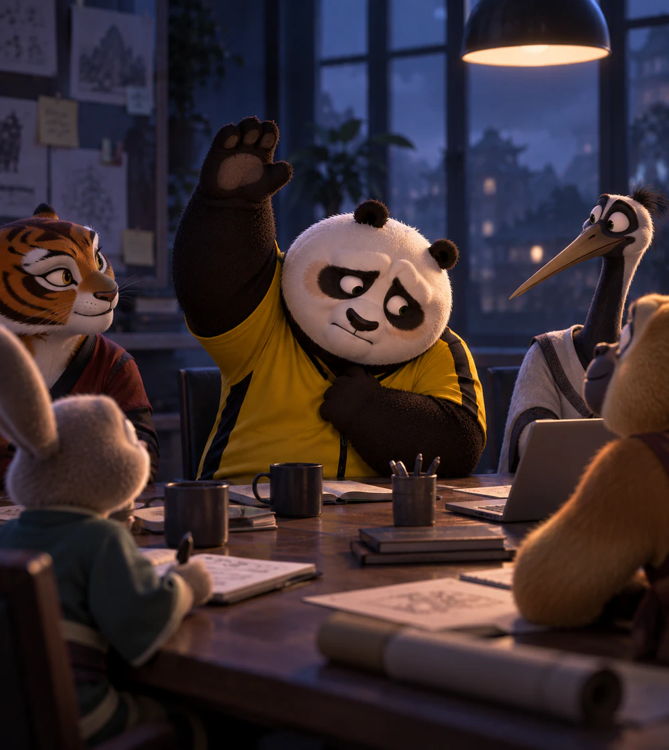
Who do you
think you are?

Slide 30
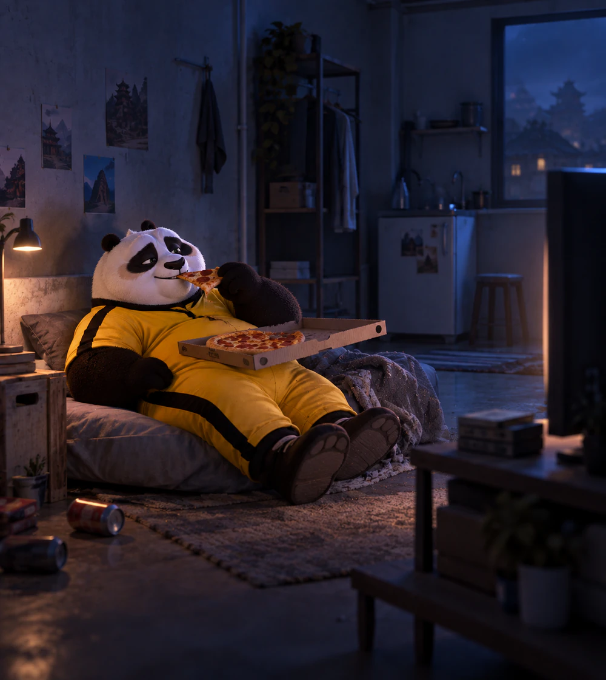
Be
happy
with
what you have.

Slide 31
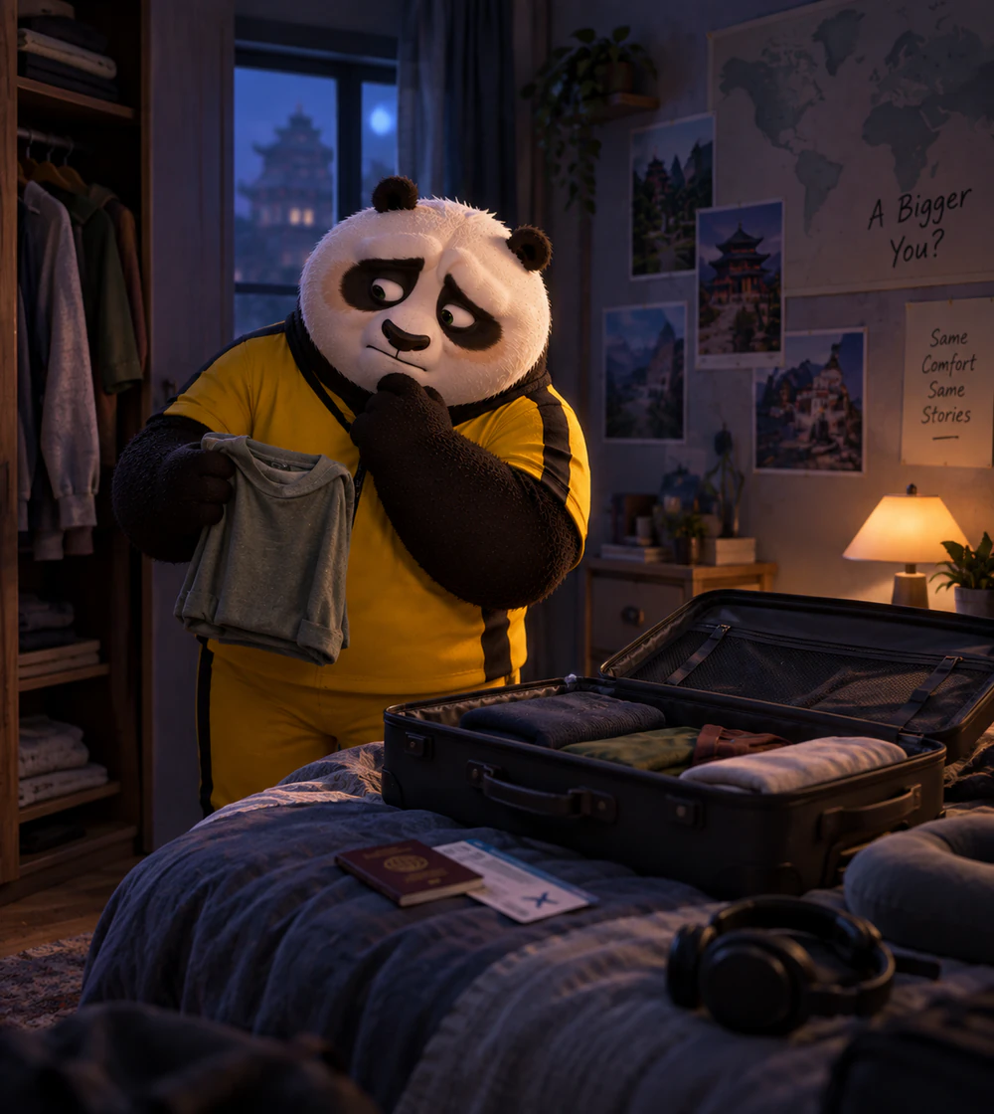
Why take the
risk
?

Slide 32
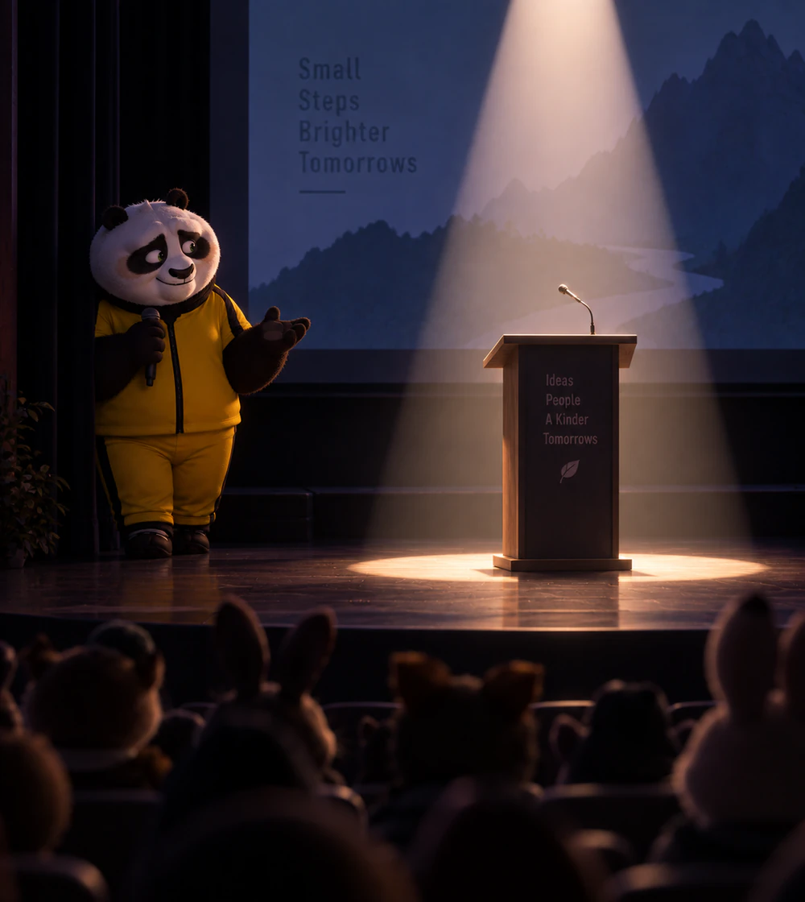
Stay
out
of
the spotlight.

Slide 33
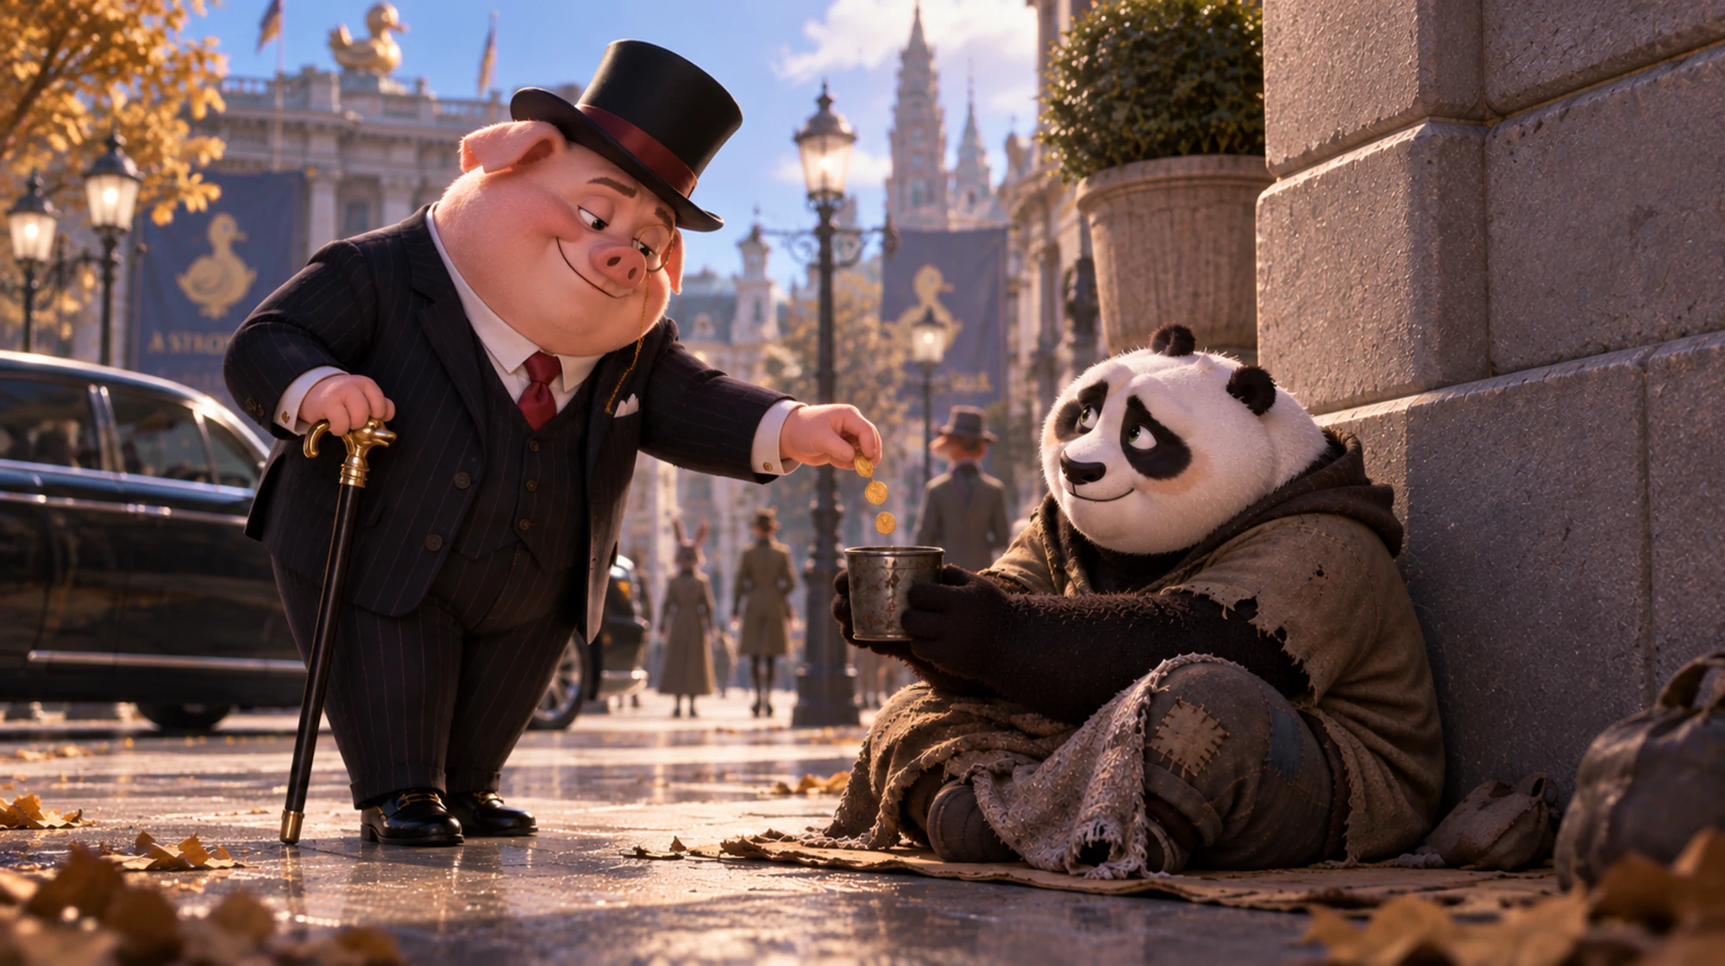
Be
grateful
for the crumbs.

Slide 34
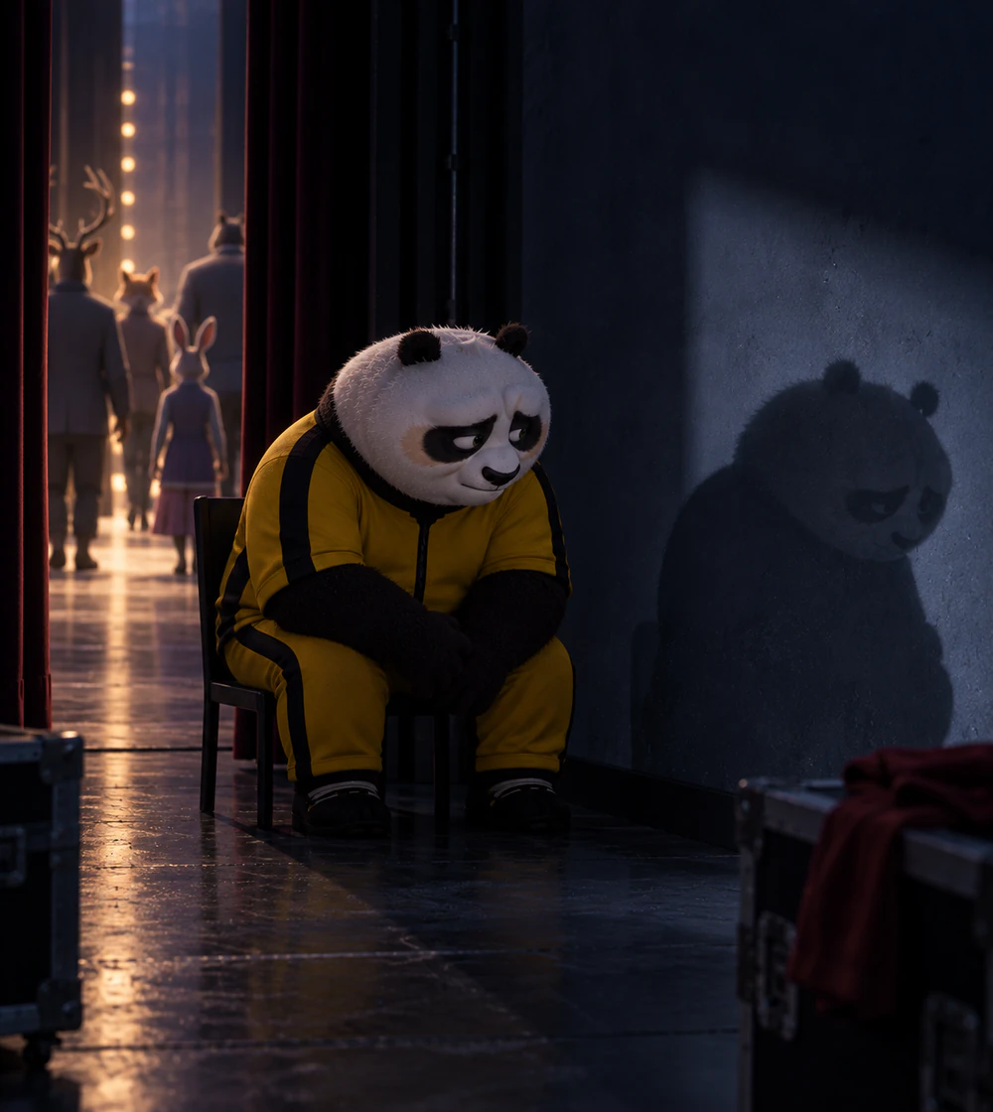
You start
believing
them
...

Slide 35
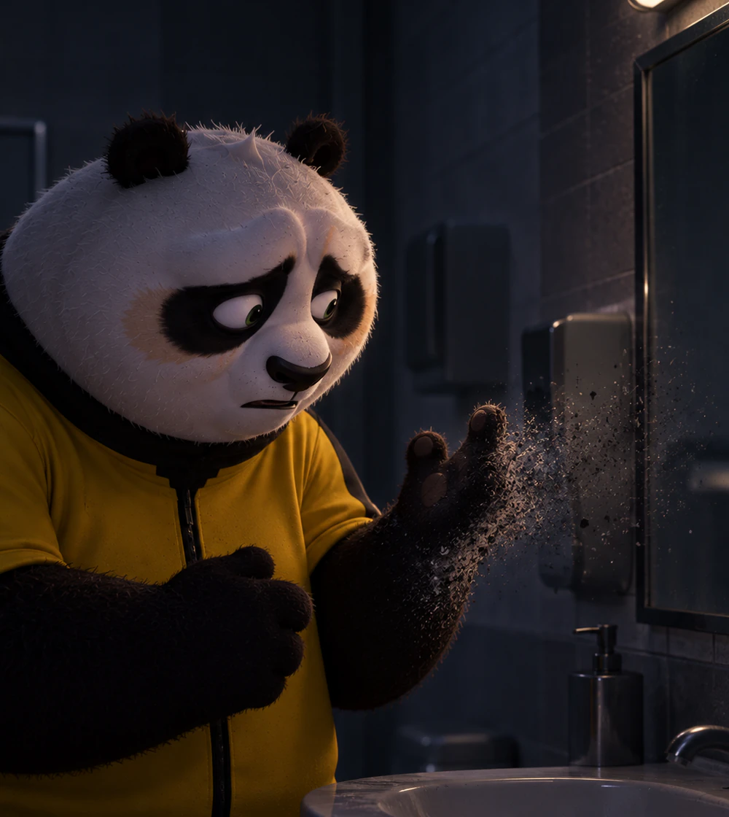
...and lose
yourself
.

Slide 36
IT'S TIME TO
KICK THEM OUT!

Slide 37
THERE IS NO
OFFICIAL PLAYBOOK.
THESE ARE MY COPING
STRATEGIES.

Slide 38

Who
do
you
think
you
are?
I am who
I
fought
to become.

Slide 39

Be
happy
with
what
you
have.
Wanting more
is
healthy
if it harms no one.

Slide 40

Why
take
the
risk?
Don’t
mistake
uncertainty
for danger.

Slide 41
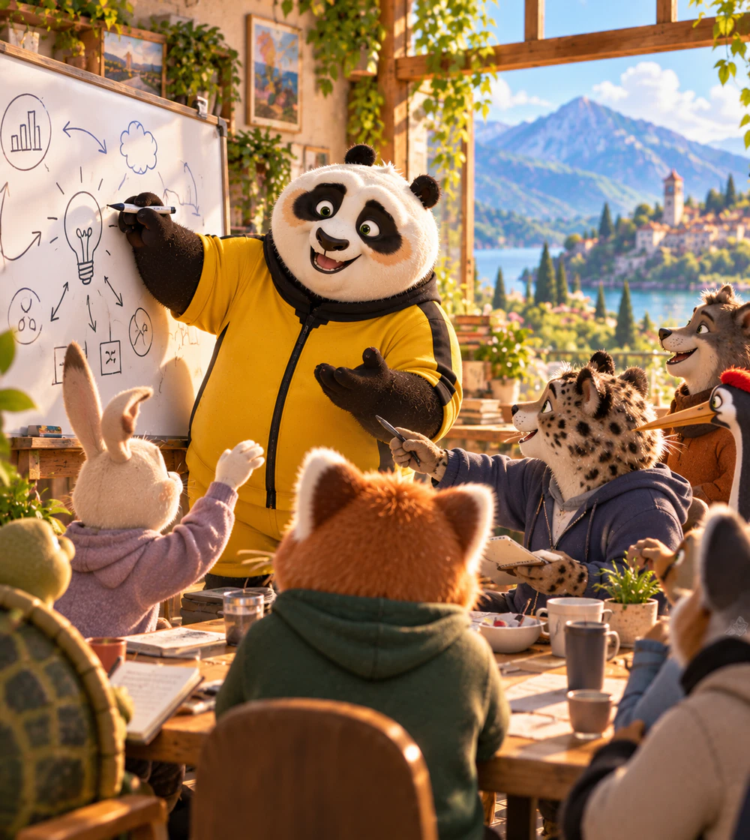
Stay
out
of
the
spotlight.
Be there to
share
knowledge,
not to brag.

Slide 42

Be
grateful
for
the
crumbs.
Know what
you
earned
.
It’s not a gift.

Slide 43

SCREW IT! Don’t
overthink
it!

Slide 44
One last thing™
“Dude, sucking at something is the first step
towards being sorta good at something.”
Jake the Dog — Adventure Time

Slide 45
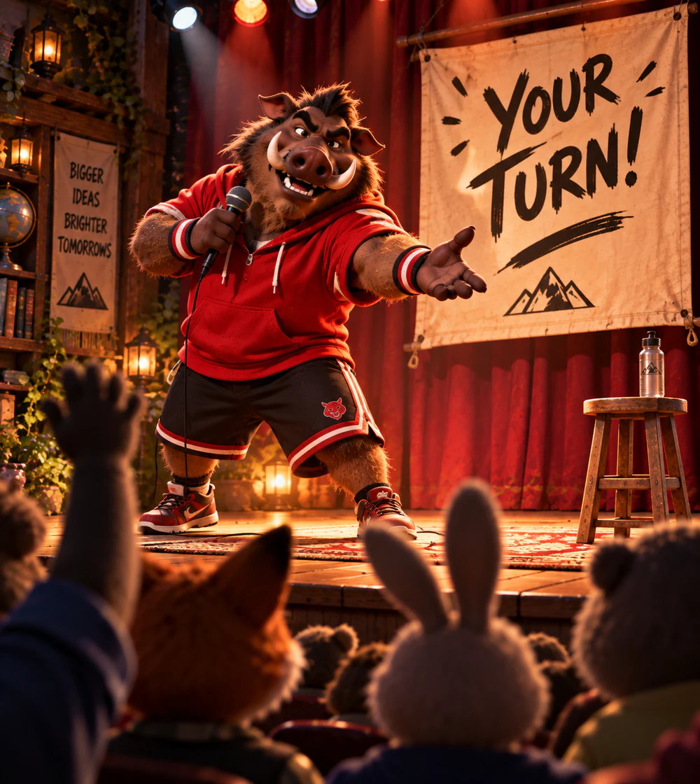
Who's
next
?

Slide 46

Thank you!
Paolo Insogna
@p_insogna
Platformatic
Node.js TSC, Principal Engineer
paolo.insogna@platformatic.dev

