Slide 1






Platformatic
View online
FFI: Crossing the
Native Boundary
Download PDF
in Node.js
Paolo Insogna
Node.js TSC, Principal Engineer

Slide 2


Not everything
needs a rewrite.

Slide 3






Hello, I'm
Paolo
!
Node.js
Technical Steering Committee Member
Platformatic
Principal Engineer
paoloinsogna.dev
ShogunPanda
p_insogna
pinsogna

Slide 4



Some companies trusting us
Article
Case Study
Case Study

Slide 5

Your next
dependency
might not be in
JavaScript.

Slide 6



What is FFI?
Foreign Function Interface
Call functions written in one language from another.
Same process, native code
Load a shared library and invoke its exported symbols.
A common binary contract
C-compatible entry points can connect C, C++, Rust, Zig, and more.

Slide 7



The ABI is the contract
Names and types
Binary representation
Calling convention
Which symbol? Which arguments?
Sizes, alignment, and memory
Each value must go in the correct
Which return value?
layout must agree.
register or stack slot.

Slide 8



Why should we care?
Reuse what already works
Decades of native libraries do not need a JavaScript rewrite.
Reach native capabilities
Integrate device SDKs, codecs, and specialized libraries.
Keep JavaScript in charge
Coordinate the application while native code does its part.

Slide 9

What can we build?

Slide 10


What can we build?
Media pipelines
Use an existing image processor or audio engine.
Hardware integrations
Call a vendor's C API from a Node.js application.
And much more…
Your imagination is the limit.

Slide 11

Yes, even Doom.
Node.js,
a
native
game
engine,
and
a
terminal.
Because
why
not?
https://github.com/platformatic/destino

Slide 12

Couldn't we just
npm install it?

Slide 13



Userland got here first
node-ffi-napi
Koffi
node-ffi-rs
Familiar API, with documented GC
Low-overhead calls, structs by
Rust + Node-API, with its own
and multithreading caveats.
value, and async support.
memory and threading model.

Slide 14



Why put FFI in core?
One fewer native addon to distribute
The FFI bridge ships with Node.js. Your target library still needs a compatible binary.
Runtime integration
Coordinate V8 fast calls, environments, permissions, and releases in one project.
Portability maintained in core
Test the FFI bridge and its ABI support alongside Node.js on supported platforms.

Slide 15

Let's get to
the action!

Slide 16
Start with a native function
#include <stdint.h>
// Export this symbol from the shared library.
int32_t add_i32(int32_t a, int32_t b) {
return a + b;
}

Slide 17
Load. Describe. Call.
import { dlopen, suffix } from 'node:ffi'
using handle = dlopen(`./mylib.${suffix}`, {
add_i32: {
arguments: ['int32', 'int32'],
return: 'int32'
}
})
// SAFETY: The signature matches the exported C function.
console.log(handle.functions.add_i32(20, 22)) // 42

Slide 18

A small API. A long journey.

Slide 19


2023: Bryan starts crossing
Bryan English (@bengl)
Original implementation:
PR #46905
.
Experience from sbffi
From a userland experiment using dyncall to a core proposal using libffi.
Portability shapes the design
The backend has to work across the platforms Node.js supports.

Slide 20


The hard part was never just calling C
Who owns the memory?
A pointer gives you an address, not a lifetime or a size.
Can native code call us back?
JavaScript callbacks add thread, lifetime, and reentrancy constraints.
Does it build everywhere?
ABI differences and native dependencies become runtime maintenance work.

Slide 21



2025: the idea keeps moving
New iteration by tianxiadys
A different API exploration
More integration questions
PR #57761
explicitly built on
UnsafePointer, UnsafePointerView,
Callbacks, permissions, and
Bryan’s work.
and UnsafeCallback.
bundled libffi.

Slide 22


2026: Colin restarts the conversation
Colin Ihrig (@cjihrig)
Opened
PR #62072
on March 2nd, 2026, renewing the initiative.
From exploration to review
The API and implementation evolved through collaboration and platform testing.
Landed on April 14th, 2026
node:ffi
became part of Node.js core.

Slide 23


Finding the API that fits Node.js
DynamicLibrary
Explicit signatures
Explicit memory operations
Keep symbols, callable wrappers,
Describe arguments and return
Copy bytes, borrow views, or
and callbacks attached to a library.
types with simple objects.
access raw pointers.

Slide 24

Welcome,
node:ffi
.
Introduced as experimental in Node.js 26.1.0.

Slide 25

How do I use it?

Slide 26
Types are part of the call
// C: uint64_t identity_u64(uint64_t value);
const identity = lib.getFunction('identity_u64', {
arguments: ['uint64'],
return: 'uint64'
})
// SAFETY: The declaration matches the exported symbol.
const value = identity(9_007_199_254_740_993n)
console.log(value) // 9007199254740993n
// A number would already have lost precision.

Slide 27

With great power
comes great
responsibility™

Slide 28



A pointer is not an ownership model
JavaScript to native
Buffers can lend their backing memory for the call; strings use temporary UTF-8 storage.
Native to JavaScript
toBuffer copies by default; a zero-copy view still depends on native memory.
Lifetime is your contract
Keep memory alive and stable for as long as either side can access it.

Slide 29
Borrow bytes, not ownership
#include <stdint.h>
uint32_t sum_bytes(const uint8_t *bytes, uint32_t length) {
uint32_t total = 0;
for (uint32_t i = 0; i < length; i++) {
// SAFETY: The caller provides length readable bytes.
total += bytes[i];
}
return total;
}

Slide 30
A Buffer crosses the boundary
import { dlopen, suffix } from 'node:ffi'
using handle = dlopen(`./mylib.${suffix}`, {
sum_bytes: {
arguments: ['buffer', 'uint32'],
return: 'uint32'
}
})
const bytes = Buffer.from([10, 20, 12])
// SAFETY: Live storage; C reads bytes.length bytes, retaining none.
const total = handle.functions.sum_bytes(bytes, bytes.length)
console.log(total) // 42

Slide 31
Cleanup has an order
1
Stop native activity
Make sure native code will no longer invoke callbacks or use borrowed memory.
2
Release owned resources
Use the library's matching release functions while its code is still loaded.
3
Close the library
DynamicLibrary supports
close()
and
Symbol.dispose
. Raw pointers are not revoked.

Slide 32
Callbacks cross the other way
registerCallback(signature, callback)
Create a native function pointer backed by JavaScript through a libffi closure.
Same thread, synchronous result
Invoke on the creating thread. Do not throw or return a Promise.
Unregister after the last native use
Never unregister an active callback or close its library while it is running.

Slide 33
C calls JavaScript, then returns
#include <stdint.h>
typedef int32_t (*transform_fn)(int32_t);
int32_t apply_once(int32_t value, transform_fn transform) {
// SAFETY: A live callback is invoked on its creating thread.
return transform(value);
}

Slide 34
Register. Call. Unregister.
import { dlopen, suffix } from 'node:ffi'
using handle = dlopen(`./mylib.${suffix}`, {
apply_once: {
arguments: ['int32', 'function'],
return: 'int32'
}
})
const callback = handle.lib.registerCallback(
{ arguments: ['int32'], return: 'int32' }, value => value
)
try {
// SAFETY: Synchronous, same-thread; no throw or Promise.
console.log(handle.functions.apply_once(42, callback)) // 42
} finally {
// SAFETY: C has returned without retaining the callback.
handle.lib.unregisterCallback(callback)
}

Slide 35



Native does not mean asynchronous
A synchronous call blocks its thread
A slow native function can still stall the main event loop.
Move suitable work to a worker
Load and manage the library there, respecting its own thread-safety rules.
getCurrentEventLoop()
Exposes the current uv_loop_t for native integration, not automatic offloading.

Slide 36
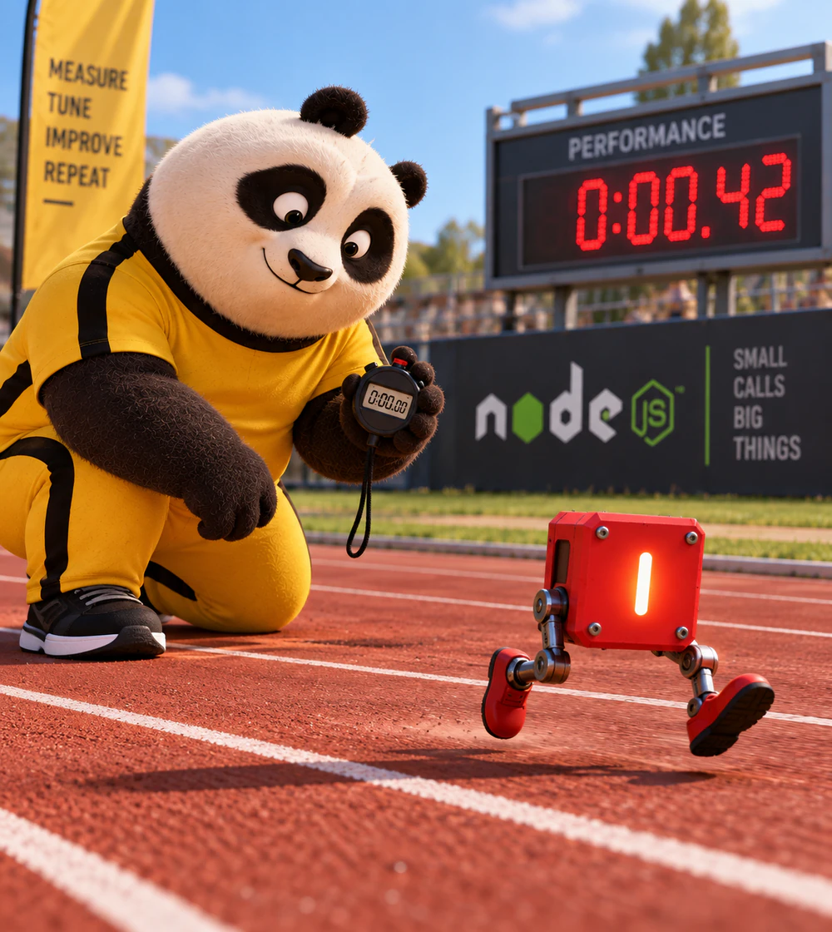
It works.
But how fast?

Slide 37
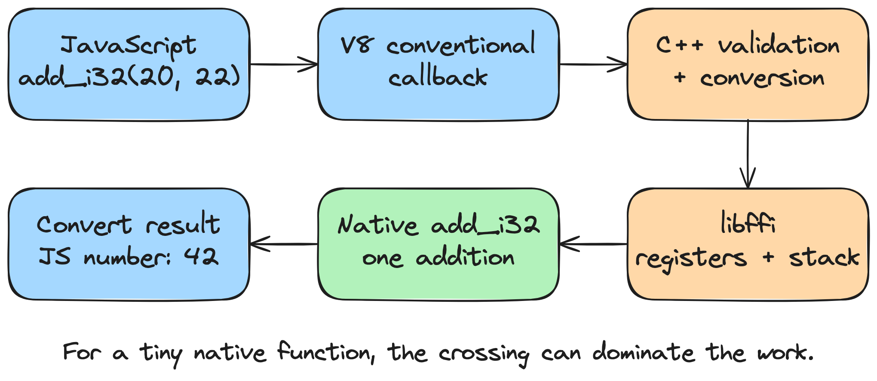
Every crossing has a cost

Slide 38
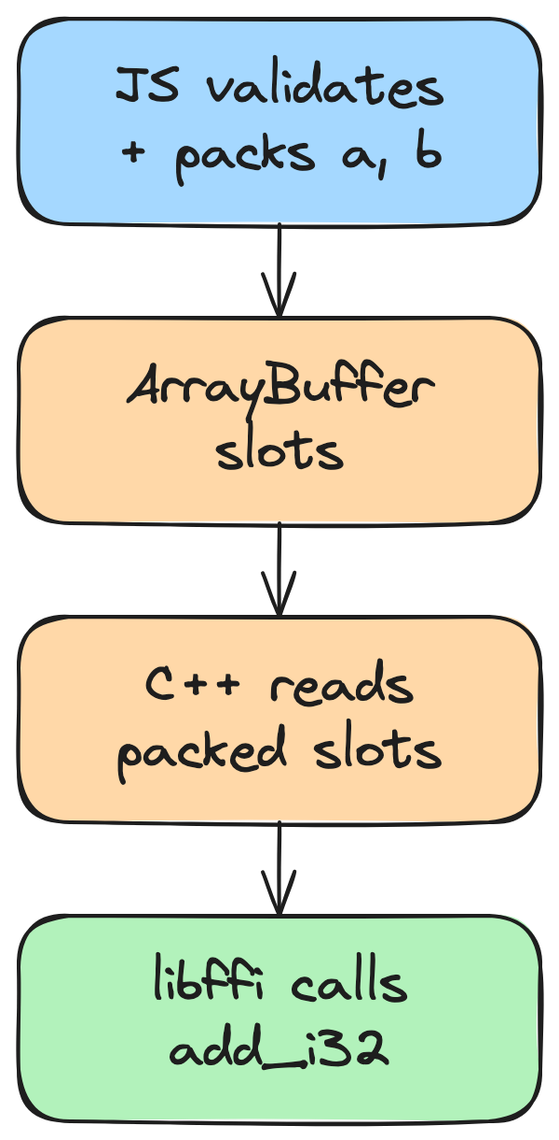
First optimizations
PR
#62918
by
Bryan
English
Less
overhead,
Still
using
libffi.
One
ArrayBuffer
per
function,
reused
by
JS
and
C++.

Slide 39
Pack once per call, reuse the storage
// Simplified internals: one reusable buffer per function.
const slots = new DataView(new ArrayBuffer(3 * 8))
// Each call validates and packs the arguments.
slots.setInt32(8, 20, true)
slots.setInt32(16, 22, true)
// C++ snapshots the slots; libffi calls add_i32.
invokeNativeWithoutJSArguments()
const result = slots.getInt32(0, true) // 42

Slide 40
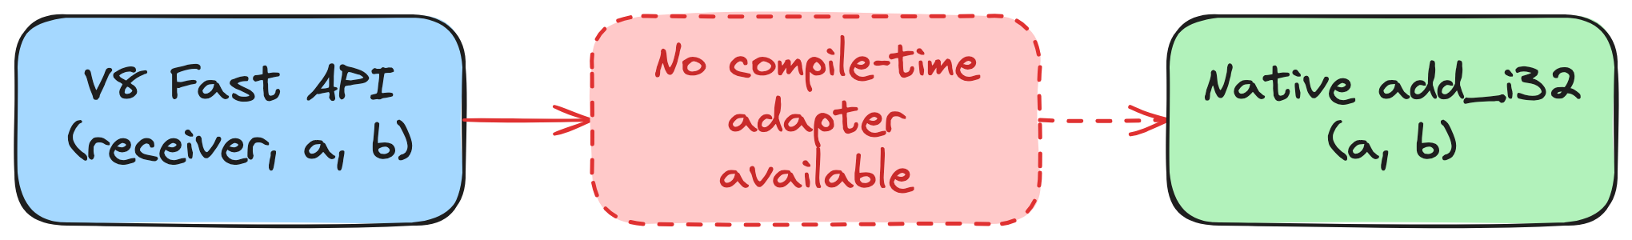
V8 already knows a faster route
Fast
API
can
call
a
typed
native
entry
point
directly.
But
this
C
function
does
not
expect
V8's
receiver.

Slide 41

One unexpected
argument.
The
JavaScript
receiver.

Slide 42
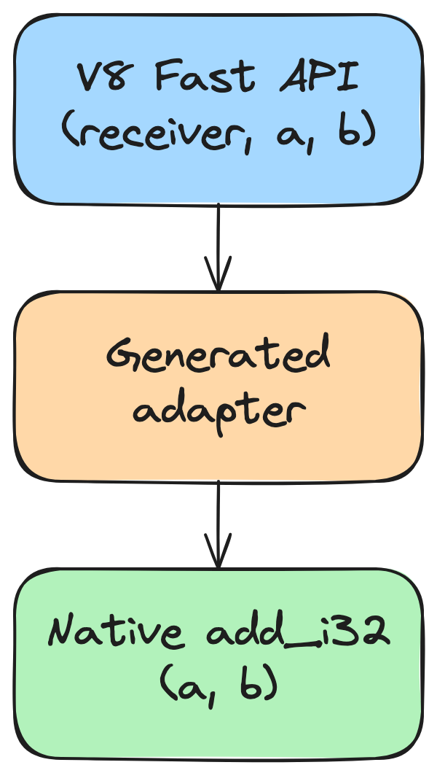
A tiny adapter
bridges the gap
The
adapter
repositions
a
and
b,
omitting
the
receiver.
The
result
is
still
42.
Prepared
once:
allocate
RW
→
emit
code
→
flush
instruction
cache
→
protect
RX.
RW
=
read/write;
RX
=
read/execute.
Fast
calls
reuse
the
RX
code.

Slide 43
We explored more than one route
Generate wrappers with a compiler
Patch V8
Cranelift, MIR, and more.
A clever suggestion from Anna Henningsen.

Slide 44

So, what happened?

Slide 45


We brought it home!
PR #63068
— June 16th, 2026
One public API
My Fast FFI implementation, co-authored
Eligible calls can use Fast API.
with Bryan, landed in Node.js.
No visible changes visible outside.

Slide 46
The adapter, in pseudocode
; ARM64 pseudocode; uppercase operations are symbolic.
; x0 = receiver, w1 = a, w2 = b. wN = low 32 bits of xN.
; sp = stack pointer; x29 = frame pointer; x30 = return address.
stp x29, x30, [sp, #-16]! ; sp -= 16; save x29 and x30.
CHECK_LIBRARY_OPEN ; If closed: JS error, restore, return.
mov x0, x1 ; Move a over the receiver.
mov x1, x2 ; Move b into C's second argument.
LOAD_ADDRESS x16, add_i32 ; Load the resolved target address.
; SAFETY: Open library; matching native signature.
blr x16 ; Call target; set x30; result in w0.
ldp x29, x30, [sp], #16 ; Restore x29/x30; sp += 16.
ret ; Return to V8 via x30; keep w0.

Slide 47

Prepared once. Reused on every fast call.
Prepare the adapter
Reuse it
When creating an eligible function, Node.js
Optimized calls reuse that adapter. Code
generates an adapter for the platform.
generation does not happen on every call.

Slide 48
Three paths, one contract
1
Generic
Convert arguments in C++ and call through libffi.
2
Shared buffer
Prepare arguments in JavaScript and still call through libffi.
3
Fast API
Optimized JavaScript calls through a generated adapter.

Slide 49

Fallback is
part of the design.

Slide 50

Was it worth it?

Slide 51



Reading the benchmark columns
ffi-rs / Koffi
Third-party FFI libraries for Node.js.
Generic / Shared
C++ argument conversion vs a reusable JS/C++ argument buffer; both call through libffi.
Fast API
V8 fast calls through a generated native adapter, when eligible.

Slide 52
How fast is Fast FFI?
Benchmarks
run
on
a
Apple
M2
Max
·
Median
ns/call,
lower
is
better
·
15
runs
+----------------------+---------+---------+---------+---------+---------+
| Benchmark | ffi-rs | Koffi | Generic | Shared | Fast API|
+----------------------+---------+---------+---------+---------+---------+
| identity-i32 | 1638.61 | 22.08 | 78.12 | 53.76 | 2.13 |
| add-i32 | 2020.85 | 26.65 | 87.73 | 70.25 | 2.21 |
| sum-8-i32 | 4178.95 | 51.51 | 122.69 | 124.65 | 124.73 |
| sum-buffer: 64 B | 2060.27 | 43.42 | 107.78 | 83.78 | 14.04 |
| sum-buffer: 1 KiB | 2094.26 | 97.19 | 161.94 | 138.32 | 68.80 |
| sum-buffer: 16 KiB | 2986.33 | 964.40 | 1037.58 | 1006.89 | 931.89 |
+----------------------+---------+---------+---------+---------+---------+

Slide 53
Let's focus on Node.js Fast API vs Koffi
Node.js
wins
on
the
fast-path
cases
measured
here;
Koffi
wins
on
the
eight-argument
fallback.
+----------------------+--------------------------+
| Benchmark | Throughput vs Koffi |
+----------------------+--------------------------+
| identity-i32 | +937.09% |
| add-i32 | +1105.01% |
| sum-8-i32 | -58.70% |
| sum-buffer: 64 B | +209.20% |
| sum-buffer: 1 KiB | +41.25% |
| sum-buffer: 16 KiB | +3.49% |
+----------------------+--------------------------+

Slide 54

What will you connect next?

Slide 55

Challenge won!

Slide 56


One last thing™
“The best way to predict the future is to invent it.”
Alan Kay

Slide 57

Thank you!
Paolo Insogna
@p_insogna
Platformatic
Node.js TSC, Principal Engineer
paolo.insogna@platformatic.dev

