Slide 1






View online
Maths or magic?
Download PDF
End-to-end encryption explained with art
Paolo Insogna
Node.js TSC, Principal Engineer @
Platformatic

Slide 2

Encrypting is like
painting!

Slide 3






Hello, I'm
Paolo
!
Node.js
Technical Steering Committee Member
Platformatic
Principal Engineer
paoloinsogna.dev
ShogunPanda
p_insogna
pinsogna

Slide 4
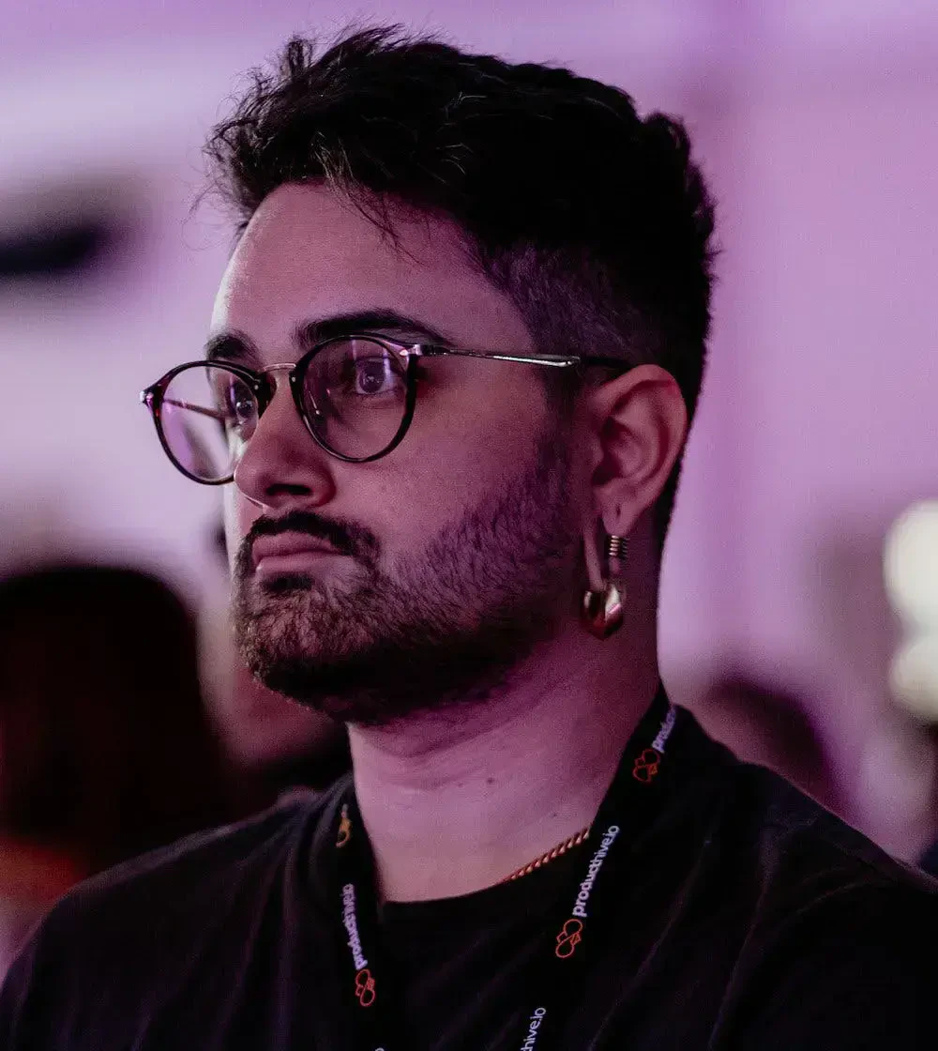
First of all, let's give
credits!
This
talk
has
originally
been
written
by
my
colleague
and
friend
Michele
Riva
.
Whatever
goes
wrong
today,
please
complain
directly
to
him
on
Twitter!
@MicheleRivaCode

Slide 5



Why do we need end-to-end encryption?
Network communications are complicated
To reach a distant peer, many compromisable network devices and links are used.
Wireless networks can be extremely insecure
Misconfigured networks allow an attacker to listen to all the traffic.
LAN connectors can be hacked
Do you believe in conspiracies?

Slide 6
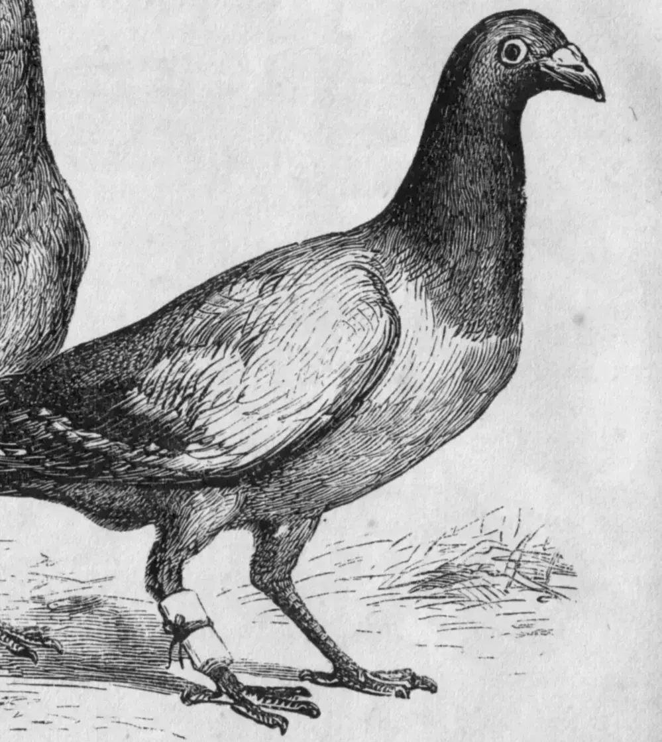
Let's send a
message ...

Slide 7

That was not an
encrypted channel!

Slide 8
What is encryption anyway?
“The act of putting information into a special
code, especially in order to prevent people from
looking at it without authority”
The Oxford Dictionary

Slide 9

An example:
The Caesar Cipher

Slide 10
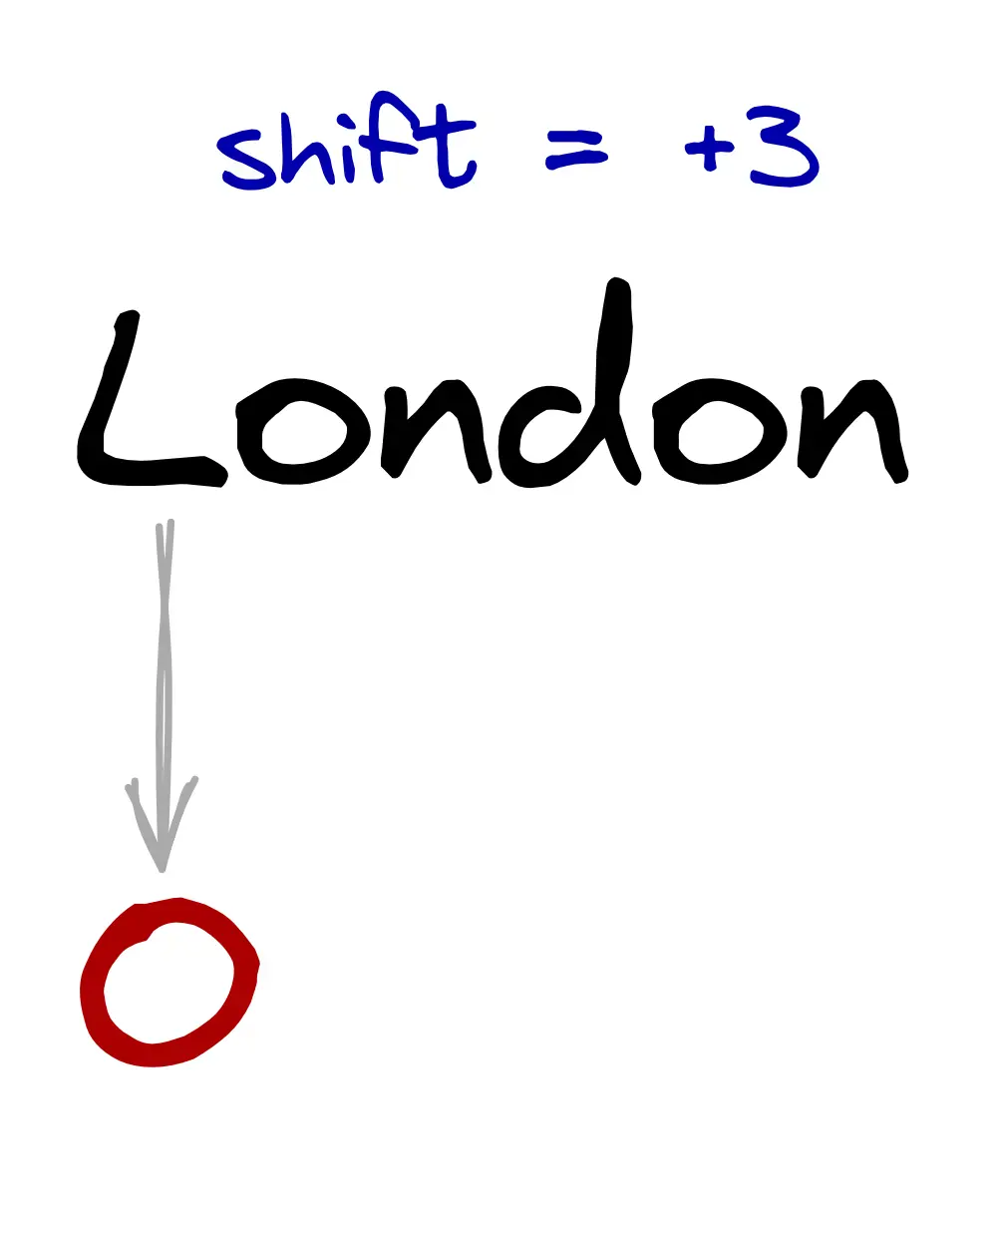
How does the Caesar Cipher work?

Slide 11
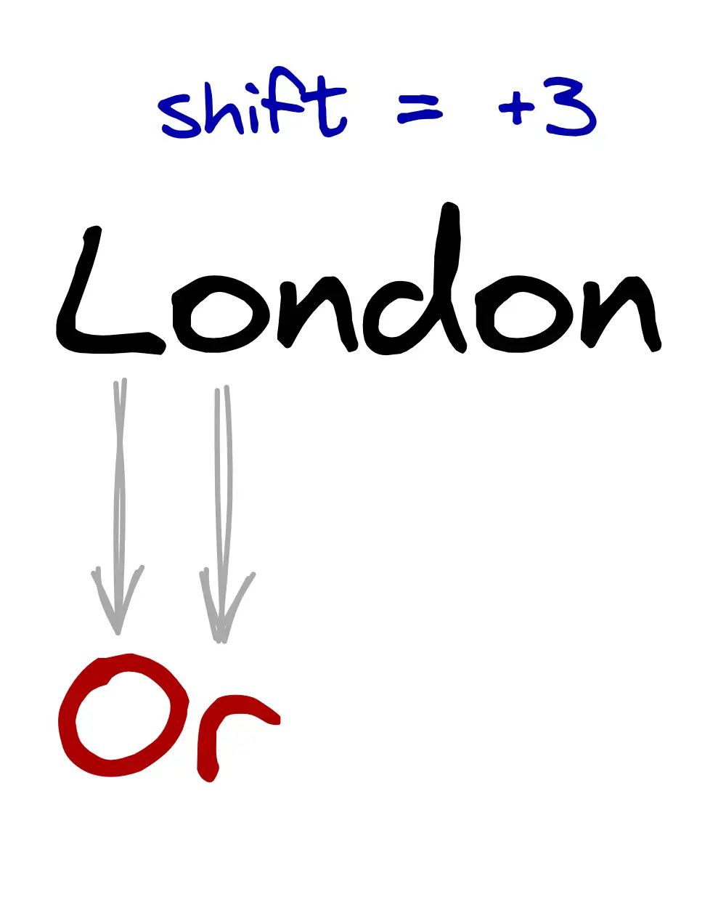
How does the Caesar Cipher work?

Slide 12
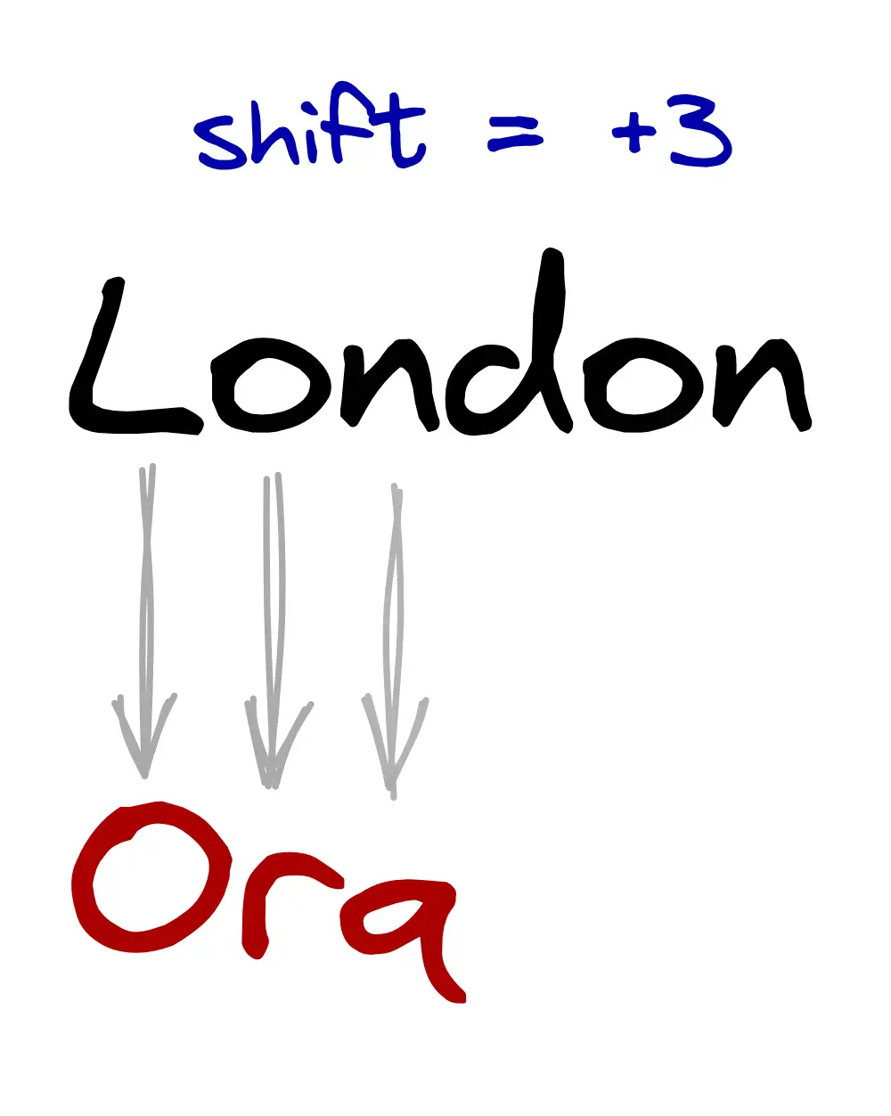
How does the Caesar Cipher work?

Slide 13
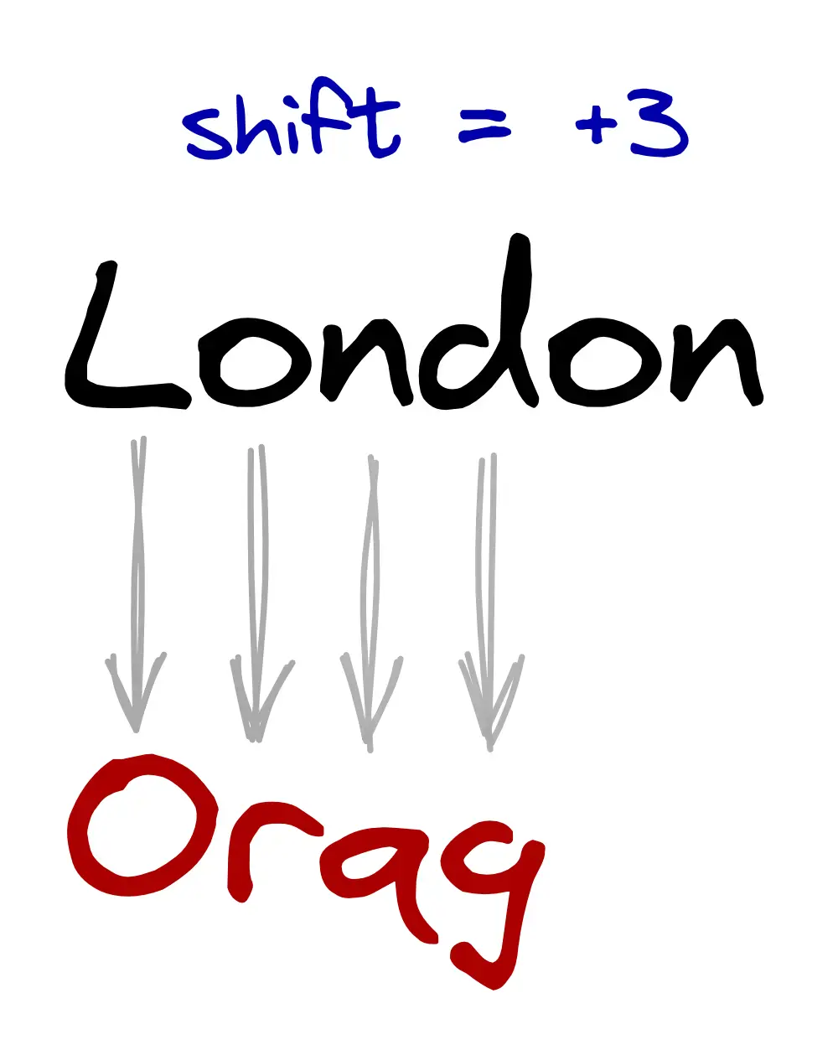
How does the Caesar Cipher work?

Slide 14
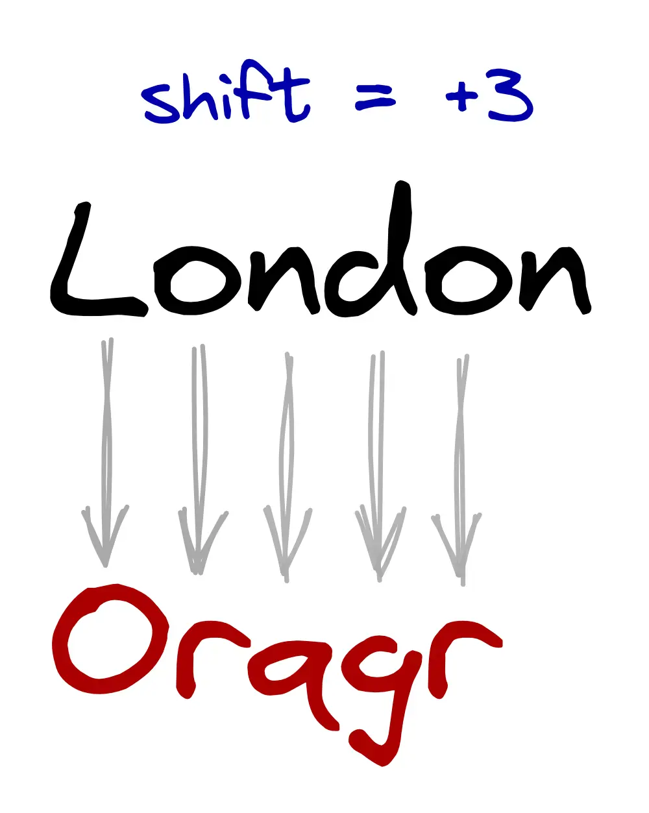
How does the Caesar Cipher work?

Slide 15
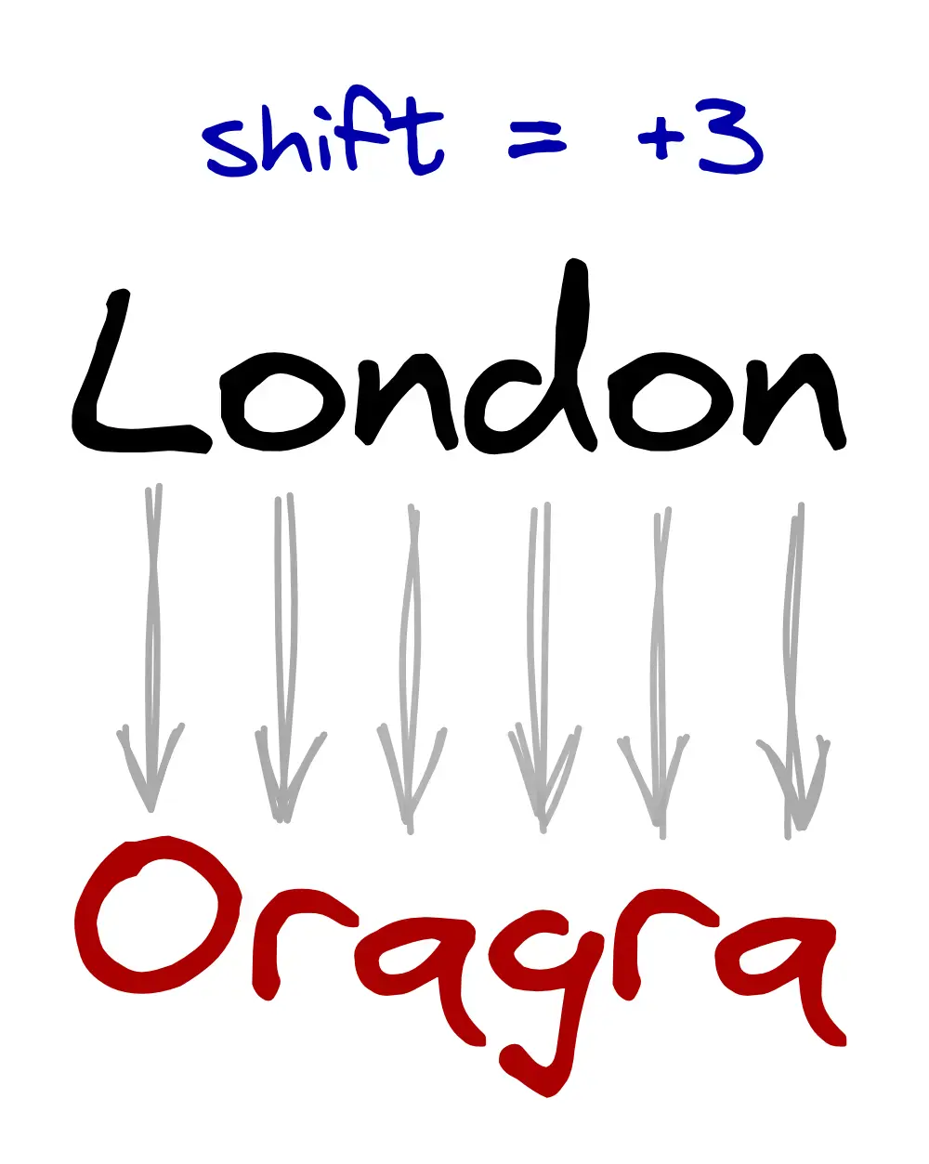
How does the Caesar Cipher work?

Slide 16
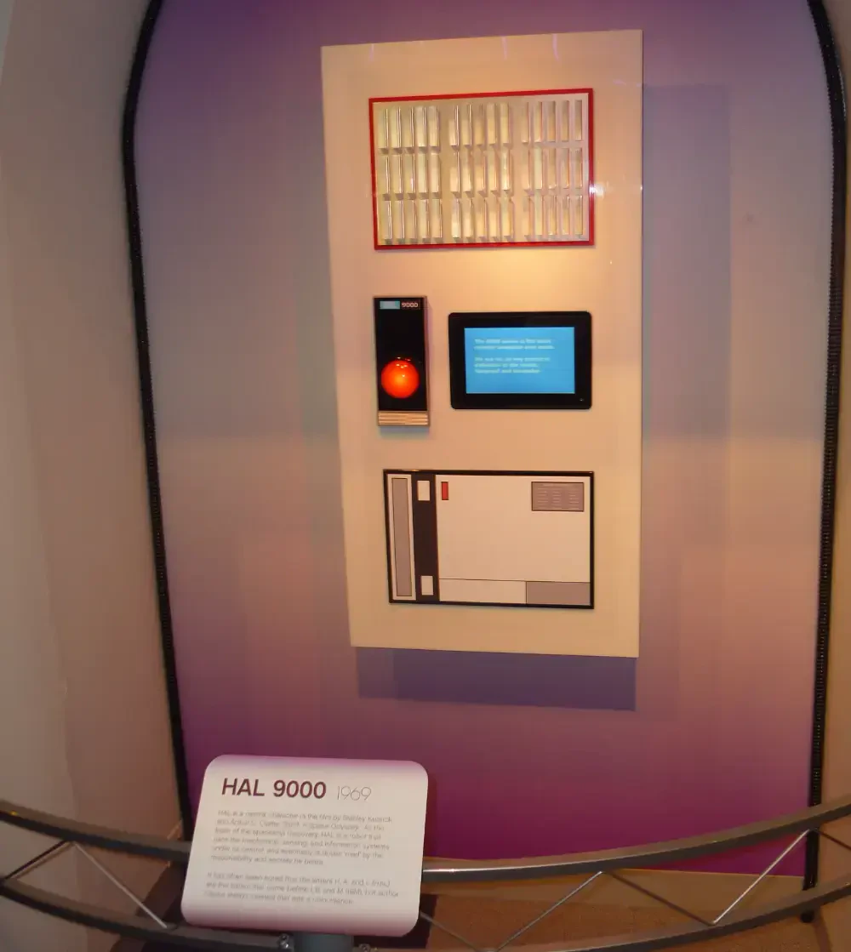
Trivia question
Where does its name come from?
It's a Caesar Cipher!

Slide 17
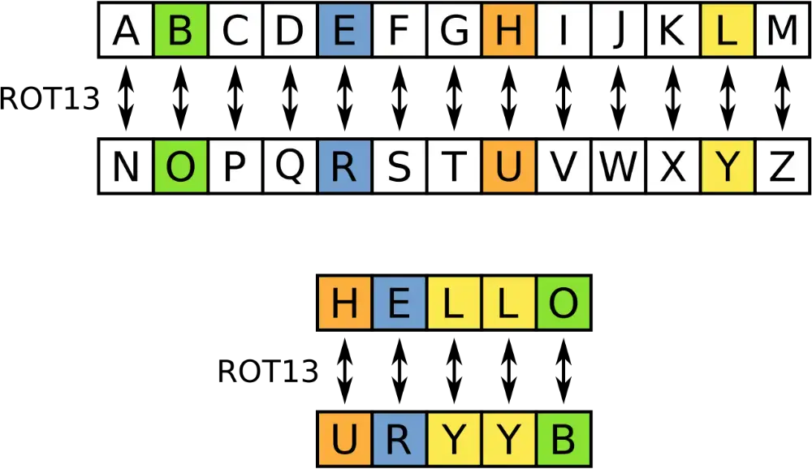
And now, a bit of pain for some of us
How
old
are
you?
Do
you
recognize
this?

Slide 18
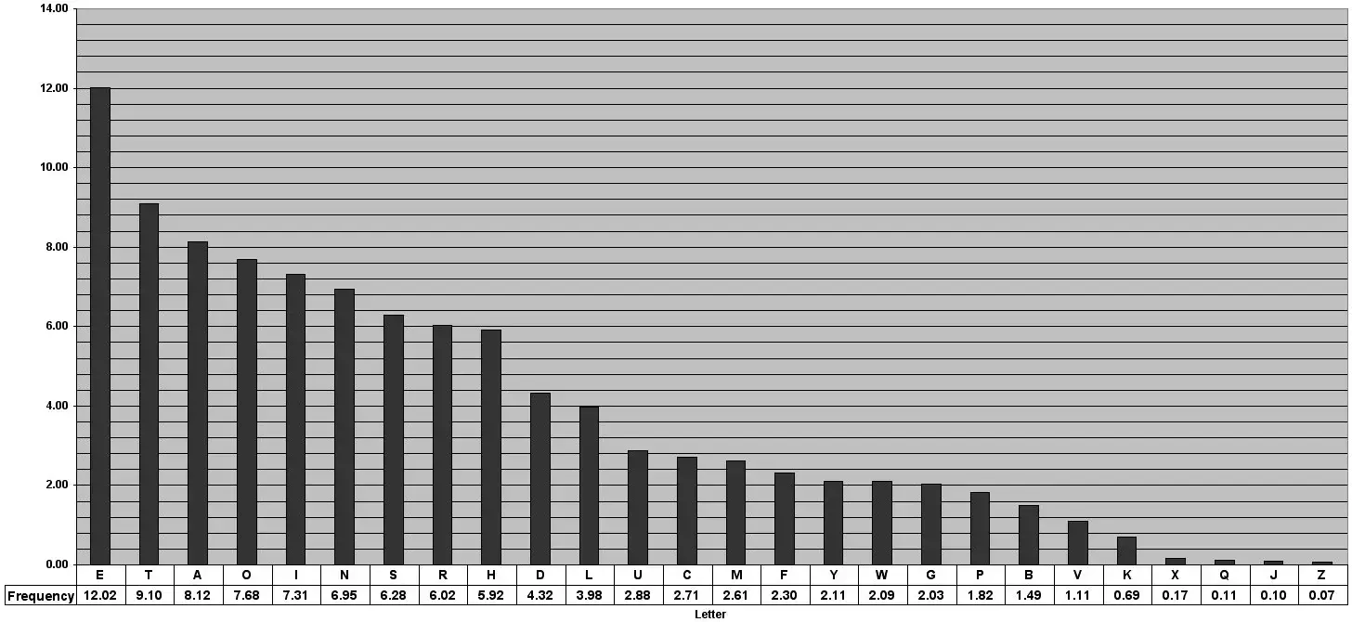
Why is Caesar Cipher weak?
Since
only
a
few
permutations
are
possible,
brute
forcing
is
quite
easy
(especially
if
using
letter
frequency
analysis).

Slide 19
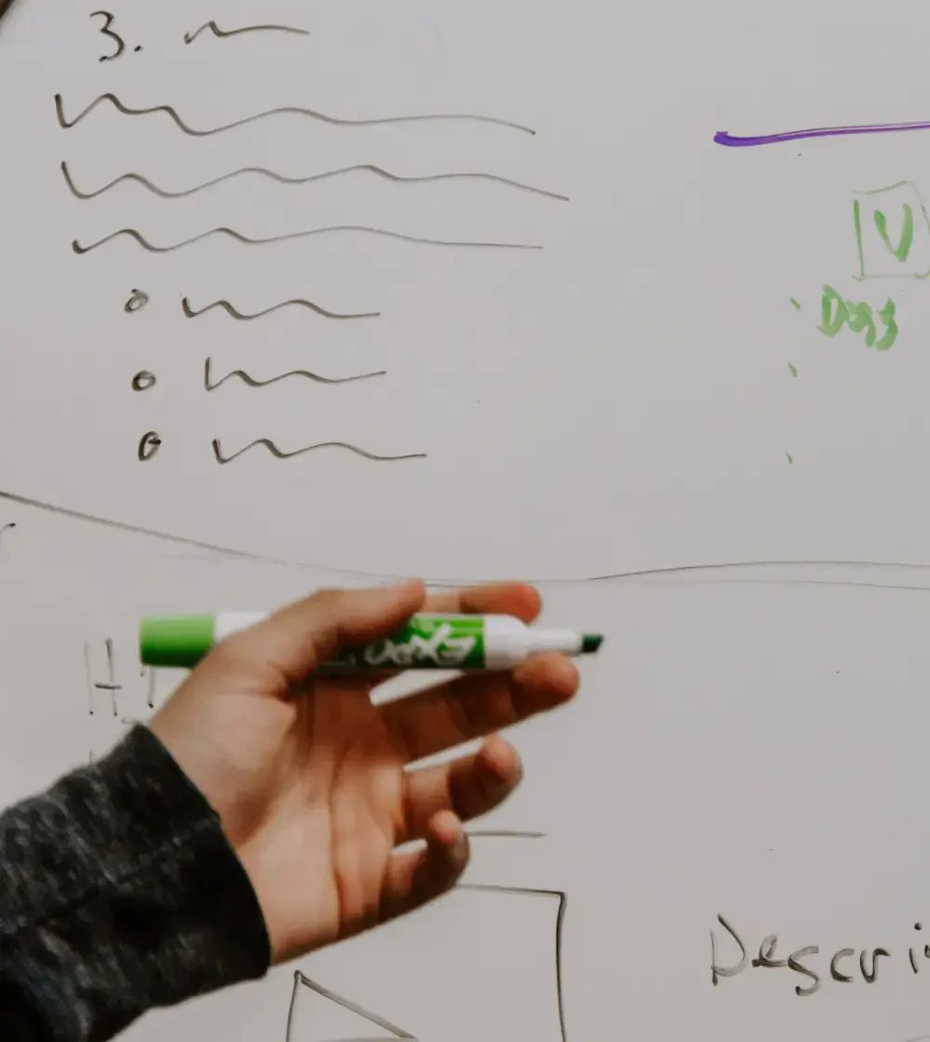


A good algorithm
The algorithm
must
be public
Public algorithms can be continuously
analyzed and validated from everyone.
The security is in the parameters
The parameters must be chosen so that brute
forcing is unfeasible.

Slide 20
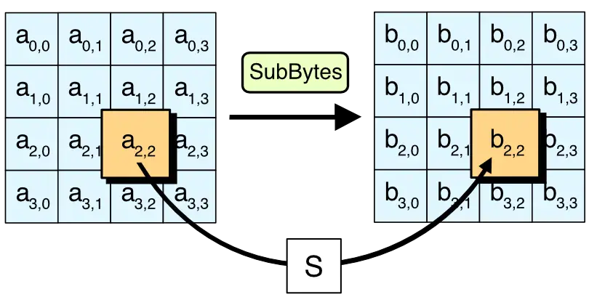
What are our choices today?
The
Advanced
Encryption
Standard
(AES)
is
a
secure
symmetric
block
algorithm.

Slide 21
Let's make the communication secure
Before
starting
encrypting
the
traffic,
the
peers
have
to
choose
a
shared
key.
Shared
key
handshaking
is
not
and
cannot
be
encrypted.
Anybody
could
steal
the
key.

Slide 22

Do we have a
solution?

Slide 23
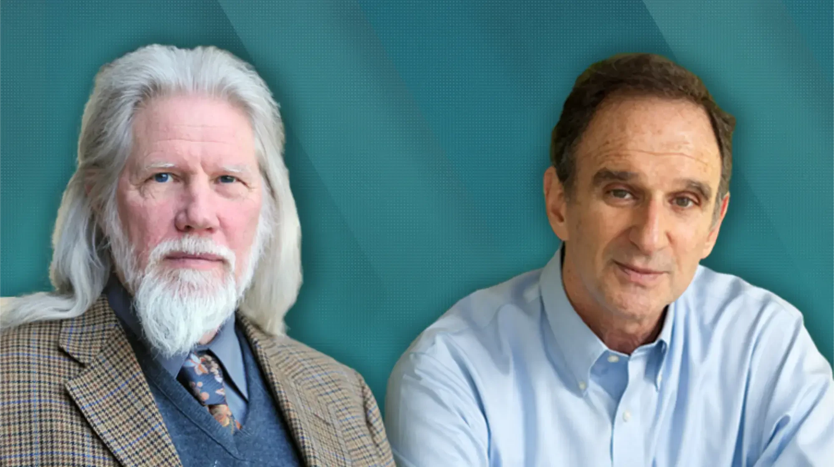
Of course!

Slide 24



The Diffie-Hellman algorithm
Brings security in the insecurity
It allows to securely exchange cryptographic keys over a public channel.
Strong mathematical basis
It uses asymmetric keys to build a shared key.
It is fast and easy to implement
Keys can (and should) be rotated with each message to improve security.

Slide 25

It's time to paint!

Slide 26
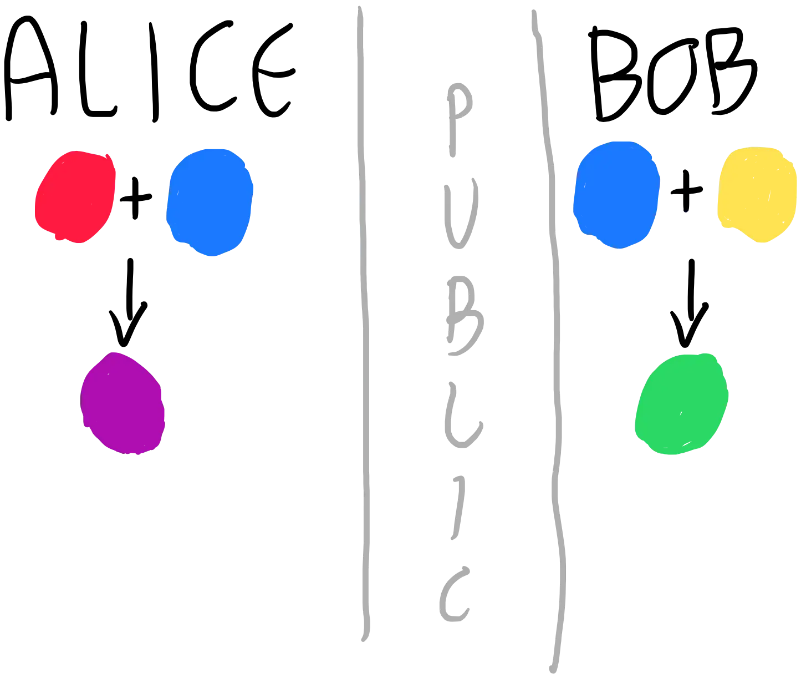
Generate the private and public keys

Slide 27
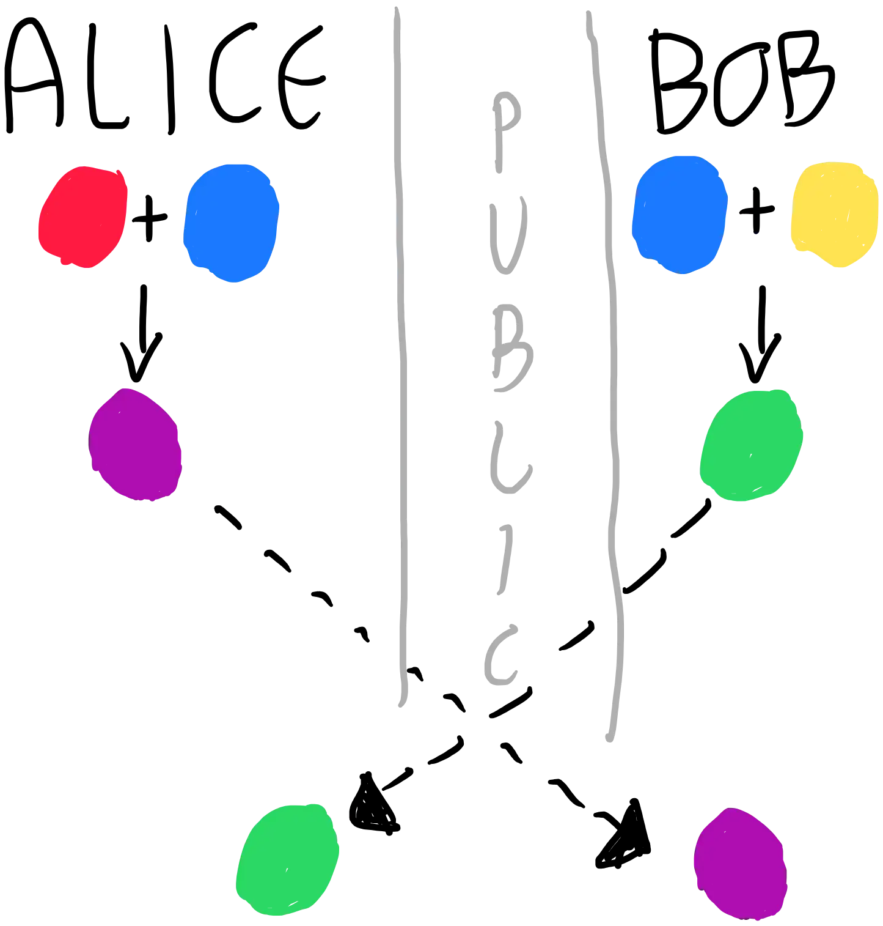
Exchange the public keys

Slide 28
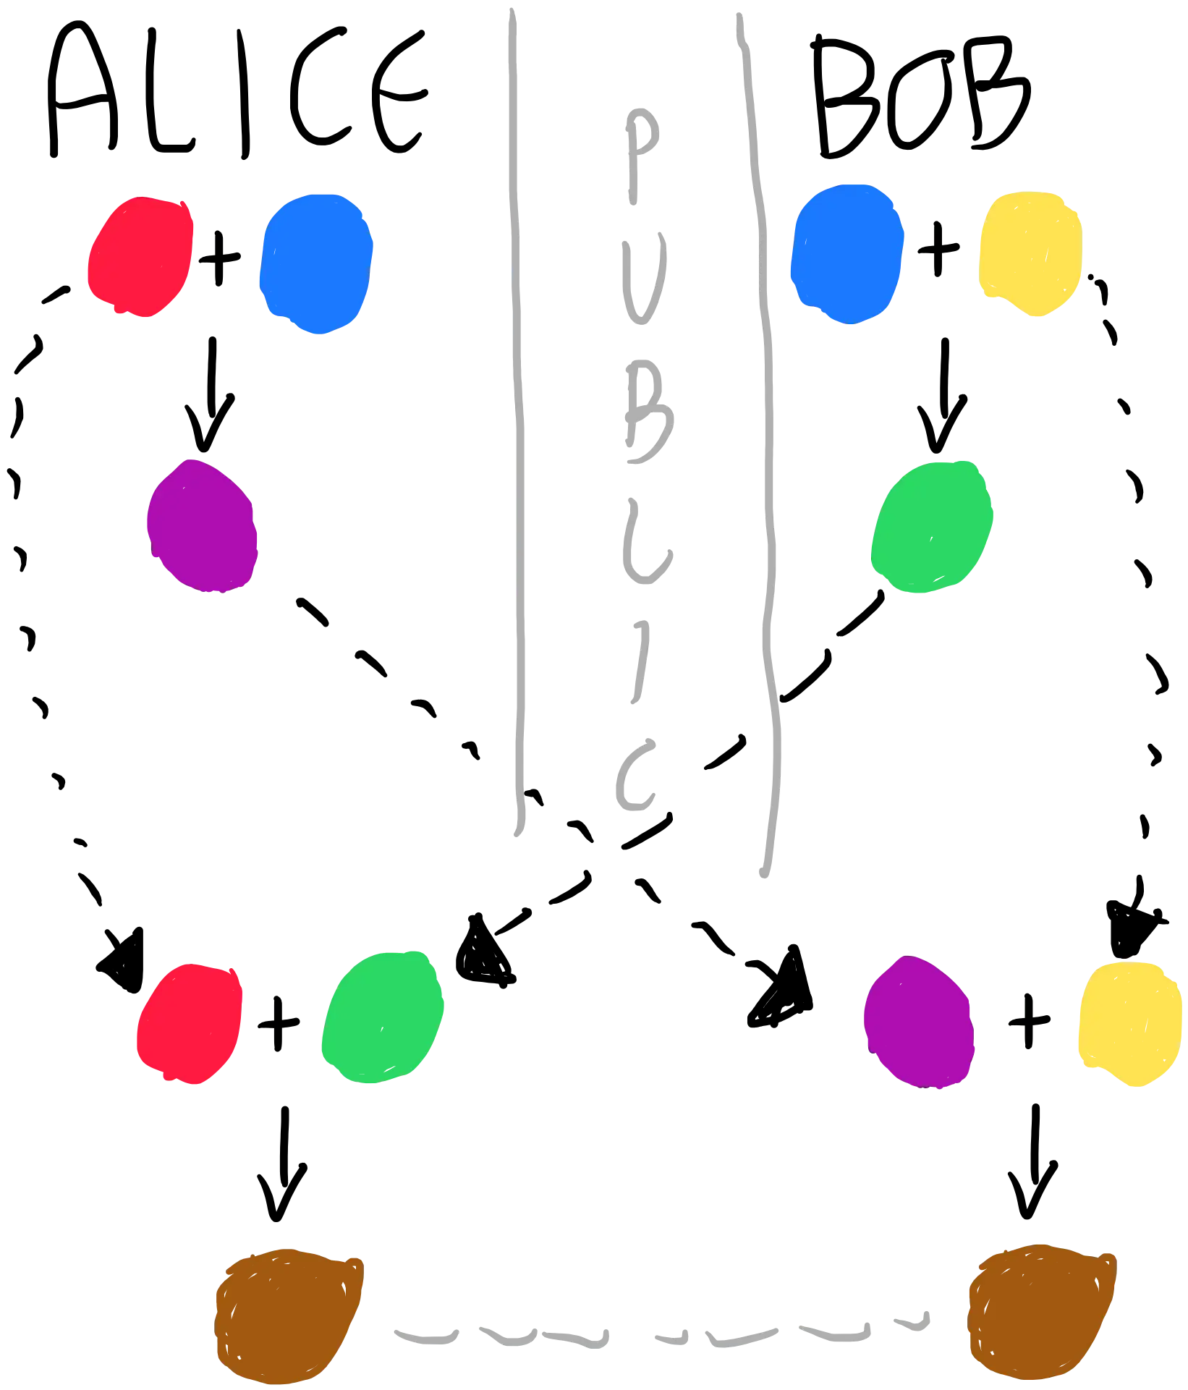
Generate the shared keys

Slide 29

Let's make some
m
a
th!

Slide 30
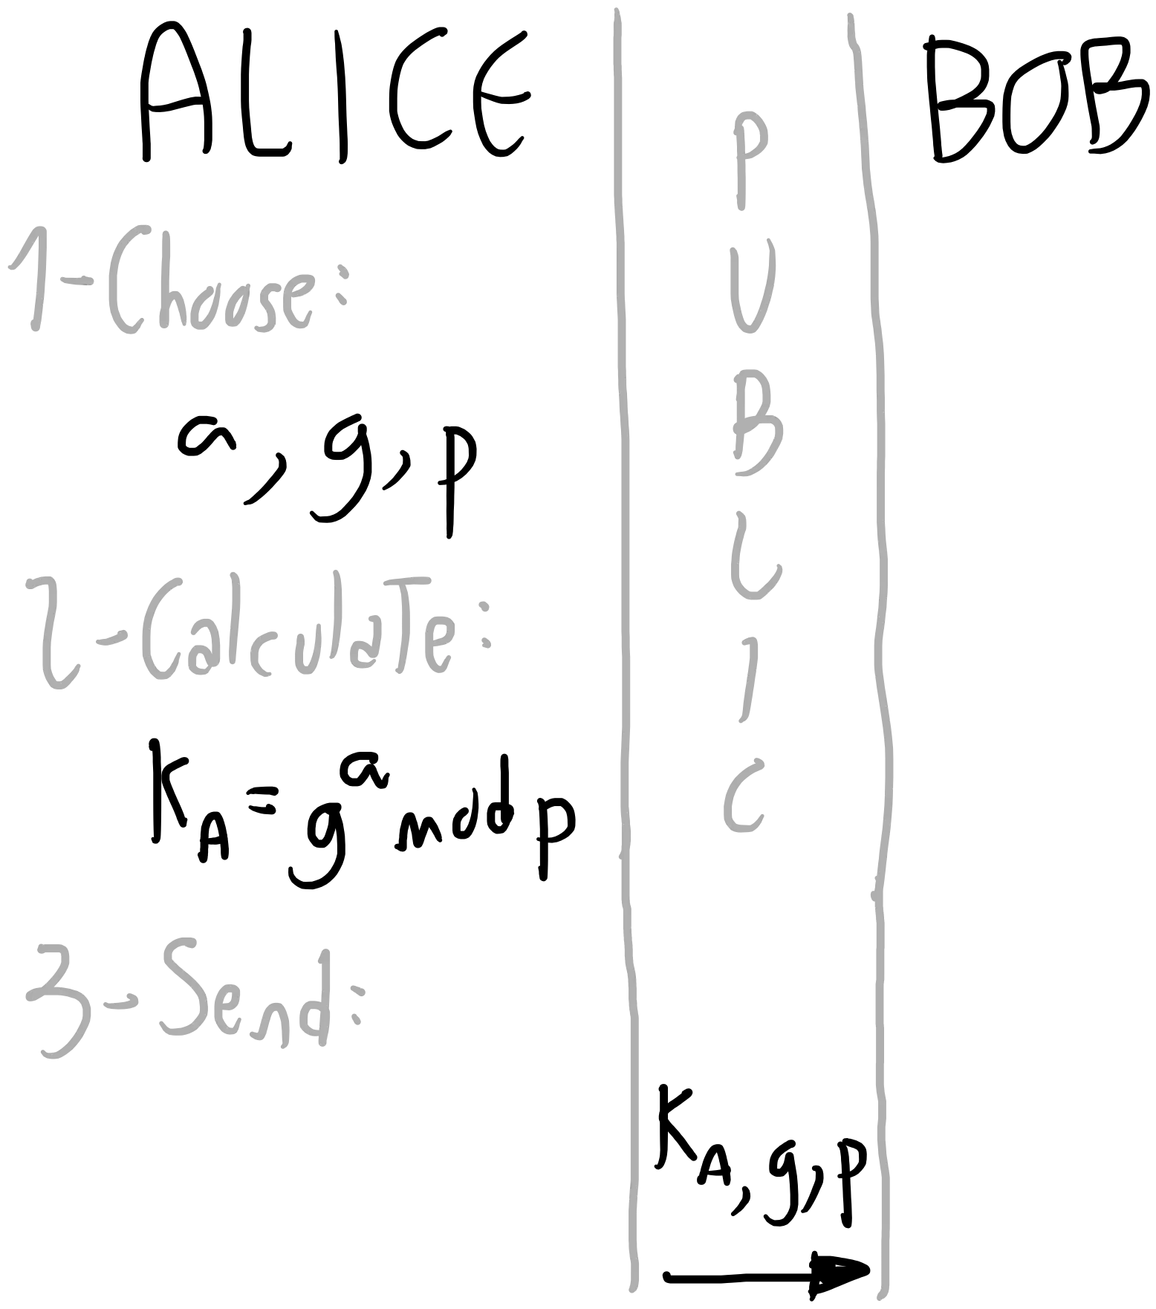
How is this possible?

Slide 31
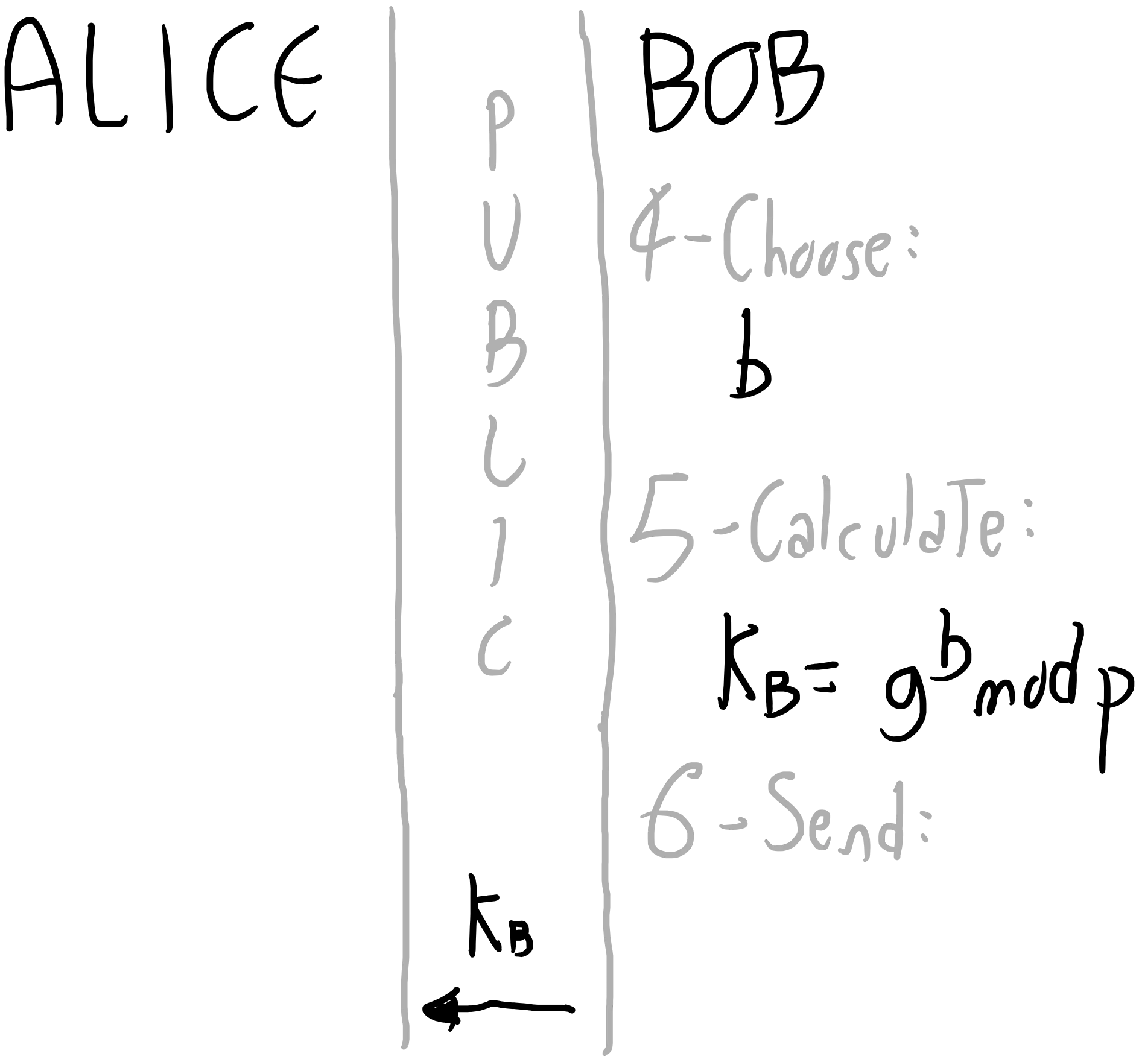
How is this possible?

Slide 32
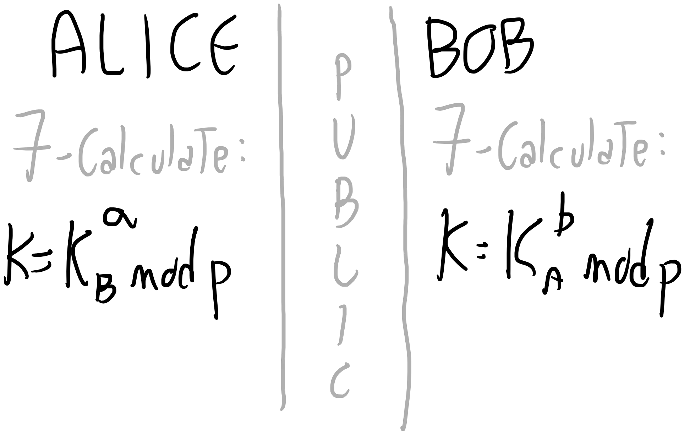
How is this possible?

Slide 33
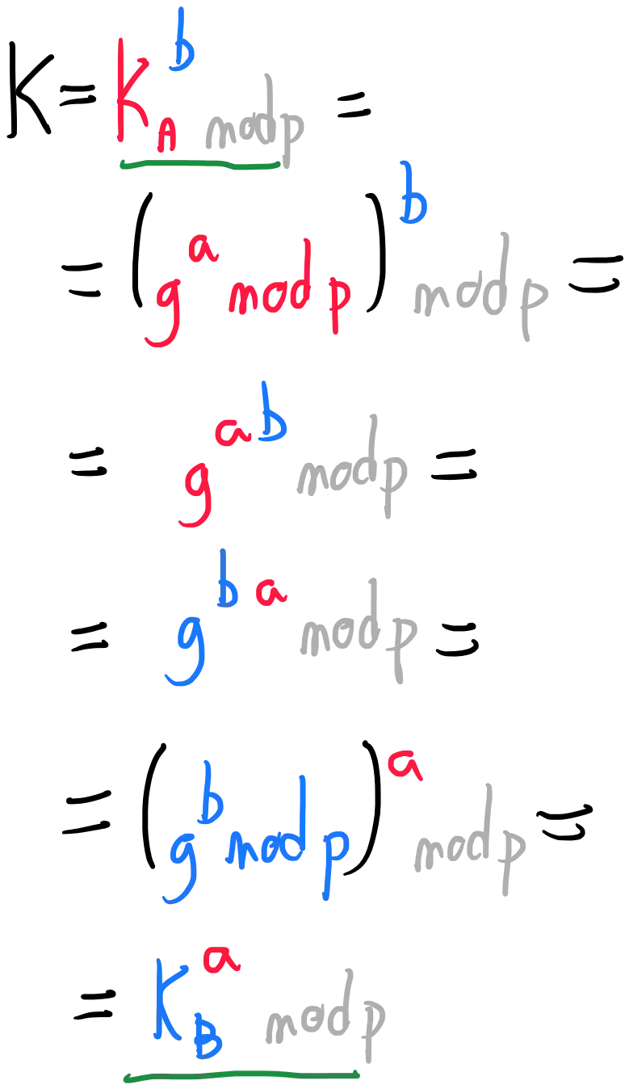
How is this possible?

Slide 34
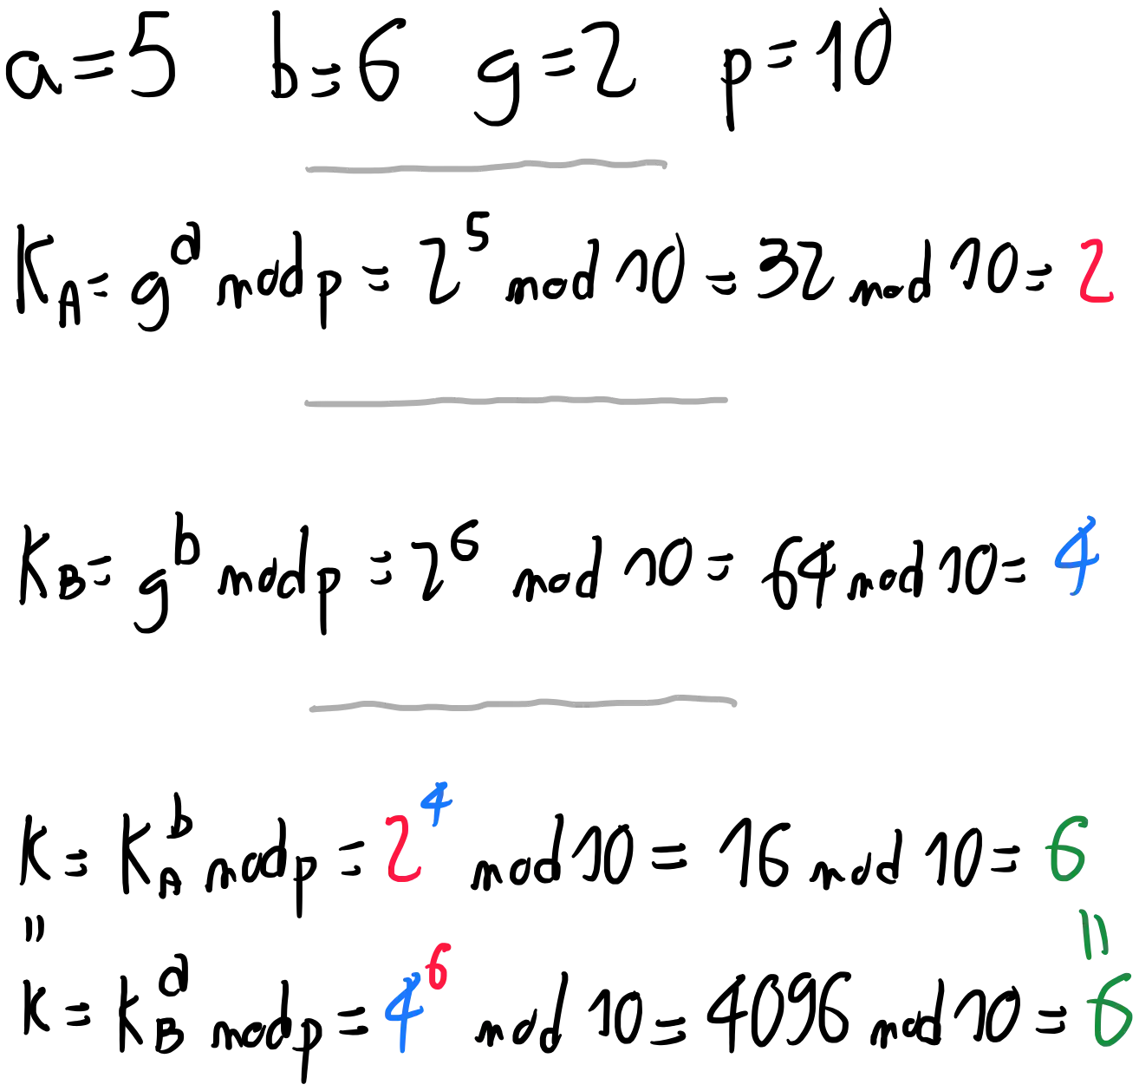
Let's prove it!

Slide 35


One last thing™
“The decisions we make about communication
security today will determine the kind of
society we live in tomorrow.”
Whitfield Diffie

Slide 36

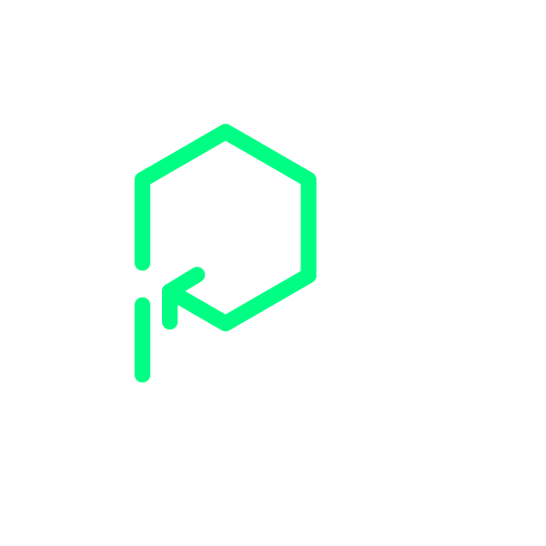
Thank you!
Paolo Insogna
@p_insogna
Platformatic
Node.js TSC, Principal Engineer
paolo.insogna@platformatic.dev

