Slide 1






View online
Horizontal Scaling of a Web3 system
Download PDF
to the sky and beyond in AWS
Paolo Insogna
Node.js TSC, Principal Engineer @
Platformatic

Slide 2

All you need to
succeed
is love!

Slide 3






Hello, I'm
Paolo
!
Node.js
Technical Steering Committee Member
Platformatic
Principal Engineer
paoloinsogna.dev
ShogunPanda
p_insogna
pinsogna

Slide 4

IPFS (InterPlanetary FileSystem)
A
protocol
designed
with
the
intention
to
preserve
and
grow
humanity's
knowledge
by
making
the
web
upgradeable,
resilient,
and
more
open.

Slide 5

web3.storage
A
service
that
makes
storing
files
on
IPFS
easier
and
more
accessible
for
non-technical
people.

Slide 6
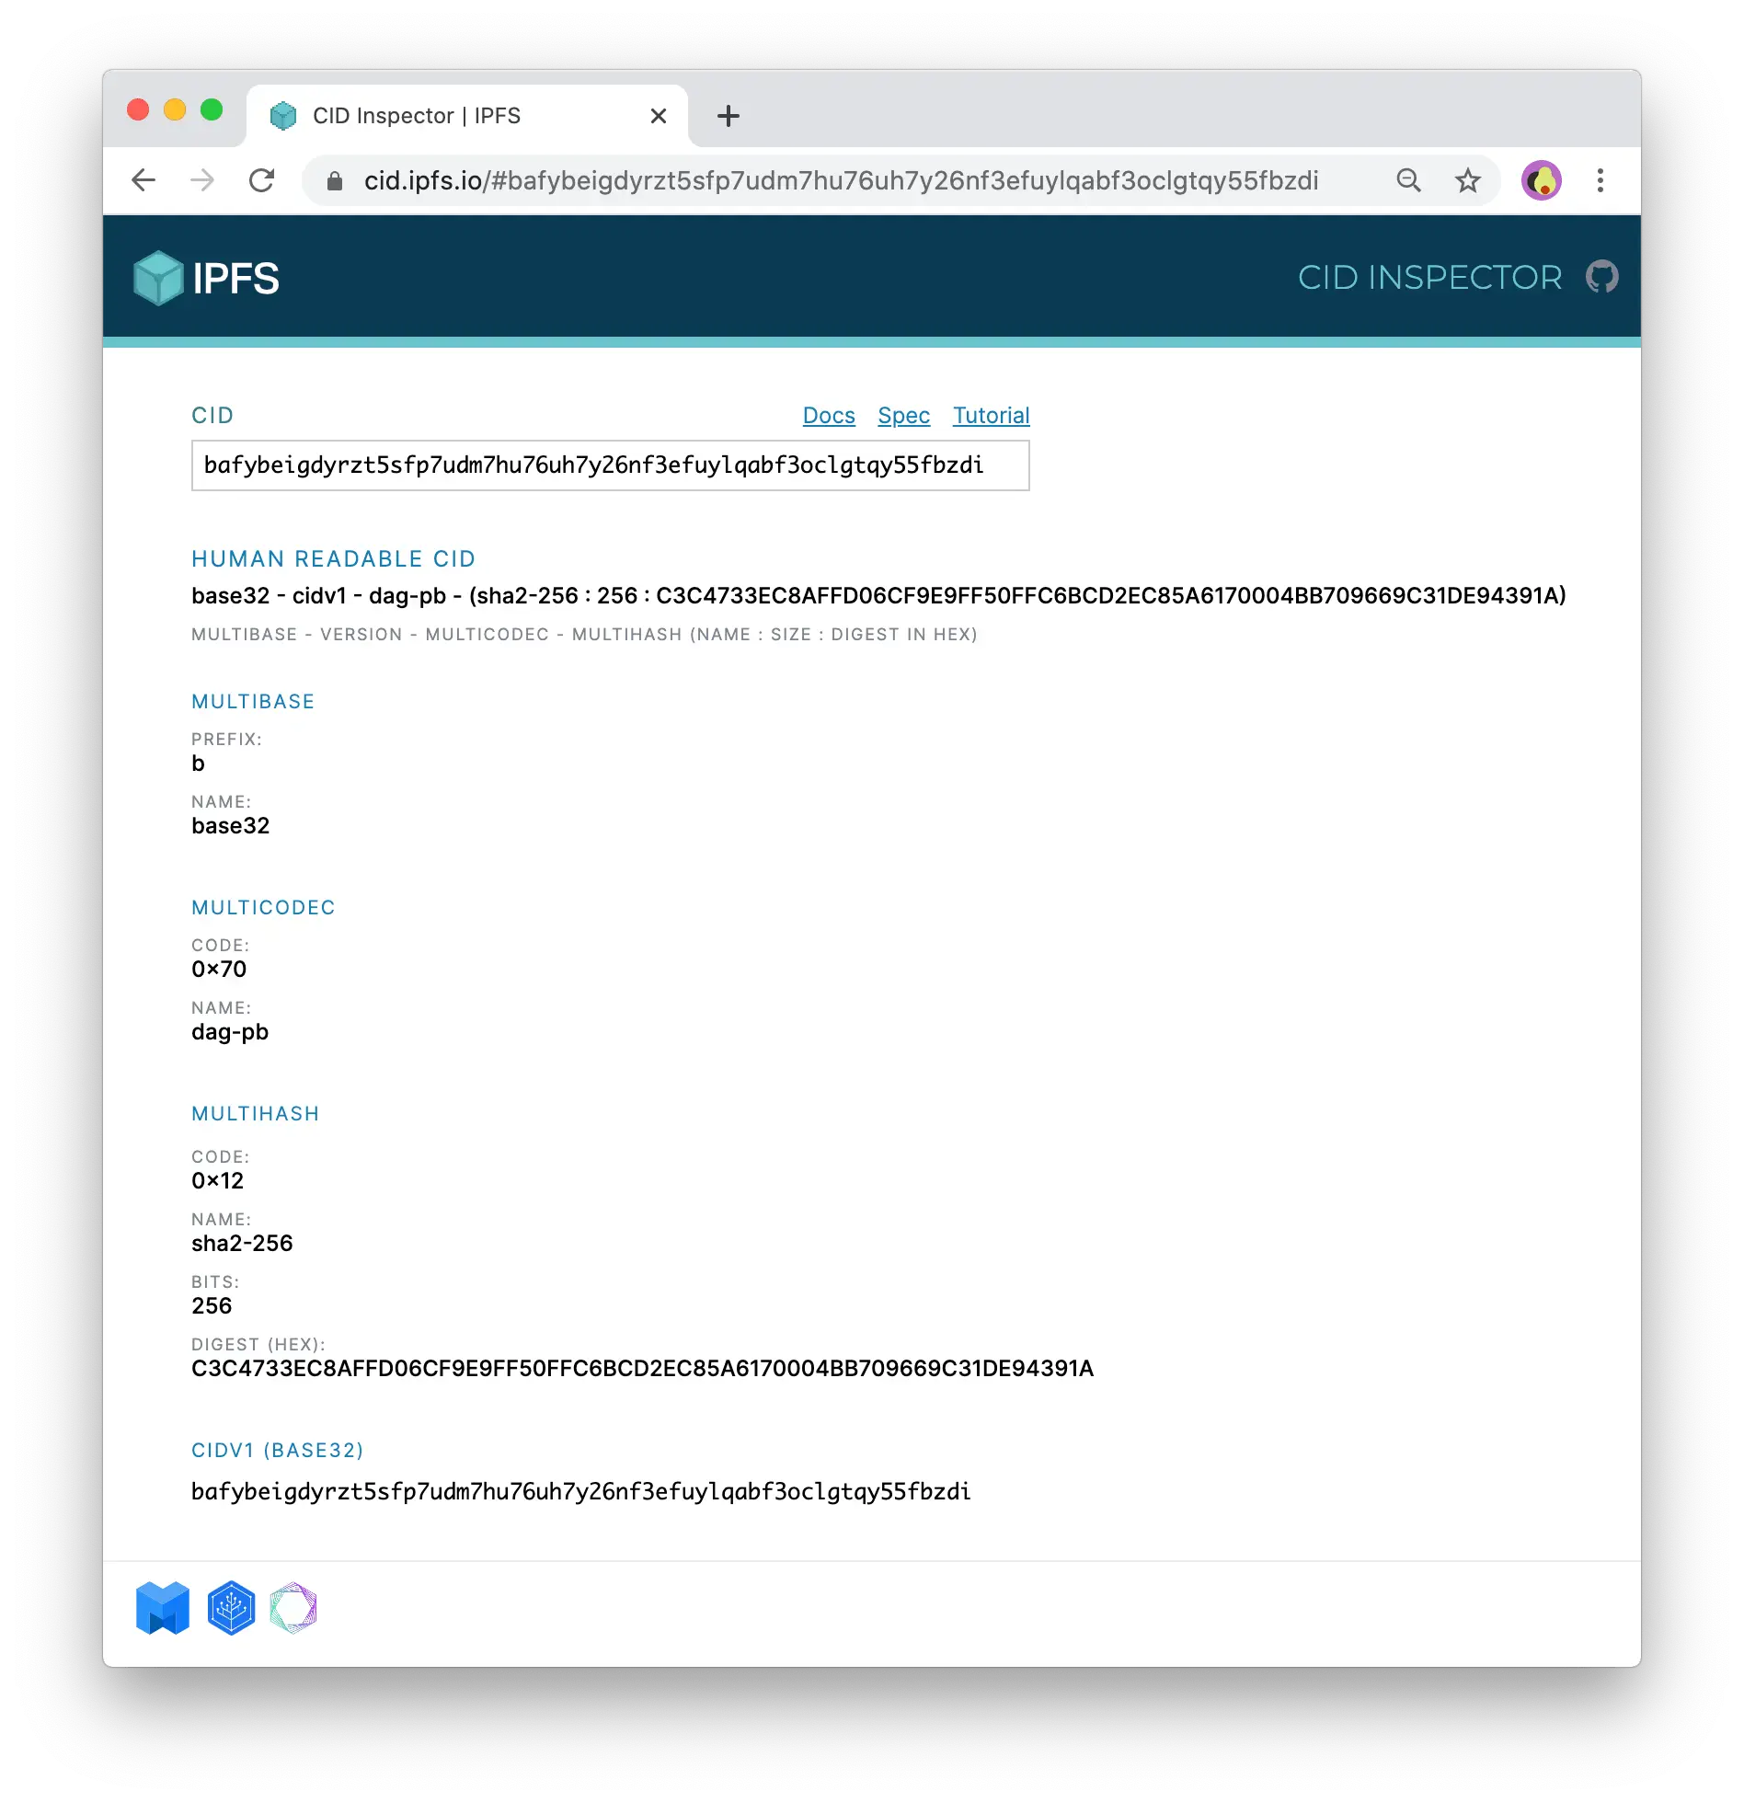
Content Identifier
A
CID
uniquely
identifies
a
chunk
of
data
in
IPFS
and
provides
information
on
how
to
verify
the
integrity
of
the
data.
It
does
not
contain
any
information
about
the
location.

Slide 7
Content Archives
The
CAR
file
format
is
optimized
for
sequential
reading
and
it's
essentially
a
concatenation
of
blocks
delimited
using
byte
length
prefixes.
| ---------- Header --------- | | ------------------------ Data ----------------------- |
| | | |
| [ varint | DAG-CBOR block ] | | [ varint | CID | block ] [ varint | CID | block ] ... |

Slide 8

What was wrong?

Slide 9


Previous Challenges
Increasing traffic
Hard to scale
The original implementation struggled to
New nodes could not be quickly added on-
handle the massive daily upload traffic.
demand due to the long bootstrap phase.

Slide 10

What was the
problem?

Slide 11
One simple question
“How can we use AWS services to make the service
horizontally scalable with no limits?”

Slide 12


Goals
Handle growth
Stateless services
Cloud based
The system should be able to
Having stateless services helps
The entire architecture should
handle the massive amount of data
horizontal scaling and greatly
leverage any modern cloud
uploaded on web3.storage.
improves fault tolerance.
services and try to be affordable.

Slide 13

The solution

Slide 14
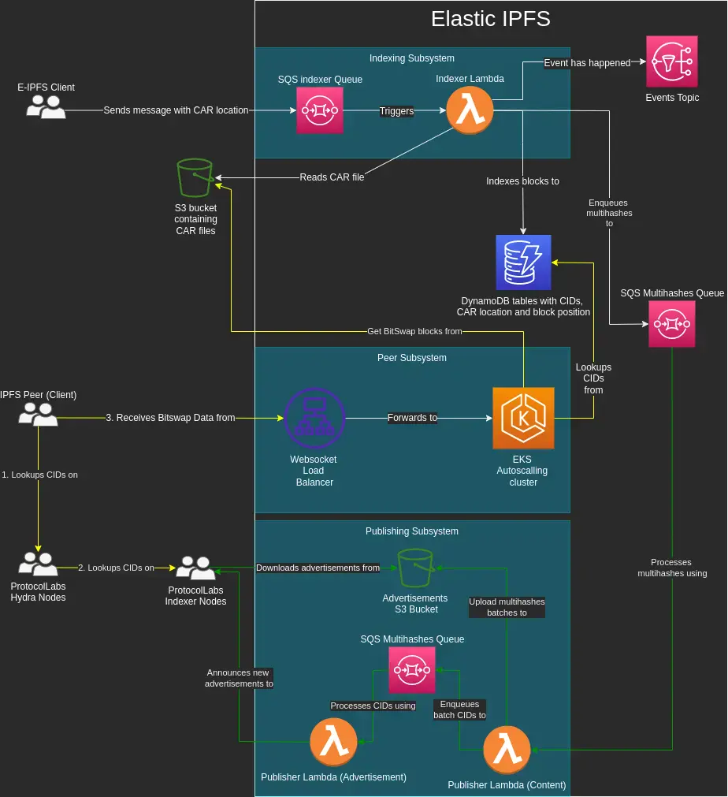
Hi, I'm Elastic IPFS!
The
architecture
is
divided
into
three
independent
and
stateless
subsystems.
New
nodes
can
be
added
or
removed
at
any
time,
global
replication
can
be
easily
achieved.
https://github.com/elastic-ipfs/elastic-ipfs

Slide 15



E-IPFS is democratic and cloud agnostic
No vendor lock-in
The AWS implementation is just the first implementation and it can also serve as reference
implementation for testing.
Generic components
As long as you have object storage, queueing and serverless systems, you can adapt and
deploy E-IPFS.
The DevOps are your limit
Mixed or on-premise approach are also possible, but be gentle with the people responsible
to maintain the infrastructure.

Slide 16
CARs Table Item
It
contains
information
about
indexed
CAR
files,
including
the
S3
full
path.
interface Car {
path: string
bucket: string
bucketRegion: string
createdAt: Date
fileSize: number
key: string
roots: Array<string>
version: number
}

Slide 17
Blocks Tables Item
It
stores
the
multihash
and
the
type
of
the
block,
used
for
debugging.
interface Block {
multihash: string
createdAt: Date
type: 'raw' | 'dag-cbor' | 'dag-json'
}

Slide 18
Blocks Position Item
The
most
important
table
in
the
architecture
It
links
blocks
to
CARs,
including
offset
and
length.
interface BlockToCars {
blockmultihash: string
carpath: string
length: number
offset: number
}

Slide 19
Indexing subsystem

Slide 20
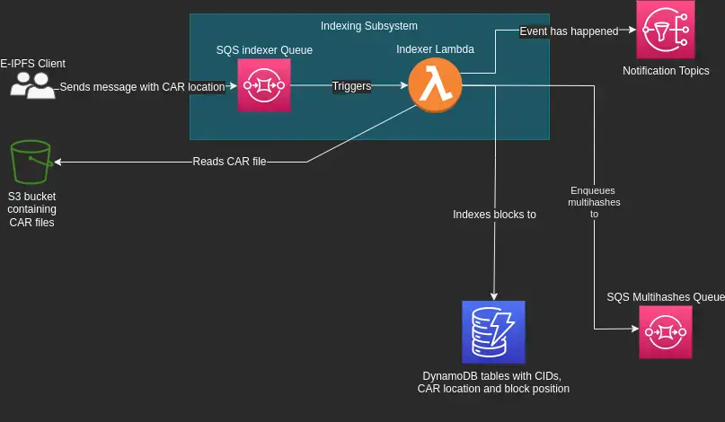
Overview

Slide 21
Indexing flow
1
CAR file is copied to S3
The event is recorded on a SQS topic which will later trigger Indexing Lambda executions.
2
Indexing Lambda executes
The Lambda processes the CAR file and copies all the relevant information in the DynamoDB
tables showed earlier.
3
Blocks are enqueued for publishing
For each block encountered in the CAR file, the Indexer Lambda enqueues its multihash in a
SQS topic which will later trigger Publishing Subsystem execution.

Slide 22


Bye, Idempotence!
The Lambda was idempotent
Indexing has very low failure rate
It required lots of additional reads on
Idempotence was removed as indexing rarely
DynamoDB and made batching unavailable.
failed and this brought big performance gain.

Slide 23
Let's talk about DHT

Slide 24



DHT Challenges
IPFS
uses
the
Kademlia
DHT
for
keeping
peers
and
blocks
information.
The Elastic IPFS claims to be a single node
Even though internally a lot of resources are used, only one
PeerID
is used.
No long connection
E-IPFS cannot directly participate to the DHT as it is not capable to connect to GossipSub.
Not self sufficient
In order to advertise content, the E-IPFS systems needs external auxiliary systems.

Slide 25

Hydra Nodes
The
Hydra
nodes
speed
up
looking
up
content
in
the
DHT.
When
What
Where
Hydra nodes are created to have
Content Routing Delegation via
The Hydra nodes are distributed in
an high chance to incur into one of
shared storage and third party
the DHT sense, not the
them when looking up data.
systems as the Indexer Nodes.
geographical one.

Slide 26
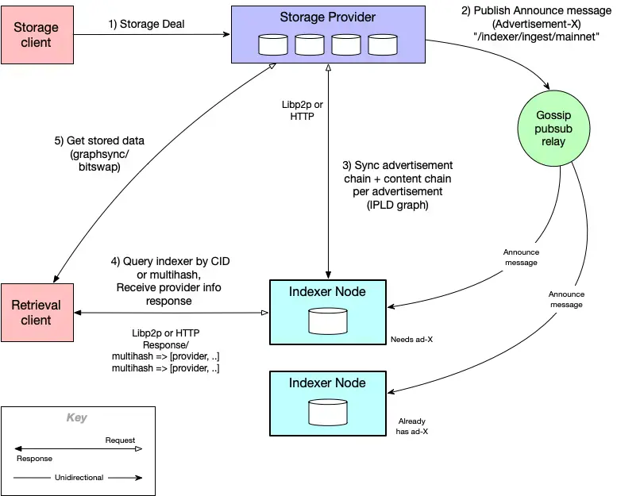
Indexer Nodes
A
system
which
maps
CID
to
content
providers
via
libp2p
or
HTTP
API.

Slide 27



What API shall we use?
E-IPFS
uses
the
HTTP
API
as
GossipSub
is
not
viable
for
the
reasons
below.
E-IPFS is on the cloud
GossipSub is verbose
libp2p optimization conflict
Maintaining long living connection,
A lot of data is exchanged and it
Destination host joins multiple
when possible, is expensive.
will impact costs as well.
streams with the same
PeerID
.

Slide 28



How does HTTP ingestion work?
The
HTTP
Ingest
API
make
the
Indexer
Nodes
choose
when
to
sync.
Upload new advertisements and entries data
The data must available over HTTP.
Advertisements are strictly ordered
Each is linked to the previous one. The
/head
one is regularly updated.
Notify Indexers on
/ingest/announce
when ready to be queried
HTTP PUT
requests will signal that new data has been published.

Slide 29
What will the Indexer Node do?
When
ready,
the
Indexer
Node
will
sync
via
the
HTTP
server.
1
Fetch the latest
/head
URL
It contains the latest advertisement data CID.
2
Fetch the advertisement data and its related entries data.
All the data we are interested into is in these files.
3
Repeat the flow
Stop when reaching an already indexed advertisement or the tail of the chain.

Slide 30
Head file
The
/head
just
maintains
a
link
to
the
latest
advertisement.
{
"head": {
"/" : "bagugeeragtbtgeb2iulx2zihnymysaebais6ysziefwih66tyc7pupns2bma"
},
"pubkey": {
"/": {
"bytes" : "CAASpgIwgg ... 9bAgMBAAE="
}
},
"sig": {
"/": {
"bytes": "hq9N33rQSZ ... BSHcoQLcbw=="
}
}
}

Slide 31
Advertisement file
It
contains
information
about
storage
provider
and
entries.
{
"Addresses" : ["/dns4/peer.ipfs-elastic-provider-aws.com/tcp/3000/ws"],
"ContextID": {
"/": { "bytes": "YmFndXF1ZXJ . .. dpdnhyYQ==" }
},
"Entries": {
"/" : "bagugeeraijghexgvdvLuk3pwd6axbvzcajhd3pylz7sm3sfaitc7lnwivxra"
},
"IsRm": false,
"Metadata": { "/": { "bytes": "gBI" } },
"PreviousID": {
"/" : "bagugeeraii6bahmbnnijhakhyscrlkcblwpwdvahzt53vzhd2jfryj43ebag"
},
"Provider": "bafzbeibhqavlasjc7dvbiopygwncnrtvjd2xmryk51aib7zyjor6kf3avm",
"Signature": { "/": { "bytes": "CqsCCAASpg ... y/yqKWQ" } }
}

Slide 32
Entries file
It
is
just
a
list
of
CIDs
made
available
by
the
provider.
{
"Entries": [
{
"/" : { "bytes": "EiCvOxoqEOhmarwWow7nY+bw2JL6SiLEYigT400EnBMeZA==" }
},
{
"/" : { "bytes": "EiBOIwugRMRrvV3LFB7i3ixzaY5XTBASznCwwTWIu9Mx3g==" }
},
{
"/" : { "bytes": "EiDc5NKXBT8ZSNfLDhTs2+72ZZ94qfruS]QEfJVM70XB6w==" }
}
]
}

Slide 33
Publishing subsystem

Slide 34
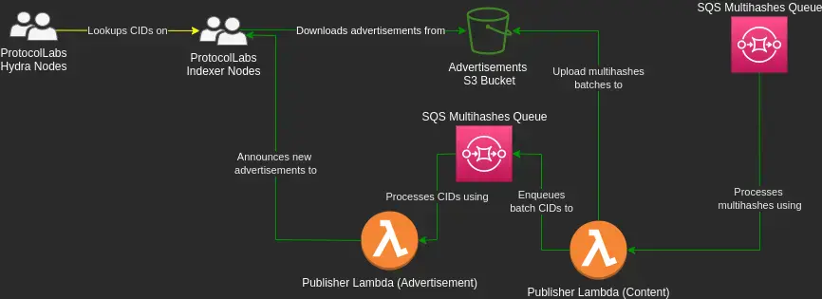
Overview

Slide 35

Concurrency Problem
Handle
the
huge
load
without
losing
data
is
challenging.
Several millions of blocks are uploaded every day
The ingestion queue can easily explode.
No advertisement can be lost
If data is not correctly received by the Indexer, it will be unreachable.
The head of the queue must be updated atomically
Concurrency control must be applied to the processors.

Slide 36

What now?

Slide 37
Publishing flow
The
solution
was
to
split
the
publishing
process
into
two
steps
in
order
to
reduce
the
size
of
the
problem.
1
Group indexed blocks into entries file
The
resulting
subsystem
is
Concurrency is not limited as order does not matter.
capable
to
easily
advertise
a
billion
blocks
per
day
.
2
Assign entries to ads, then update the head
Concurrency is limited to
1
, with
10000
advertisement sent
per execution.

Slide 38
Peer subsystem

Slide 39
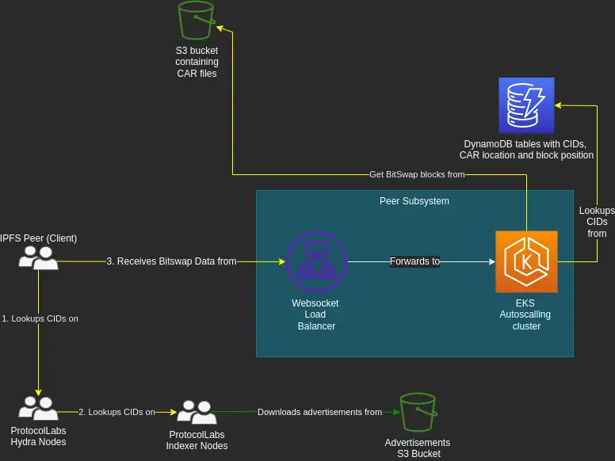
Overview

Slide 40

Peer subsystem characteristic
Fully automatic
Stateless and lean
Simplified BitSwap
The subsystem is an autoscaling
Searches for blocks on DynamoDB
No external data is fetched,
EKS Node.js cluster managed by
and leverages plain HTTP Byte-
allowing to ignore wantlists and
an Elastic Load Balancer.
Range on S3 for serving.
ledgers management.

Slide 41
How does E-IPFS perform?

Slide 42
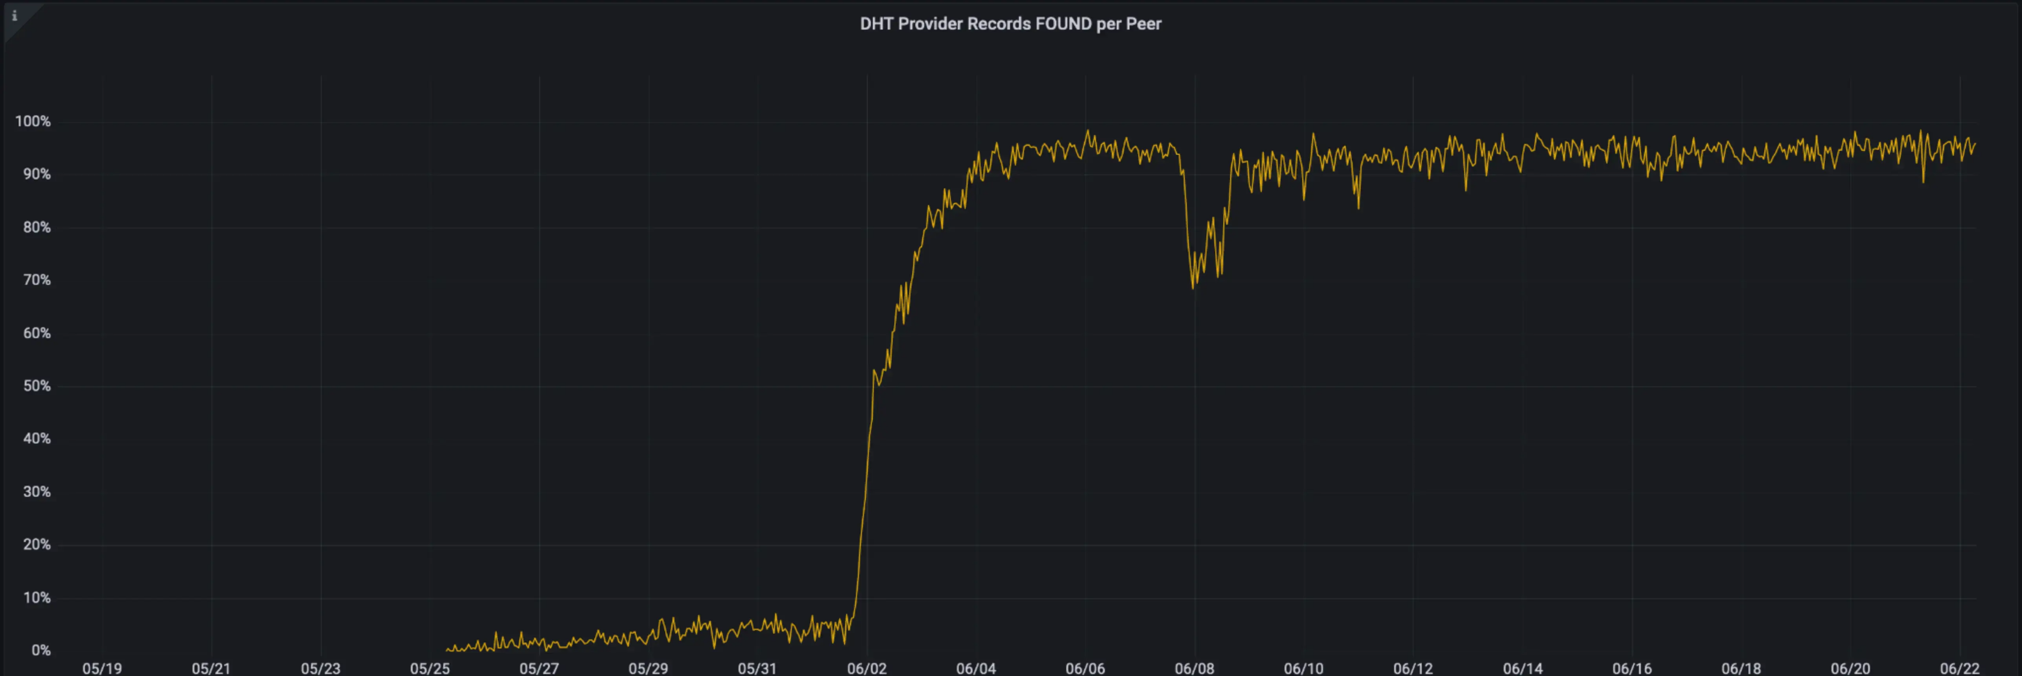
Hit rate went almost to 100%
The
graph
shows
the
hit-rate
across
200TB
of
data.

Slide 43
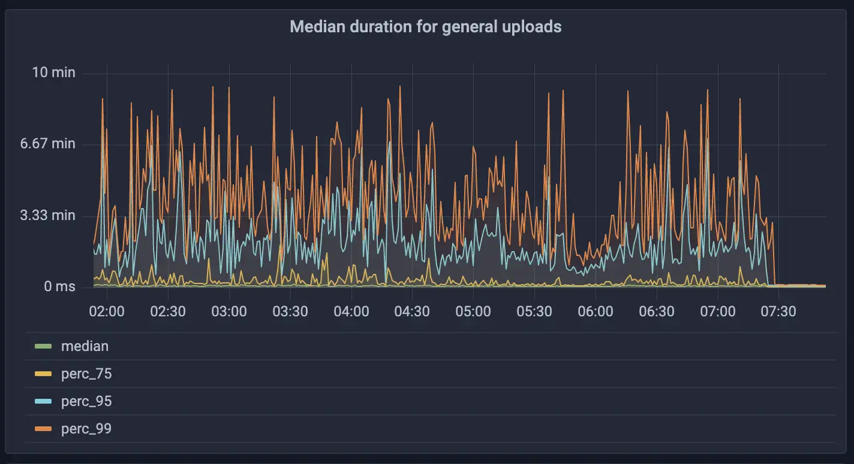
The average indexing time has dropped

Slide 44
Give me the numbers!
Here
are
the
numbers
after
six
months
in
production.
180M
16B
24B
CARs
Blocks
Blocks to Cars

Slide 45

Take home lessons
What
can
we
learn
from
this
long
journey?
K.I.S.S.
HTTP is not dead yet
Democracy is good
IPFS protocols are very complex.
New protocols are very
Being unable to lock in a single
Simplifying is the only way to have
fashionable, but the good old
cloud provider led to flexible and
viable products.
HTTP can still be very performant.
lean architecture.

Slide 46


One last thing™
“Keep your eyes on the stars,
and your feet on the ground.”
Theodore Roosevelt

Slide 47


Thank you!
Paolo Insogna
@p_insogna
Platformatic
Node.js TSC, Principal Engineer
paolo.insogna@platformatic.dev

