Slide 1






Platformatic
View online
Project Destino:
Doom In The Terminal
Download PDF
with Node.js and OpenTUI
Paolo Insogna
Node.js TSC, Principal Engineer

Slide 2

STFU!

Slide 3






Hello, I'm
Paolo
!
Node.js
Technical Steering Committee Member
Platformatic
Principal Engineer
paoloinsogna.dev
ShogunPanda
p_insogna
pinsogna

Slide 4



Some companies trusting us
Article
Case Study
Case Study

Slide 5

This started
as a joke...

Slide 6
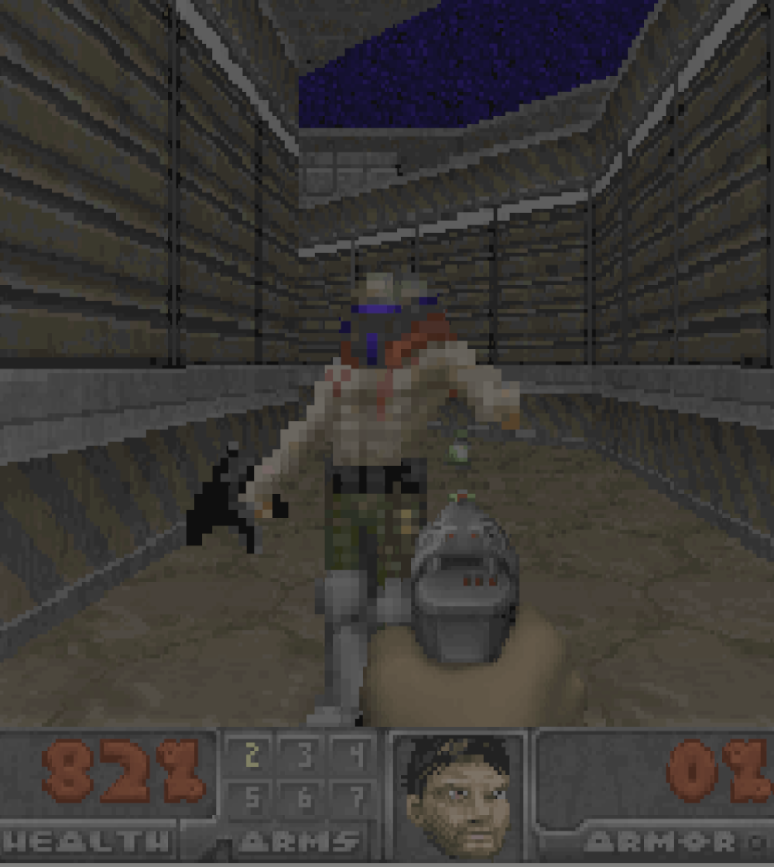
... and now we have
Doom in the
terminal!

Slide 7

The joke was simple
1
Doom can run everywhere.
Like a pregnancy test.
2
Node.js can now run native code.
Surprisingly, this was missing.
3
Why not run Doom in a terminal?
I mean, why not?

Slide 8
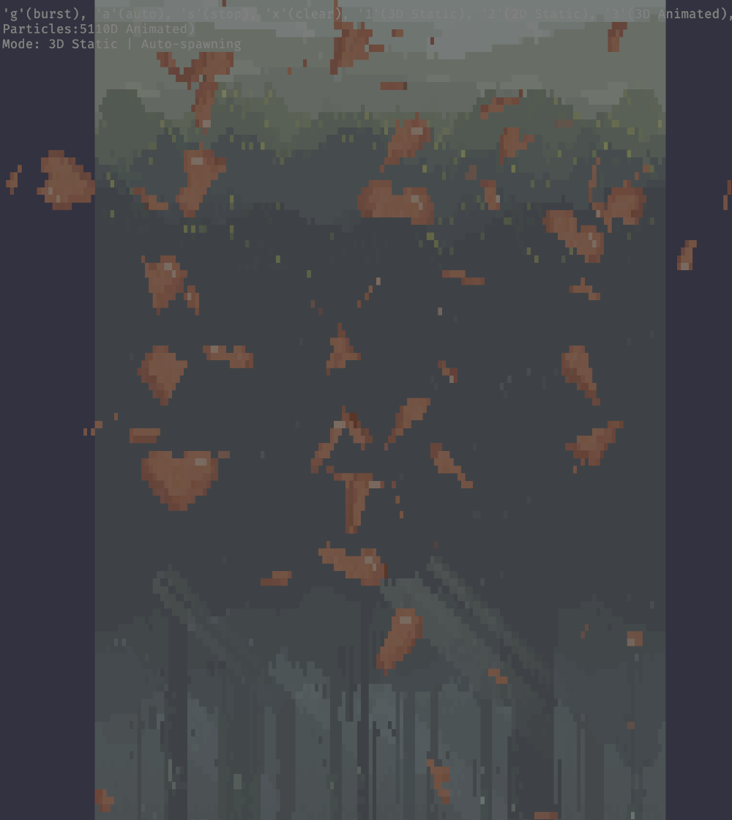
The
terminal
is the
new
UI.
Thanks
to
AI.
🤷

Slide 9

OpenTUI
A
native
terminal
UI
core
written
in
Zig
with
TypeScript
bindings.
It
powers
OpenCode.
https://github.com/anomalyco/opentui

Slide 10



They really push the terminal hard
More than text
Terminal interfaces can combine text and graphics through dedicated protocols.
Refresh rates matter
Dynamic interfaces need redraws that feel immediate.
OpenCode proves the edge
Complex tools can live where terminals usually break.

Slide 11
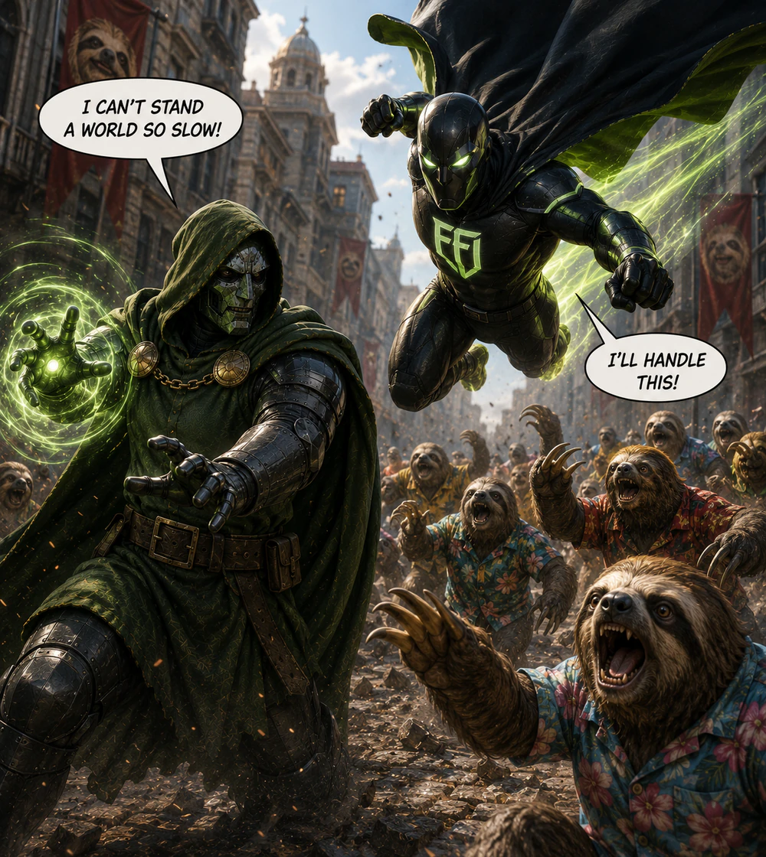
But this is not
only about Doom.

Slide 12


What is FFI?
Foreign Function Interface
A bridge that lets code call functions from another runtime.
C as the common ground
Most native libraries expose symbols using the C calling convention.
Languages can talk
If both sides understand the ABI, JavaScript can call native code.

Slide 13
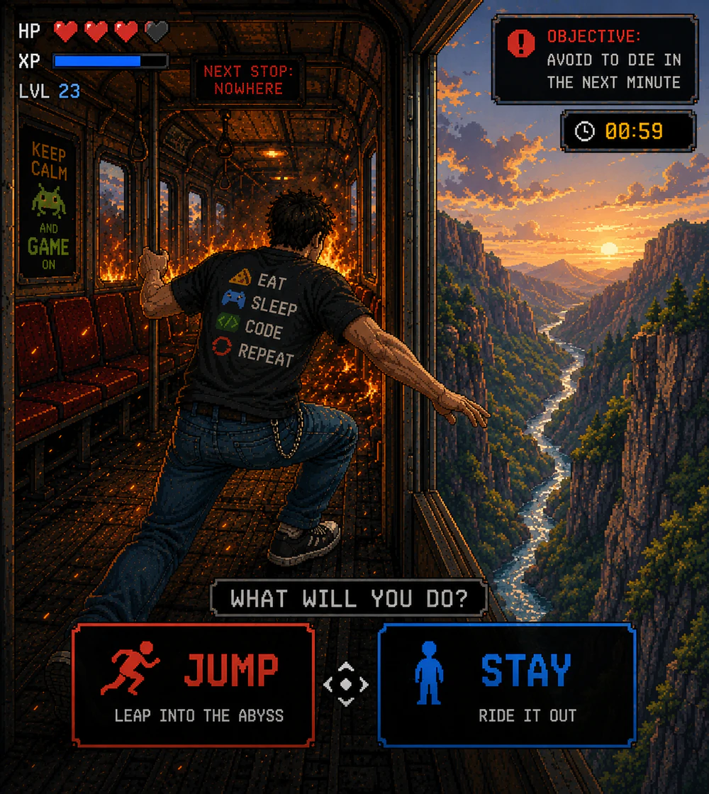
Before FFI,
we had choices.

Slide 14


The "choice"
Native addons
Not direct enough
Powerful, but abstractions like NaN
You still had to write a lot
used to break with Worker Threads.
of glue code around the library.

Slide 15

Say hello
to
node:ffi
.

Slide 16
node:ffi
changes the shape.
Load
a
shared
library,
describe
the
ABI,
and
call
native
symbols
directly
from
JavaScript.
import { dlopen } from 'node:ffi'
const { functions } = dlopen(libPath, {
doomgeneric_Tick: { arguments: [], return: 'void' },
send_key: { arguments: ['uint8', 'int32'], return: 'void' },
get_framebuffer: { arguments: [], return: 'pointer' }
})

Slide 17



The boundary is explicit
Symbols are named
JavaScript points at the native entry points directly.
Types are declared
Arguments and return values become part of the call site.
Risk is visible
The dangerous part is not hidden inside generated glue.

Slide 18

FFI is
very
powerful.

Slide 19

What can go
wrong?

Slide 20


Pretty much everything
And
this
is
because
you
are
in
full
control.
Signature mismatch
Unsafe memory access
One wrong type can shift registers, stack
A bad pointer can read freed memory or
slots, and return values.
overwrite valid data.

Slide 21
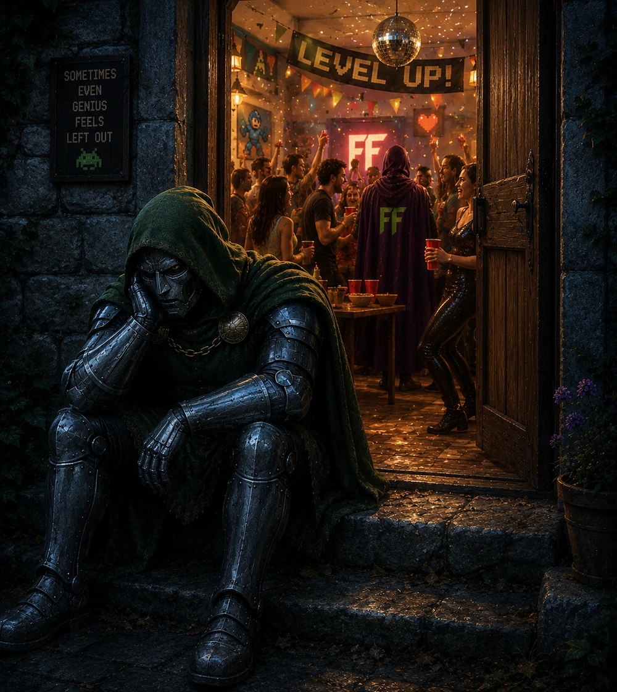
OK, but what
about Doom?

Slide 22

Say hi to
Destino
.

Slide 23
The Destino stack
1
Node.js (
https://github.com/nodejs/node
)
The best JavaScript runtime.
Ever.
😈 It coordinates native calls through
node:ffi
.
2
doomgeneric (
https://github.com/ozkl/doomgeneric
)
The game core and native adapters produce frames and audio samples.
3
OpenTUI + Kitty protocols + SDL3
Kitty Graphics presents frames; Kitty keyboard reports key releases; SDL3 plays audio.

Slide 24


How doomgeneric works
Doom stays portable
The platform fills the gaps
The engine calls a tiny platform layer for
Destino implements that layer as a native
video, input, timing, and shutdown.
library that JavaScript can drive.

Slide 25



Everyone owns a piece
Node.js owns the
Native code owns
OpenTUI and SDL3
loop and the loading
the game and audio mixing
handle output
It parses input and coordinates
The engine and audio backend
OpenTUI presents frames through
ticks, video, audio, and cleanup.
produce pixels and PCM samples.
Kitty Graphics; SDL3 plays PCM.

Slide 26
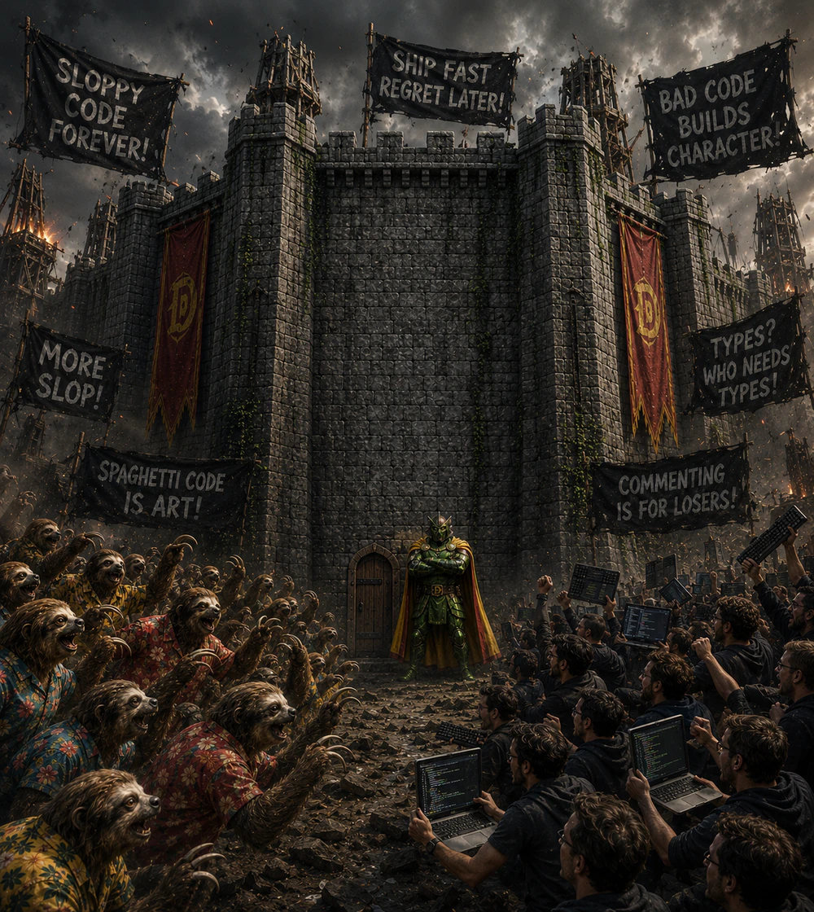
Keep the native
boundary explicit.

Slide 27



The C platform layer
Initialize and cleanup
Start Doom with assets and release native resources.
Advance ticks and deliver input
Let JavaScript drive the engine and forward key transitions.
Expose pixels and PCM
Give JavaScript a framebuffer and blocks of mixed audio.

Slide 28
The 35 Hz loop
// Simplified: error handling and cleanup omitted.
setInterval(() => {
engine.tick()
audio.write(engine.renderAudio())
renderer.render()
if (engine.quitRequested()) {
shutdown()
}
}, 1000 / 35)

Slide 29
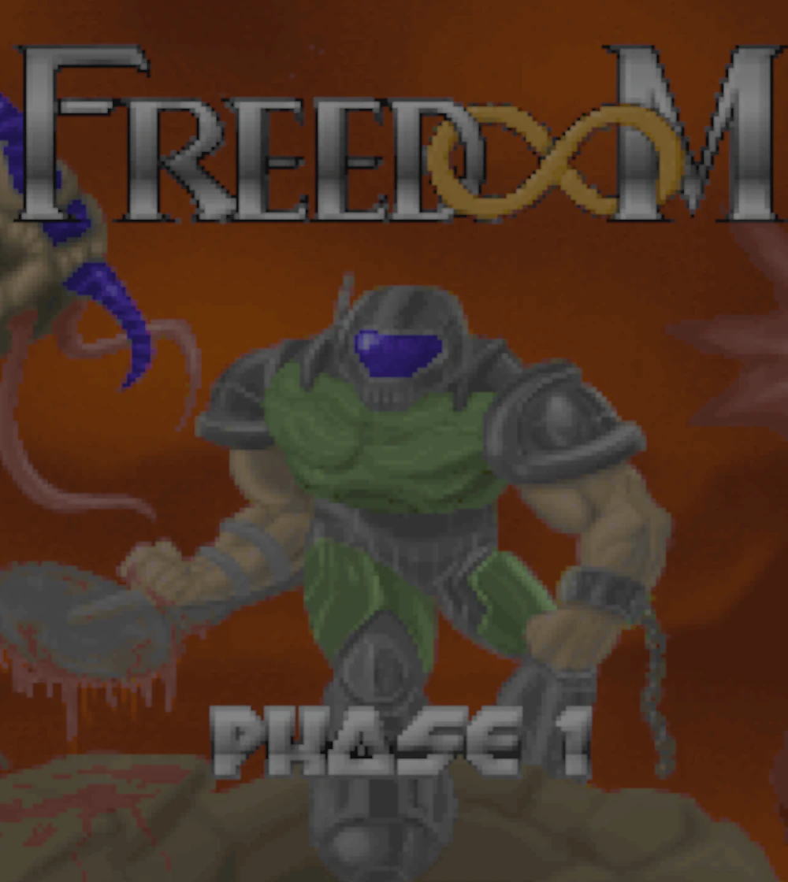
Now render Doom
in a terminal.

Slide 30



Framebuffer to terminal
Doom exposes BGRA
Native pixels are exposed through a borrowed Buffer.
JavaScript prepares RGBA
Channels are converted before passing the frame to OpenTUI through FFI.
OpenTUI speaks Kitty Graphics
Native rendering produces the terminal output.

Slide 31



Terminals are weird
Cells are not pixels
Geometry affects aspect ratio and perceived detail.
Layout can change
Resizing and font changes affect how the frame fits.
Negotiate, don't assume
Require Kitty Graphics and query pixel geometry, with no fallback.

Slide 32
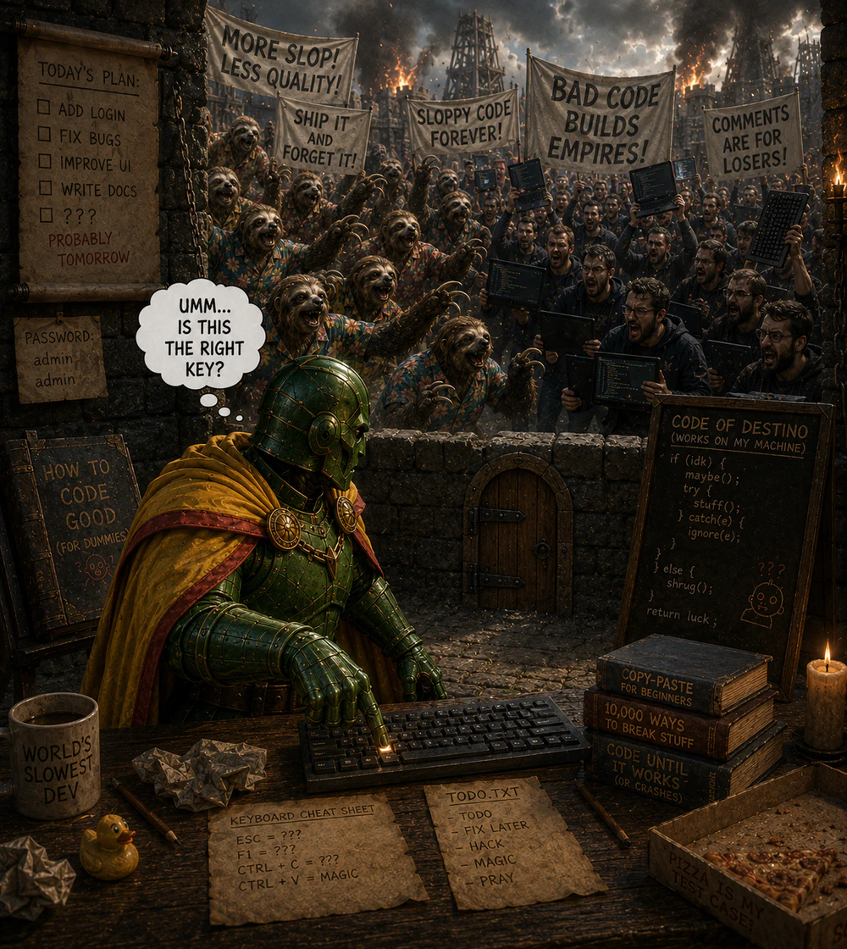
Input is the
awkward part.

Slide 33



Every game needs input
Key press
Key repeat
Key release
Movement starts when the key
Holding a key must keep the action
Movement stops when the key
goes down.
alive.
comes back up.

Slide 34



Why the Kitty keyboard protocol?
Terminals speak text
Doom needs state
Kitty reports it
Classic input streams are great for
Controls depend on press, repeat,
Destino verifies
characters, not game controls.
and release events being distinct.
press/repeat/release support.

Slide 35



Native mixing. JavaScript orchestration.
Native code produces PCM
TinyMidiLoader and TinySoundFont drive music; the C backend mixes effects.
Samples cross FFI in blocks
Each tick produces 1,260 stereo frames at 44.1 kHz.
Node feeds SDL3
JavaScript queues the PCM and limits backlog without mixing individual samples.

Slide 36

How did we
package
this monster?

Slide 37


Node.js SEA works, with a catch
SEA provides a virtual filesystem
Native I/O is a different boundary
JavaScript, libraries, and assets
C calls to
fopen()
do not automatically
ship together with
useVfs
.
use Node's virtual filesystem.

Slide 38
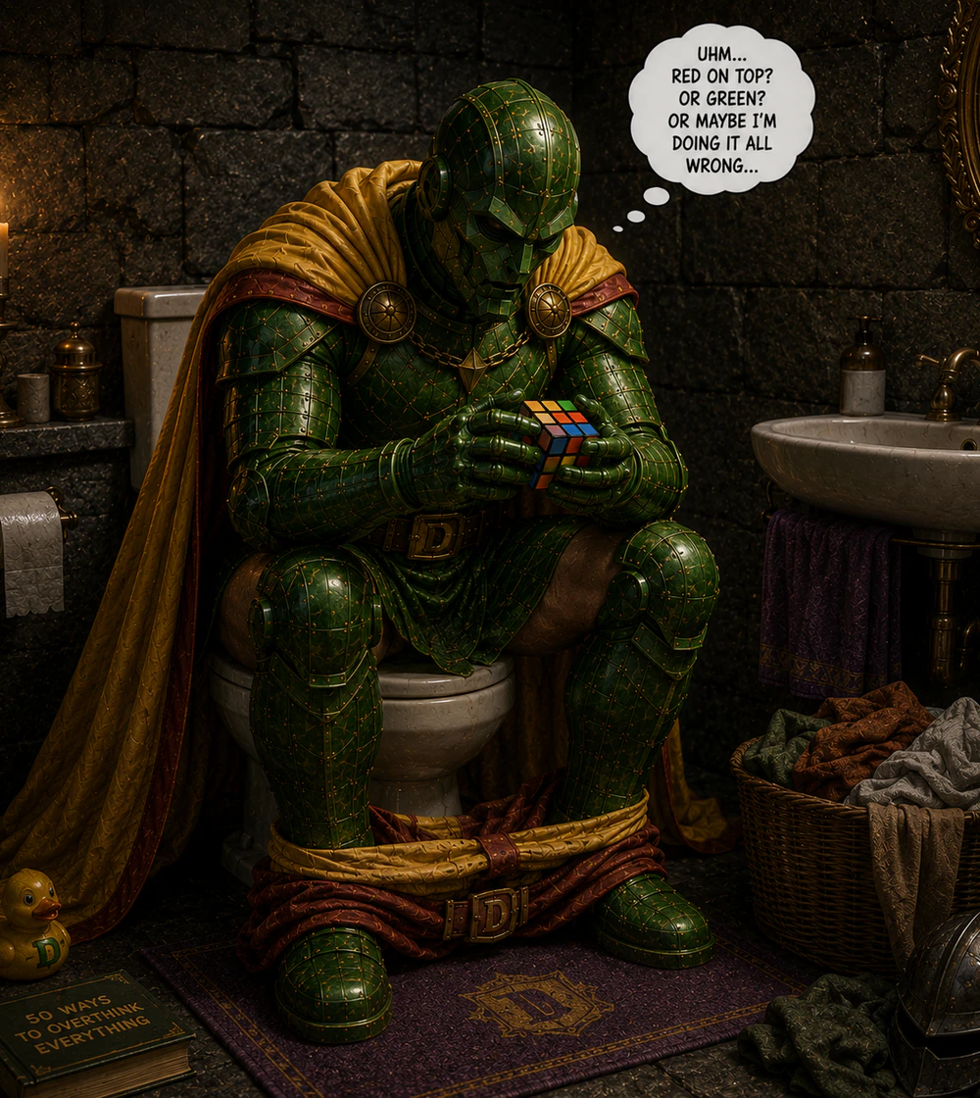
How would you
solve that?

Slide 39

Don't forget
about
K.I.S.S.
ing!

Slide 40
Assets in memory. Saves on disk.
1
Pass assets through FFI
Node reads WAD and SF2 assets and passes their bytes to native code.
2
Adapt native file access
The engine uses memory-backed files in SEA mode.
3
Persist the saves
Save files live on disk; other engine writes stay in process memory.

Slide 41

Then comes
performance.

Slide 42


Destino is not the hottest case
Doom runs at 35 Hz
The main loop is steady, but not extreme.
Batch work across the boundary
44,100 audio frames per second become 35 PCM blocks, not 44,100 FFI calls.
Real apps can be hotter
Enterprise libraries may sit on critical paths.

Slide 43

(Very) Fast FFI is
now in Node.js.
Starting
in
Node.js
26.4.0

Slide 44



What was added?
Check
it
out
at
https://github.com/nodejs/node/pull/63068
.
V8 Fast API path
Eligible calls avoid the generic callback route.
Native trampolines
Generated code adapts V8 calls to the target ABI.
Safe fallback
Unsupported signatures continue through existing paths.

Slide 45

Why trampolines?
V8 Fast API skips the slow callback
V8 can call a known, typed native function directly.
FFI symbols are discovered at runtime
The target signature is not a handwritten C++ binding.
Trampolines adapt the call
They move arguments from V8's call shape into the target C ABI.

Slide 46
DEMO
TIME

Slide 47

Check it out!
As
usual,
everything
we
build
at
Platformatic
is
available
on
GitHub.
https://github.com/platformatic/destino

Slide 48
WHAT'S
NEXT?

Slide 49


One last thing™
“The only way of discovering the limits of the
possible is to venture a little way past
them into the impossible.”
Arthur C. Clarke

Slide 50

Thank you!
Paolo Insogna
@p_insogna
Platformatic
Node.js TSC, Principal Engineer
paolo.insogna@platformatic.dev

