Slide 1






View online
Compiling and bundling JS,
Download PDF
the painless way
Paolo Insogna
Node.js TSC, Principal Engineer @
Platformatic

Slide 2

Fight your fears!

Slide 3






Hello, I'm
Paolo
!
Node.js
Technical Steering Committee Member
Platformatic
Principal Engineer
paoloinsogna.dev
ShogunPanda
p_insogna
pinsogna

Slide 4

First of all, let's give
credits!
This
talk
has
originally
been
written
by
my
colleague
and
friend
Michele
Riva
.
Whatever
goes
wrong
today,
please
complain
directly
to
him
on
Twitter!
@MicheleRivaCode

Slide 5

Compiling and
bundling JavaScript
is often a pain ...

Slide 6

…but it
should not!

Slide 7
A bit of terminology: Compiling
“To change a computer program
1
into a machine language”
Cambridge Dictionary

Slide 8
A bit of terminology: Transpiling
“To translate a source code into
2
a different language source code”
Michele Riva

Slide 9
A bit of terminology: Bundling
“To pack all code and resources in
3
a single source file or executable”
Me, a.k.a. Paolo Insogna

Slide 10
Transpilation

Slide 11


Why do we want to transpile our code?
We
all
have
a
loved
language
we'd
like
to
see
everywhere.
Adopt new language features
Write once, run everywhere™
Runtimes update slower than the languages.
We want to write our scripts in our language
We don't want to wait.
despite of the runtime environment.

Slide 12


Who are you missing the most?
We
all
have
a
loved
language
we'd
like
to
see
everywhere.
Scala.js
Opal
Scala to Javascript
Ruby to Javascript

Slide 13
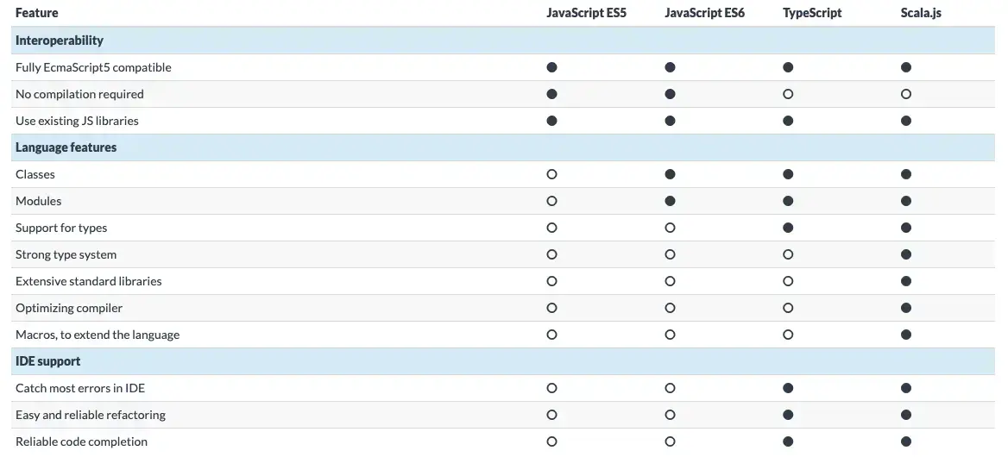
An example: transpilation of Scala.js

Slide 14







Where do we (mostly) run?
There
are
few
known
runtimes
and
browsers,
way
less
than
in
the
past.

Slide 15






There is a transpiler for everything…™
F#
Kotlin
Gleam
ReasonML
ELM
ReScript

Slide 16

… and that's thanks to LLVM!
The
project
is
a
collection
of
modular
and
reusable
compiler
and
toolchains.

Slide 17
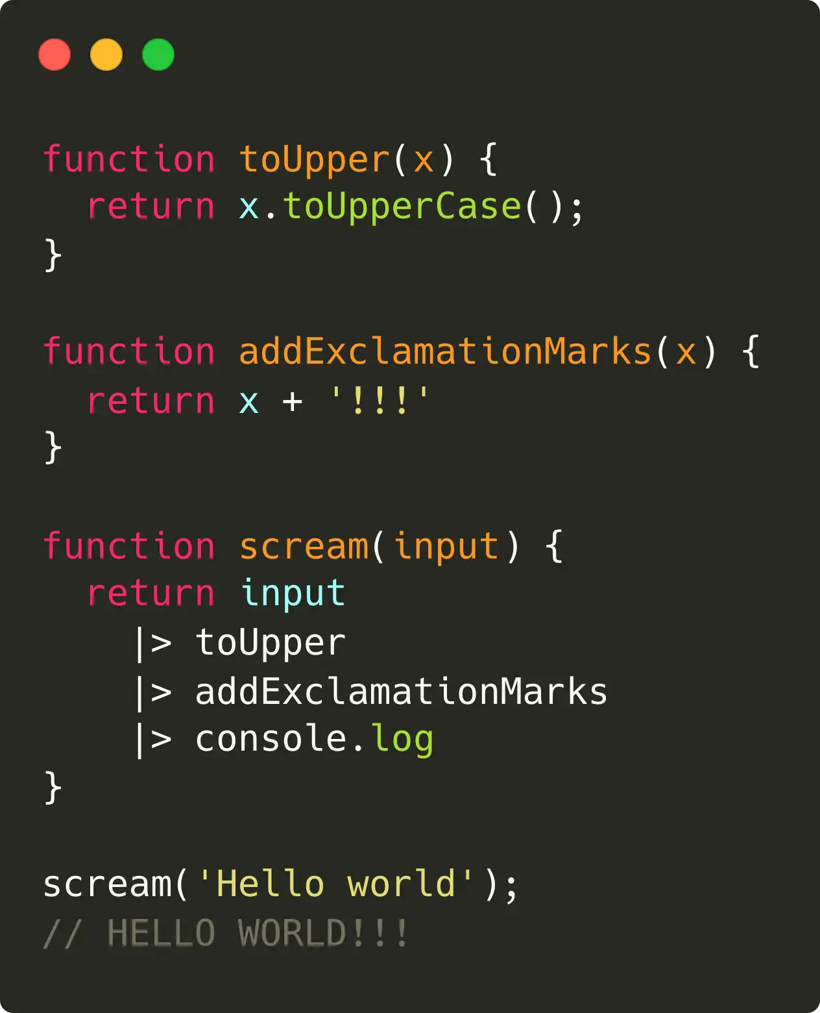
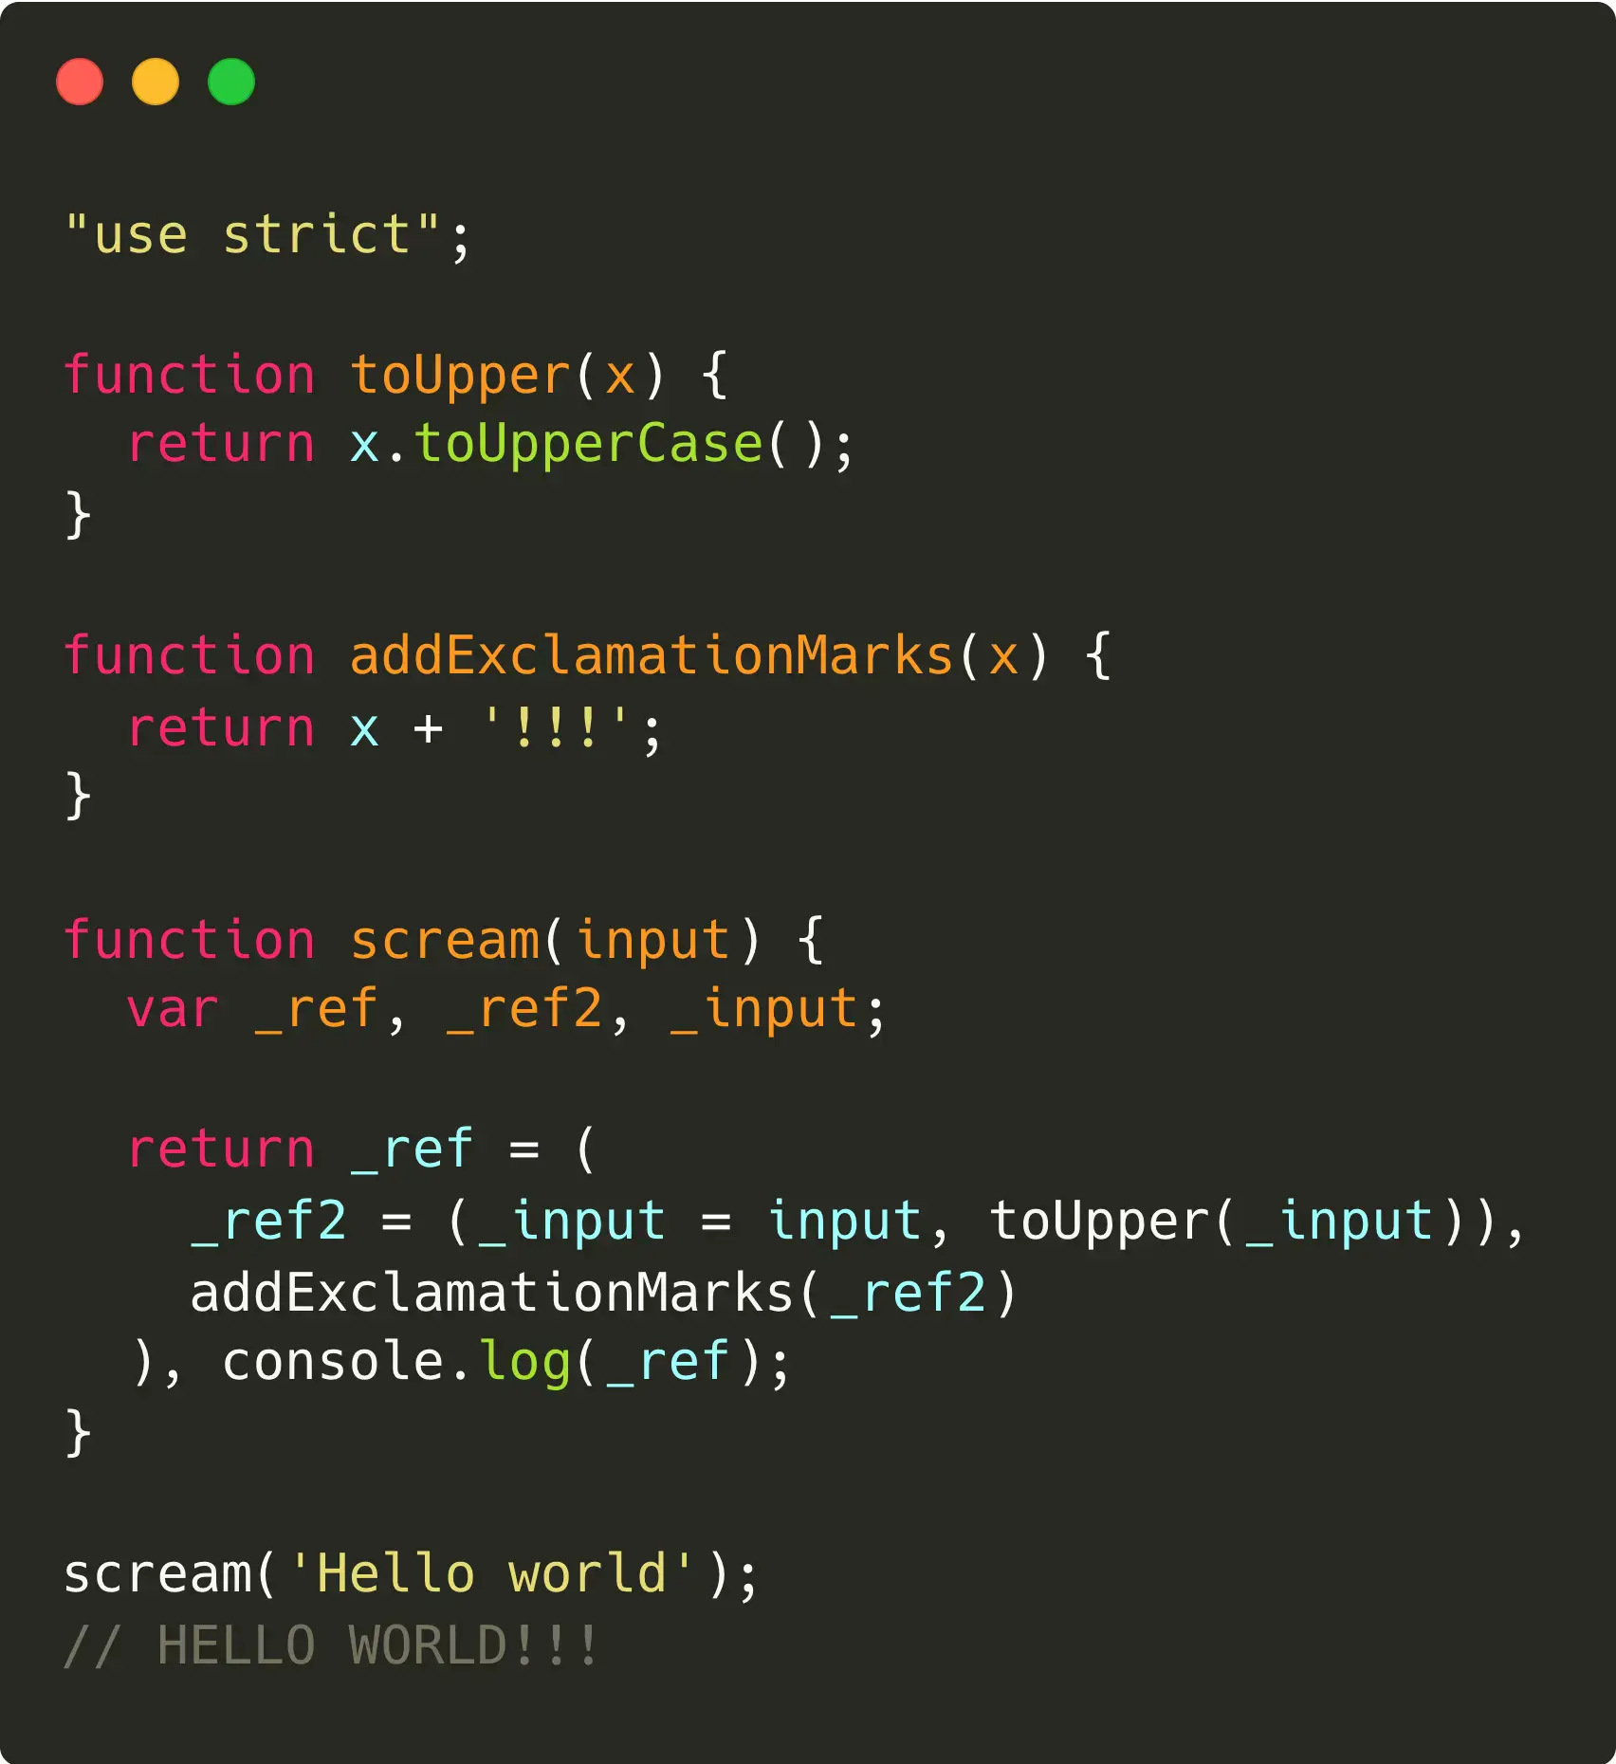
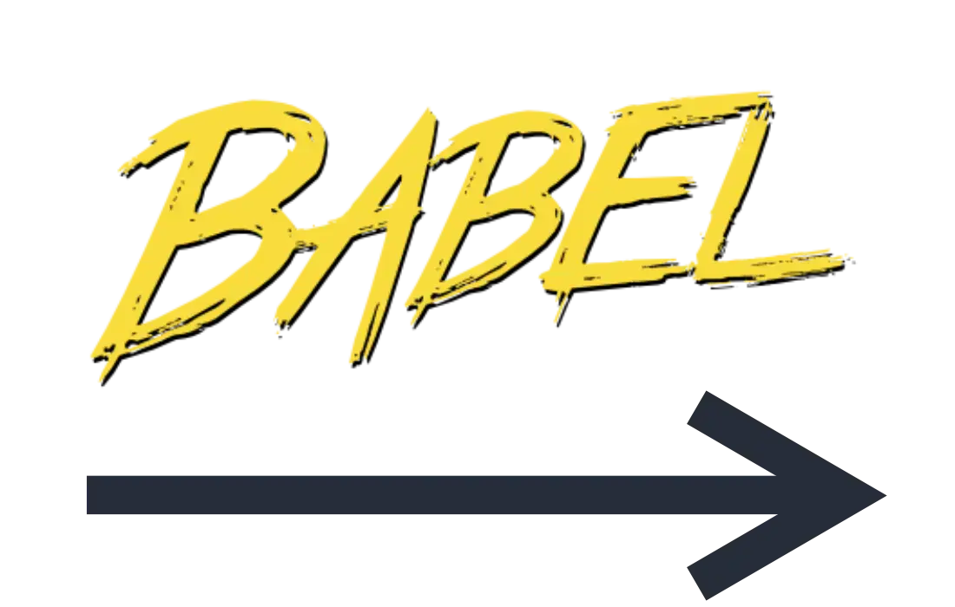
What are you missing the most?
We
all
want
to
adopt
new
language
features
even
before
they
are
finalised.

Slide 18
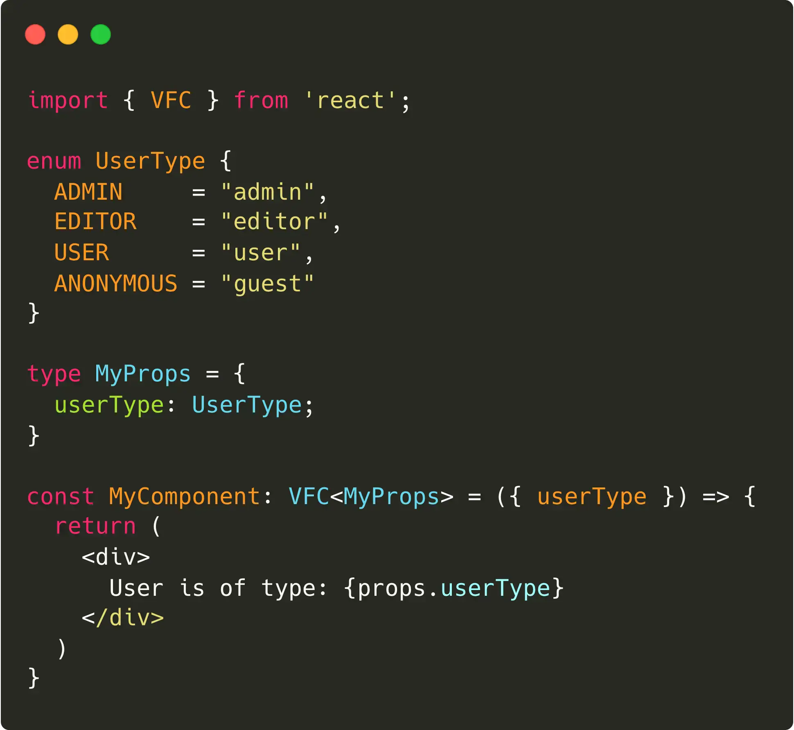
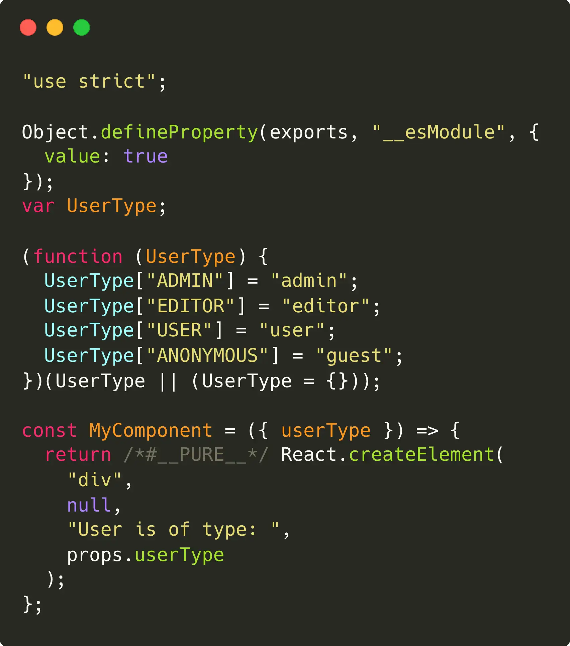
There is no end to what we can achieve
We
can
even
transpile
features
that
likely
will
never
get
into
the
language.

Slide 19
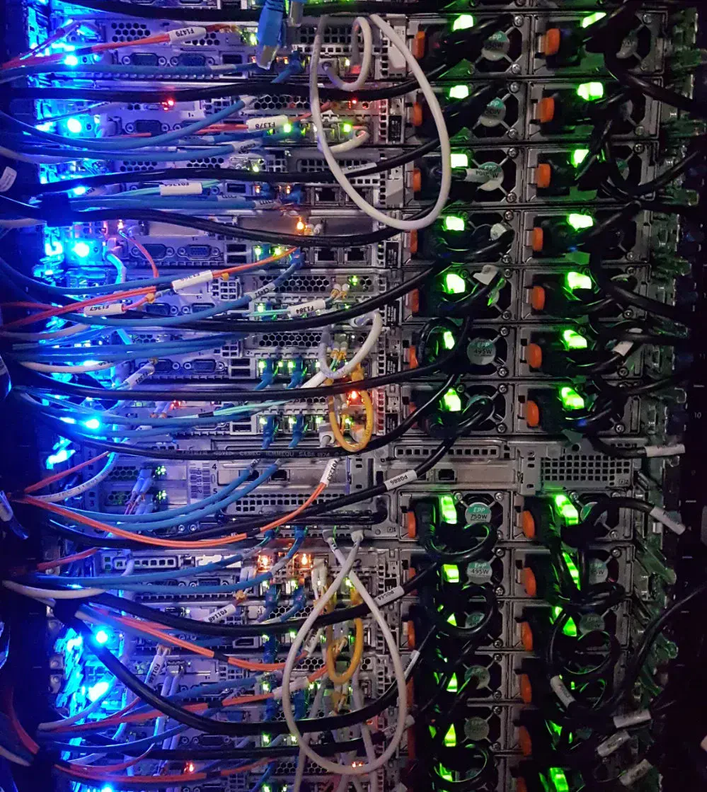
Transpiling,
in depth
Let's
have
a
deep
look
on
how
a
transpiler
really
works.

Slide 20
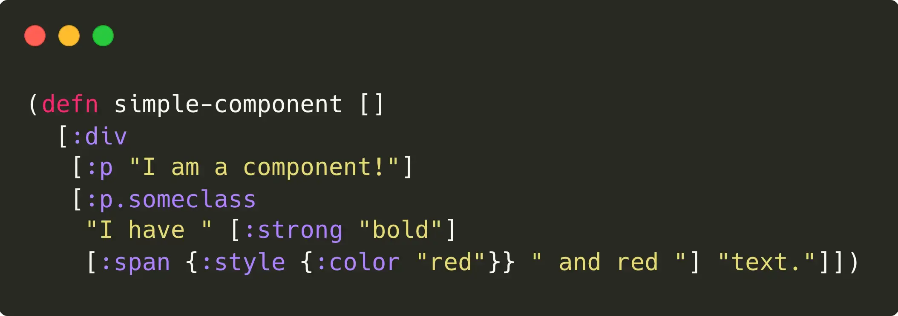

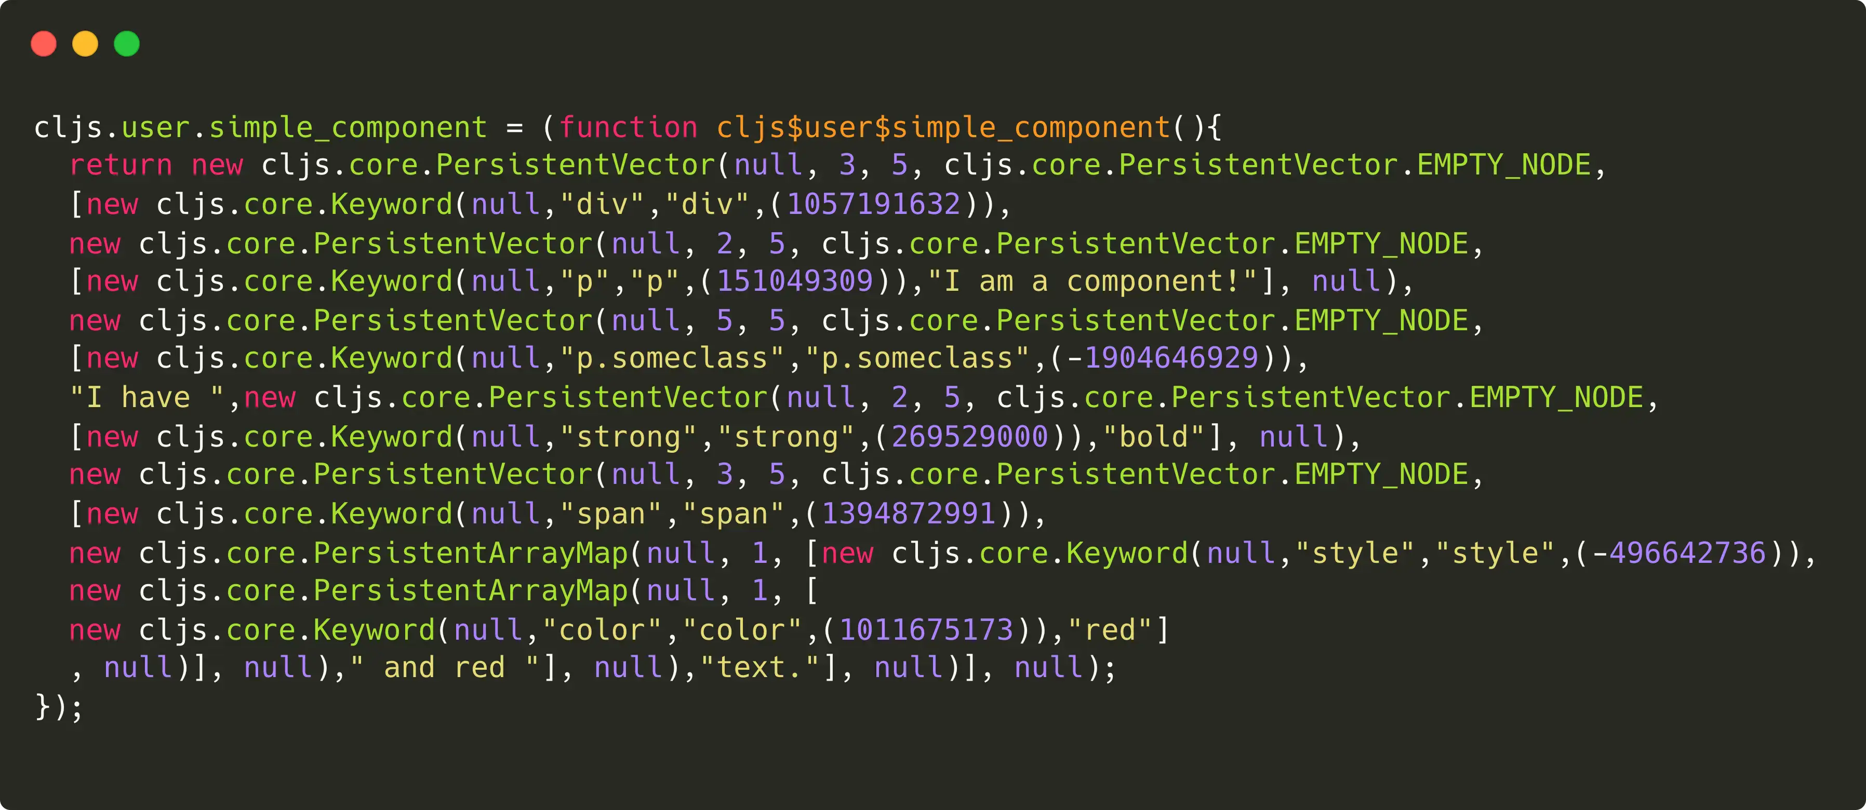
Generated code is not always readable…

Slide 21
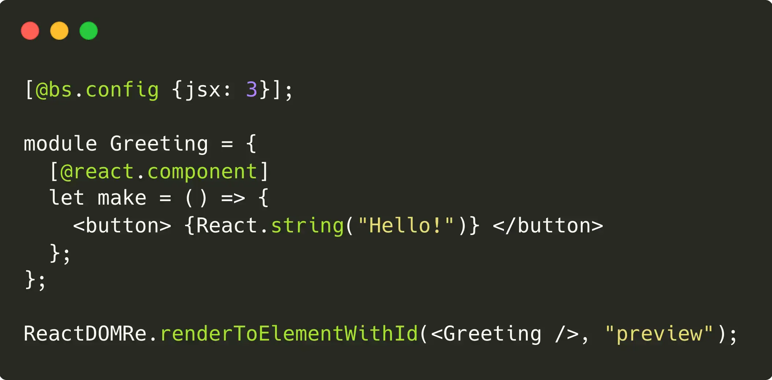
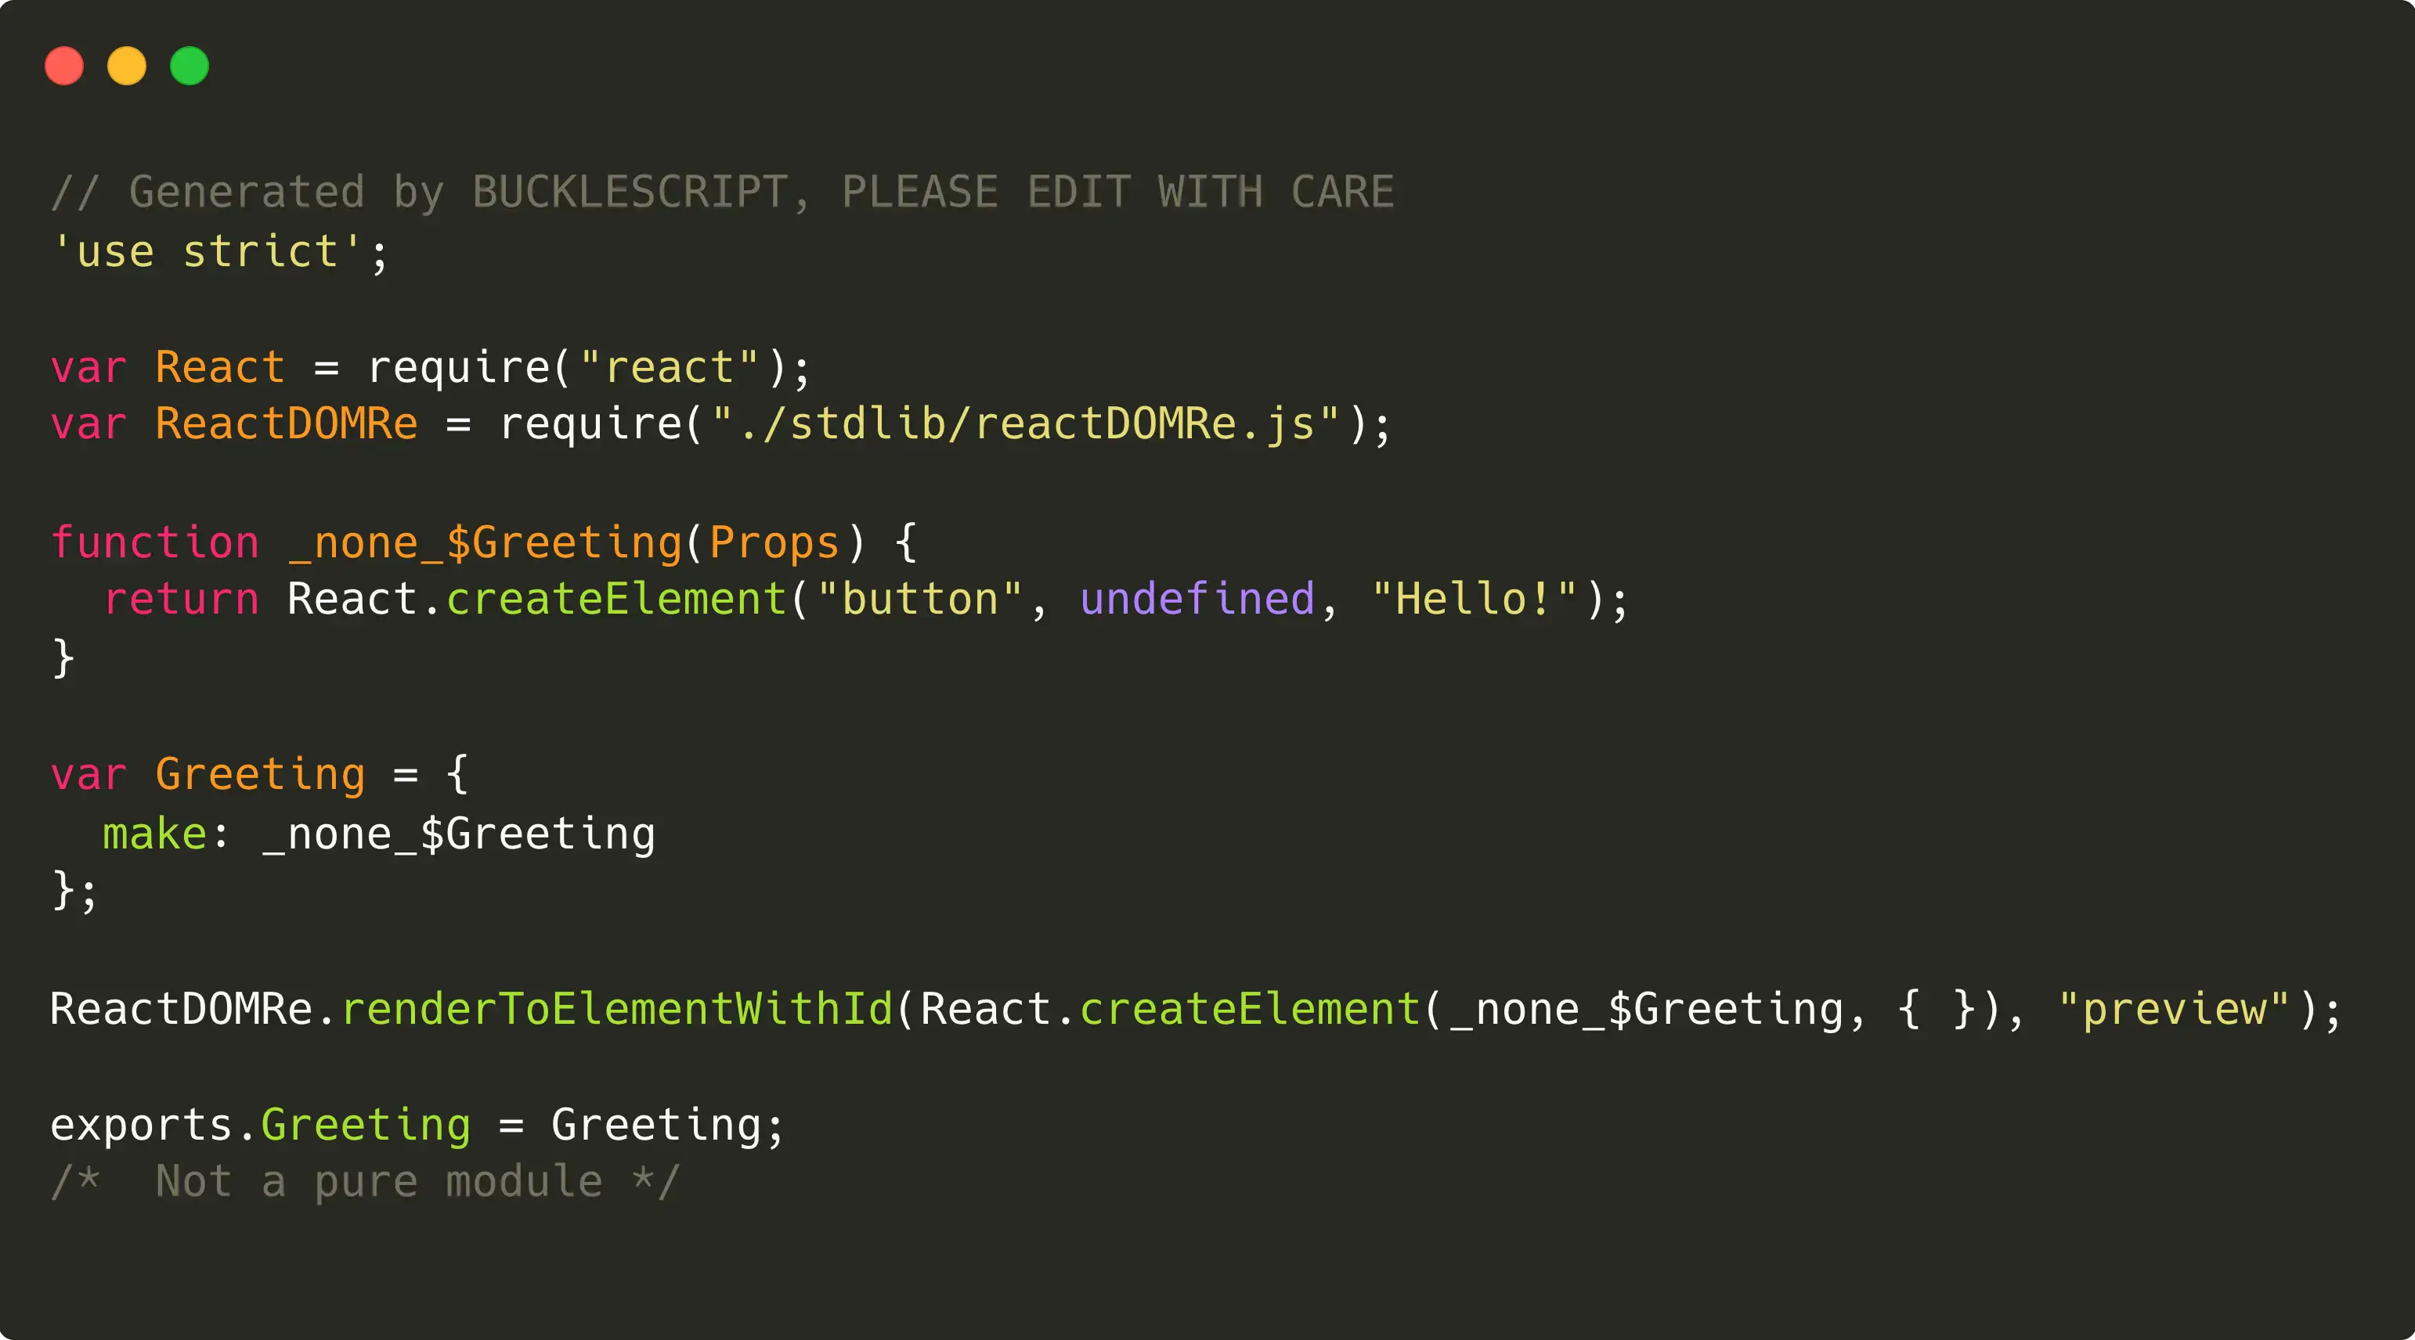

…but some transpilers are really good!

Slide 22



Each language has its own transpiler
Babel
TSC
BuckleScript
ClojureScript

Slide 23

No transpiler is
perfect!

Slide 24
Problem #1: Transpilation time
1
Slow on large codebases
Slow on large codebases
Really fast
Average

Slide 25
Problem #2: Output optimization
2
Well optimized
Quite optimized
Beautifully optimized
Awful

Slide 26
Let's focus on the popular one!
No
intention
to
discriminate
any
language.
Babel
TSC
Quite fast, well optimized
Quite slow, quite optimized

Slide 27
How does a transpiler work?
Transpiling
time
grows
proportionally
to
the
source
code.
1
Parsing
The source code is parsed and converted to an Abstract Syntax Tree (AST)
2
Transformation
The source language AST is traversed and mapped to the destination language AST.
3
Code generation (codegen)
The destination language AST is converted to the destination source code.

Slide 28

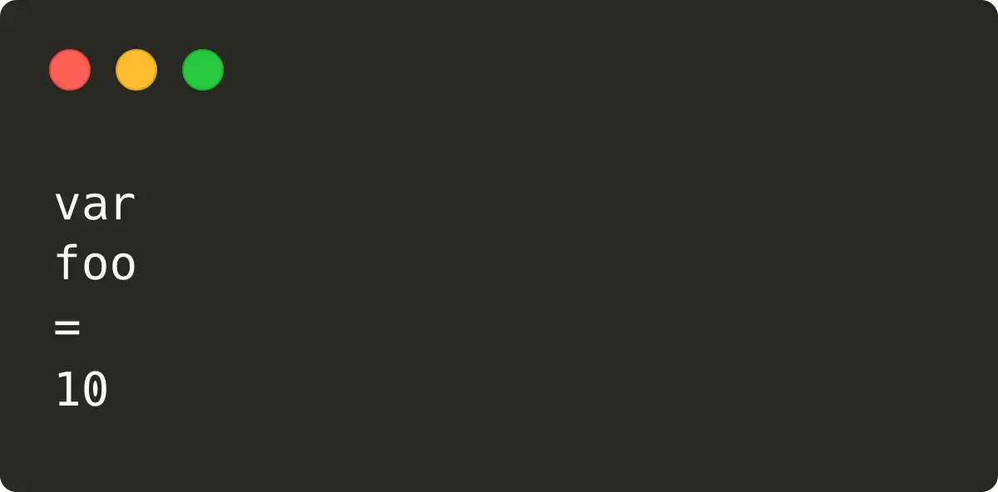
Parsing step #1: Tokenization
The
input
is
divided
into
tokens.
1
Input
Output

Slide 29
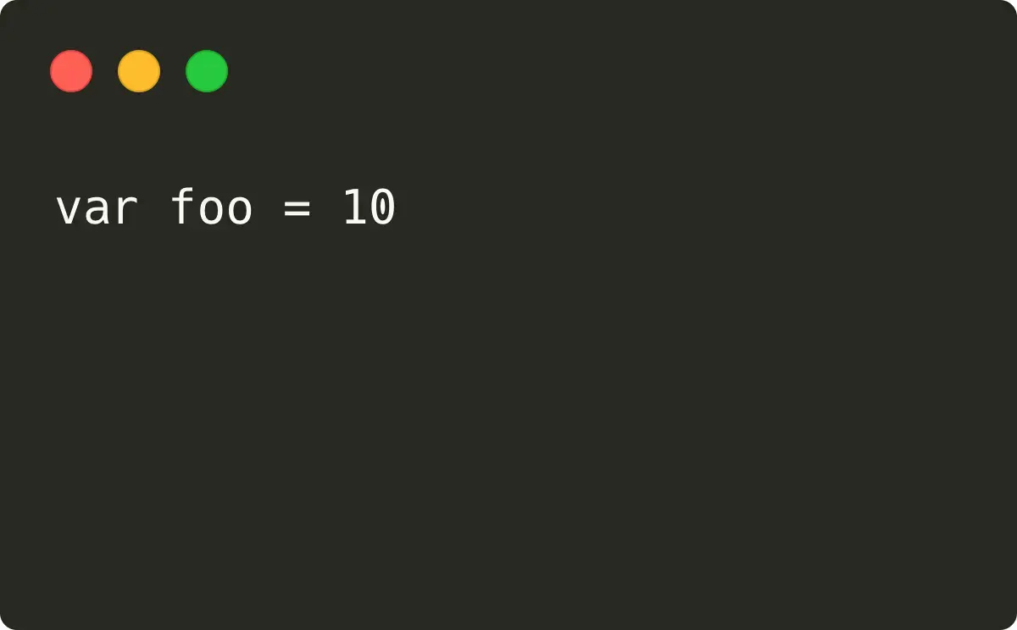
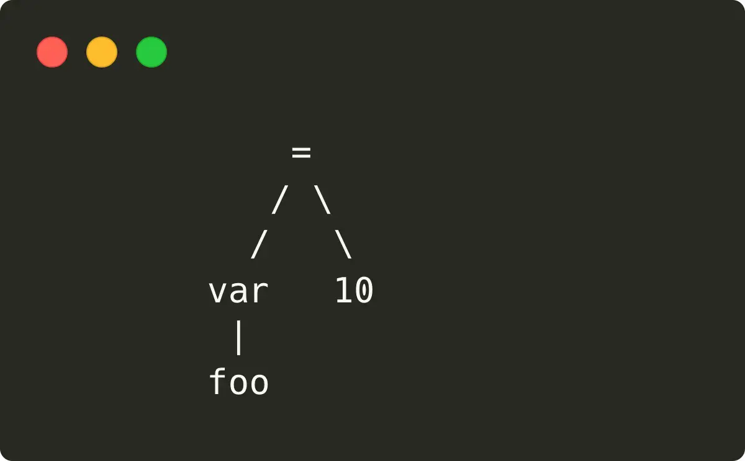
Parsing step #2: Syntactical Analysis
The
tokens
are
parsed
and
analysed.
2
Input
Parse Tree
(user code)
(a.k.a. Concrete Syntax Tree)

Slide 30
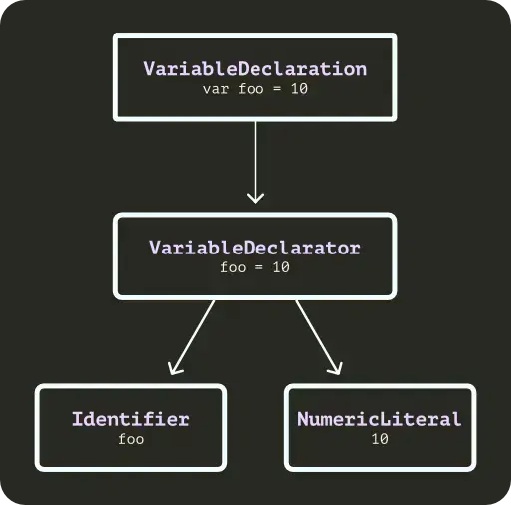
Parsing step #3: Prepare the AST
The
Parse
Tree
is
converted
into
the
Abstract
syntax
tree.
3

Slide 31
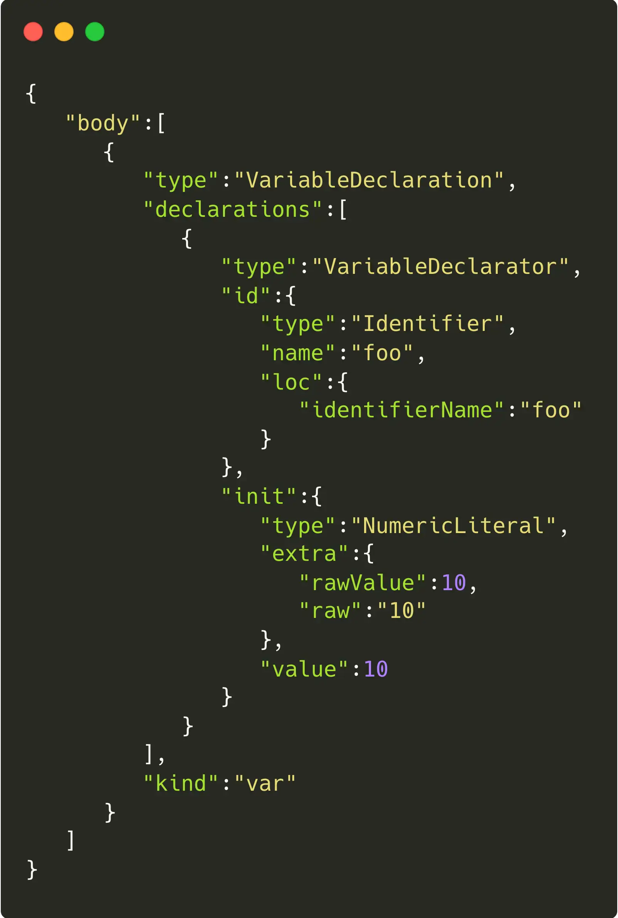
Parsing step #4: Build the AST
The
Abstract
Syntax
Tree
is
built
and
returned
to
the
developer.
4

Slide 32
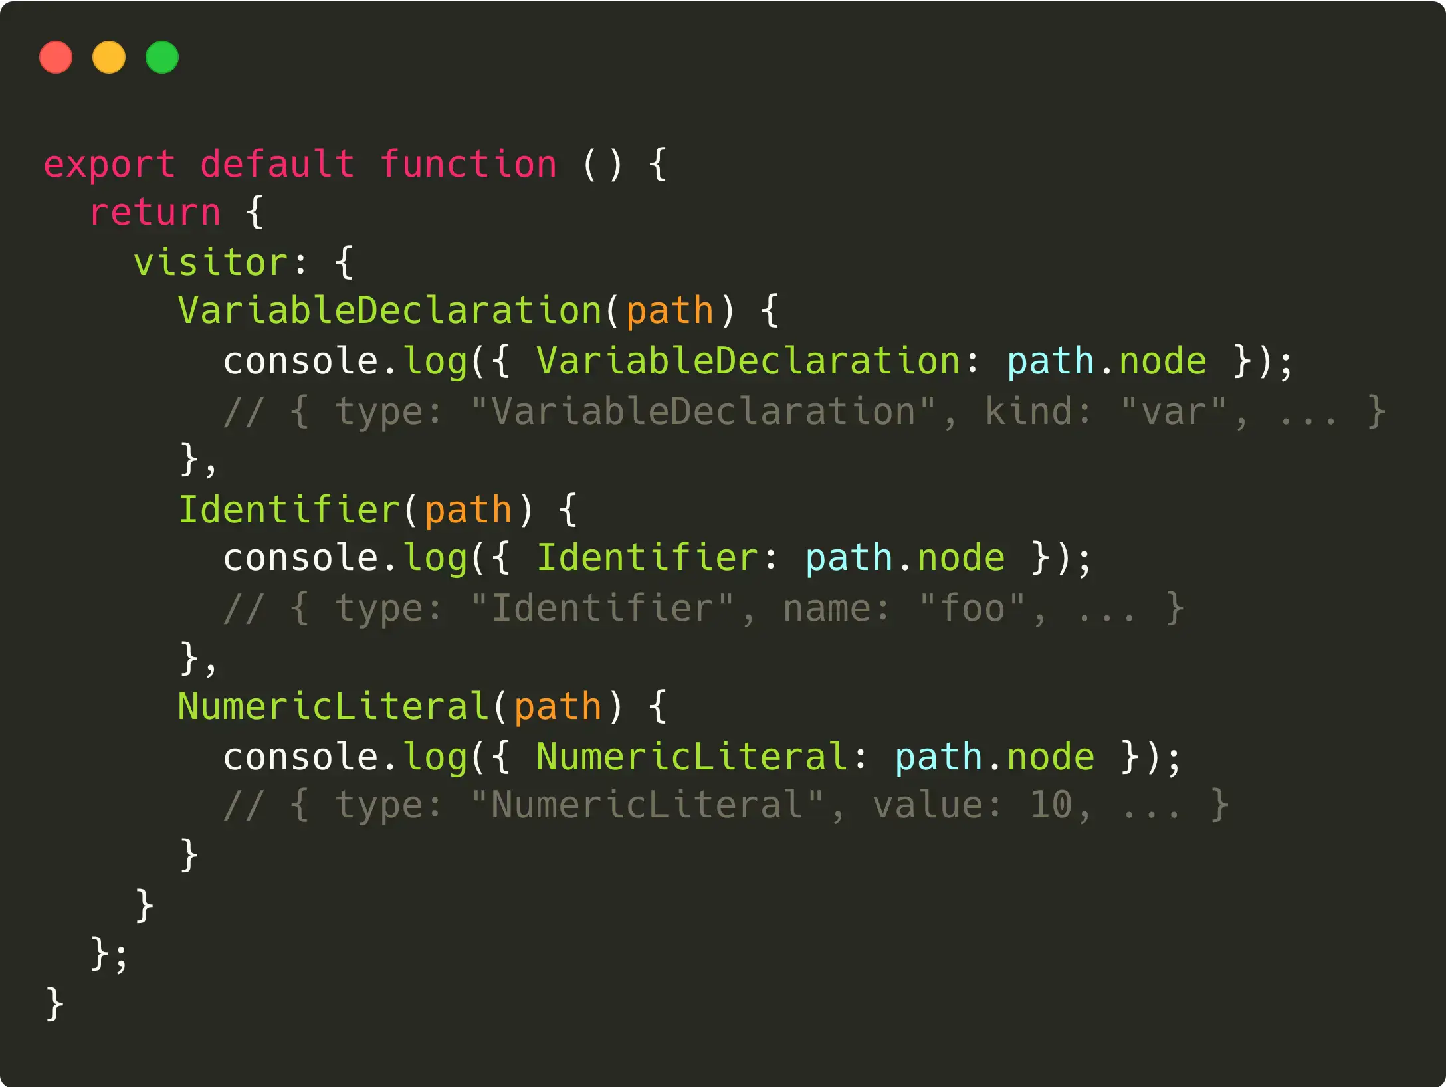
Traversing the AST
The
transpiler
exposes
an
API
to
allow
developer
to
manipulate
the
AST.

Slide 33
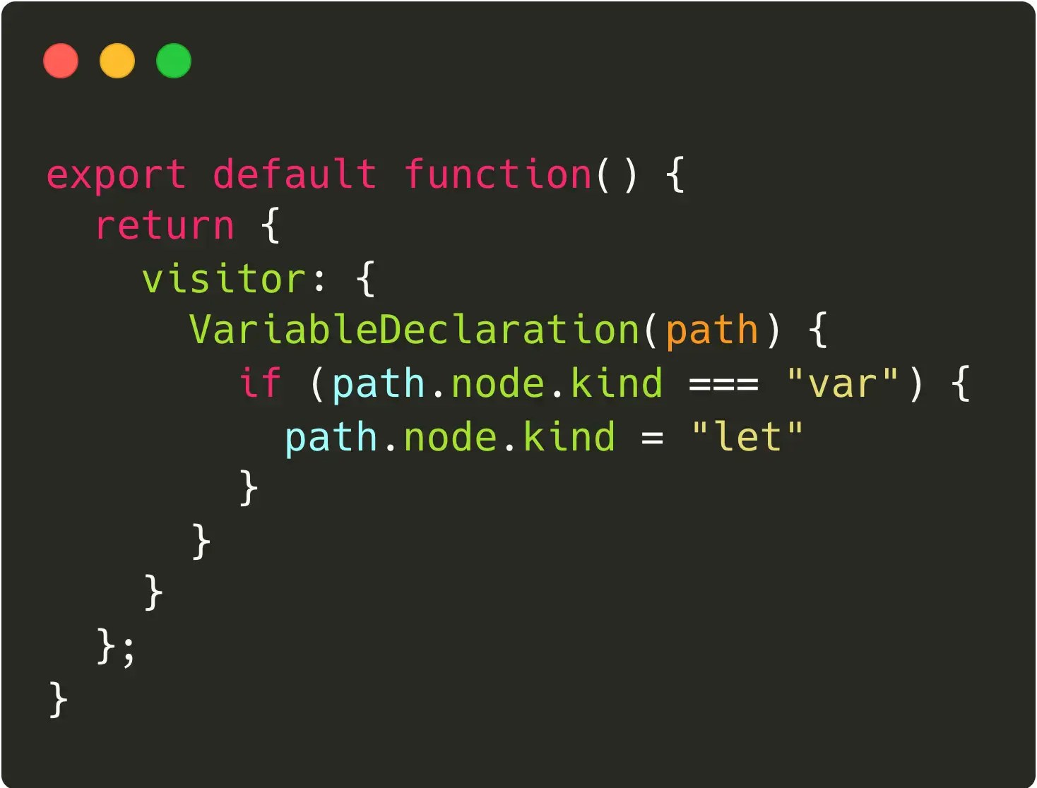
Transforming the AST
The
traversing
API
allows
to
manipulate
the
AST.

Slide 34
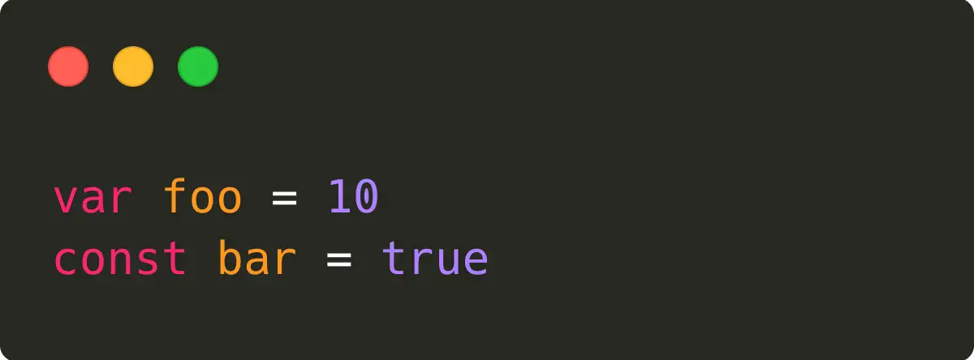
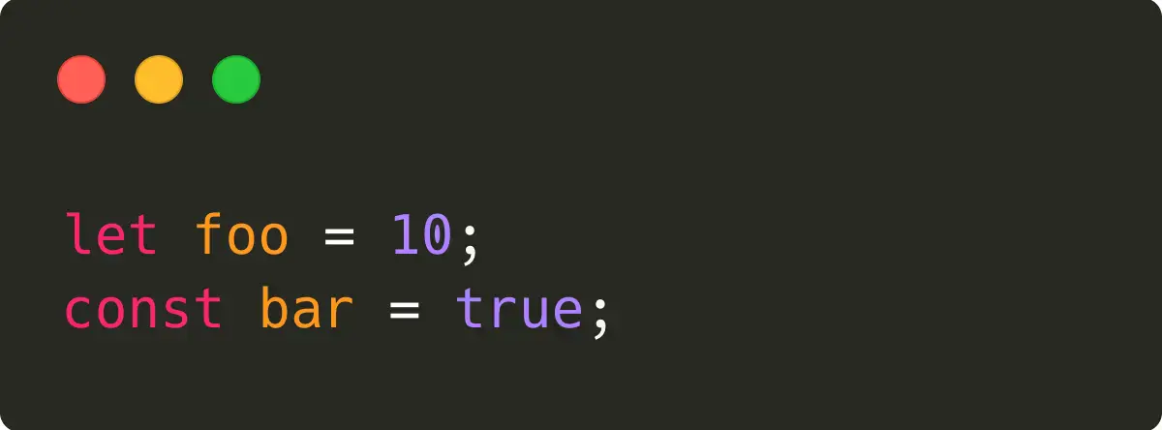
Code generation
The
modified
AST
is
used
to
generate
the
final
transpiled
code.
Input
Output

Slide 35
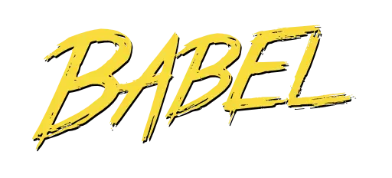


All your popular tools use this flow
Babel
Prettier
ESLint

Slide 36
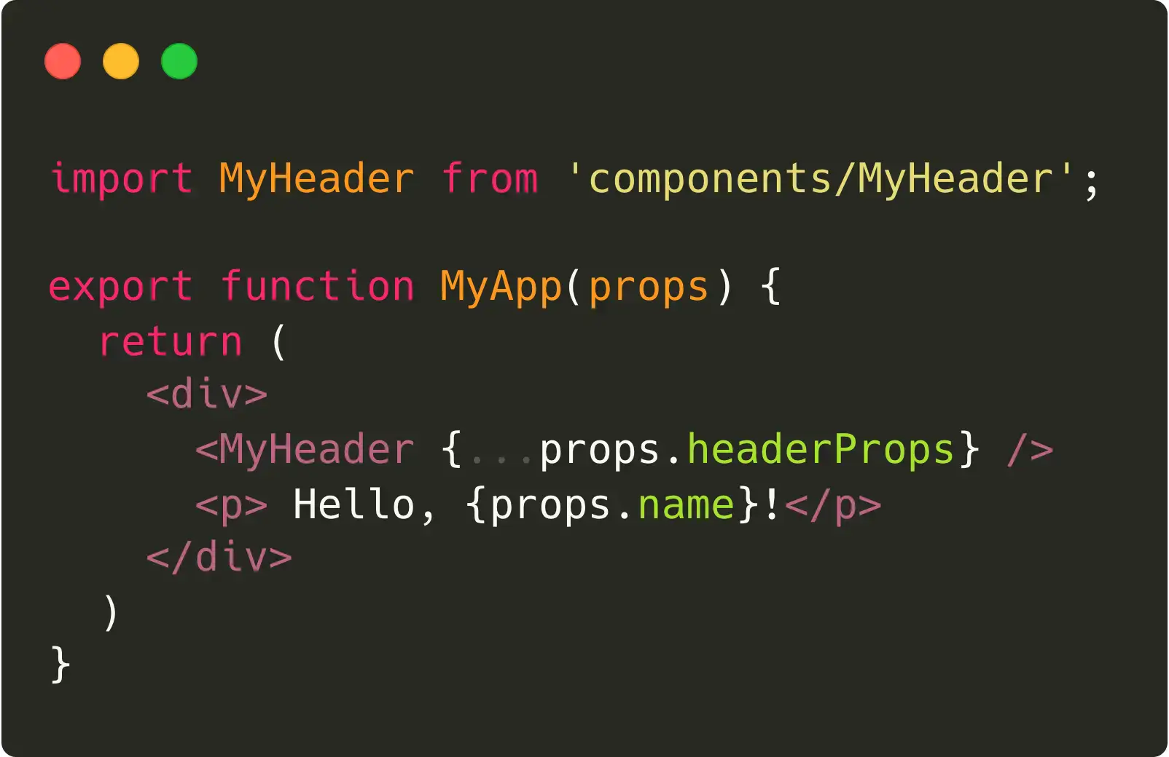
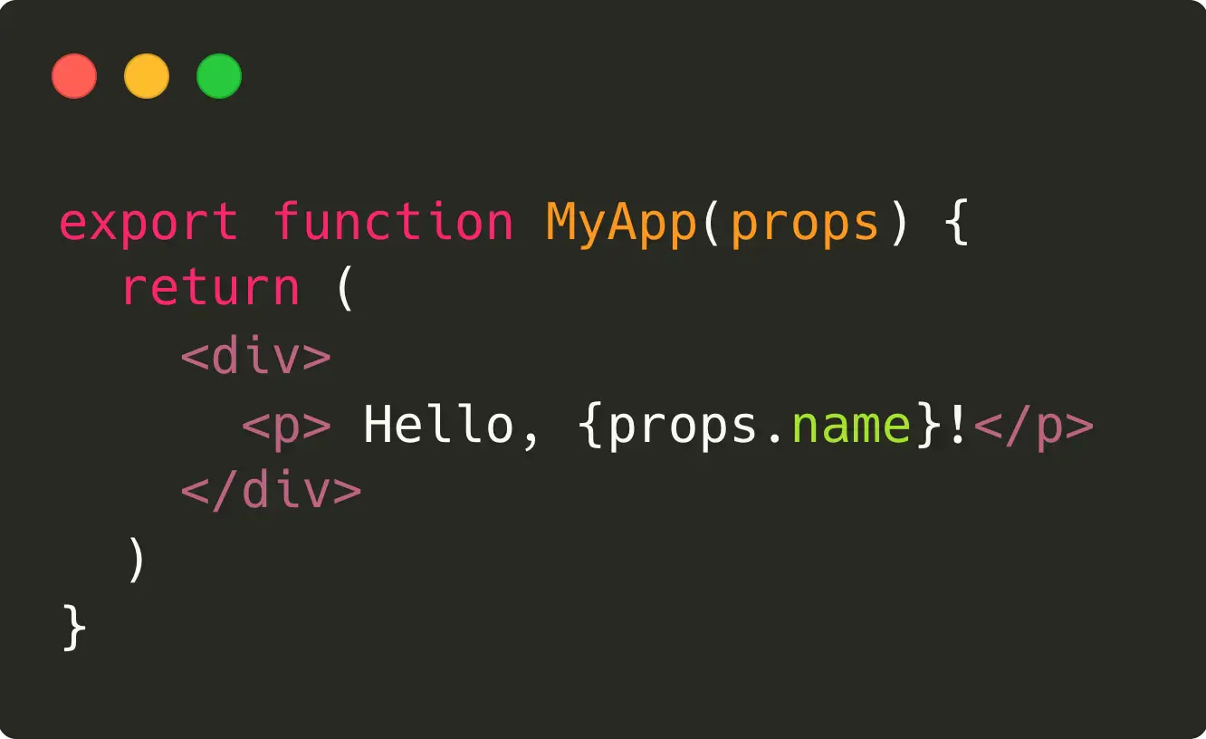
A more complex example: the problem
jscodeshift
can
be
used
to
easily
migrate
codebases.
Input
Desired output

Slide 37
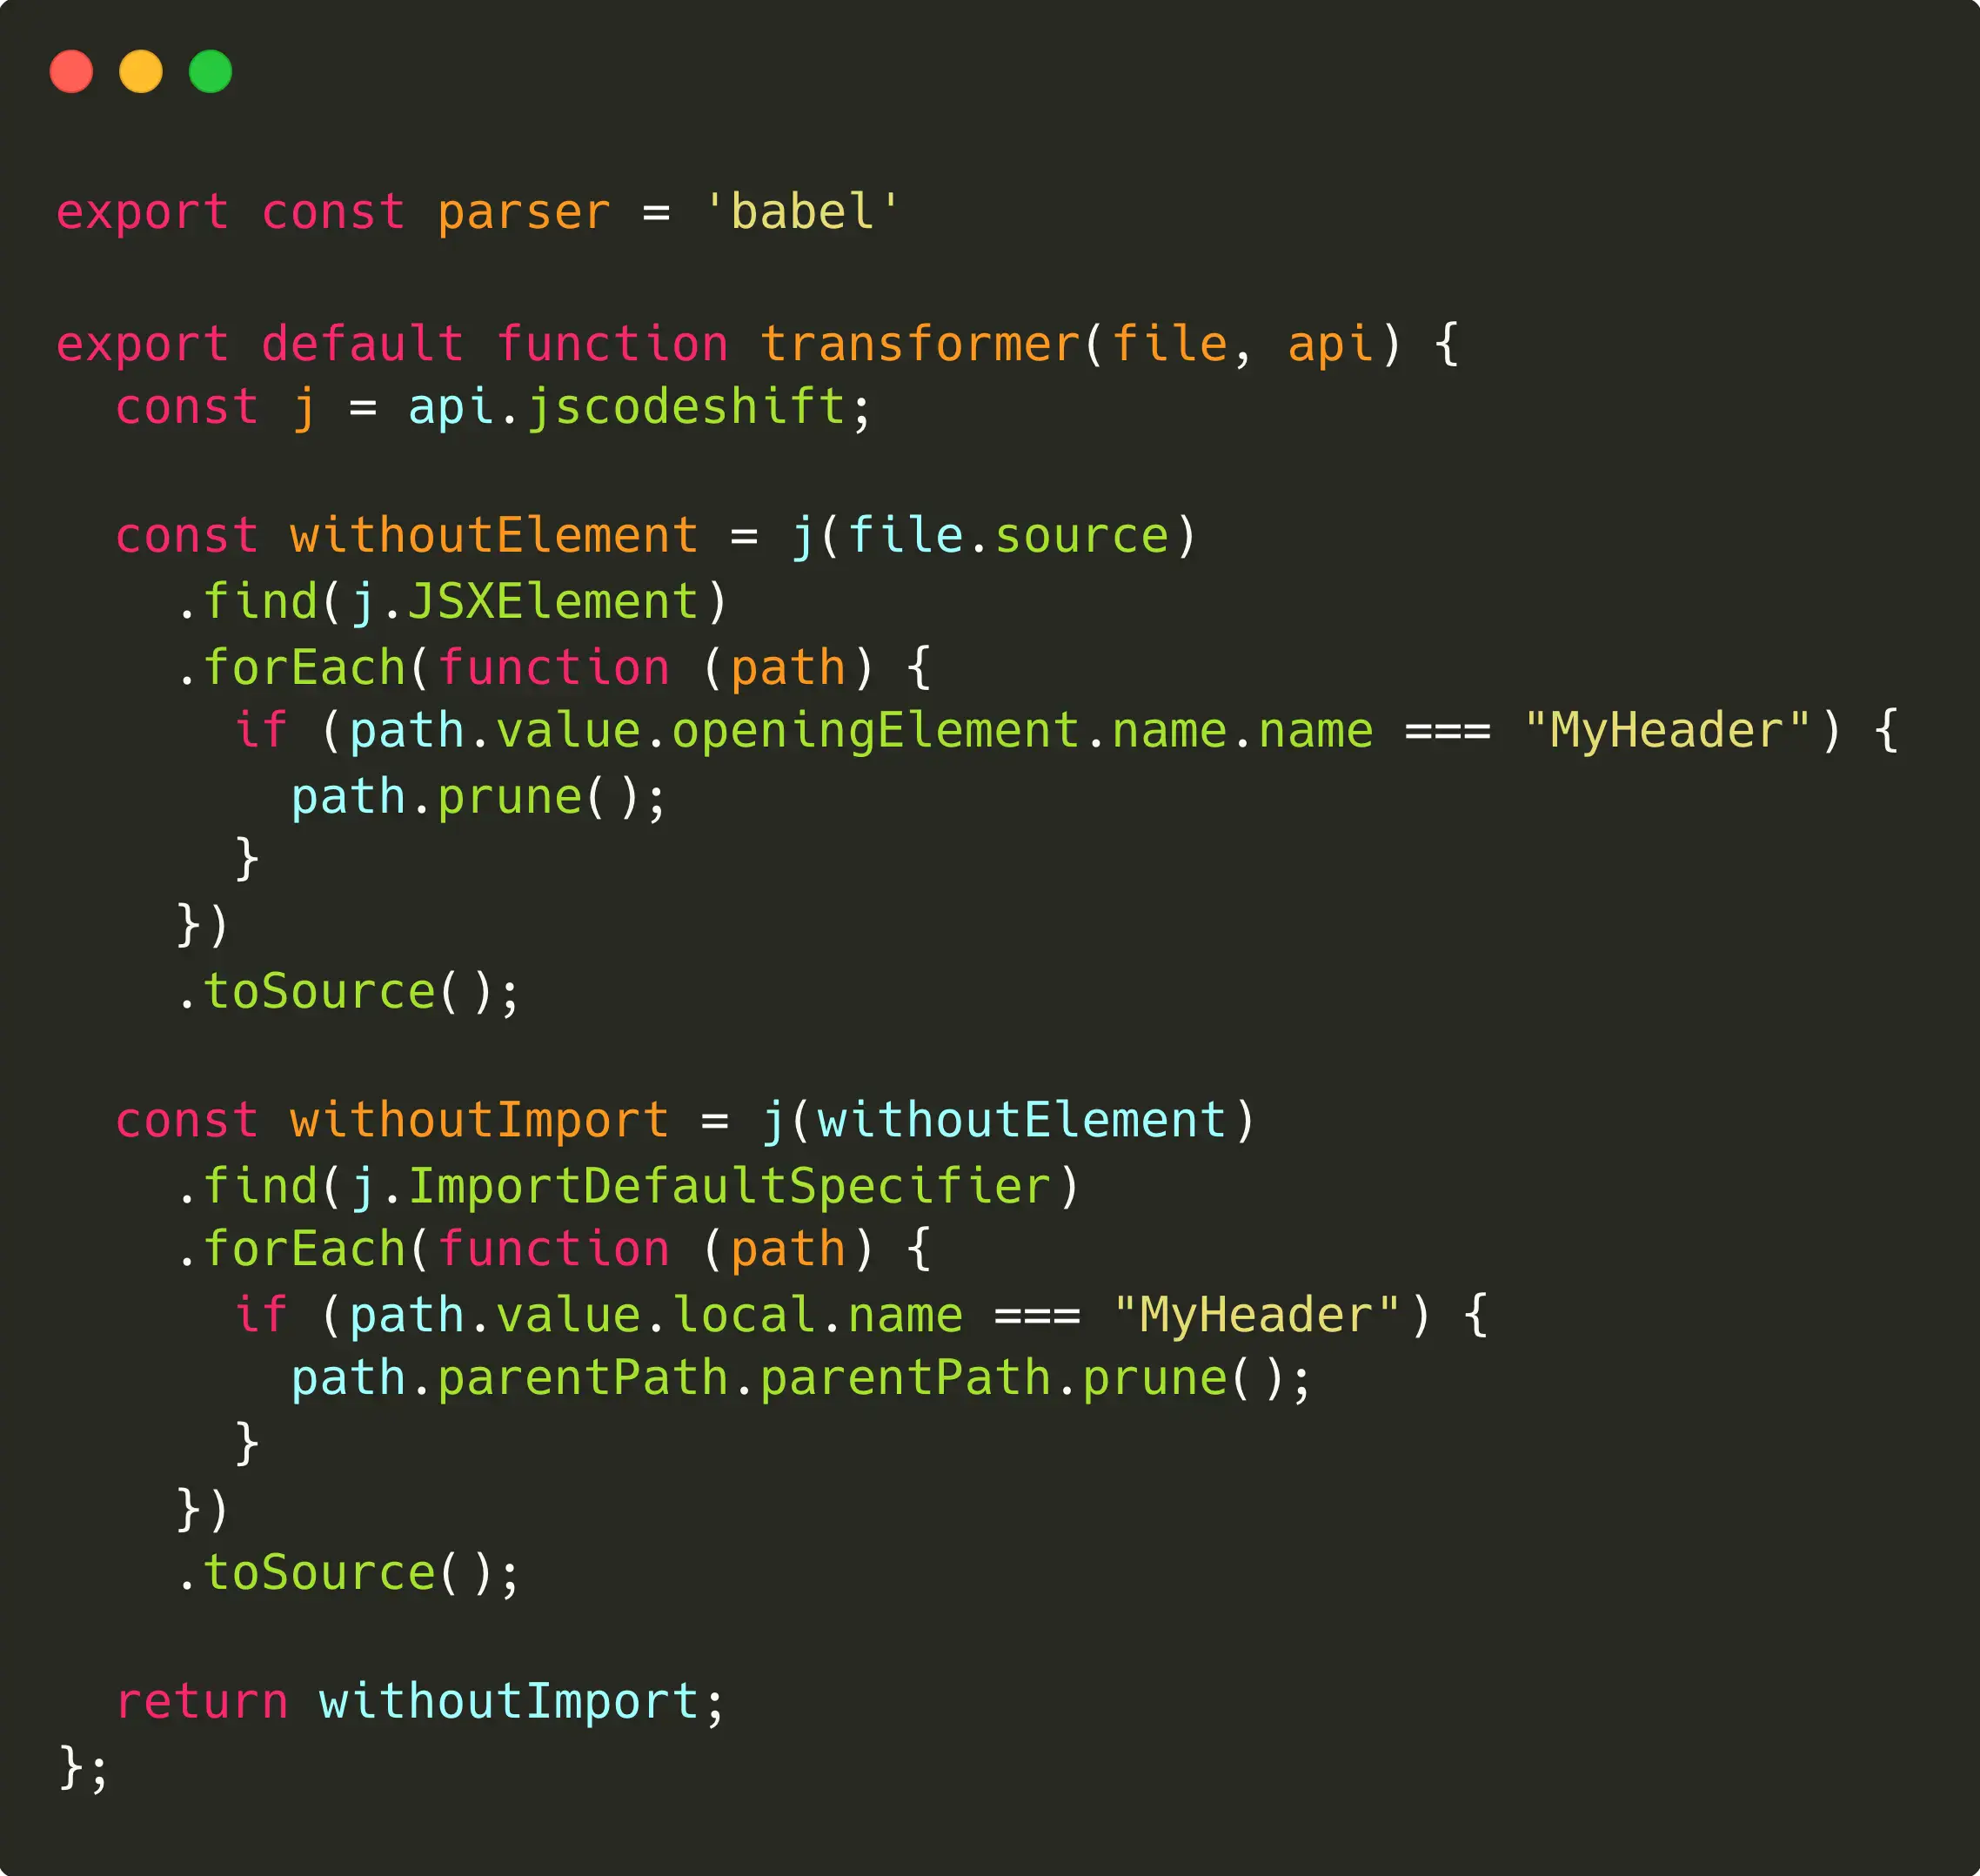
A more complex example: the solution

Slide 38
Bundling

Slide 39
Why do we want to bundle our code?
Bundling
improves
the
developer
experience.
And
it
also
benefits
users.
To create a single executable file
To serve a single JavaScript file
A single file, especially if statically linked, is
Serving only a single file reduces the
much easier to distribute and to install.
overhead and improves the user experience.

Slide 40



The three horsemen
These
are
the
mostly
used
bundlers,
each
with
pros
and
cons.
Webpack
Rollup
Parcel
Hardest
Easy
Easiest
Slower
Slow
Fast

Slide 41
Is webpack still
worth it?

Slide 42




Are there any better alternatives?
ESBuild
SWC
Vite
SnowPack

Slide 43
ESBuild

Slide 44
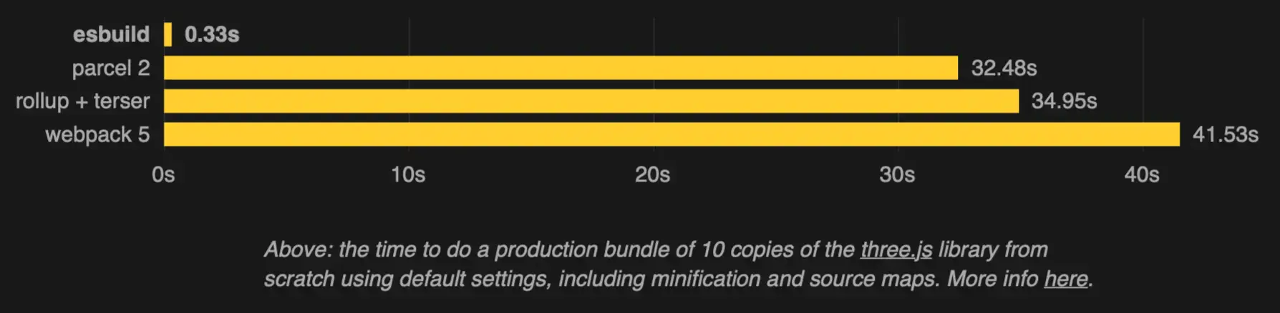
How fast ESBuild is?
A
lot,
especially
when
comparing
with
webpack.

Slide 45
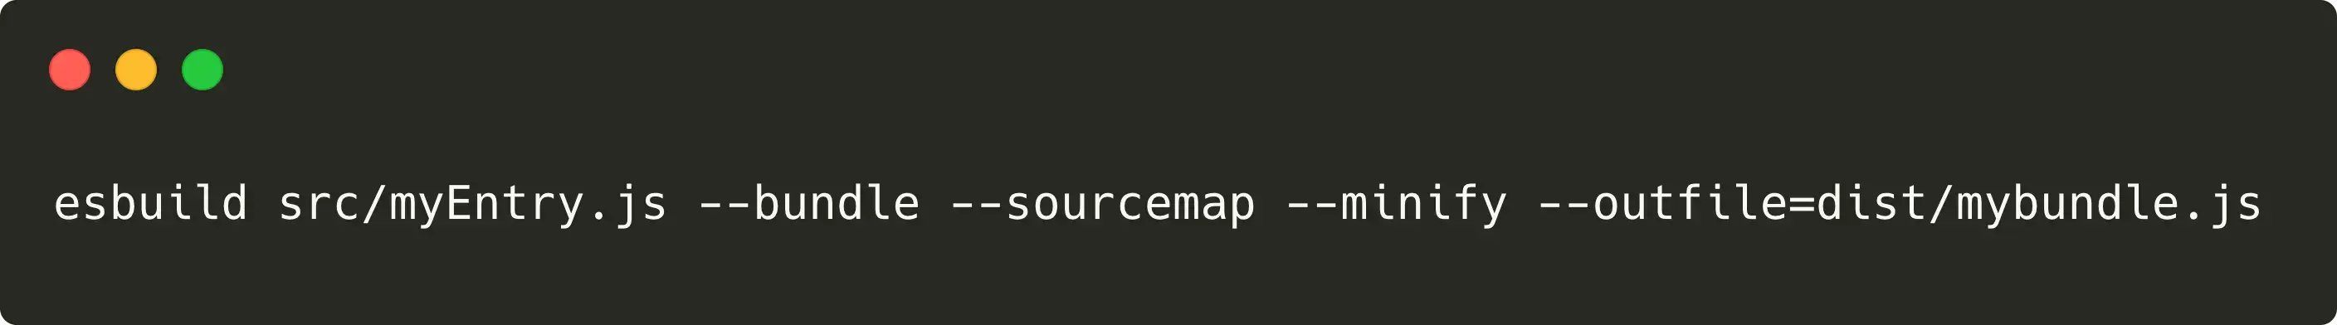
Ok, it's fast. What about configuration?
ESBuild
CLI
is
definitely
easy
to
use.

Slide 46
SWC

Slide 47
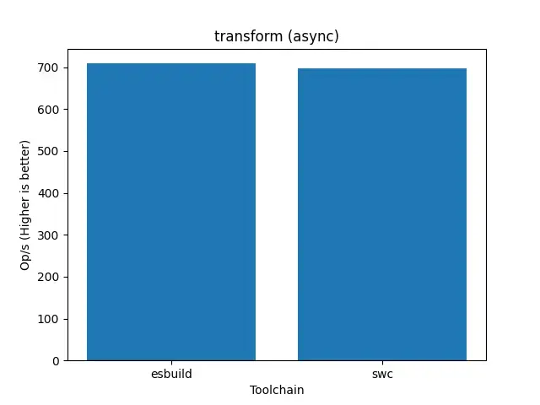
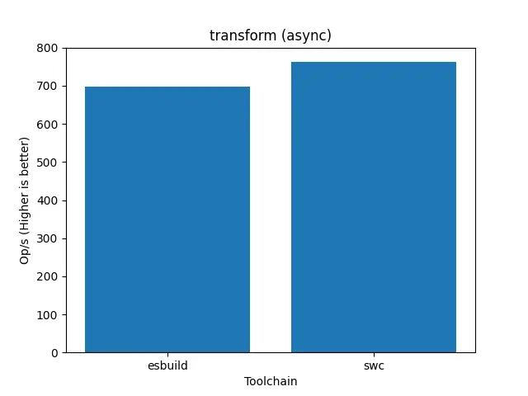
How does it compare to ESBuild?
SWC
is
sometimes
faster
than
ESBuild.
ES2019
ES2020

Slide 48
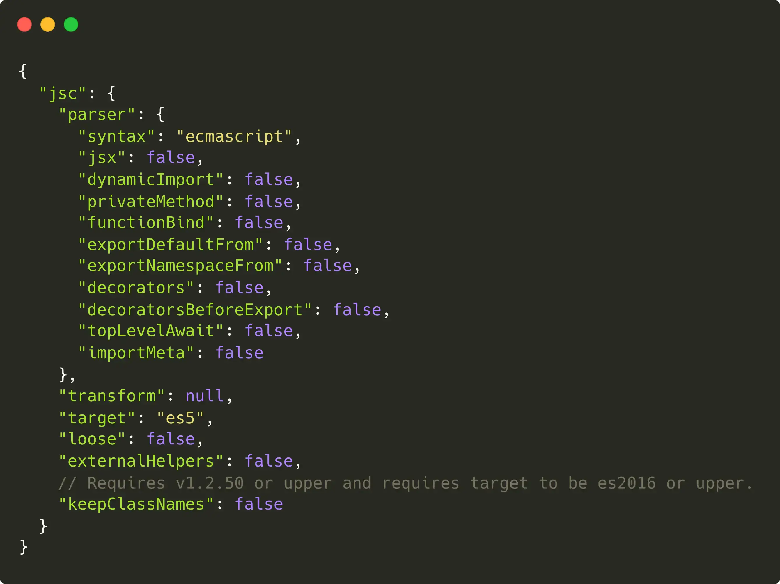
An example of SWC configuration

Slide 49

SWC can run in a
browser thanks to
WASM

Slide 50
Vite

Slide 51



A little insights into Vite
Complete developer experience
It provides a webserver with Hot Module Reload support.
A bundler that doesn't actually bundle
It completely leverages ECMAScript Modules.
Still very fast
We will talk about this is in a bit.

Slide 52
Vite leverages existing tools
ESBuild
and
Rollup
are
used
under
the
hood.

Slide 53
Snowpack

Slide 54
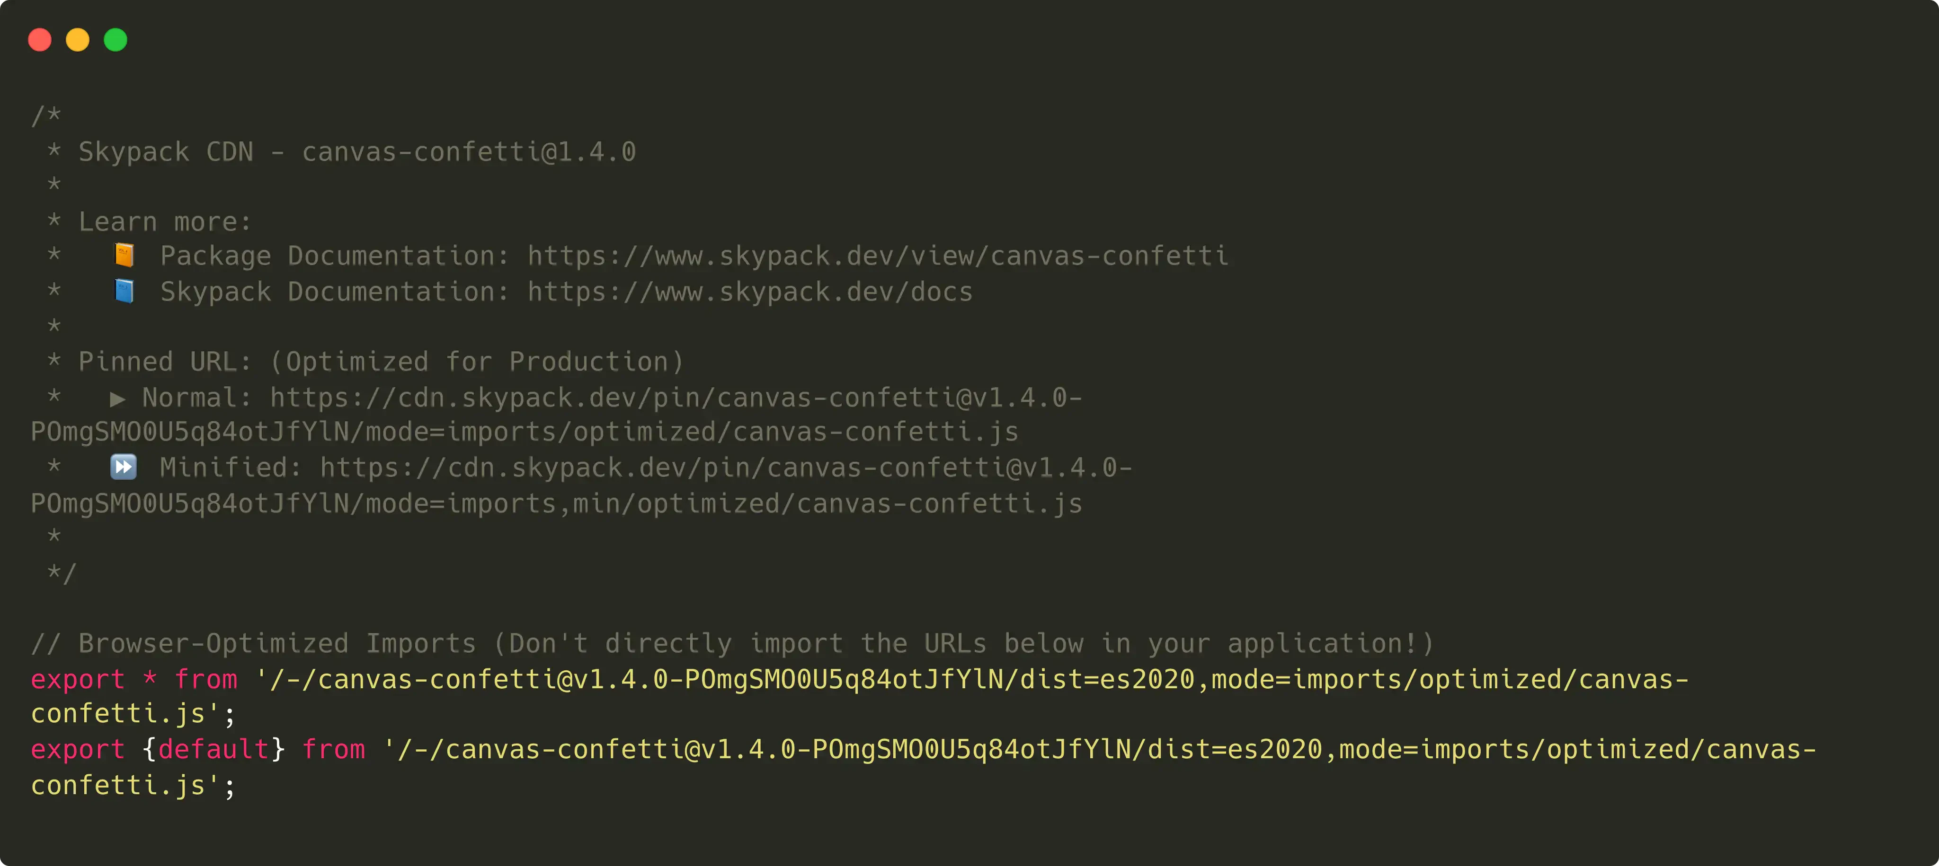
And now something completely different™
Skypack
used
snowpack
to
load
module
in
the
browsers
without
a
bundler.

Slide 55
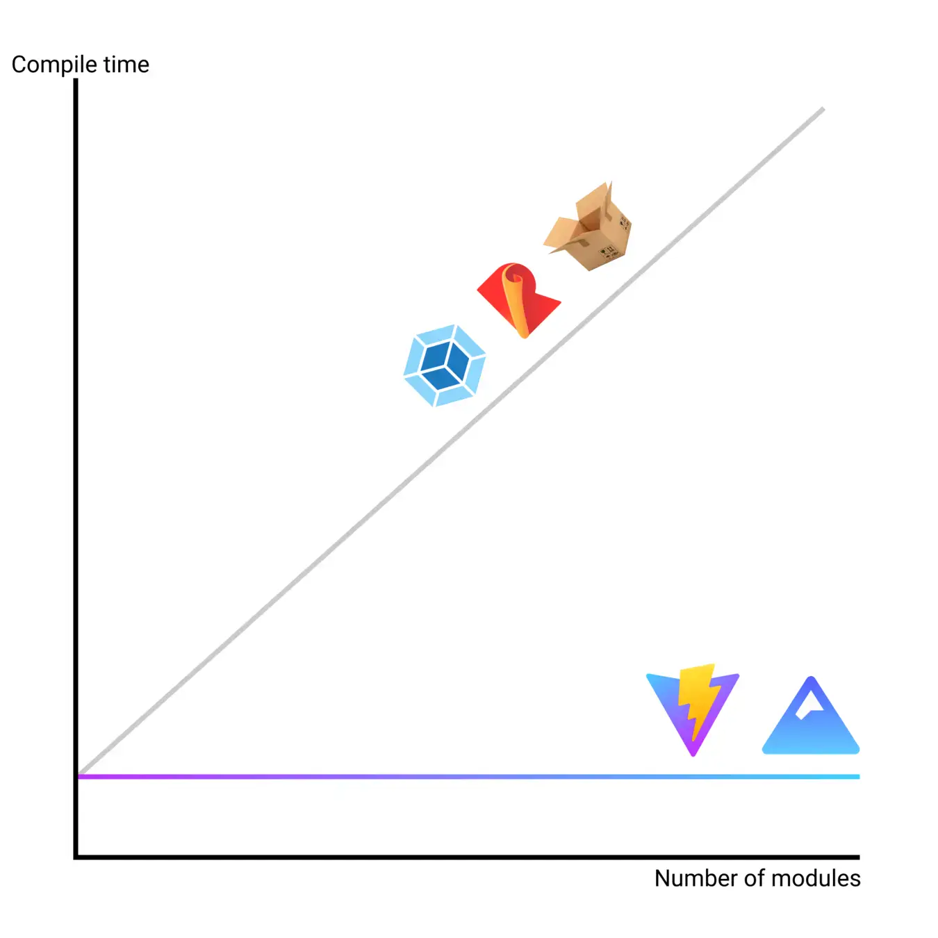
The greatest gain
in new bundlers
New
bundlers
give
O(1)
compile
time
which
is
great
when
the
number
of
modules
grows.

Slide 56


Take home lessons
What
can
we
learn
from
this
long
journey?
The future is no bundle
The future is bright
Competition is good
As ECMAScript module support
Big companies are sponsoring
Having multiple transpilers and
increases, bundlers will not be
transpilers and bundlers and this
bundlers competing to be the
needed anymore.
ensures continuity.
winner gives the best DX.

Slide 57


One last thing™
“Working hard and working smart
can be two different things.”
Byron Dorgan

Slide 58


Thank you!
Paolo Insogna
@p_insogna
Platformatic
Node.js TSC, Principal Engineer
paolo.insogna@platformatic.dev

