Slide 1

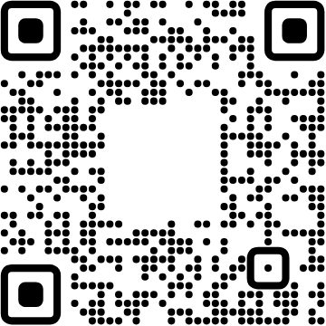


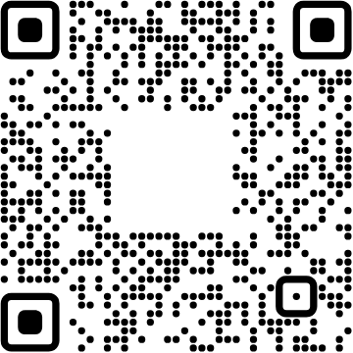

View online
Download PDF
How to breed a good OSS community
Paolo Insogna
Node.js TSC, Principal Engineer @
Platformatic

Slide 2
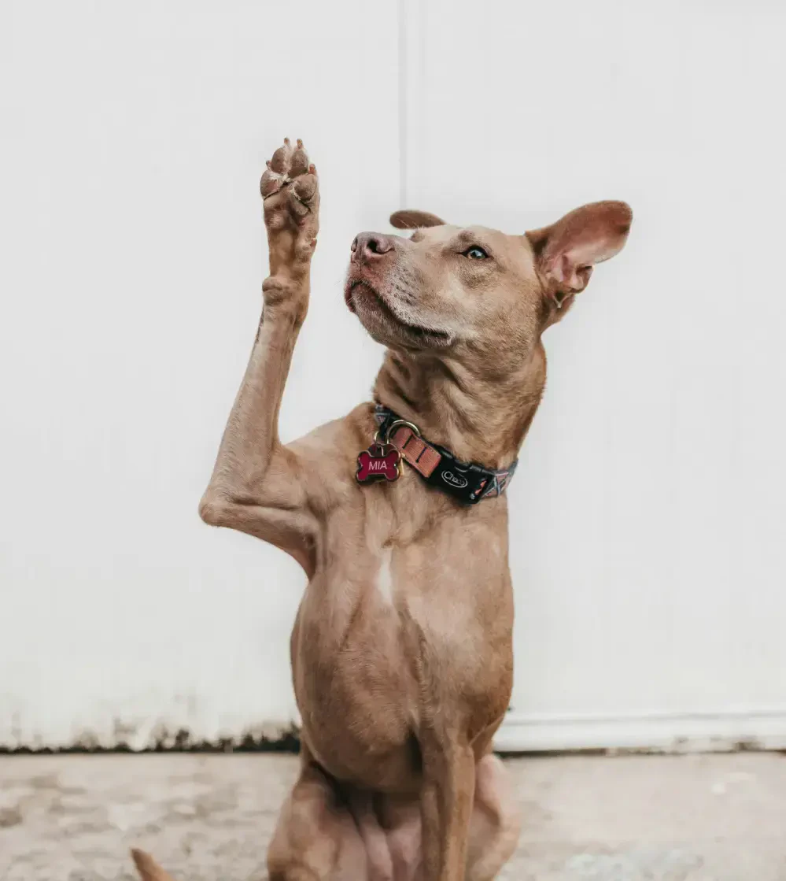
Don't ask if you
can't handle the
answers!

Slide 3

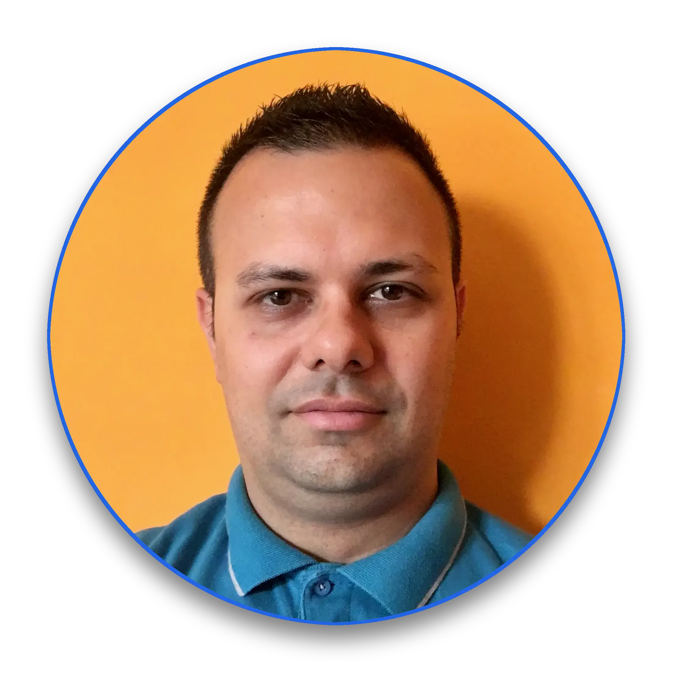
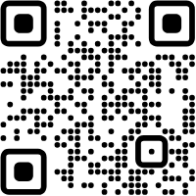



Hello, I'm
Paolo
!
Node.js
Technical Steering Committee Member
Platformatic
Principal Engineer
paoloinsogna.dev
ShogunPanda
p_insogna
pinsogna

Slide 4

Do you want to
mess with Open
Source?

Slide 5



Let's clarify things
What is it?
A decentralized software development model that
encourages open collaboration
.
How is it possible?
The secret is in the
passion
of the people.
Is it working?
Open Source has proven to be really effective in improving software quality.

Slide 6


How did it start?
Initially, it was free, not open
In the 70s the
free software movement
challenged the for-profit based development.
Free means too much
In English, the word free is ambiguous.
Not paid
was the most understood meaning.
Open Source was branched off the Free Software Movement
OSS software can be used for commercial purposes.
The freedom is retained.

Slide 7
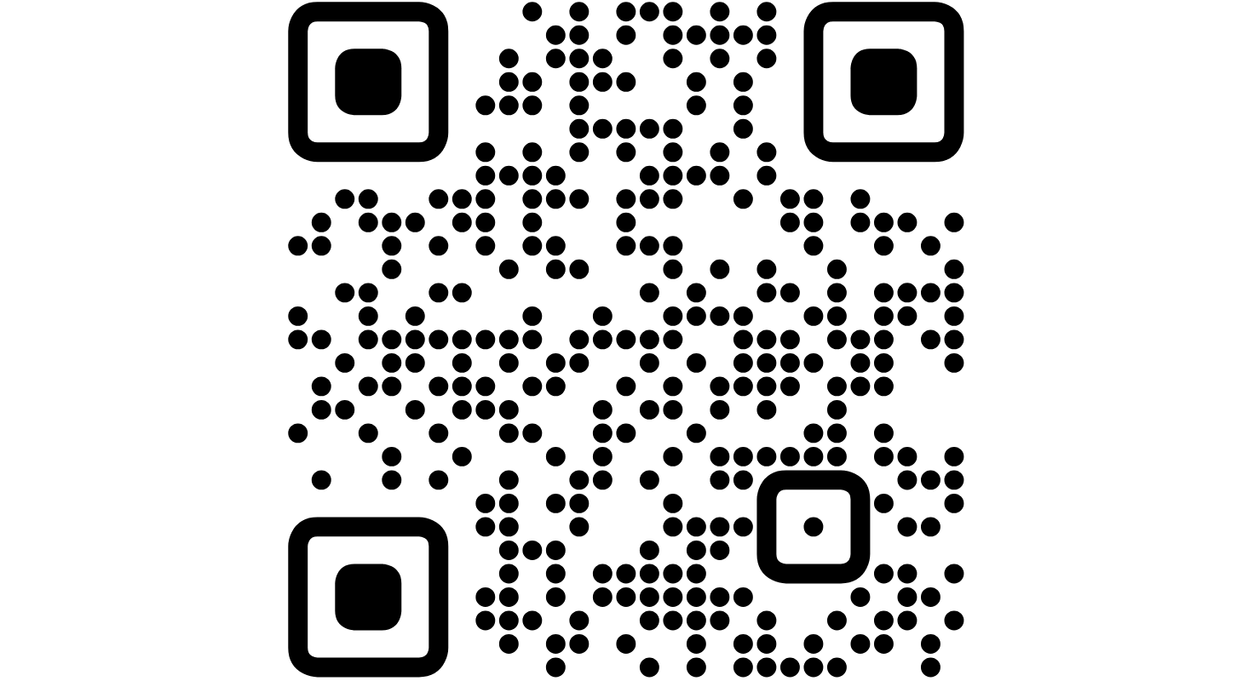
It might not be OpenSource
To
be
considered
Open
Source,
a
software
must
use
a
OSS
compatible
license.
The
Open
Source
Initiative
maintains
a
list
of
such
licenses.

Slide 8

Beware!

Slide 9
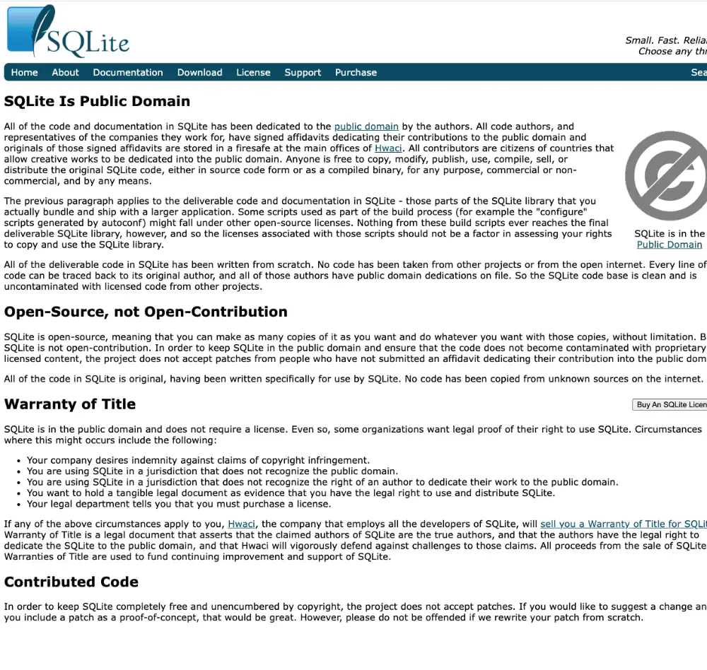
The devil is in the
details
Even
if
a
software
has
a
OSS
license,
it
might
not
strictly
be
OSS.
SQLite
is
Open
Source
but
not
Open
Contribution
.

Slide 10


Why would somebody want to go Open Source?
The best of the best of the best
You can access a developer base not physically close to you.
Different cultures, backgrounds and capabilities
You get different point of views, which increases quality.
Low maintenance cost
You don't need an office, just a version control server.

Slide 11

Wait a sec...

Slide 12
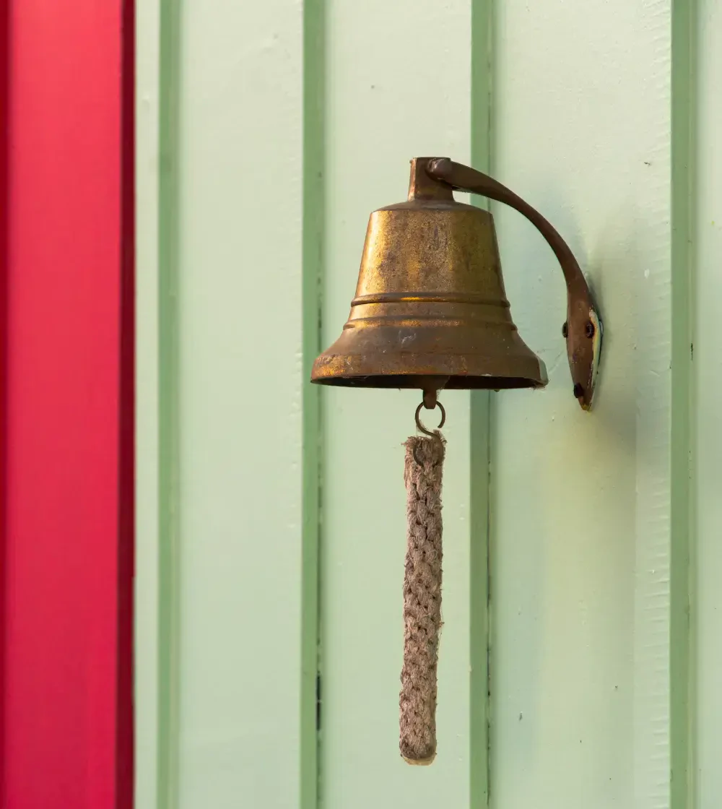
Ring a bell?

Slide 13
It's similar, but it's not!
The
Open
Source
development
model
is
similar
to
Remote
Working.
The
huge
difference
is
that
people
are
driven
by
passion
,
not
money.
You
are
not
their
boss!

Slide 14

How to make it
similar?
You
can
create
bounty
programs
to
prioritize
collaboration
on
bug
fixing
or
feature
development.

Slide 15
BAD!
DON'T!

Slide 16


Diversity and freedom are a huge treasure
Let them follow their path
The Open Source model works because people can freely follow their paths.
It's a hobby
Most collaborators send code in their free time, after a day of boring coding.
Keep the difference
If you make it look like a job, you will lose them.

Slide 17
How can you avoid losing control?
1
2
3
Propose, don't impose
Follow your path
Be open
You can share your vision and see
You can still deliver the features
Other people's path might be
if people are interested.
you care about.
useful for yours.

Slide 18

Trust the
community!

Slide 19
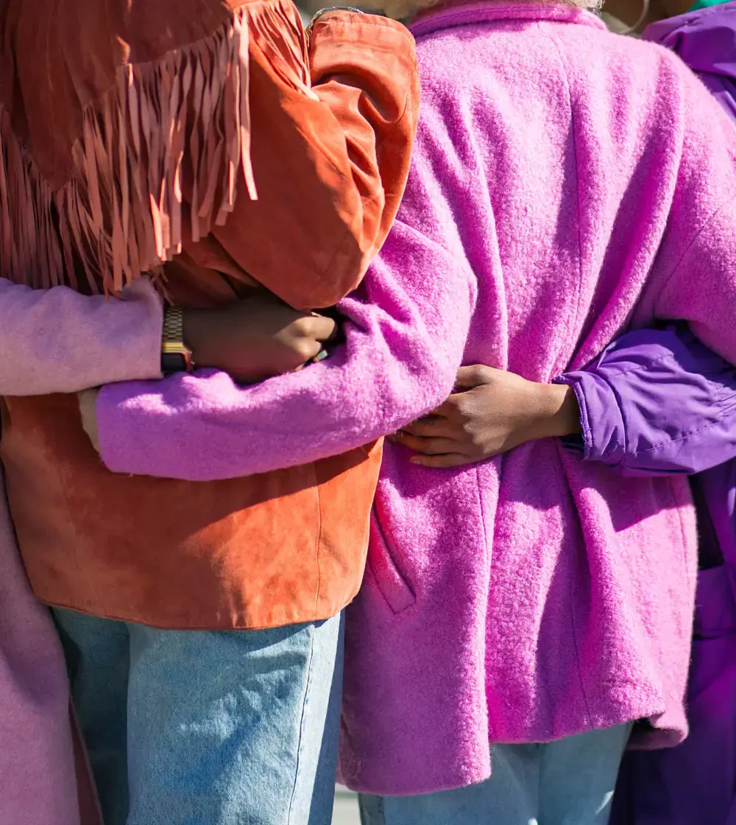
The world is nice ...
People
generally
want
to
help.
They
have
interest
in
what
you
are
doing
for
their
own
needs.

Slide 20

... but don't be afraid
to be harsh ...
Quick
and
effective
interventions
about
uncomfortable
situations
are
the
key.
Avoiding
creating
a
toxic
community
is
always
your
first
priority.

Slide 21

... and don't forget to
be kind!
You
will
get
people
of
all
knowledges
and
expertises.
Be
patient,
especially
with
newcomers.
Basically,
it's
like
parenting
:
endless
patience,
close
to
no
recognition.

Slide 22
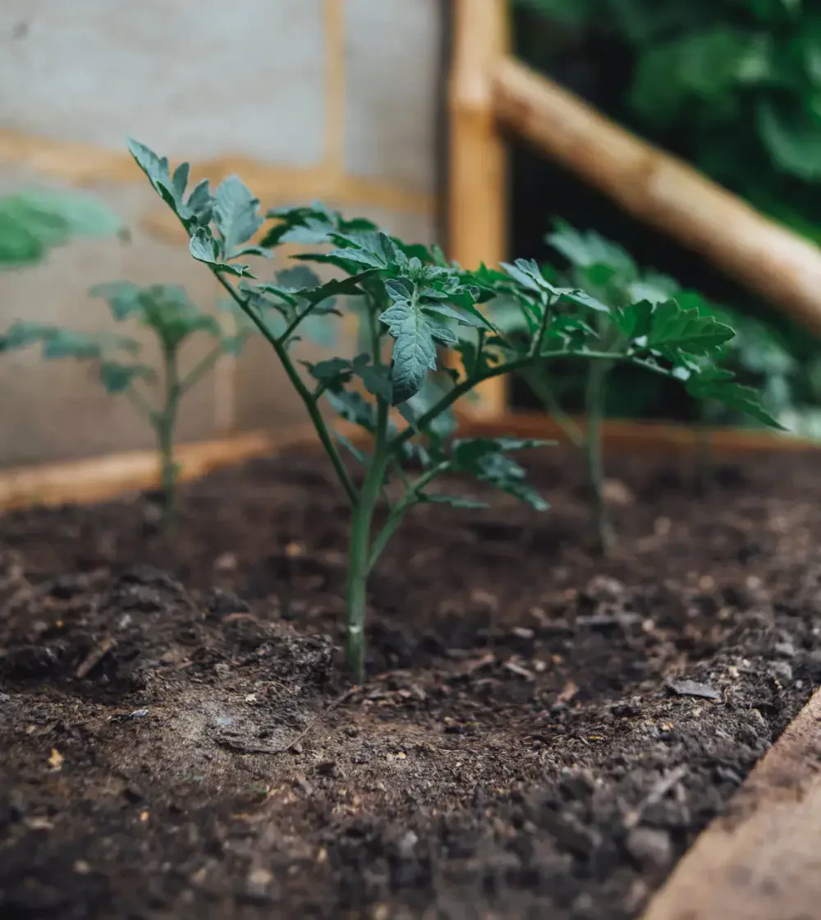
But here we're
talking about
breeding...

Slide 23


The job NEVER ends
Too big to fail
Once you start a community, you are responsible for maintaining it. Potentially forever.
Don't take it personally
The best way to manage such communities is to avoid a
one-person show
.
Everybody is replaceable
All people are important, but prepare the community to survive if people suddenly disappear.

Slide 24
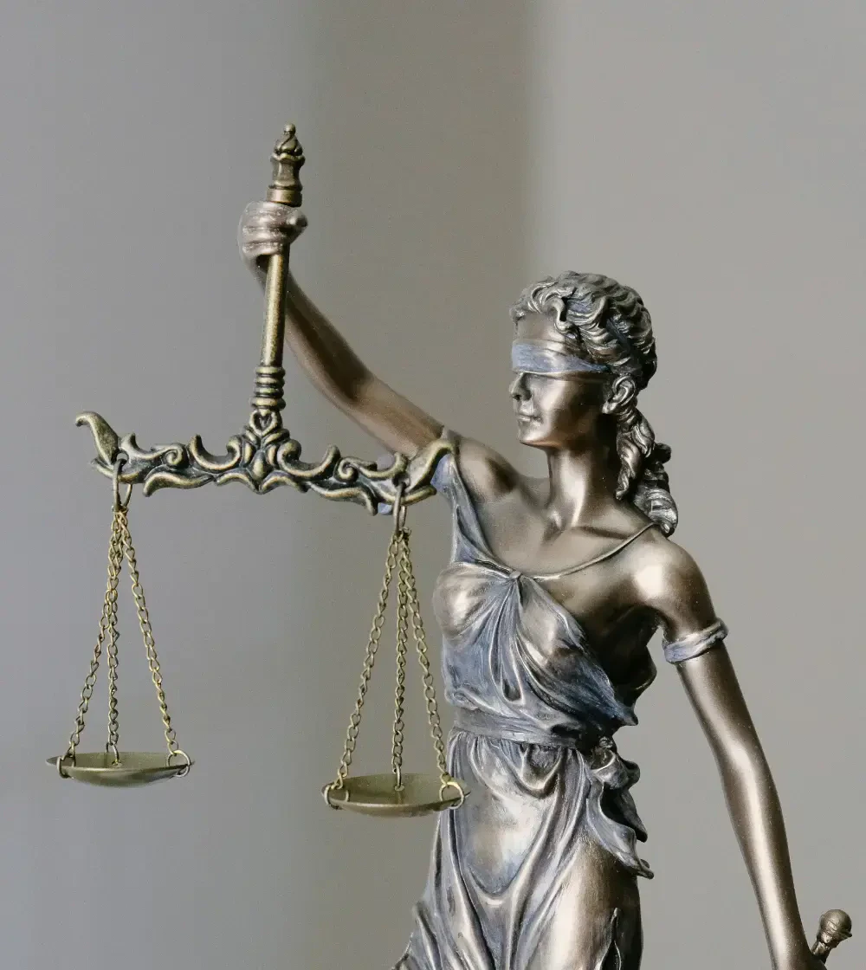
Nobody wants
to be sued!

Slide 25
Why do we need legal licenses?
Since
Open
Source
Software
is
used
in
every
sector,
it
has
legal
implications
and
liability.
You
need
to
avoid
consequences.
Do
not
reinvent
the
wheel,
choose
an
existing
license!

Slide 26



Remember, it's permanent ...
You can change...
... but not retroactively.
Forking is unavoidable
With every release, you can pick a
Only new releases use different
If people don't like the new license,
new compatible license.
licenses. Past is unchangeable.
they can fork the software.

Slide 27


...but you can still profit from it!
Remember how it started?
Open Source doesn't mean free.
Think outside of the box
You don't have to think about profiting directly from the software.
Be around and everywhere
You can profit by offering premium services or a commercial derived product.

Slide 28
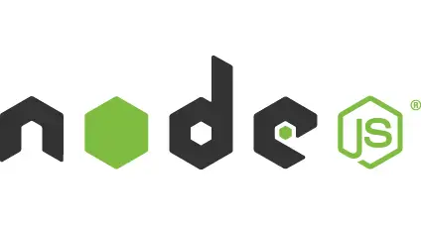


Don't try to mess the system
People
don't
like
if
you
try
to
take
away
their
beloved
Open
Source
software.
Node.js
Terraform
Rust

Slide 29
Being kind
never hurts!

Slide 30

Questions?

Slide 31
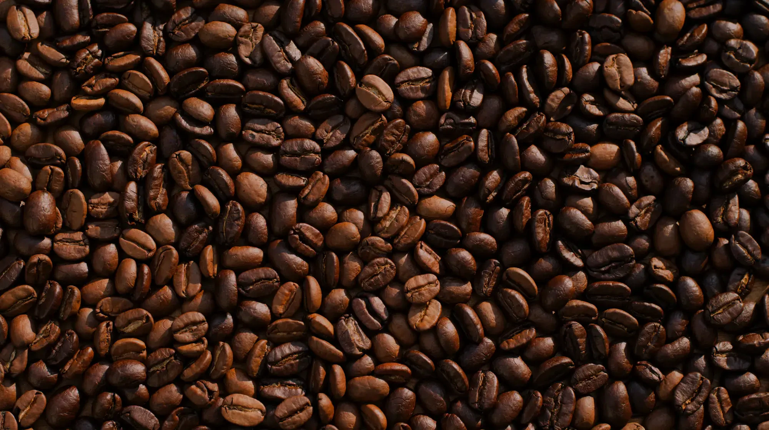
Coffee Break

Slide 32

Let's get to
the action!

Slide 33
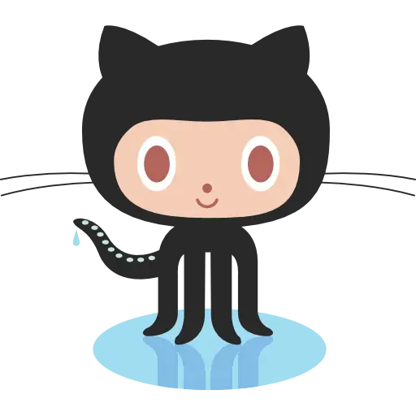


First of all, choose the hosting
GitHub
GitLab
BitBucket

Slide 34
Three reasons not to go self-hosted or exotic
1
2
3
Self hosting is hard
Self hosting is hidden
Git is well known
Ownership cost will increase.
You will be difficult to find.
Do not create entry barriers.

Slide 35
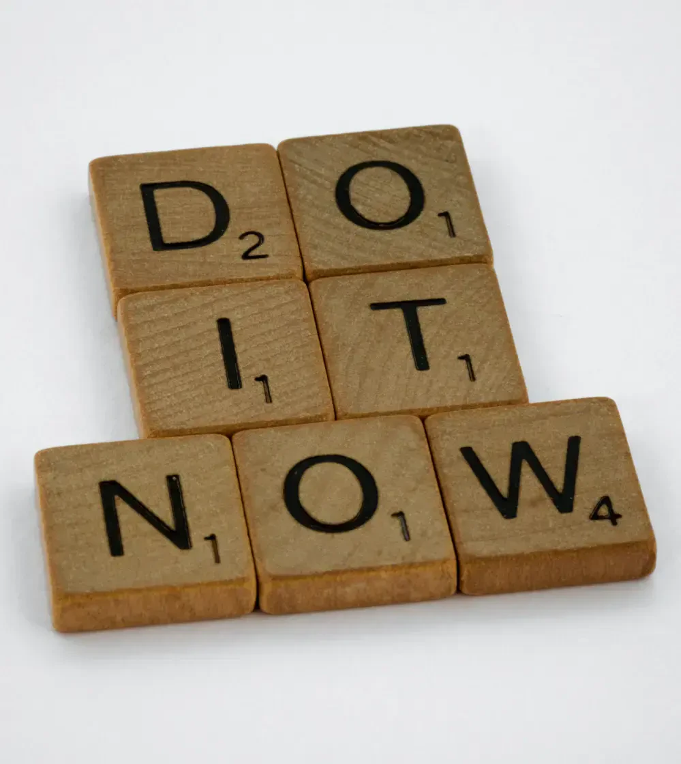
How do we get
started?

Slide 36
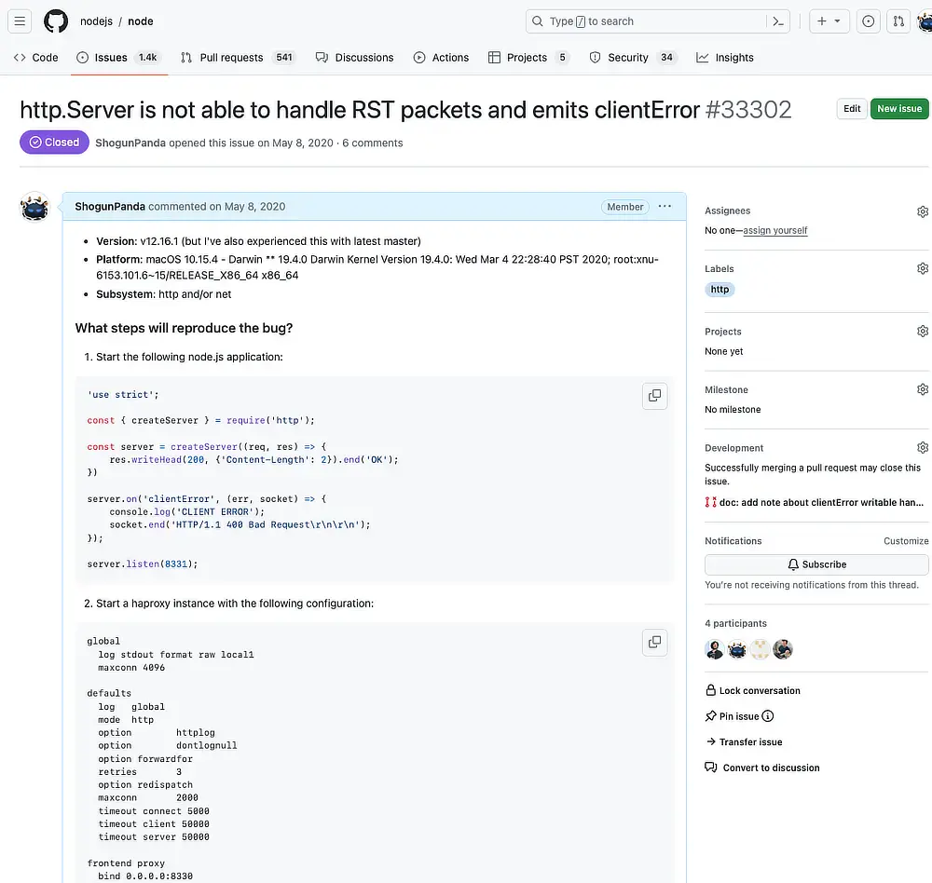
Everybody has issues
The
core
idea
to
attract
people
is
to
show
you
care.
The
issue
system
is
where
you
usually
take
feedback
and
bug
reports
from
your
user
base.

Slide 37
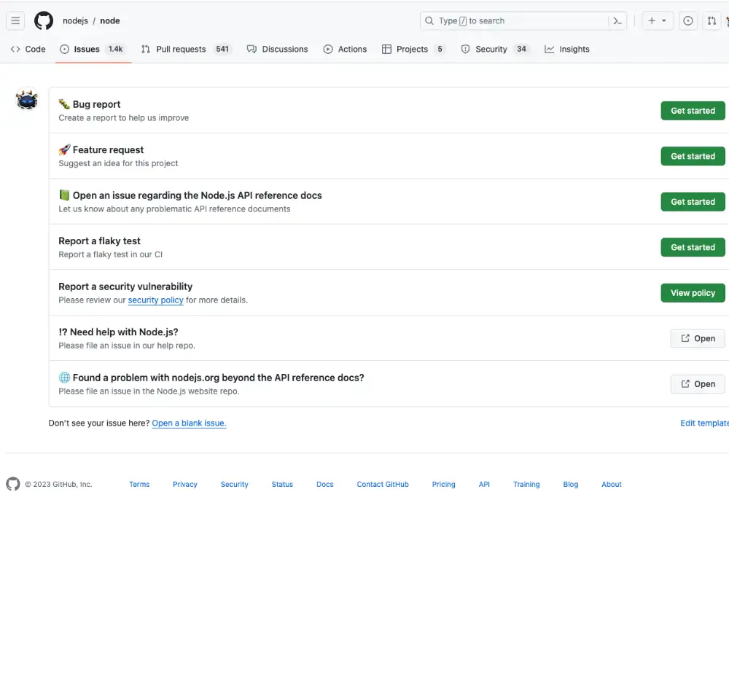
Templates help
It will help you
You can explicitly ask for the info you care the most.
It will help them
Having templates speeds up their reporting time.

Slide 38
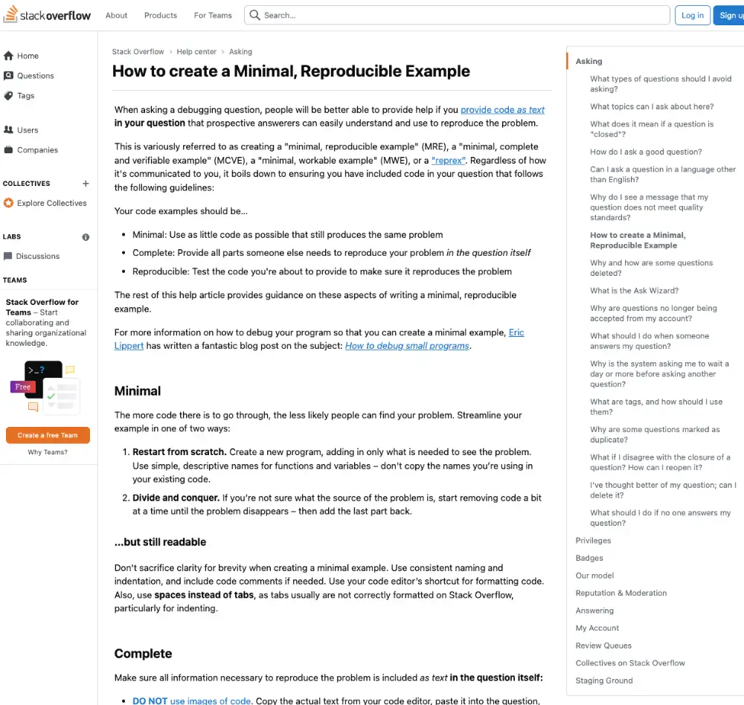


Reproducible
examples are crucial
for bugs
Reduce to the minimum
You want to rule out all irrelevant details.
Remove sensitive information
Nobody wants to get in trouble.
Ask for a public repository
It will facilitate reporters to help triagers.

Slide 39

You don't owe
anybody anything ...
It
is
in
your
rights
to
close
bugs
or
features
without
solving
them.

Slide 40
... but don't forget kindness!
1
2
3
Be respectful
Be gentle
Be reasonable
Provide an exhaustive explanation.
Use a kind tone.
Be open to change your mind.

Slide 41


In case of doubts
“A component of a system should behave in a way
that most users will expect it to behave, and
therefore not astonish or surprise users.”
Principle of least surprise

Slide 42

Label everything
Have a process
Following procedures will speed you up.
Divide et impera
Using labels helps categorizing and dividing tasks.
Don't overcommit
Limit the number of labels so that they are still useful.

Slide 43
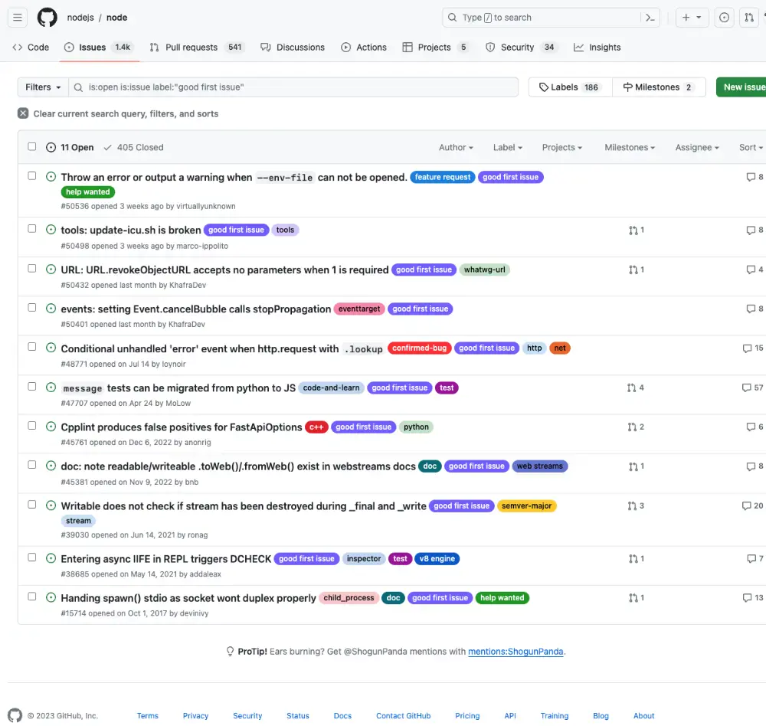
Remember about
good first time issues
When
people
come
in
your
community
and
want
to
help,
they
don't
know
where
to
start.
Having
good
first
time
issues
will
help
them
to
independently
starting
being
involved.

Slide 44
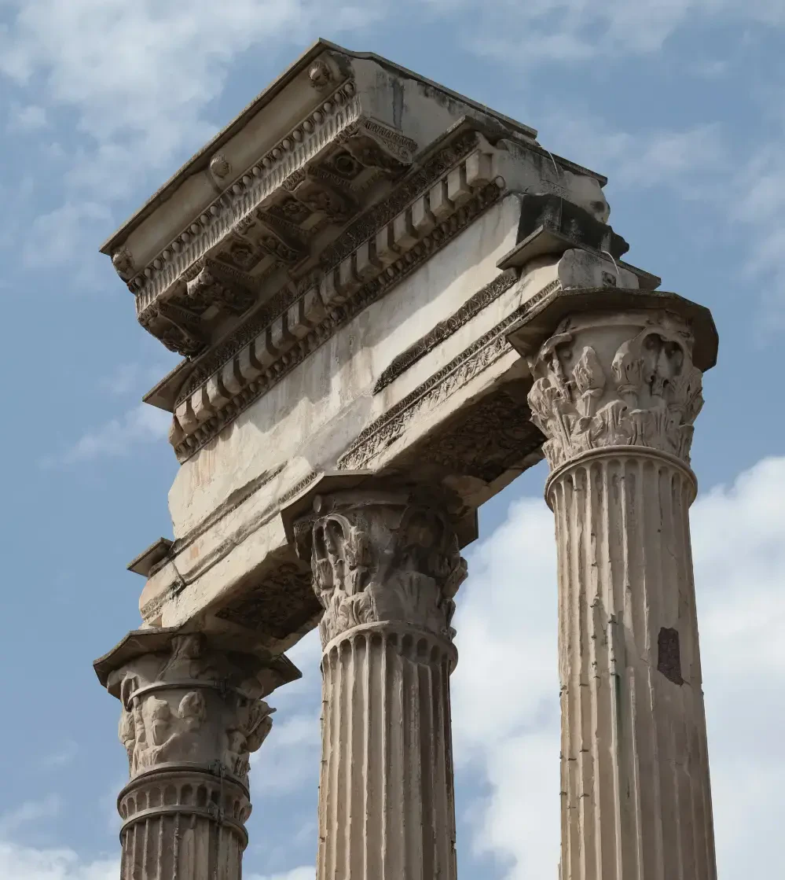
The next
big pillar

Slide 45
Pull Request
The core of the model
This is how collaborators send you code.
The quality will vary
It is your responsibility to maintain the level.
The scope will vary
Same as above,
don't be afraid of changes
.

Slide 46
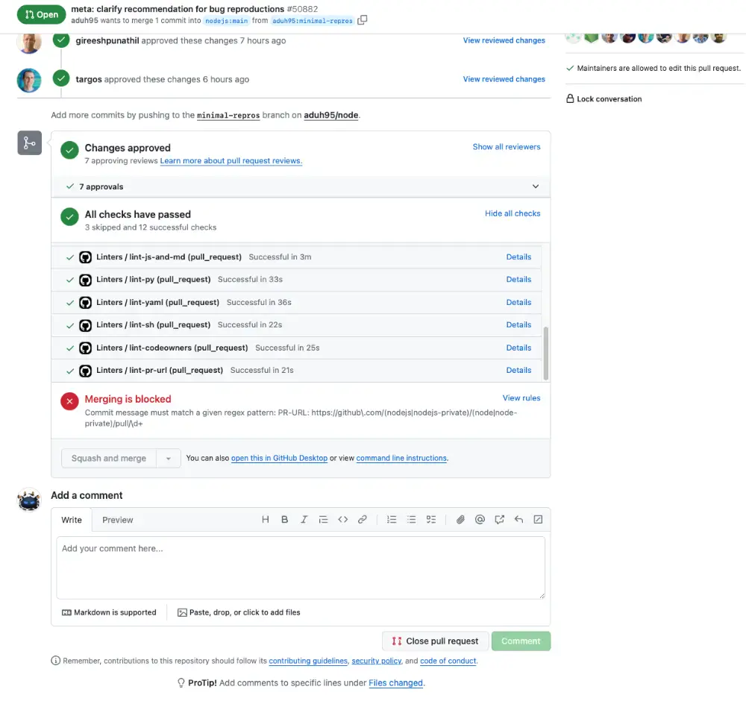
Always ask for tests
While
formal
TDD
is
hard,
Pull
Requests
must
contain
tests
when
non
trivial.
Even
if
a
PR
content
is
very
appealing,
you
have
to
resist
the
temptation
to
accept
it
without
tests
.

Slide 47
The review process
1
Behavior and security
Make sure the PR does what it claims, and double check security implications.
2
Performance
Nobody likes slow software, do they?
3
Quality and clarity
Poorly (or obscurely) written performant code makes more harm than good.
4
Enforce the conventions
Same as above,
don't be afraid to ask for picky changes
.

Slide 48

Review must be
thorough
No
one
rushes
you
to
merge
code.
If
possible,
require
for
multiple
approvals
before
committing.
Once
you
give
enough
time
for
objection,
then
you
can
merge.

Slide 49


CI and workflows
Available everywhere
In modern services you have a CI and workflow system.
It's so easy
Most of these tools are very easy to use.
CI is a life saver
Don't merge any PR with a red CI.

Slide 50
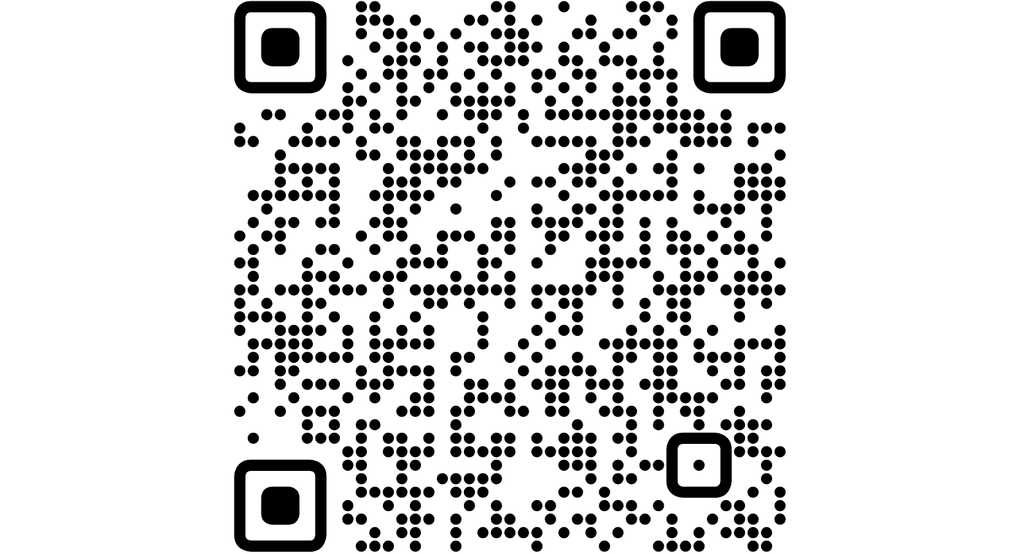
Conventional commits
How
to
add
human
and
machine
readable
meaning
to
commit
messages.
Check
the
official
website
!

Slide 51
Show me some examples
shogun@panda:~/repo$ git commit -m "feat!: send an email to the customer when a product is shipped"
shogun@panda:~/repo$ git commit -m "feat: allow provided config object to extend other configs"
shogun@panda:~/repo$ git commit -m "fix: prevent racing of requests"
shogun@panda:~/repo$ git commit -m "chore!: drop support for Node 6"
shogun@panda:~/repo$ git commit -m "docs: correct spelling of CHANGELOG"

Slide 52
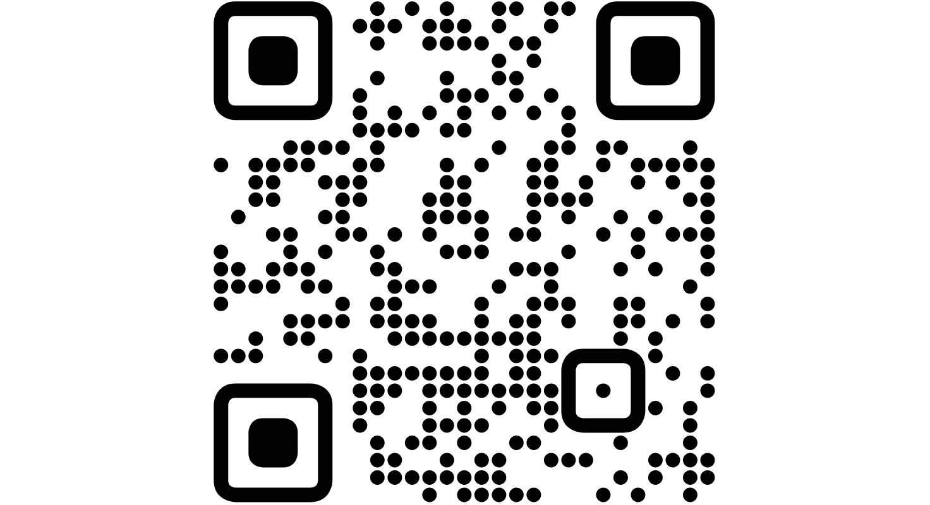
Semantic versioning
A
specification
for
having
meaningful
software
versions.
Check
the
official
website
!

Slide 53
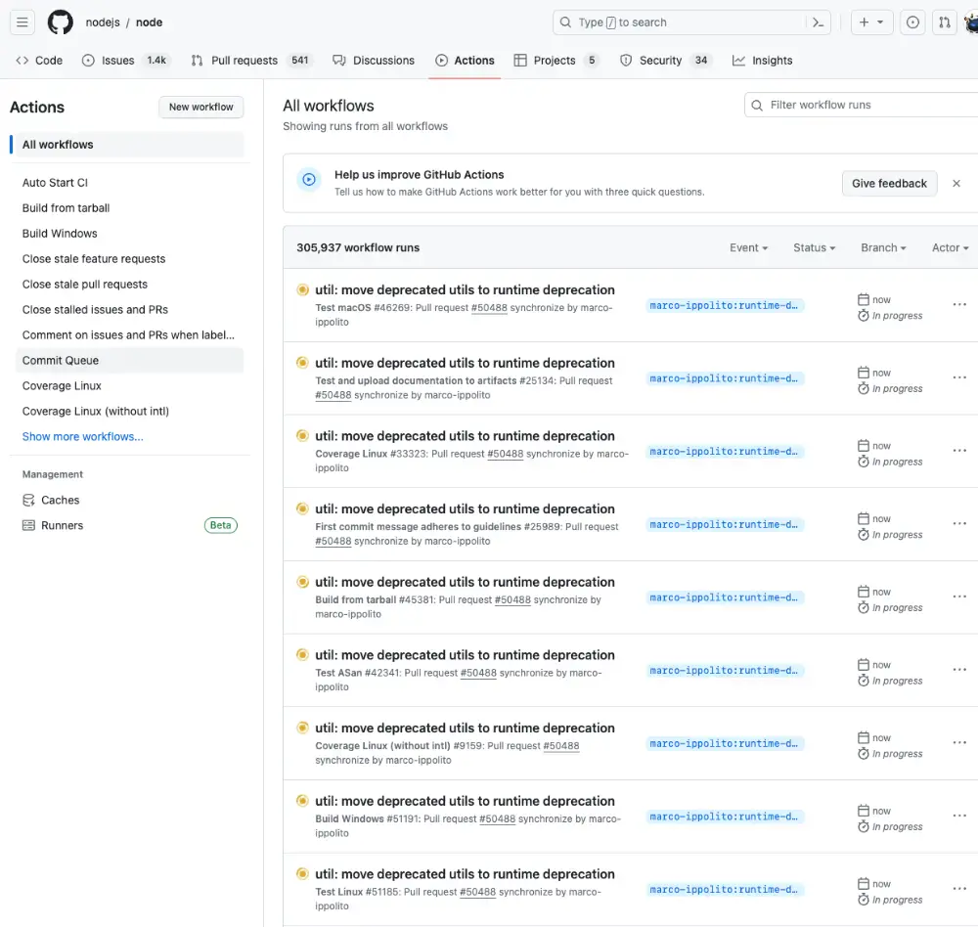
(Semi) Automated
releasing
By
leveraging
existing
tools
and
the
workflow
feature
you
can
release
new
version
with
just
a
click.

Slide 54
Questions?

Slide 55
Coffee Break

Slide 56
Humans are
social beings

Slide 57
Let's talk about the
community
Even
if
we're
developing
software,
it's
always
about
the
people.
A
line
of
code
can
be
replaced
at
any
time
with
no
effort,
you
can't
do
the
same
with
people.

Slide 58
Where do you store the code?
It's better to keep things separate
The management will be simplified.
Public, separate organizations are the best
They give you the visibility and ease of use you need.

Slide 59
Which accesses do you want to give?
Keep the accesses to the minimum
This is a general rule that should be followed as much as possible.
Make sure people cannot cut you out
It will be very hard to retake control.

Slide 60


Remember, you don't really own the code
It started with you ...
You own the software as whole.
... but it doesn't end with you ...
People are still owners and responsible for their contributions.
... so don't forget about others!
Contributors should have a say in relevant administrative tasks.

Slide 61

Diversity and
Inclusion

Slide 62
Conscious and unconscious bias
We
all
suffer
from
these
biases,
there
is
simply
no
escape.
1
2
Conscious
Unconscious
We all have and use attitudes and heuristics.
More subtle because we don't control them.

Slide 63



Why do you want D&I?
Richness
New experiences
New perspectives
Diversity is a pot of values.
All people are having their lives ...
... and different point of views.

Slide 64
How do you enforce it? (1/2)
1
2
Be pro-active
Be receptive
You can't wait for things to happen to act.
Ask for suggestion from affected people.

Slide 65
How do you enforce it? (2/2)
3
4
Code of Conduct
Zero Tolerance
This must be enforced from day zero.
No exception allowed.

Slide 66
Everybody is
responsible for
moderation!

Slide 67
Last advices
1
2
3
Common sense
Yield control
Be genuine and honest
It might be surprising, but it is very
You can't and neither want to
People will never fail to notice,
underestimated and
never hurts
.
control everything.
Don't burn out!
appreciate and
love you
.

Slide 68
Questions?

Slide 69
Coffee Break

Slide 70
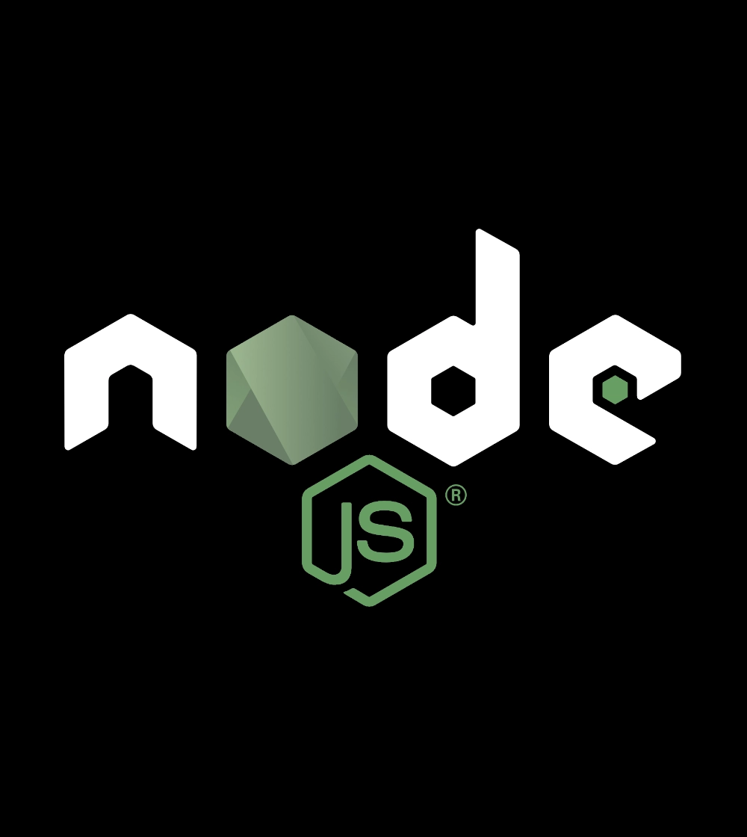
What about
Node.js?

Slide 71
Questions?

Slide 72


One last thing™
“Money is just a way to keep score.
The best people in any field are motivated
by passion. That becomes more true
the higher the skill level gets.”
Eric Raymond

Slide 73
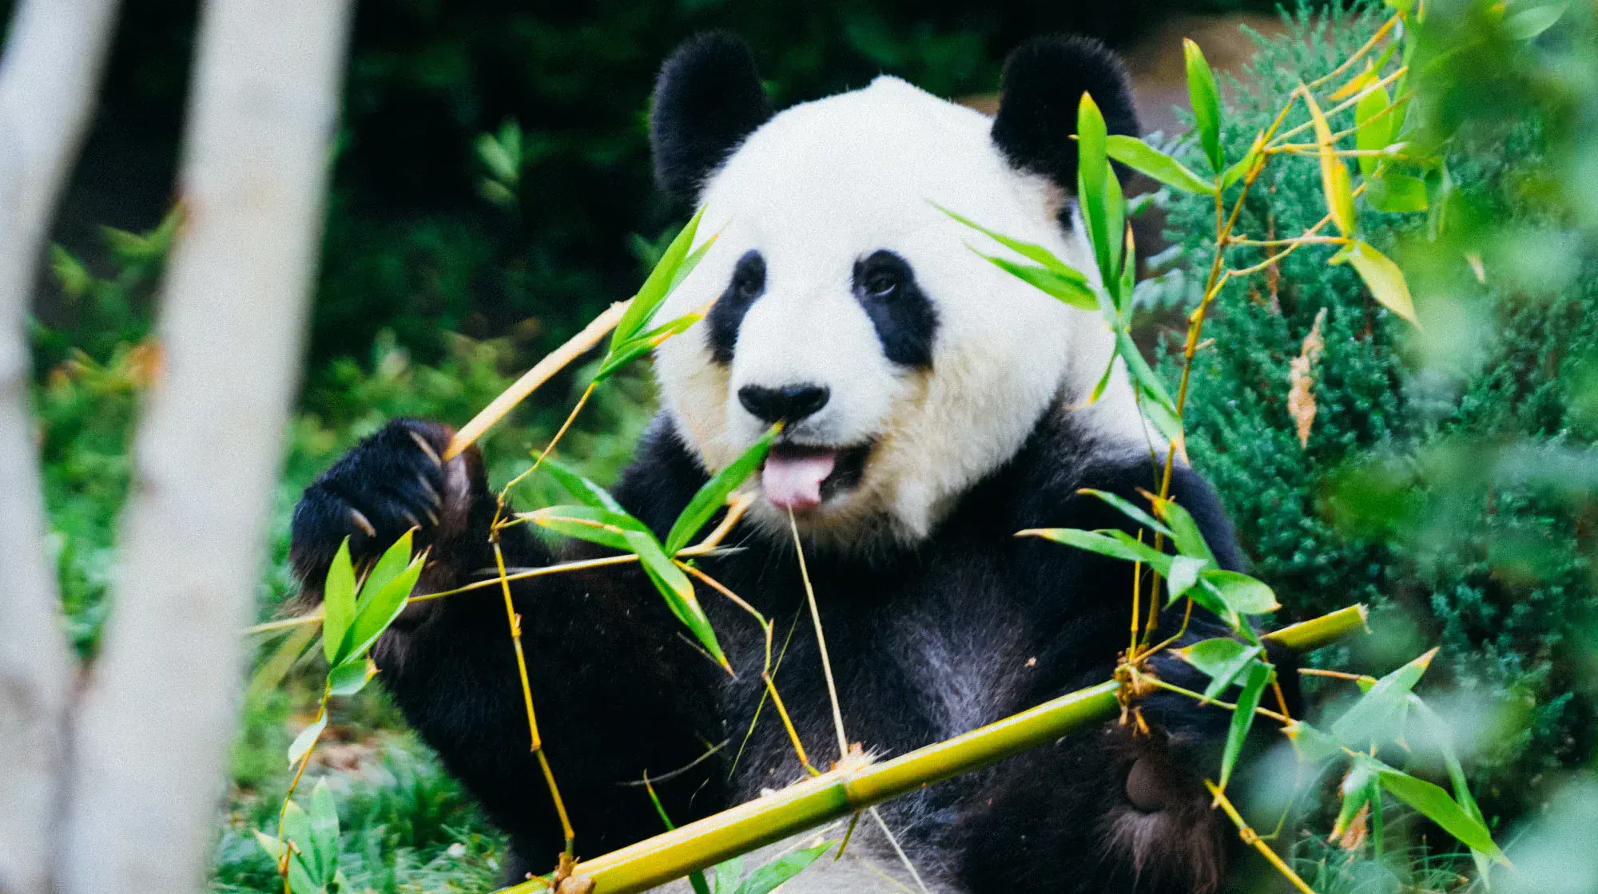
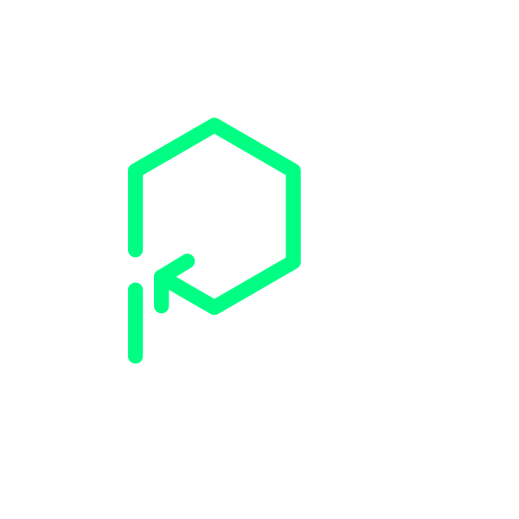
Thank you!
Paolo Insogna
@p_insogna
Platformatic
Node.js TSC, Principal Engineer
paolo.insogna@platformatic.dev

