Slide 1






View online
The bees are important:
Download PDF
use SDKs wisely
Paolo Insogna
Node.js TSC, Principal Engineer @
Platformatic

Slide 2

Mothers are
always right!

Slide 3






Hello, I'm
Paolo
!
Node.js
Technical Steering Committee Member
Platformatic
Principal Engineer
paoloinsogna.dev
ShogunPanda
p_insogna
pinsogna

Slide 4

Our entire
existence is on
their shoulders!

Slide 5



How is that?
They are related to our food
Over 70% of the food we eat is directly or indirectly related to their pollination.
We are endangering them
Pesticides and climate change made them an endangered species.
No coming back
If they disappear, we have no natural or artificial replacement.

Slide 6

Aren't we here for
dev stuff?

Slide 7

Yes, we do!
APIs are related to our application
Over 100% of the application we use is directly or indirectly related to their quality.
We are endangering them
Adding complexity between applications and APIs made them an endangered species.
No coming back
If they disappear, we have no other replacement.

Slide 8

Are you
trolling us?

Slide 9

Well, try to
translate
bees
in Italian!

Slide 10


Say hello to SDKs
We don't do everything by ourselves
Our application and servers often talk to third party services.
Third parties usually give us an SDK
The kit makes our life easier by simplifying integration.
Lot of goodies
Authentication, retry logic and other boring tasks are already implemented.

Slide 11


What do we get, in short?
Focus
Feel at home
All the API services are made simpler to use,
Each SDK is designed to be easily adopted
hiding all implementation details.
by your favorite programming language.

Slide 12

Are there just pros?

Slide 13

You already know
the answer...

Slide 14


What do we ALSO get, in short? (1/2)
Roadmap dependency
Supply chain
Since you don't control the SDK development,
If you have a bug or vulnerability in the SDK,
you can't embrace features at your pace.
you have to wait for the vendor to solve it.

Slide 15


What do we ALSO get, in short? (2/2)
Quality
Performance
Often vendors automate the generation of
SDKs are often underperforming due
SDKs out of API definitions.
to the attempt to keep a unique
Native language experience is lost.
architecture across languages.

Slide 16

Only an example
can enlighten us!

Slide 17


Case study: uploaded a file to AWS S3
Why?
It's a pretty simple use case that we all faced sometimes.
Which one?
I'm gonna analyze two different versions of the AWS JavaScript SDK.
How?
I'm gonna show you how many dependencies the SDK brings and how it performs.

Slide 18

Let's go!

Slide 19
AWS SDK v2: Dependencies in theory
We
only
add
dependency
in
the
package.json
file
...
{
"name": "aws-sdk-v2",
"version": "1.0.0",
"main": "index.mjs",
"scripts": {},
"dependencies": {
"aws-sdk": "^2.1508.0"
}
}

Slide 20
AWS SDK v2: Dependencies in reality
...
but
we
actually
get
a
lot
more!
shogun@panda:~/example$ pnpm list --depth=2 | wc -l
28

Slide 21
AWS SDK v2: The code
1
2
3
4
5
6
7
8
9
10
11
12
13
14
15
16
17
18
19
20
21
import AWS from 'aws-sdk'
import { readFile } from 'node:fs/promises'
// Create the client, this implicitly reads
// the AWS_ACCESS_KEY_ID and AWS_SECRET_ACCESS_KEY
// environment variables.
const client = new AWS.S3({
apiVersion: '2006-03-01',
region: process.env.AWS_DEFAULT_REGION
})
for (let i = 0; i < 100; i++) {
// Upload the file
await client
.putObject({
Bucket: process.env.BUCKET,
Key: process.env.KEY,
Body: await readFile(process.env.FILE, 'utf-8')
})
.promise()
}

Slide 22
AWS SDK v2: How does it perform?
shogun@panda:~/example$ time node index.mjs
________________________________________________________
Executed in 13.76 secs fish external
usr time 1.40 secs 84.00 micros 1.40 secs
sys time 0.13 secs 732.00 micros 0.13 secs

Slide 23
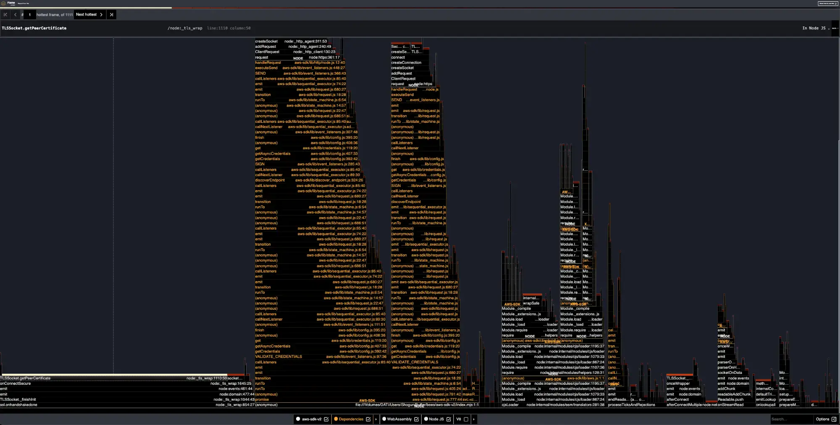
AWS SDK v2: What's happening under the hood?

Slide 24

Let's get modern!

Slide 25
AWS SDK v3: Dependencies in theory
A
little
more
detailed
dependencies
in
package.json
...
{
"name": "aws-sdk-v3",
"version": "1.0.0",
"main": "index.mjs",
"scripts": {},
"dependencies": {
"@aws-sdk/client-s3": "*",
"@aws-sdk/credential-providers": "^3.462.0"
}
}

Slide 26
AWS SDK v3: Dependencies in reality
...
but
we
actually
get
even
more
packages!
shogun@panda:~/example$ pnpm list --depth=2 | wc -l
524

Slide 27
AWS SDK v3: The code
1
2
3
4
5
6
7
8
9
10
11
12
13
14
15
16
17
18
19
20
21
22
import { readFile } from 'node:fs/promises'
import { S3Client, PutObjectCommand } from '@aws-sdk/client-s3'
import { fromEnv } from '@aws-sdk/credential-providers'
// Create the client
const client = new S3Client({
region: process.env.AWS_DEFAULT_REGION,
// This implicitly reads
// the AWS_ACCESS_KEY_ID and AWS_SECRET_ACCESS_KEY
// environment variables.
credentials: fromEnv()
})
for (let i = 0; i < 100; i++) {
await client.send(
new PutObjectCommand({
Bucket: process.env.BUCKET,
Key: process.env.KEY,
Body: await readFile(process.env.FILE, 'utf-8')
})
)
}

Slide 28
AWS SDK v3: How does it perform?
shogun@panda:~/example$ time node index.mjs
________________________________________________________
Executed in 8.22 secs fish external
usr time 723.14 millis 0.08 millis 723.06 millis
sys time 80.60 millis 1.17 millis 79.44 millis

Slide 29
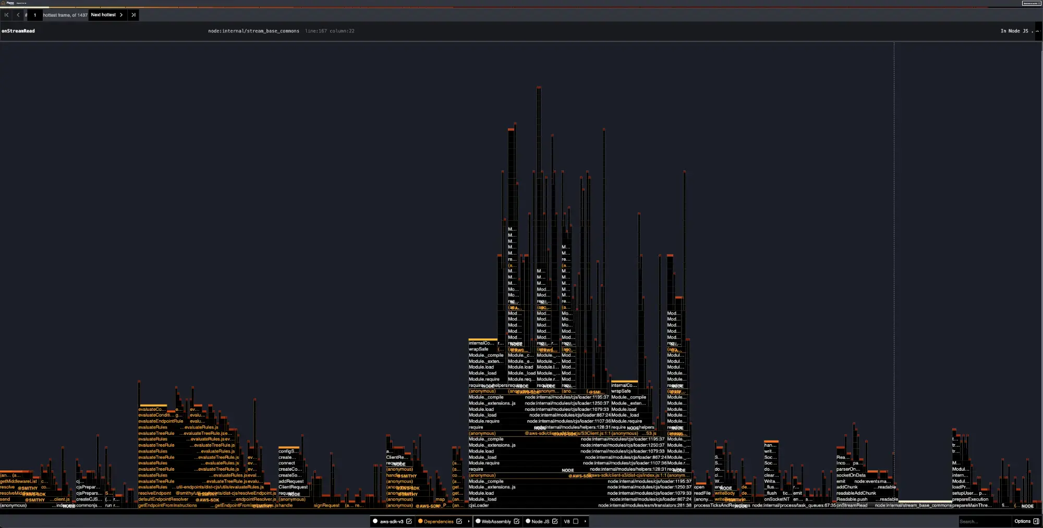
AWS SDK v3: What's happening under the hood?

Slide 30



Quod Erat
Demonstrandum
You only see a bit of it
Each SDK brings a lot more complexity which
is hidden under the rug.
Not really a monolith
How many point of failures can you afford?

Slide 31

Do we have the
solution?

Slide 32
Yes, use the APIs
directly!

Slide 33
How many will you use?
1
2
Unified signing
One REST HTTP call
Each AWS API uses the same
algorithm
.
Uploading a file to S3 only uses one
API call
.

Slide 34

Let's get to
the action!

Slide 35
No SDK: Setup
No
dependencies
in
package.json
,
Node.js
already
got
our
backs
...
{
"name": "direct",
"version": "1.0.0",
"main": "index.mjs",
"scripts": {},
"dependencies": {}
}

Slide 36
No SDK: Signing the call
1
2
3
4
5
6
7
8
9
10
11
12
13
14
15
16
17
18
19
import { createHash, createHmac } from 'node:crypto'
import { readFile } from 'node:fs/promises'
const awsS3UnsignedPayload = 'UNSIGNED-PAYLOAD'
function sha256(contents) {
return createHash('sha256').update(contents).digest('hex')
}
function hmacSha256(key, contents) {
return createHmac('sha256', key).update(contents).digest()
}
// Implements the Authenticating Requests (AWS Signature Version 4) algorithm.
function signS3Upload(keyId, accessKey, region, method, rawUrl, headers, payloadHash) {
// CanonicalRequest calculation
// StringToSign calculation
// Signature calculation
}

Slide 37
No SDK: CanonicalRequest
1
2
3
4
5
6
7
8
// CanonicalRequest calculation
const url = new URL(rawUrl)
const path = encodeURIComponent(url.pathname).replaceAll('%2F', '/')
// The last one is for the queryString, which is empty
const canonicalRequestComponents = [method, path, '']
const signedHeadersComponents = []
// Next step: StringToSign calculation

Slide 38
No SDK: StringToSign
1
2
3
4
5
6
7
8
9
10
11
12
13
14
// Previous step: CanonicalRequest calculation
// Create the StringToSign
const timestamp = headers['x-amz-date']
const date = timestamp.slice(0, 8)
const scope = `${date}/${region}/s3/aws4_request`
const stringToSign = [
'AWS4-HMAC-SHA256',
timestamp,
scope,
sha256(canonicalRequest)
].join('\n')
// Next step: Signature calculation

Slide 39
No SDK: Signature
1
2
3
4
5
6
7
8
9
10
11
12
13
14
15
// Previous step: StringToSign calculation
// Signature calculation
const dateKey = hmacSha256(`AWS4${accessKey}`, date)
const dateRegionKey = hmacSha256(dateKey, region)
const dateRegionServiceKey = hmacSha256(dateRegionKey, 's3')
const signingKey = hmacSha256(dateRegionServiceKey, 'aws4_request')
const signature = hmacSha256(signingKey, stringToSign).toString('hex')
return [
`AWS4-HMAC-SHA256 Credential=${keyId}/${date}/${region}/s3/aws4_request`
`SignedHeaders=${signedHeaders}`,
`Signature=${signature}`
].join(',')

Slide 40
No SDK: REST API call
1
2
3
4
5
6
7
8
9
10
11
12
13
14
15
16
17
18
19
20
function uploadFile(keyId, accessKey, region, bucket, key, contents) {
const host = `${bucket}.s3.${region}.amazonaws.com`
const payloadHash = 'UNSIGNED-PAYLOAD'
const headers = {
'x-amz-content-sha256': payloadHash,
'x-amz-date': new Date()
.toISOString()
.replace(/\.\d{0,3}/, '')
.replaceAll(/[:-]/g, ''),
host
}
const url = `https://${host}/${key}`
headers.authorization = signS3Upload(
keyId, accessKey, region,
'PUT', url, headers, payloadHash
)
return fetch(url, { method: 'PUT', headers, body: contents })
}

Slide 41
No SDK: Main loop
1
2
3
4
5
6
7
8
9
10
for (let i = 0; i < 100; i++) {
await uploadFile(
process.env.AWS_ACCESS_KEY_ID,
process.env.AWS_SECRET_ACCESS_KEY,
process.env.AWS_DEFAULT_REGION,
process.env.BUCKET,
process.env.KEY,
await readFile(process.env.FILE, 'utf-8')
)
}

Slide 42
No SDK: How does it perform?
shogun@panda:~/example$ time node index.mjs
________________________________________________________
Executed in 6.64 secs fish external
usr time 353.39 millis 54.00 micros 353.34 millis
sys time 42.81 millis 513.00 micros 42.30 millis

Slide 43
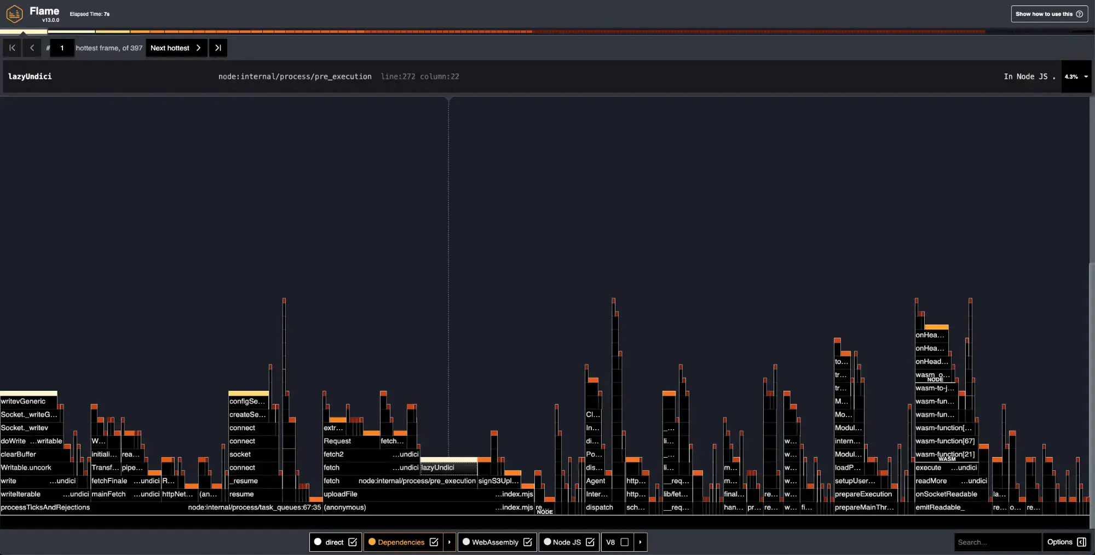
No SDK: What's happening under the hood?

Slide 44


Mission completed!

Slide 45



Take home lessons
What
can
we
learn
from
this
long
journey?
SDKs are not always bad
Be flexible
Read the API docs
Sometimes making things manually
You don't have to remove all SDKs.
If it's simple to use, maybe you
will
cost too much time
.
But you can
optimize some calls
.
don't need an SDK
.

Slide 46


One last thing™
“Don't take candies from strangers”
Every mother in the world

Slide 47

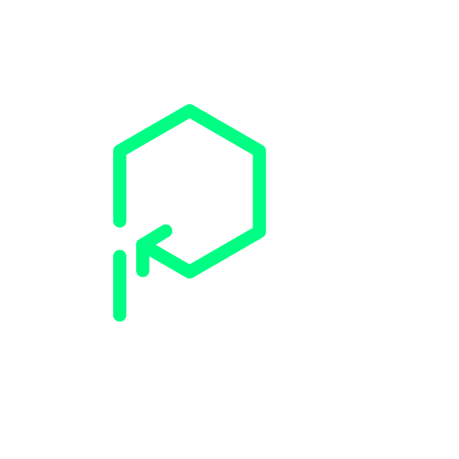
Thank you!
Paolo Insogna
@p_insogna
Platformatic
Node.js TSC, Principal Engineer
paolo.insogna@platformatic.dev

