Slide 1


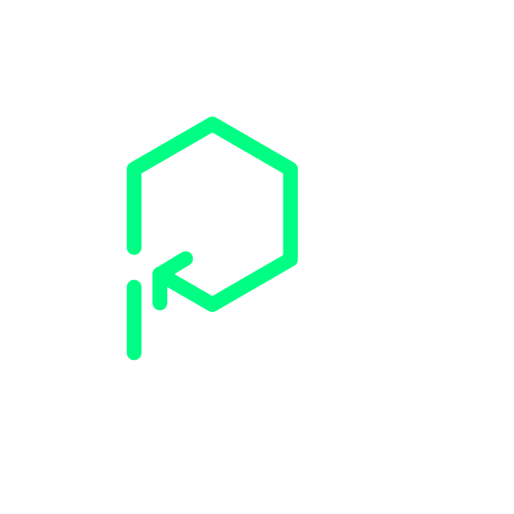



View online
Platformatic
Download PDF
Why Node.js needs an application server
Paolo Insogna
Node.js TSC, Principal Engineer

Slide 2






Hello, I'm
Paolo
!
Node.js
Technical Steering Committee Member
Platformatic
Principal Engineer
paoloinsogna.dev
ShogunPanda
p_insogna
pinsogna

Slide 3



Some companies trusting us
Article
Case Study
Case Study

Slide 4

Node.js is
everywhere

Slide 5



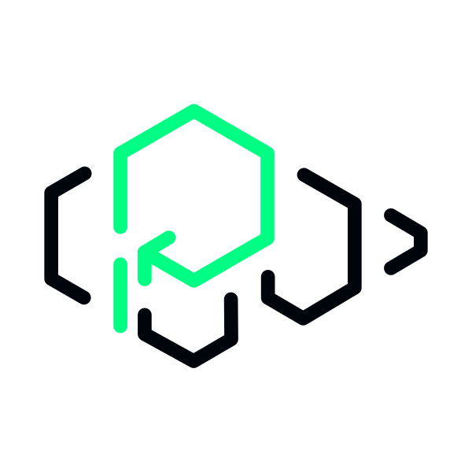
The numbers speak for themselves
2+ billion downloads annually
Node.js is one of the most popular web development tools in the world.
Powers millions of applications
From startups to Fortune 500 companies, Node.js runs critical infrastructure.
Fast and efficient
Built on V8, it delivers excellent performance for I/O-bound applications.

Slide 6

But there's a catch...

Slide 7



Single-threaded by design
One thread per process
By default, it runs JavaScript on a single event loop.
Non-blocking I/O
It's the perfect fit for web servers and APIs.
Limited for CPU-intensive tasks
Heavy computation can block the entire application.

Slide 8

Is this still true?

Slide 9

Did you hide
in a cave?

Slide 10



Worker Threads have existed since 2018
Introduced in Node.js 10.5.0
The Worker Threads API was added in June 2018 and has been stable since Node.js 12.
True parallelism
Run JavaScript in multiple threads, each with its own V8 instance and event loop.
Not widely adopted
Way too many applications still don't leverage them, missing out on multi-core performance.

Slide 11
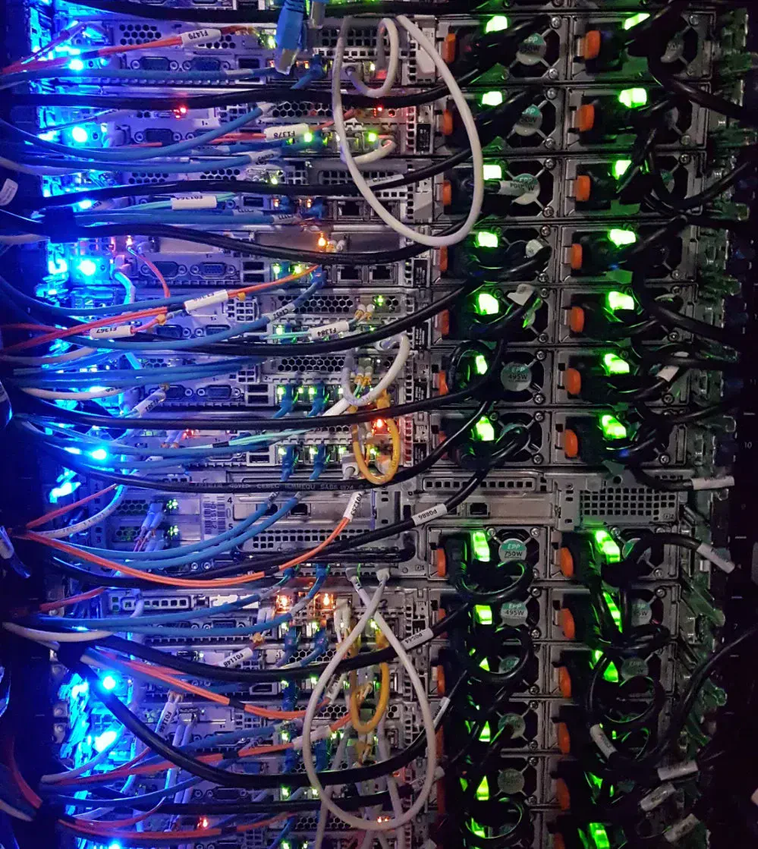
Running Node.js
in production

Slide 12



The three pillars
Monitoring
Track application health and detect issues before they become critical.
Metrics
Collect and expose performance data for observability platforms.
Fault tolerance
Handle failures gracefully and recover quickly from errors.

Slide 13
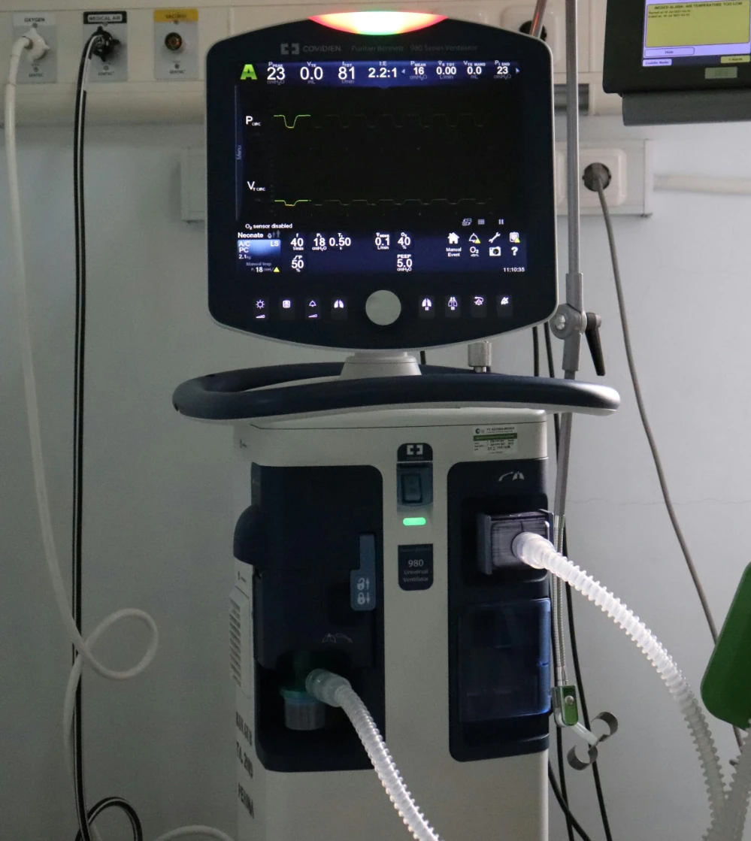
How do we
monitor health?

Slide 14
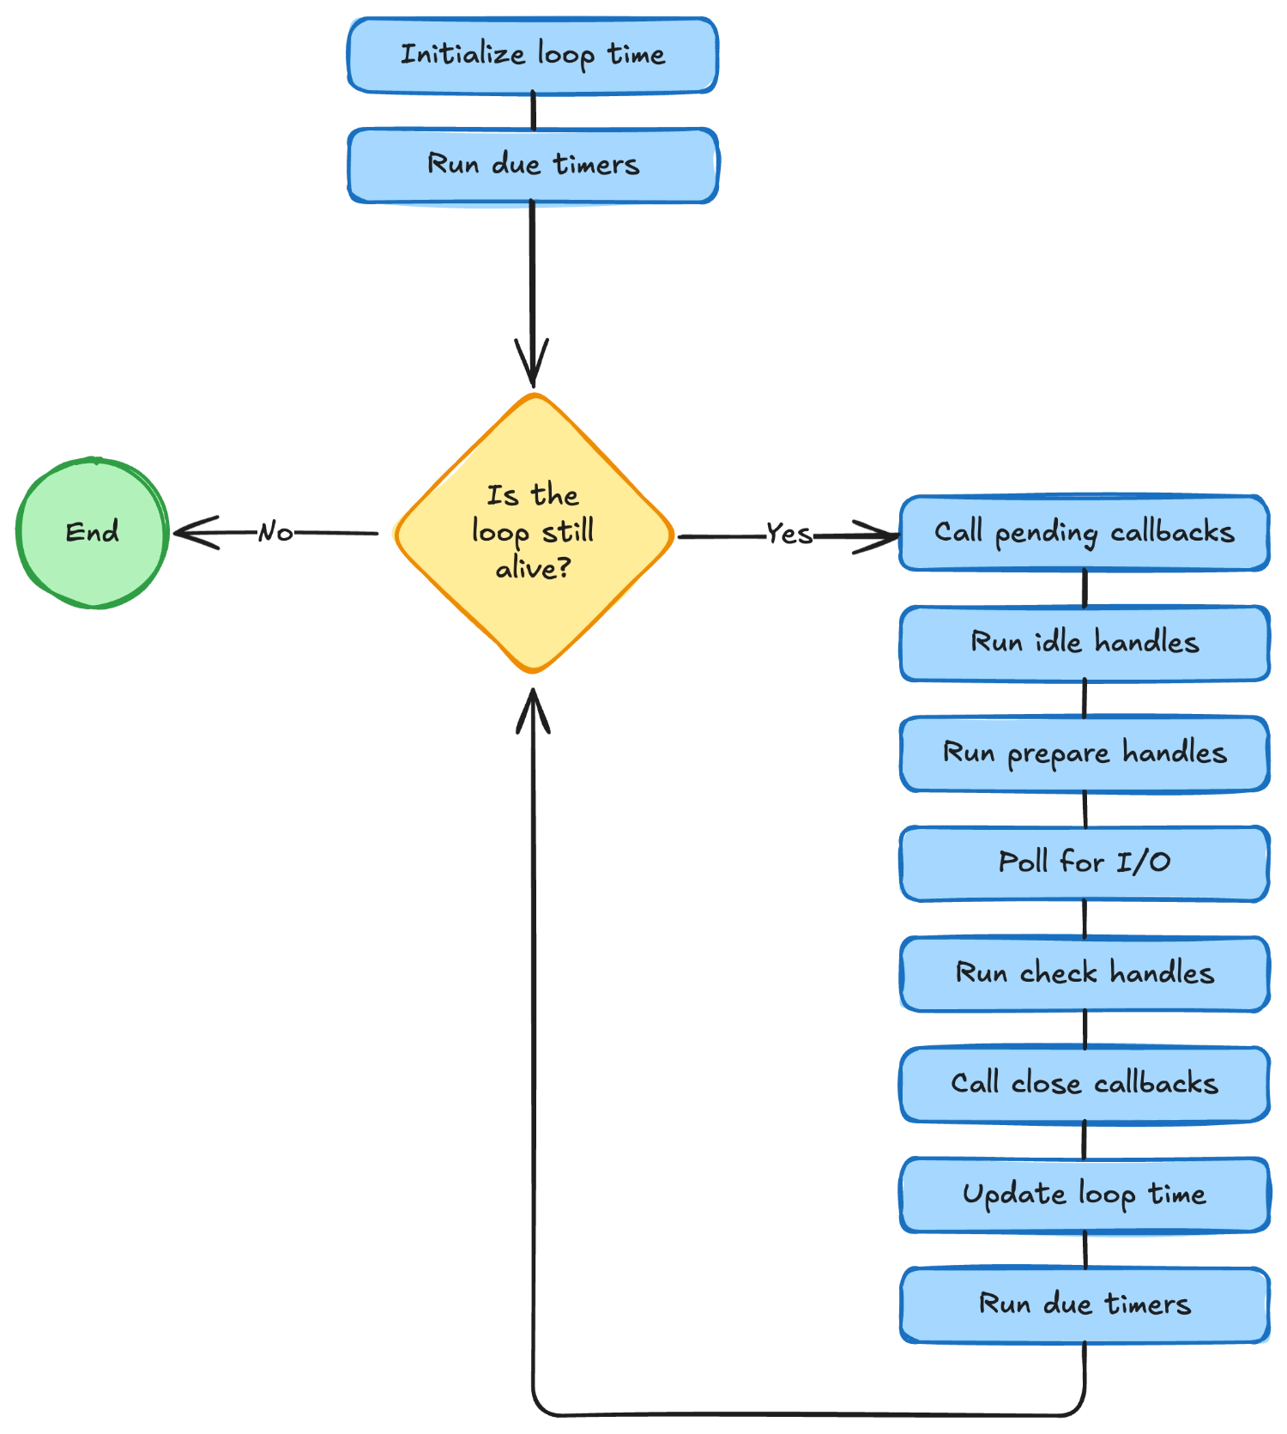
The Node.js event loop

Slide 15


The event loop observation problem
The paradox
Monitoring gets blocked too
A busy event loop
If your application is overloaded,
cannot observe itself
.
the monitoring code is also blocked.

Slide 16


Backpressure management loses effectiveness
Resource waste is "suboptimal"
Ineffective under load
You must set low thresholds
If the thread is truly stuck,
to allow monitoring to run.
no monitoring code runs.

Slide 17

We need a better
architecture!

Slide 18

Introducing Watt
A
Node.js
application
server,
done
the
right
way!
https://www.platformatichq.com/watt

Slide 19

Here's our
secret sauce
!
Move applications to threads
Each gets its own separate worker thread.
Main thread as coordinator
The main thread manages workers and routes requests.
External observation
The coordinator can monitor worker health from outside.

Slide 20


How does it work?
Main thread (coordinator)
Worker threads
Monitors workers
Run applications, report health status,
and handles their lifecycle.
and support independent restart and scaling.

Slide 21

What about
metrics?

Slide 22


Prometheus server on the main thread
Dedicated metrics server
Prometheus metrics are exposed from the main thread, not from worker threads.
Avoid the paradox
A blocked worker cannot report its own metrics reliably.
Always available
The metrics endpoint always responds, regardless of worker state.

Slide 23
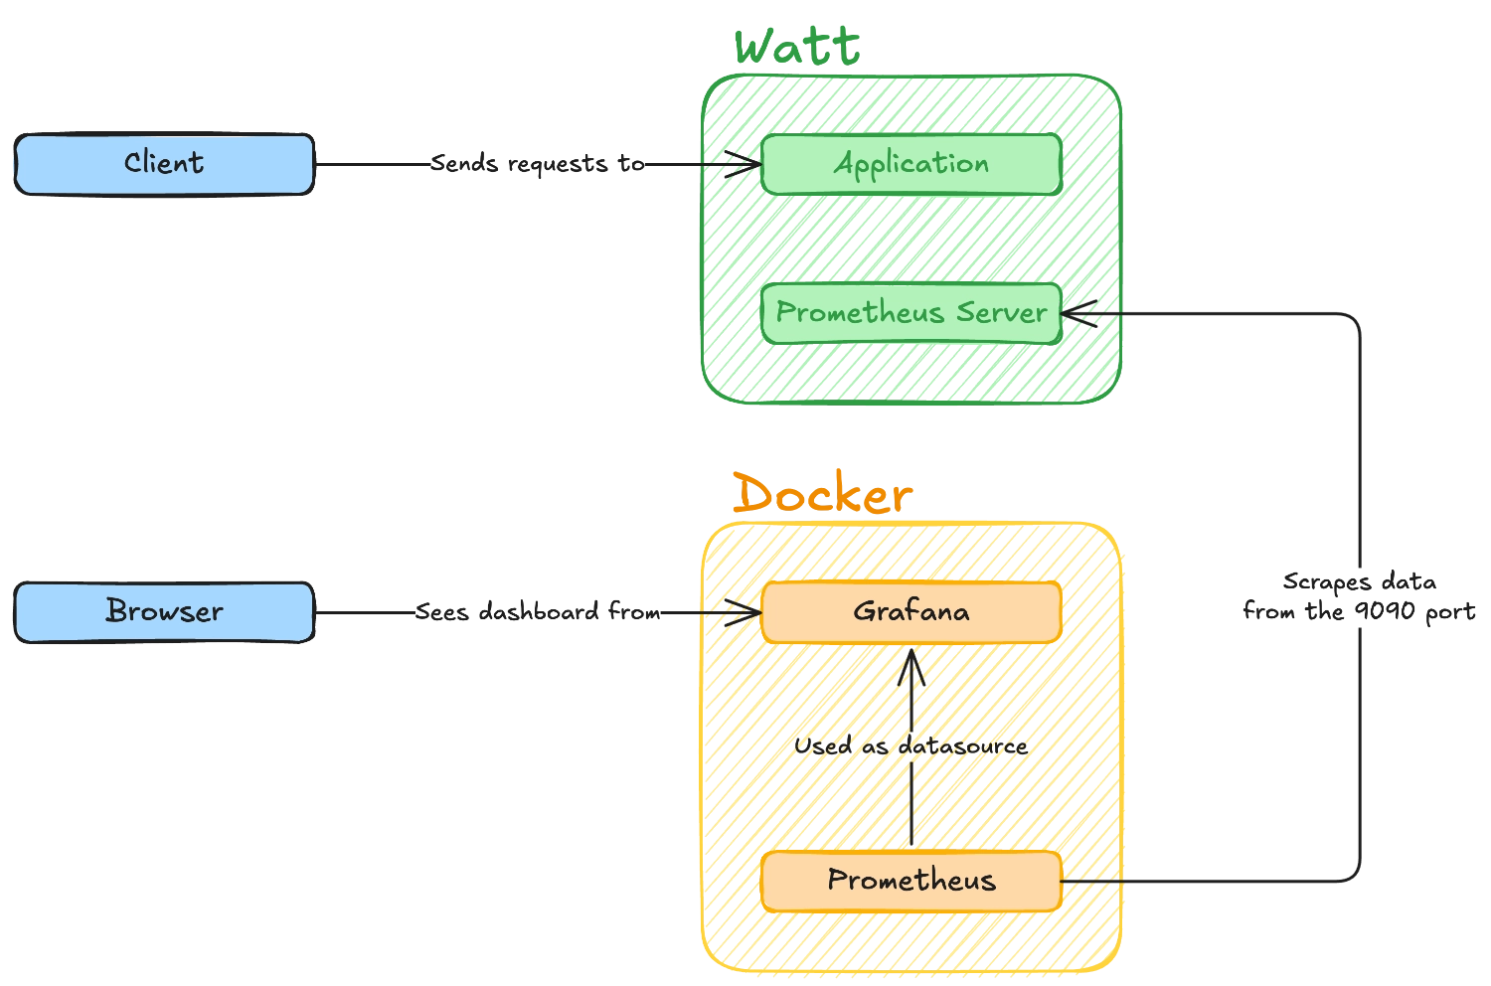
Monitoring architecture

Slide 24

Kubernetes probes benefit too
Reliable readiness probes
Report as ready only when workers are actually available.
Reliable liveness probes
Always respond to liveness checks, even under heavy load.
True health visibility
Kubernetes sees the real application health, not just thread responsiveness.

Slide 25

Handling failures

Slide 26


The traditional single-threaded scenario
Degradation goes unnoticed
Health checks stop responding when the thread is busy, hiding the real problem.
Critical failures are catastrophic
Memory exhaustion, a crash, or an unhandled exception takes down the entire application.
Long recovery time
During process restart, there might be downtime or performance loss due to fewer replicas.

Slide 27



The innovative Watt multi-threaded approach
Let it fail
Proactive approach
Replace before restart
If a worker thread crashes,
If health metrics degrade,
Start a new thread before
restart it immediately.
terminate and restart the worker.
stopping unhealthy ones.

Slide 28

Why is this
approach better?

Slide 29

Because I'm
telling you!
Don't
you
just
trust
me?
😭

Slide 30


Seriously, why is this approach better?
Much faster recovery
Restarting a single thread is orders of magnitude faster than restarting the entire process.
Replace, don't restart
New workers start before unhealthy ones stop, ensuring zero wait time.
No request loss
Traffic seamlessly shifts to healthy workers with no dropped connections or failed requests.

Slide 31

Not convinced yet?

Slide 32


Multiple applications, one process
Run multiple applications
Independent scaling
They all run in the same Node.js process,
Scale each application independently based
each isolated in its own worker thread.
on its own load and resource requirements.

Slide 33
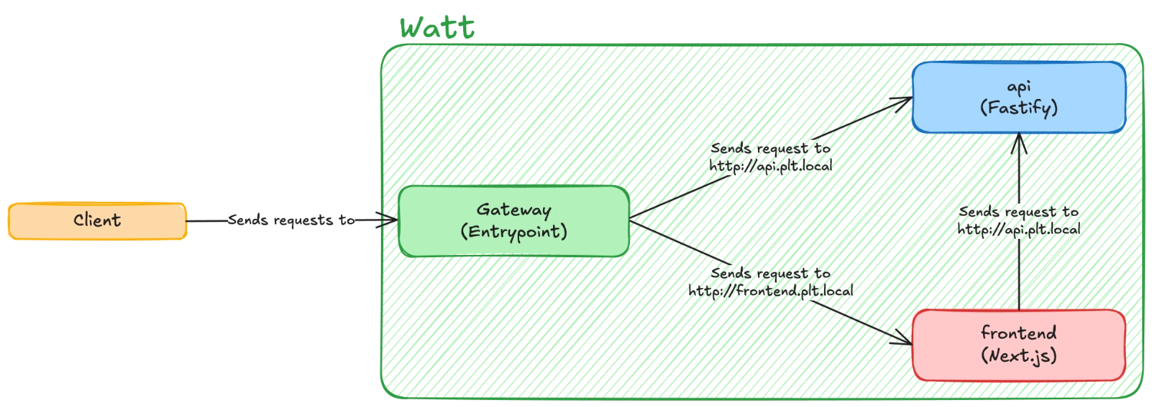
Watt in action: the mesh network

Slide 34


Intelligent dynamic in-process scaling
Use all available cores
Spawn workers to match available CPU cores.
Dynamic worker count
Scale workers up or down dynamically based on load and performance.
Better resource utilization
Get more from your existing infrastructure before scaling horizontally.

Slide 35
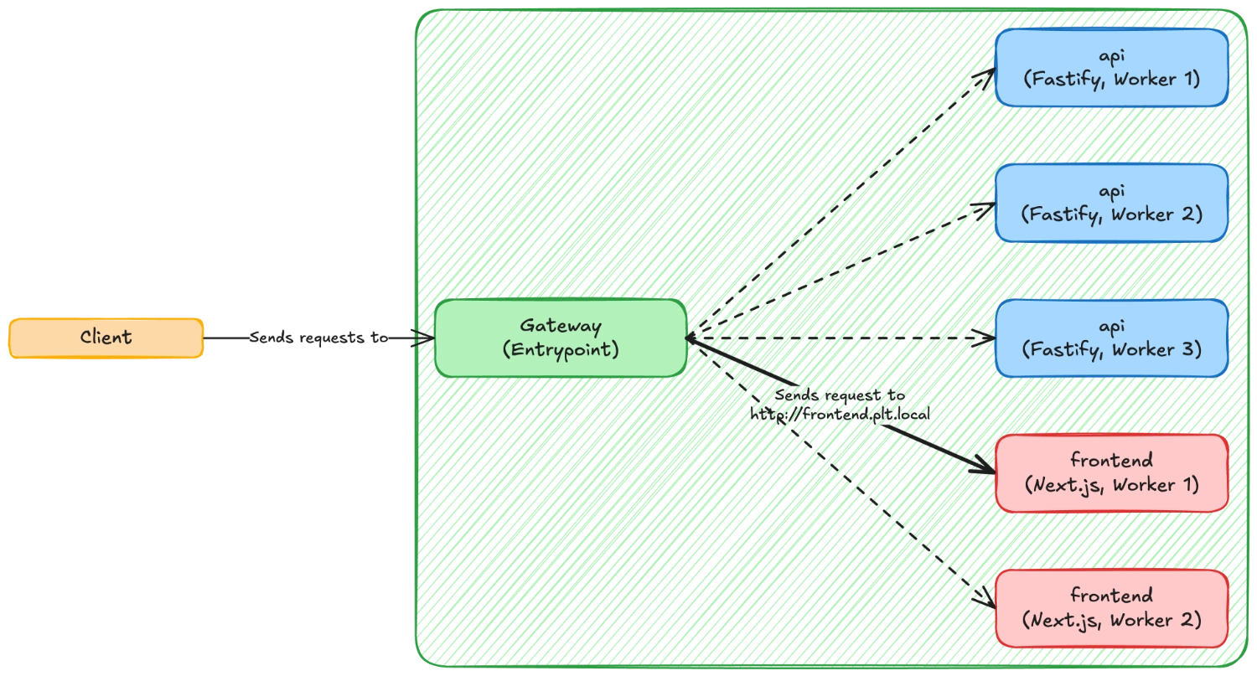
Watt in action: multiple workers

Slide 36


Dynamic applications
Hot-swap made easy
Movable and flexible
Add or remove applications from a running
Redistribute applications for load balancing or
process with zero downtime.
resource optimization without interruption.

Slide 37

Please, just
let me go!
I
promise
I
understood
everything!
🙏

Slide 38


Take-home lessons
The monitoring paradox
Separation of concerns
Let it fail
Self-monitoring on a single thread
Application logic, coordination, and
Fast restarts are better than trying
is fundamentally flawed.
monitoring should be isolated.
to recover unhealthy processes.

Slide 39


One last thing™
“Success is often achieved by those
who don't know that failure is inevitable.”
Coco Chanel

Slide 40

Thank you!
Paolo Insogna
@p_insogna
Platformatic
Node.js TSC, Principal Engineer
paolo.insogna@platformatic.dev

