Slide 1






Platformatic
View online
The alleged "end" of Node.js
Download PDF
is much ado about nothing
Paolo Insogna
Node.js TSC, Principal Engineer

Slide 2

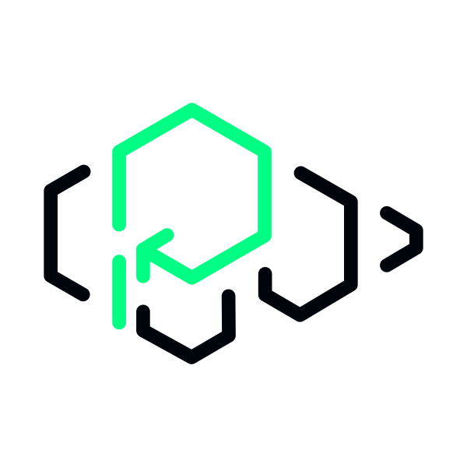
How can Platformatic help?
Platformatic
gives
you
the
complete
out-of-the-box
primitive
to
deploy,
optimize,
autoscale,
and
secure
all
your
Node.js
apps.
No
rewrites,
no
overhauls.
Just
plug
and
play.
https://qr.link/uCLwdt

Slide 3

Don't count your
chickens before
they hatch.

Slide 4






Hello, I'm
Paolo
!
Node.js
Technical Steering Committee Member
Platformatic
Principal Engineer
paoloinsogna.dev
ShogunPanda
p_insogna
pinsogna

Slide 5



Some companies trusting us
Article
Case Study
Case Study

Slide 6

First of all, let's give
credits!
This
talk
has
originally
been
authored
by
Platformatic
CTO
and
friend
of
mine,
the
only
Matteo
Collina
.
Whatever
goes
wrong
today,
please
complain
directly
to
him
on
Twitter!
@matteocollina

Slide 7
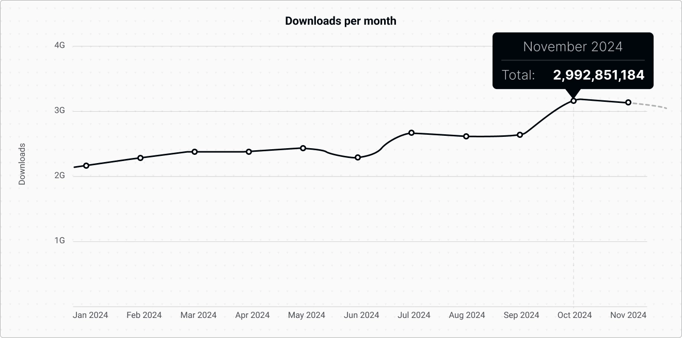
I think we should start by looking at numbers.
30 Billion
downloads per year

Slide 8


Usually we read this all over the internet...
“ZYX will flip the default backend JavaScript
runtime from Node.js”
Random excited user #1

Slide 9
... or, actually, something like this.
“XYZ will destroy Node.js”
Random excited user #2

Slide 10

This talk is about a
question we are
trying to answer…

Slide 11

Is Node.js dead yet?

Slide 12

Period.

Slide 13
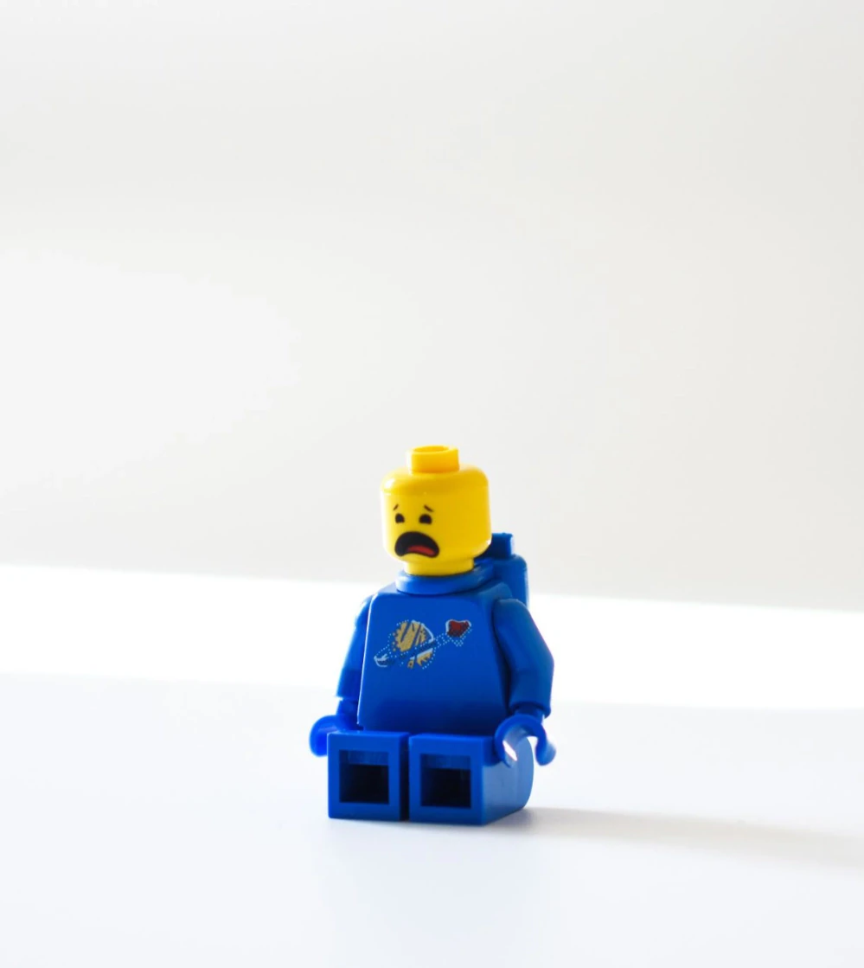
To
all
of
you
that
"aim"
to
destroy
other
technologies...
...let me tell you a
secret!

Slide 14
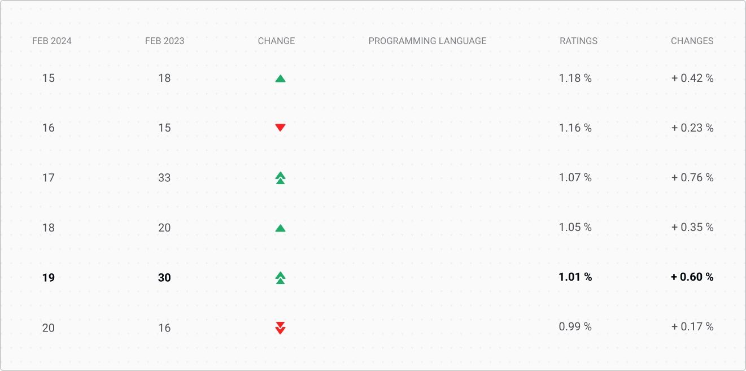
A technology born in
1959
is on the RAISE!
Have
you
have
heard
about
COBOL
?
Source:
https://www.tiobe.com/tiobe-index/

Slide 15
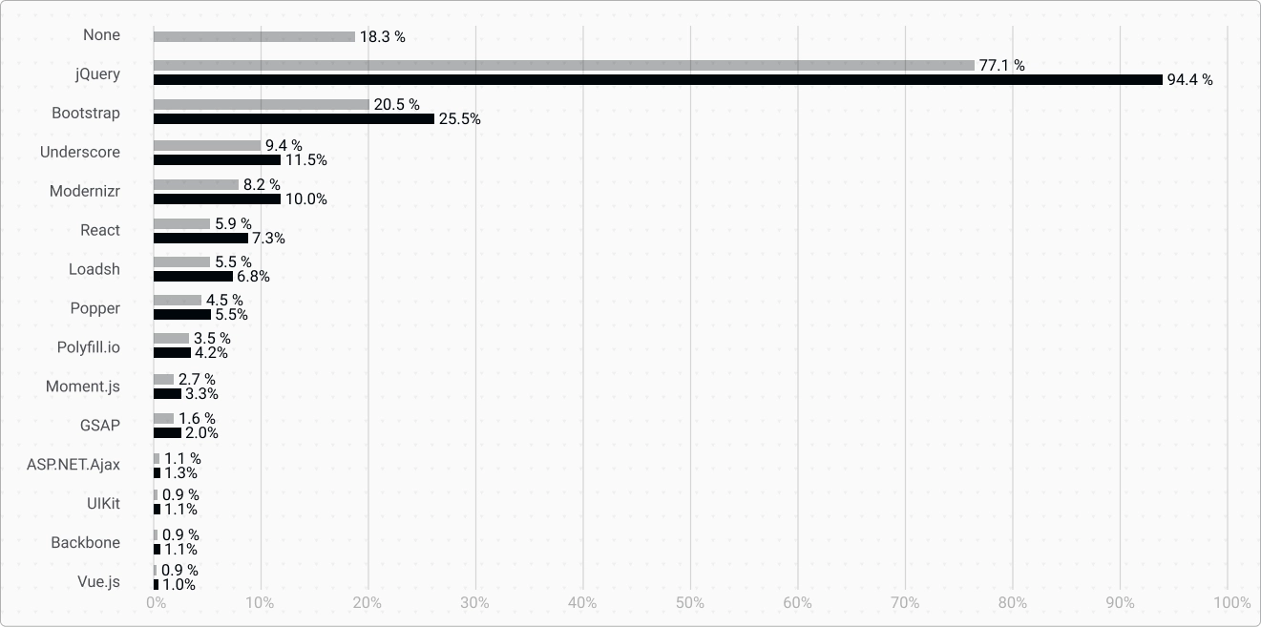
jQuery is used by
94.4%
of the JS-enabled sites
And
v4
was
just
released!
Source:
https://w3techs.com/technologies/overview/javascript_library

Slide 16
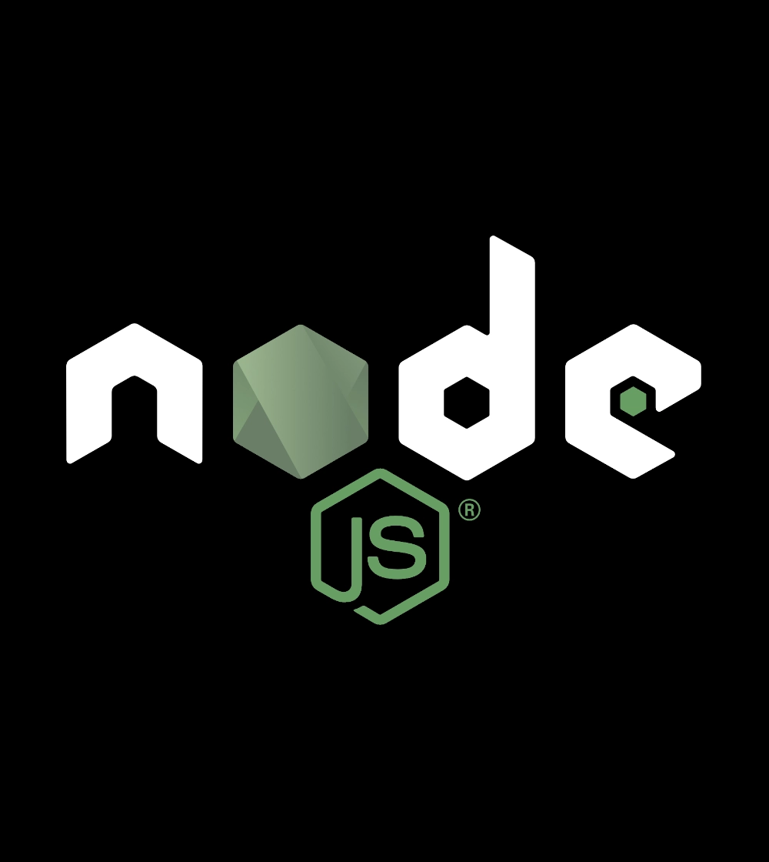
What about
Node.js?

Slide 17
Node.js is the most popular technology according
to StackOverflow
Source:
https://survey.stackoverflow.co/2023/#technology-most-popular-technologies

Slide 18
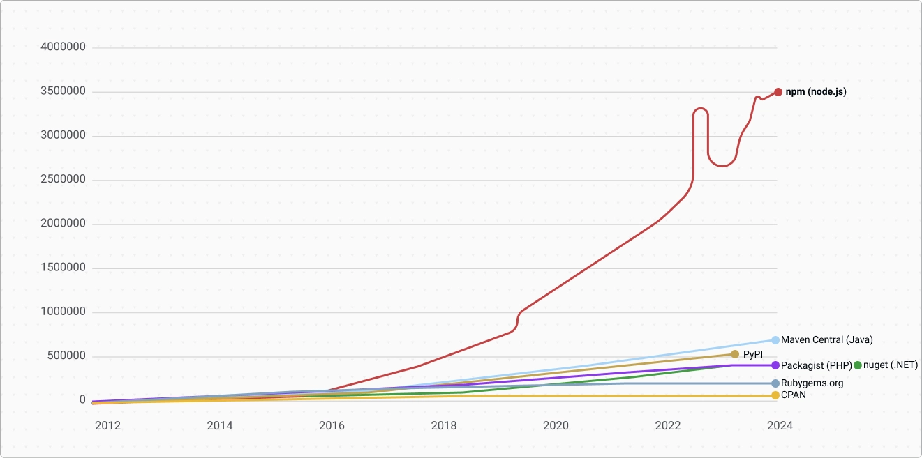
No, bundling npm and Node.js was not a mistake
A
combo
that
solve
software
reuse,
at
scale.
No
one
else
did.
Source:
http://www.modulecounts.com/

Slide 19
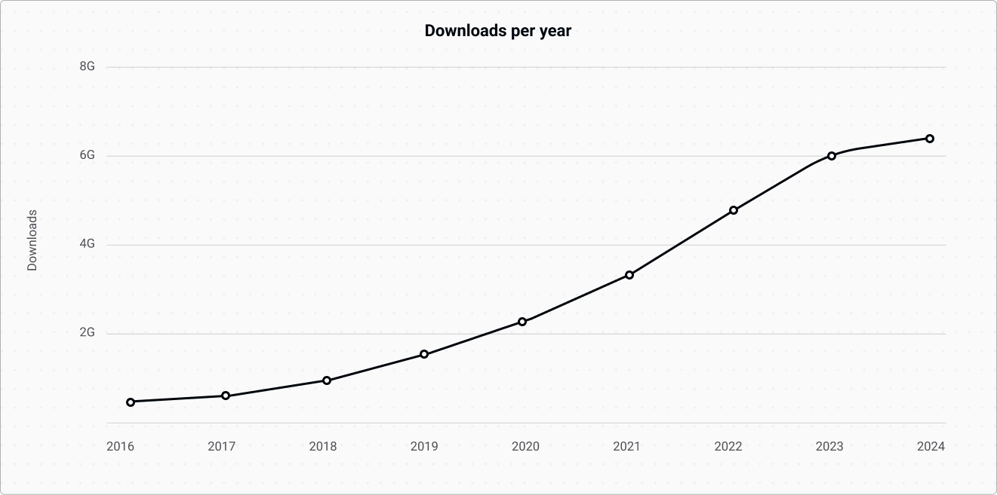
Module usage also grew
Downloads
of
readable-stream
(4th
most
downloaded
module
on
npm)
The
"usage"
of
Node.js
is
growing
roughly
+50%
year
over
year
,
or
doubling
every
2
years

Slide 20
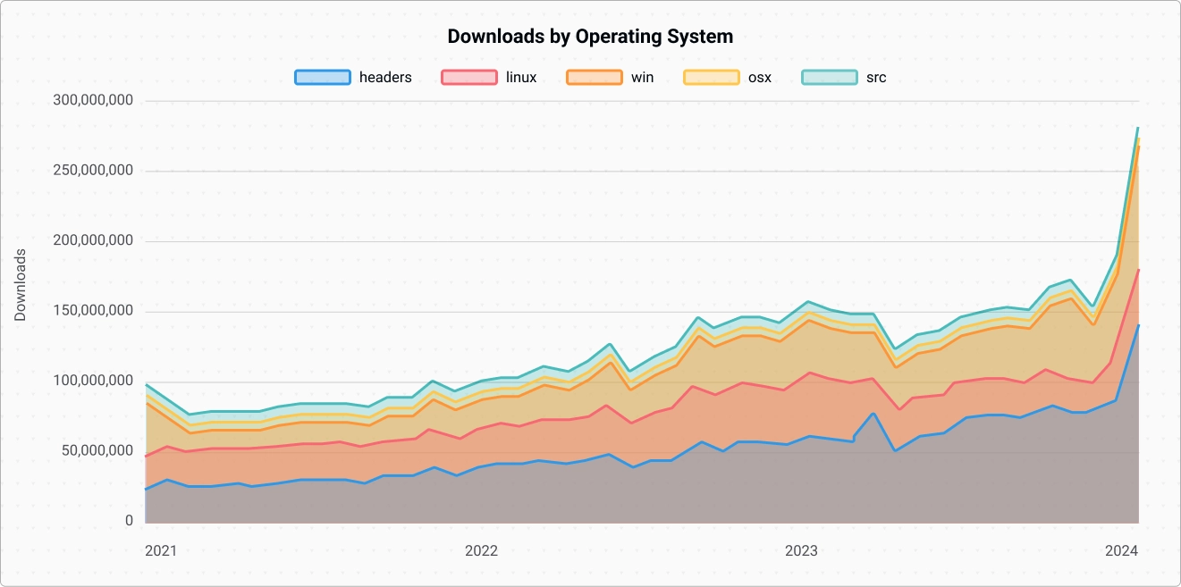
Half of Node.js downloads are the headers files
Source:
https://nodedownloads.nodeland.dev/

Slide 21
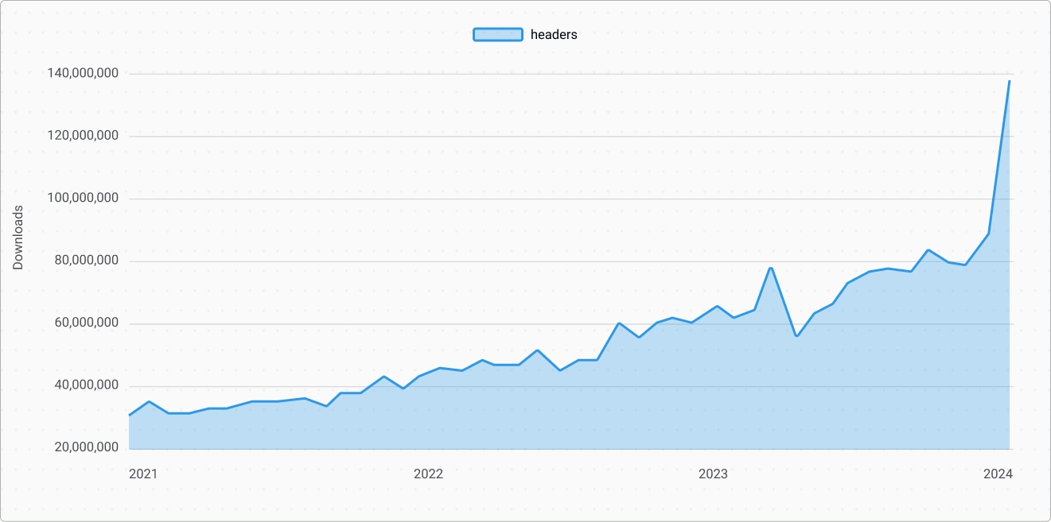
What are "headers" downloads?
Headers
are
downloaded
whenever
an
"npm
i"
needs
to
compile
binary
addons.
Then
they
are
cached
to
disk.

Slide 22
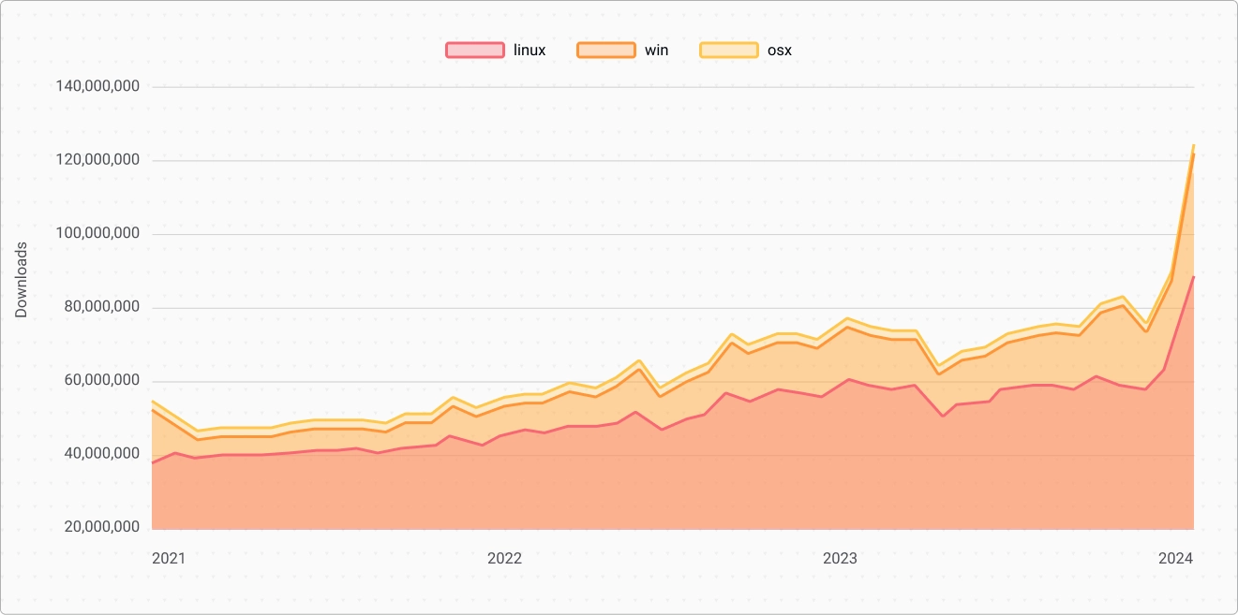
Downloads of the Node.js binary, per OS
We
believe
Linux
is
the
default
for
CI.
OSS
projects
often
test
on
Windows
for
CI
as
well.

Slide 23

30
million monthly downloads in 2021

Slide 24
60
million monthly downloads in 2024

Slide 25
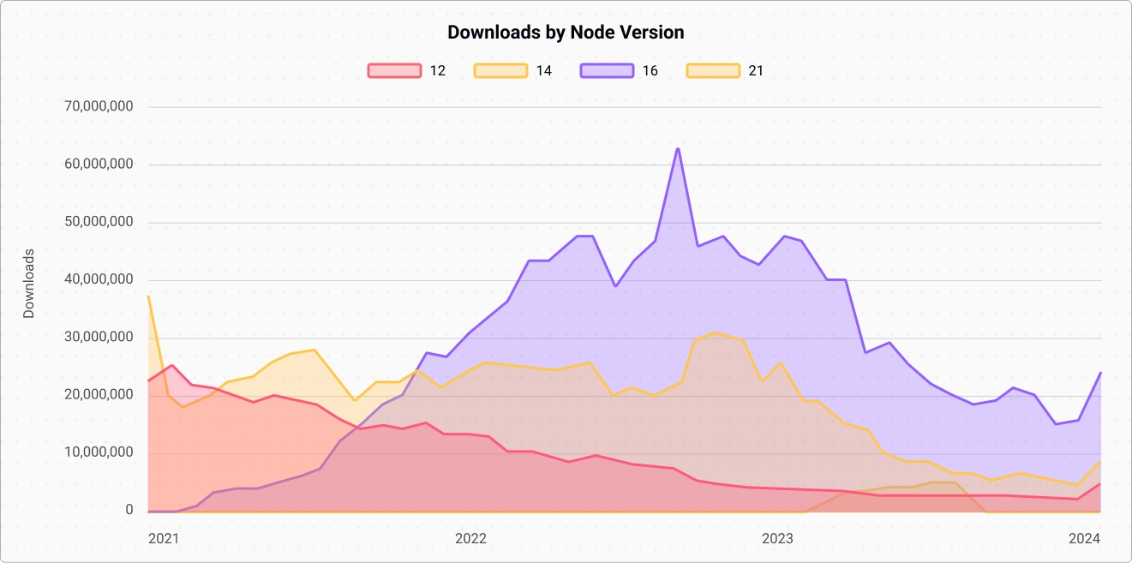
Node.js v16, v14, v12 are massively popular, while
they all have
KNOWN VULNERABILITIES

Slide 26

If you are not
updating Node.js...

Slide 27
...you are putting
yourself at risk!

Slide 28
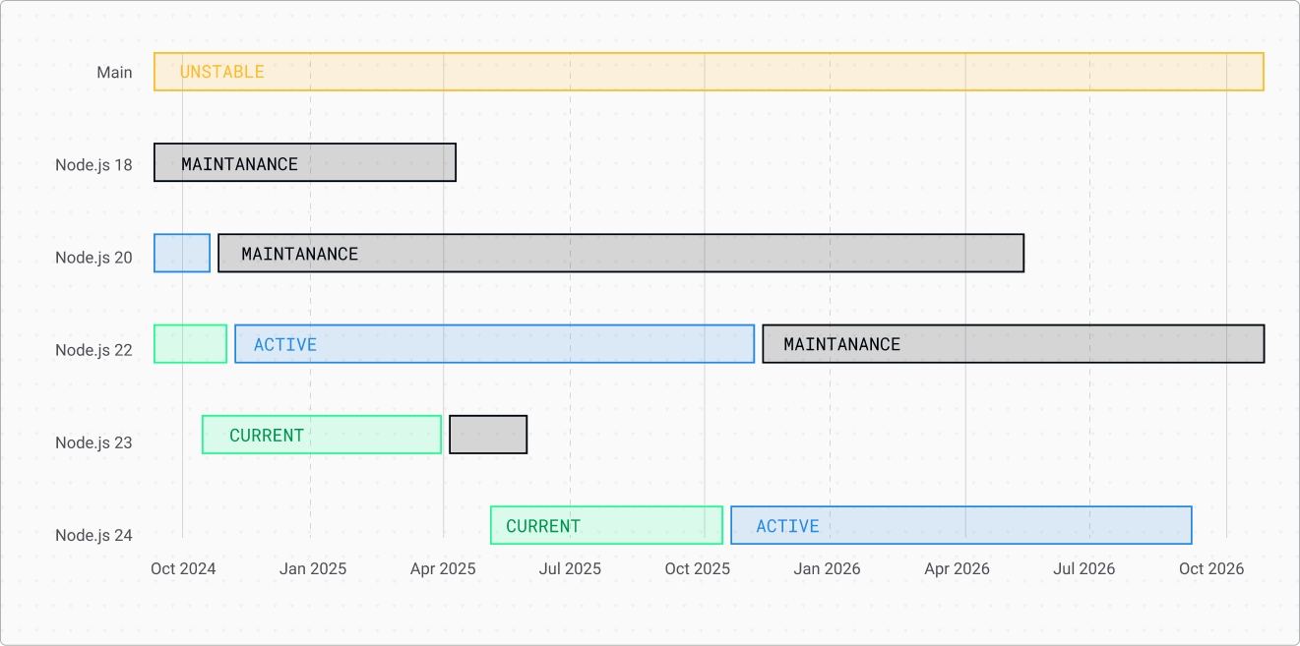
Long Term Support (LTS) Schedule

Slide 29
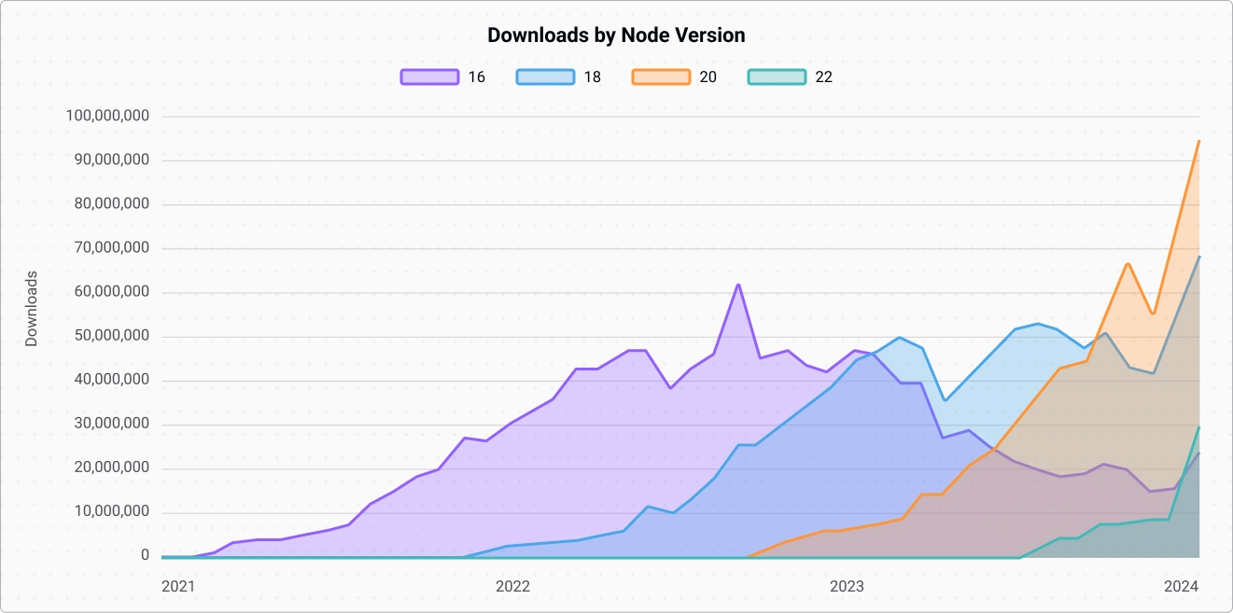
Most teams update their Node.js
version every 2 LTS releases

Slide 30
Organization Activity from Nov 2023 to Nov 2024
Source:
https://next.ossinsight.io/analyze/nodejs?period=past_12_months#overview
19,917
5,261
28,438
4,499
Star Earned
Pull Requests
Reviews
Issues
+ 6.61 %
+ 8.72%
- 2.71 %
- 3.69 %

Slide 31
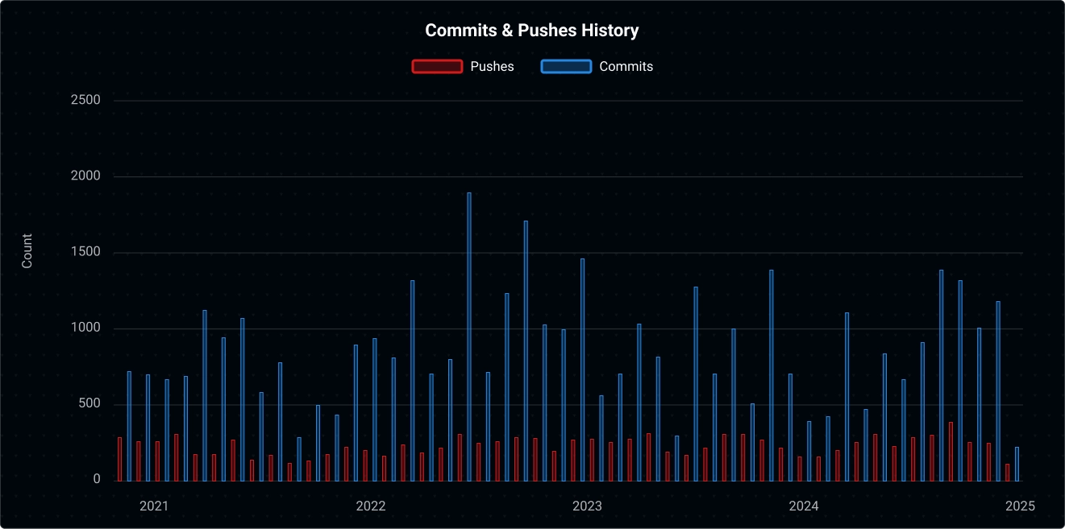
Commits & Pushes to Node.js Core
Source
https://ossinsight.io/analyze/nodejs/node

Slide 32
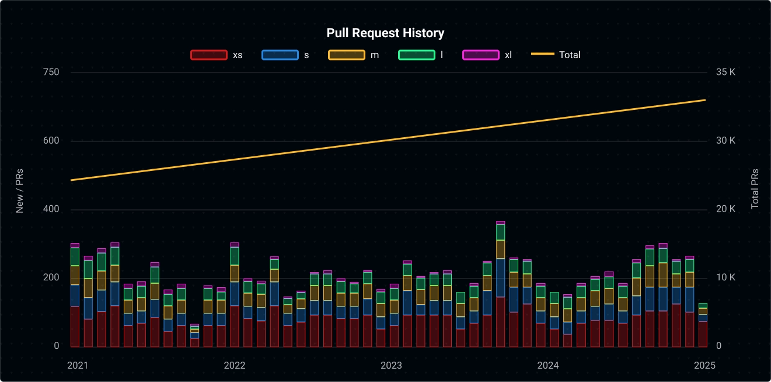
The number of pull requests is (mostly) stable
Source
https://ossinsight.io/analyze/nodejs/node

Slide 33
We work hard to
keep
you
safe!

Slide 34
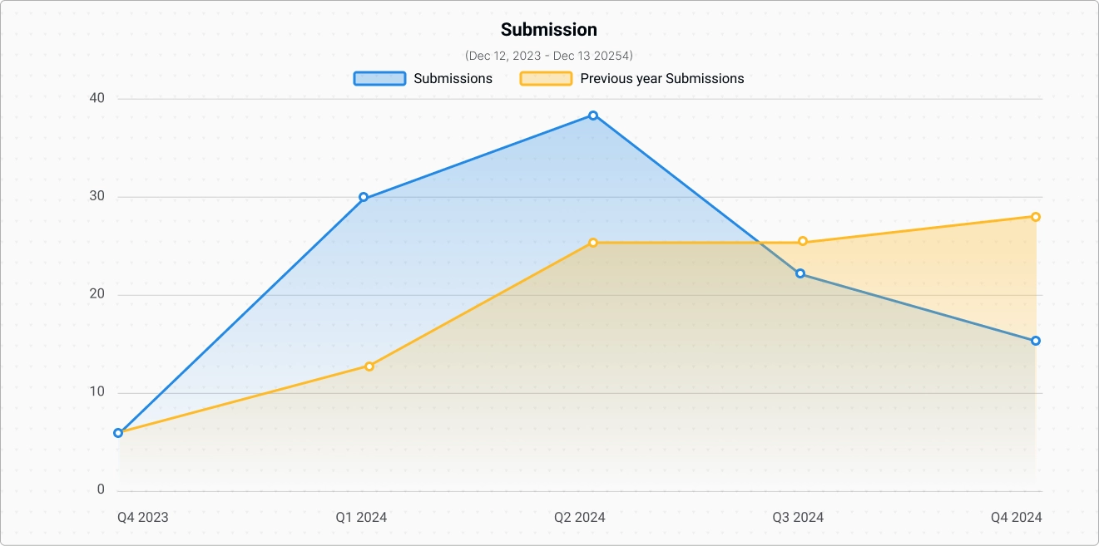
Node.js Security Submissions
Submissions
are
not
turned
into
vulnerabilities,
but
they
need
to
be
handled
by
the
team

Slide 35
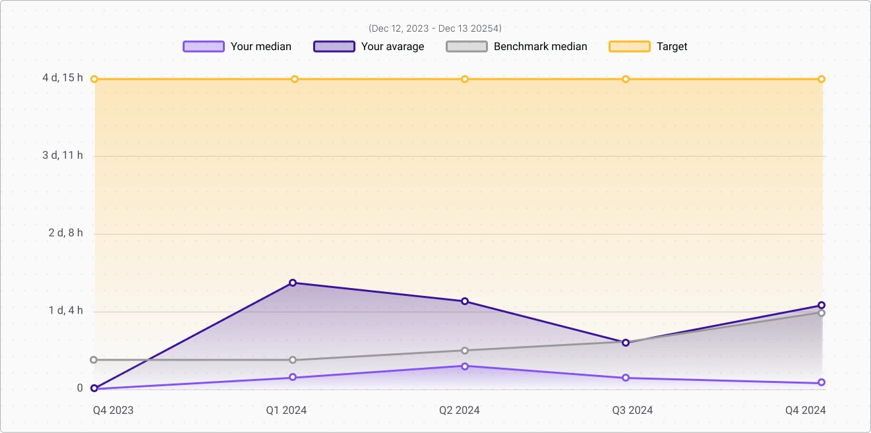
Average time to first response
Submissions
are
not
turned
into
vulnerabilities,
but
they
need
to
be
handled
by
the
team

Slide 36
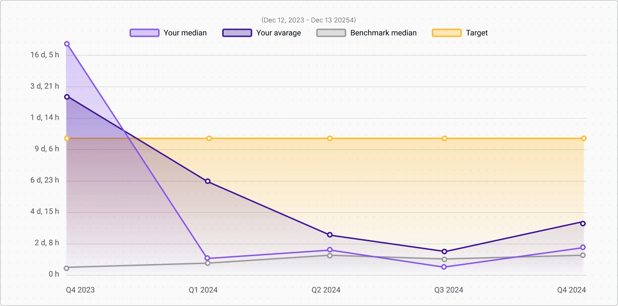
Average time to triage
Submissions
are
not
turned
into
vulnerabilities,
but
they
need
to
be
handled
by
the
team

Slide 37

Node.js was one of the first project sponsored by
Alpha-Omega
is
an
associated
project
of
the
OpenSSF,
established
in
February
2022,
funded
by
Microsoft,
Google,
and
Amazon,
and
with
a
mission
to
protect
society
by
catalyzing
sustainable
security
improvements
to
the
most
critical
open
source
software
projects
and
ecosystems.
The
project
aims
to
build
a
world
where
critical
open
source
projects
are
secure
and
where
security
vulnerabilities
are
found
and
fixed
quickly.

Slide 38
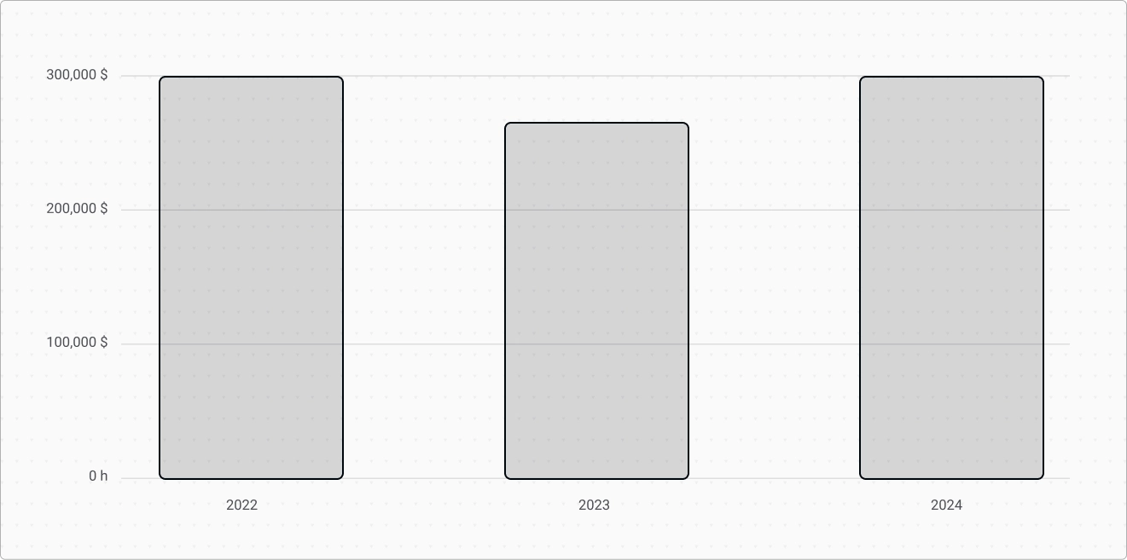
Total funding for Security work

Slide 39

What did we ship in
the last few years?

Slide 40
ESM
// addTwo.mjs
function addTwo(num) {
return num + 2
}
export { addTwo }
// app.mjs
import { addTwo } from './addTwo.mjs'
// Prints: 6
console.log(addTwo(4))

Slide 41
Threads
import {
Worker,
isMainThread,
setEnvironmentData,
getEnvironmentData,
} from 'node:worker_threads'
if (isMainThread) {
setEnvironmentData('Hello', 'World!')
const worker = new Worker(import.meta.filename)
} else {
console.log(getEnvironmentData('Hello')) // Prints 'World!'
}

Slide 42
Fetch
const res = await fetch('https://example.com/data')
const json = await res.json()
console.log(json)

Slide 43
Web Platform Compatibility
•
fetch()
and
Response
•
Web
Streams
•
Web
Crypto
•
FormData
•
structuredClone()
•
TextEncoder
and
TextDecoder
•
Blob
and
File
•
EventTarget
•
Initial
Symbol.dispose
...
and
there's
more!

Slide 44
Promises
import { readFile } from 'node:fs/promises'
try {
const filePath = new URL('./package.json', import.meta.url)
const contents = await readFile(filePath, { encoding: 'utf8' })
console.log(contents)
} catch (err) {
console.error(err.message)
}

Slide 45
node:
only core modules
import assert from 'assert'
import test from 'test'
import assert from 'node:assert'
import test from 'node:test'

Slide 46



Watch mode
Few simple CLI flags
--watch
command line flag,
--watch-path
customizes watched files
Watches imported files and restarts Node.js when they change
Works with test runner to rerun tests
Limited platform support
macOS and Windows only

Slide 47
AsyncLocalStorage
import http from 'node:http'
import { AsyncLocalStorage } from 'node:async_hooks'
const asyncLocalStorage = new AsyncLocalStorage()
function logWithId(msg) {
const id = asyncLocalStorage.getStore()
console.log(`${id !== undefined ? id : '-'}: `, msg)
}
let idSeq = 0
http.createServer((req, res) => {
asyncLocalStorage.run(idSeq++, () => {
logWithId('start')
// Imagine any chain of async operations here
setImmediate(() => {
logWithId('finish')
res.end()
})
})
}).listen(8080)
http.get('http://localhost:8080')
http.get('http://localhost:8080')
Without
it,
we
would
not
have
had
React
Server
Components
!

Slide 48
WebCrypto
import { webcrypto } from 'node:crypto'
const subtle = webcrypto.subtle
async function main() {
const key = await webcrypto.subtle.generateKey(
{ name: 'HMAC', hash: 'SHA-256', length: 256 },
true,
[ 'sign', 'verify' ]
)
const enc = new TextEncoder()
const message = enc.encode('I love cupcakes')
const sign = await subtle.sign({ name: 'HMAC' }, key, message)
return Buffer.from(sign).toString('hex')
}
console.log(await main())

Slide 49
util.parseArgs()
import { parseArgs } from 'node:util'
const args = ['-f', '--bar', 'b']
const options = {
foo: {
type: 'boolean',
short: 'f'
},
bar: {
type: 'string'
}
}
const { values, positionals } = parseArgs({ args, options })
console.log(args)
// Prints: [Object: null prototype] { foo: true, bar: 'b' } []

Slide 50

Single Executable Applications
Inject application code into Node.js binary.
Originally developed by Postman Labs
Single CommonJS file is currently supported
Binaries can be distributed without Node/npm installation.
Node.js project offers a helper module named postject
Similar tools exist. They should work but have not been tested.

Slide 51

Permission System
Simple to use CLI flags
--experimental-permissions
,
--allow-fs-read
,
--allow-fs-write
,
--allow-
child-process
, and
--allow-worker
.
process.permissions.has
API
process.permissions.deny()
has been removed but may be added again in the future.

Slide 52


Test Runner
Supports subtests, skipping, only, lifecycle hooks
node:test
module,
--test
flag,
test
on npm.
Supports function and timer mocking.
Module mocking soon.
Code coverage via
--experimental-test-coverage
Reporters via
--test-reporter
and
--test-reporter-destination
.
Good reporting defaults
Defaults to
spec
or
tap
on stdout based on TTY.

Slide 53
Test Runner
import assert from 'node:assert'
import test from 'node:test'
test('synchronous passing test', (t) => {
// This test passes because it does not throw an exception.
assert.strictEqual(1, 1)
})
test('asynchronous failing test', async (t) => {
// This test fails because the Promise returned by the async
// function is rejected.
assert.strictEqual(1, 2)
})

Slide 54
WebSocket
Thanks
Matthew
Aitken
for
implementing
this!
shogun@panda:~/example$ node
Welcome to Node.js v22.12.0.
Type ".help" for more information.
> WebSocket
[class WebSocket extends EventTarget] {
CONNECTING: 0,
OPEN: 1,
CLOSING: 2,
CLOSED: 3
}

Slide 55

Are you using the
latest Node.js
features?
Or
are
you
still
stuck
in
2015?

Slide 56

What's coming?
Let's
look
at
the
two
most
exciting
things
in
v22!

Slide 57

require(esm)
.mjs is not needed anymore

Slide 58
require(esm)
Learn
more
on
Joyee's
blog:
https://joyeecheung.github.io/blog/2024/03/18/require-esm-in-node-js/
Thanks
to
Geoffrey
Booth
for
remove
the
need
of
.mjs
.
'use strict'
const { answer } = require('./esm.mjs')
console.log(answer)

Slide 59
Typescript

Slide 60
Automatic TypeScript support
Thanks
Marco
Ippolito
for
implementing
this!
// hello.ts
import {
setTimeout as sleep
} from 'node:timers/promises'
function hello(who: string) {
console.log(`Hello ${who}!`)
}
await sleep(1000)
hello('world')
shogun@panda:~/example$ node hello.ts
(node:30248) ExperimentalWarning: Type Stripping is
an experimental feature and might change at any time
(Use `node --trace-warnings ...` to show where
the warning was created)
Hello world!

Slide 61

Node.js is not
always relaxing...

Slide 62

...because
we need you!

Slide 63
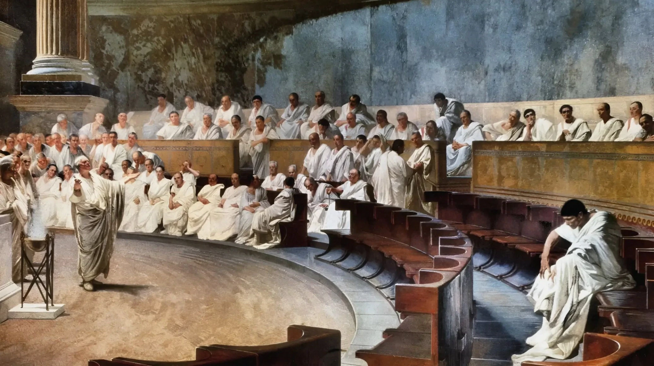
Project Governance

Slide 64


Slide 65
Node.js core collaborators maintain the
nodejs/node GitHub repository
@nodejs/collaborators
have
commit
access
to
the
nodejs/node
repository
and
access
to
the
Node.js
continuous
integration
(CI)
jobs.
Both
collaborators
and
non-collaborators
may
propose
changes
to
the
Node.js
source
code.
The
mechanism
to
propose
such
a
change
is
a
GitHub
pull
request
(PR).
Collaborators
review
and
merge
(
land
)
pull
requests.

Slide 66
The review process
Two
collaborators
must
approve
a
pull
request
before
the
pull
request
can
land.
(
One
collaborator
approval
is
enough
if
the
pull
request
has
been
open
for
more
than
7
days.
)
Approving
a
pull
request
indicates
that
the
collaborator
accepts
responsibility
for
the
change.
Approval
must
be
from
collaborators
who
are
not
authors
of
the
change.
If
a
collaborator
opposes
a
proposed
change,
then
the
change
cannot
land.
The
exception
is
if
the
TSC
votes
to
approve
the
change
despite
the
opposition.
Involving
the
TSC
is
usually
unnecessary:
often,
discussions
or
further
changes
result
in
collaborators
removing
their
opposition
.

Slide 67
The Node.js Technical Steering Committee
The
TSC
voting
members
are
responsible
for
all
technical
development
within
the
Node.js
project,
including:
•
Setting
release
dates.
•
Release
quality
standards.
•
Technical
direction.
•
Project
governance
and
process.
•
GitHub
repository
hosting.
•
Conduct
guidelines.
•
Maintaining
the
list
of
additional
Collaborators.
•
Development
process
and
any
coding
standards.
•
Mediating
technical
conflicts
between
Collaborators
or
Foundation
projects.

Slide 68
In case of disagreements, the TSC votes
TSC
members
can
be
either
regular
members
or
voting
members.
Regular
members
can
attend
meetings
and
participate
in
TSC
discussions,
but
do
not
vote.
Voting
members
can
do
everything
regular
members
can
do,
and
also
have
the
ability
to
cast
votes
when
consensus
is
not
reached
on
an
issue.
TSC
memberships
are
not
time-limited
and
there
is
no
maximum
size
of
the
TSC.
The
TSC
must
have
at
least
four
voting
members.
No
more
than
one-fourth
of
the
TSC
voting
members
may
be
affiliated
with
the
same
employer
at
any
time.

Slide 69

No one can control Node.js

Slide 70

We all have to
to
COMPROMISE
to achieve our
objectives

Slide 71
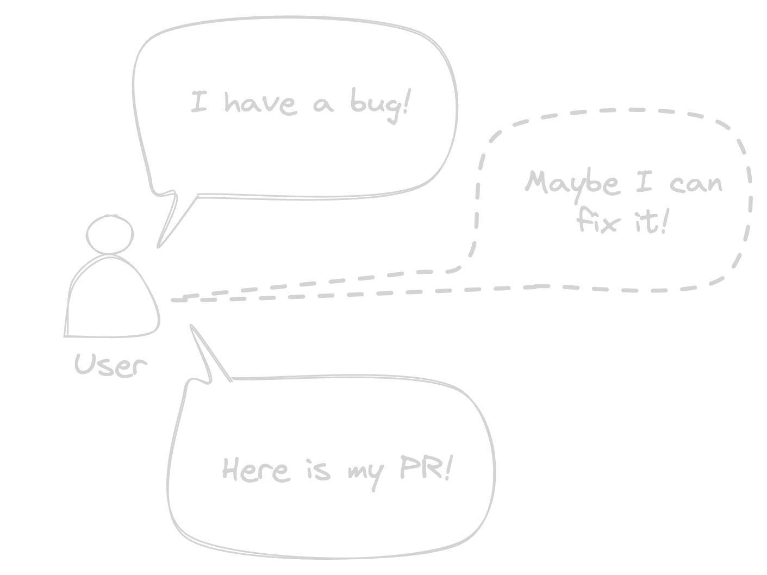
Do you want to have
a say in the
future of Node.js?

Slide 72
Start contributing!

Slide 73


One last thing™
“It is not how old you are
but how you are old.”
Jules Renard

Slide 74

Thank you!
Paolo Insogna
@p_insogna
Platformatic
Node.js TSC, Principal Engineer
paolo.insogna@platformatic.dev

